Slide 1
Tracking of Snow Accumulation Layers Using ML Models Implemented in OPR Toolbox
Oluwanisola Ibikunle, John Paden, and Jilu Li
The Center for Remote Sensing and Integrated Systems (CReSIS)

Slide 2
1. Overview
Snow and ice layers of ice sheets and glaciers in radar data contain critical information of climate and ice sheet and glacier dynamics and mass balance.
Tracking these layers in big data at ice sheet scale is a huge workload and challenging.
Traditional manual and semi-automated methods are not efficient and expensive.
Machine Learning (ML) algorithms have emerged as the efficient ways for fully automatic tracking of multiple snow and ice layers.
NSF supported project BIGDATA: IA: Collaborative Research: Intelligent Solutions for Navigating Big Data from the Arctic and Antarctic ( 09/01/2018-08/31/2022: Maryam Rahnemoonfar and John Paden)
CReSIS has compiled an AI-ready training dataset and implemented ML models in OPR toolbox for tracking snow layers (Oluwanisola Ibikunle).
Fig. 1 An AI-ready training dataset
https://data.cresis.ku.edu/data/temp/bigdata/NASA_OIB_test_files/image_files/Dataset/snow/SR_Dataset_v1/

Slide 3
2. ML_tracker setup
ML tracker Location in OPR toolbox: ~/scripts/opr/python/ML_tracker
ML models were developed using Python 3.9, required packages to be installed include:
Anaconda or miniconda
TensorFlow
PyTorch
Small_requirements.txt in ML_tracker folder include a full list of required packages and their versions.
Follow the step-by-step setup instructions on OPR wiki page:
https://gitlab.com/openpolarradar/opr/-/wikis/ML-Tracker-setup

Slide 4
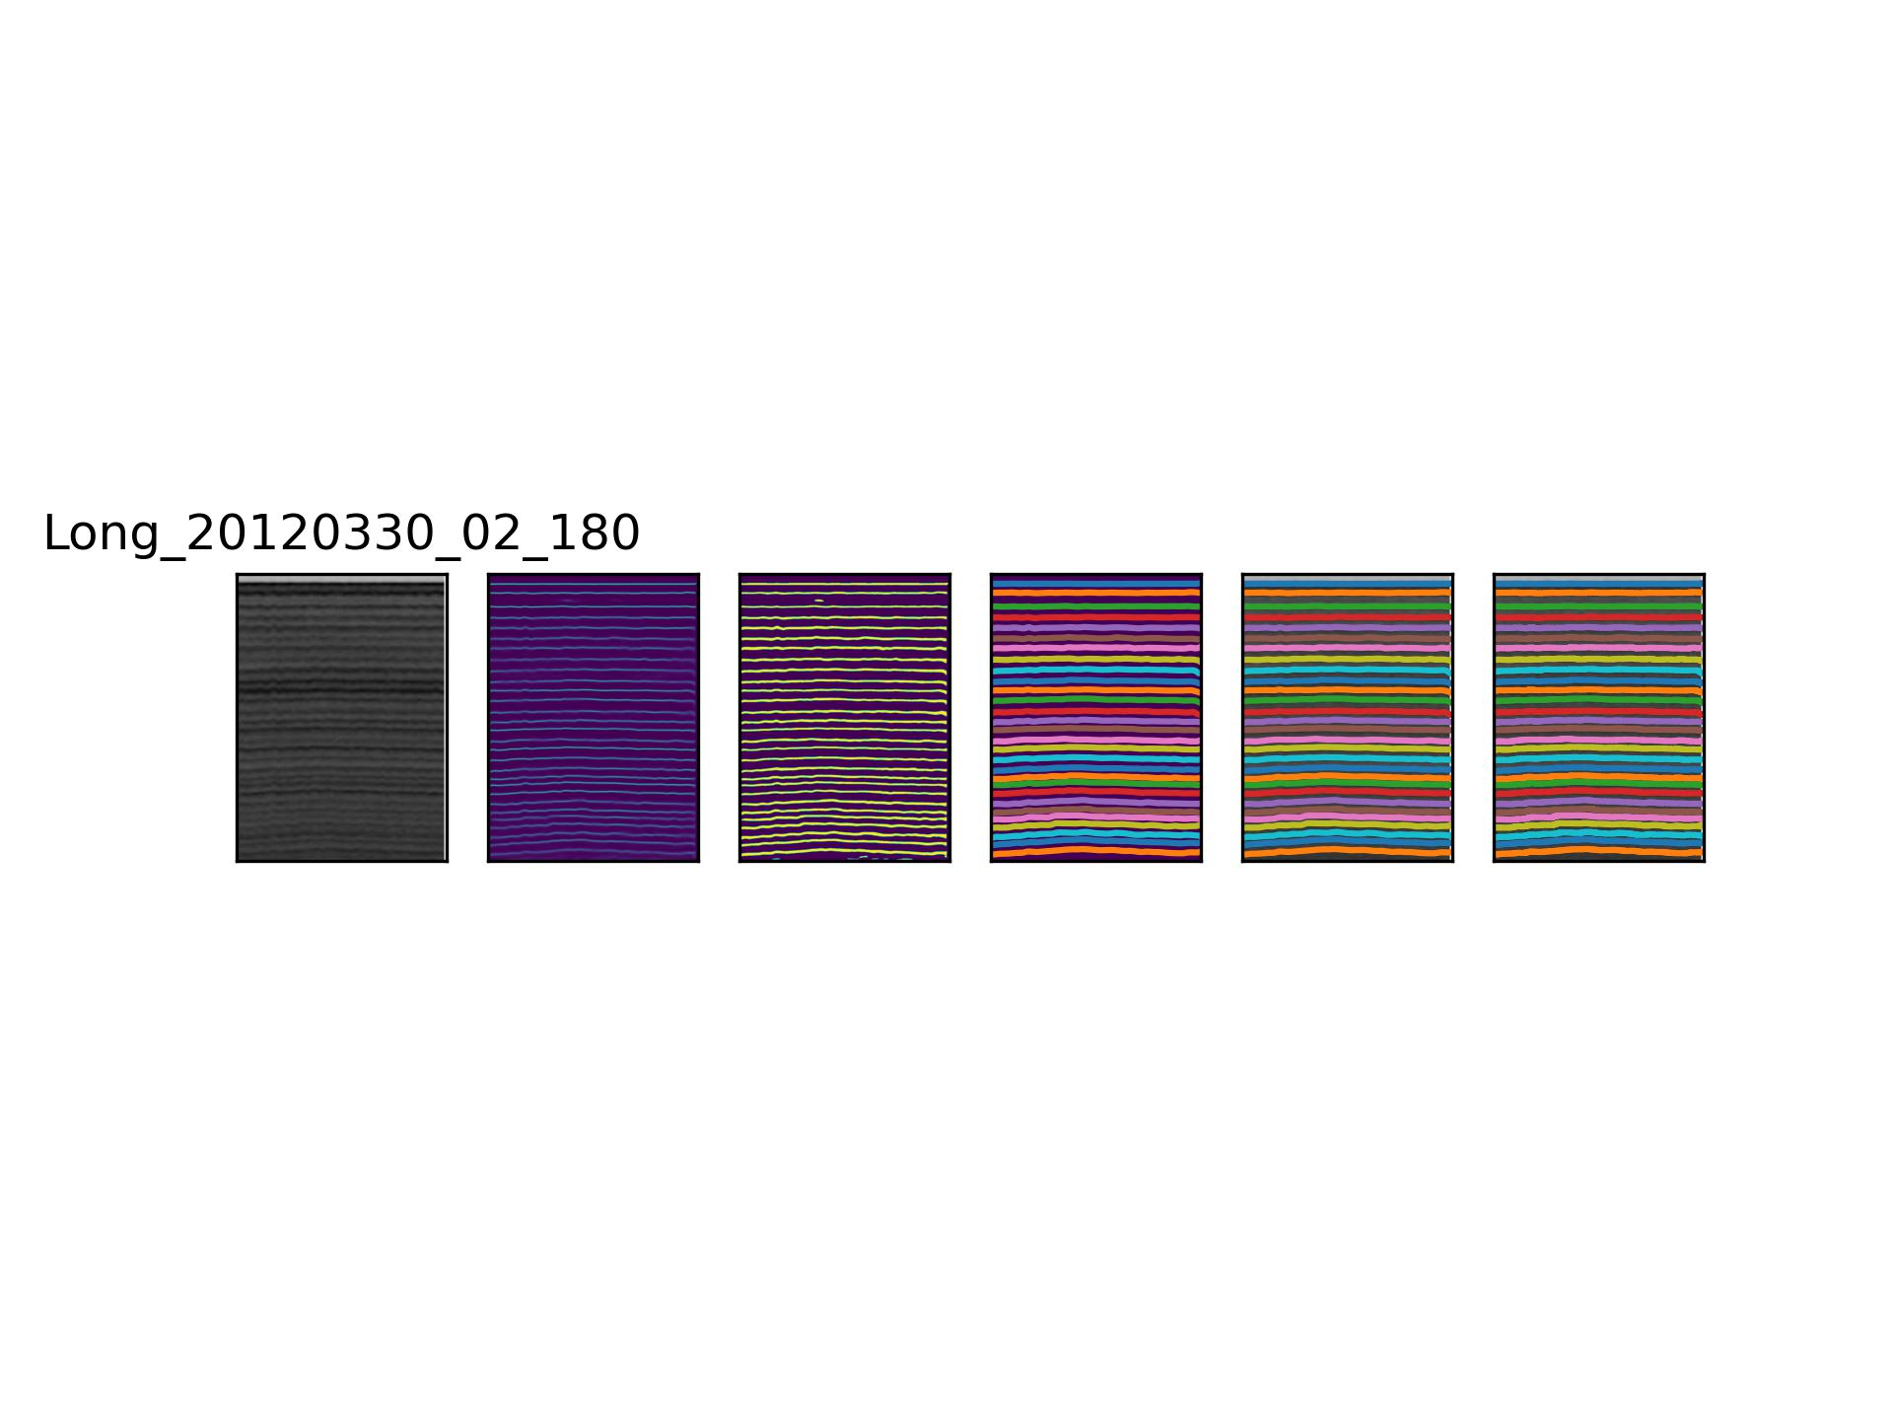
3. Test of virtual python environment setup
>python -m test_installation
Installation works perfectly!
Echogram layers have been tracked
Fig. 2 Image from setup testing by running test_installation.py using sample_echogram.mat

Slide 5
4. How to run ML_tacker
The trained ML models are accessed by executing python scripts (return_tracked_layers_argp.py & return_few_layers_argp.py ) in return_ML_layers.m
To ML tracker is run with the following settings in run_layer_tracker.m
track.method = 'ML’ % hard coded
track.layer_names = {'ML_layer’} % user changeable
param_override.layer_tracker.echogram_source = 'CSARP_post/qlook’; % user changeable
param_override.layer_tracker.layer_params(layer_idx).layerdata_source = 'CSARP_post/layer’; % user changeable
param_override.layer_tracker.layer_params(layer_idx).layerdata_destination = '~/ML_prediction’
% hard coded, the location for saving the layer files with tracked layers by ML tracker. If it was not setor empty, the source
layer files will be updated.
The following functions will be called in sequence:
run_layer_tracker.m, layer_tracker.m, layer_tracker_task.m
return_ML_layers.m, return_tracked_layers_argp.py, return_few_layers_argp.py
layer_tracker_combine_task.m, runOpsCopyLayers.m

Slide 6
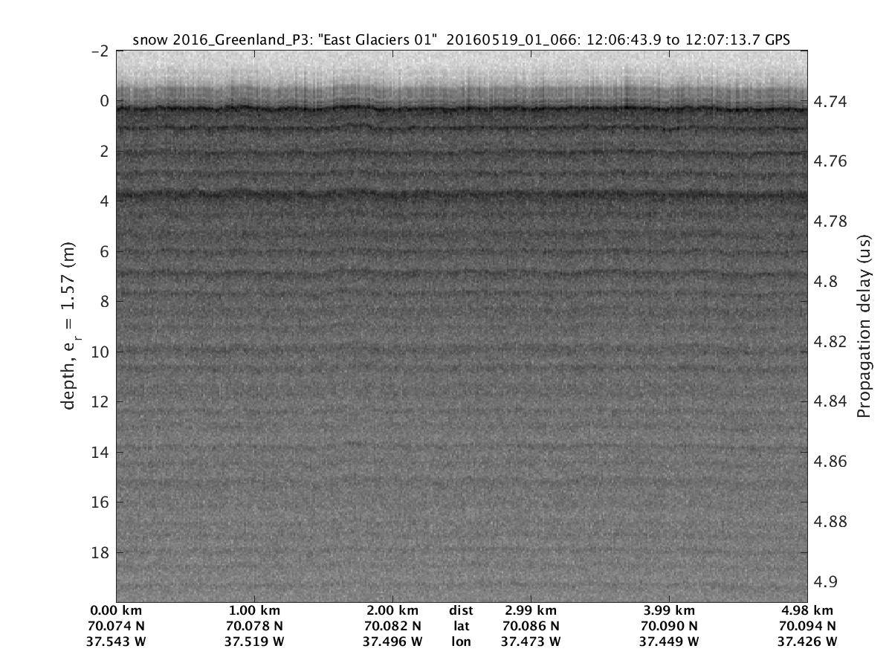
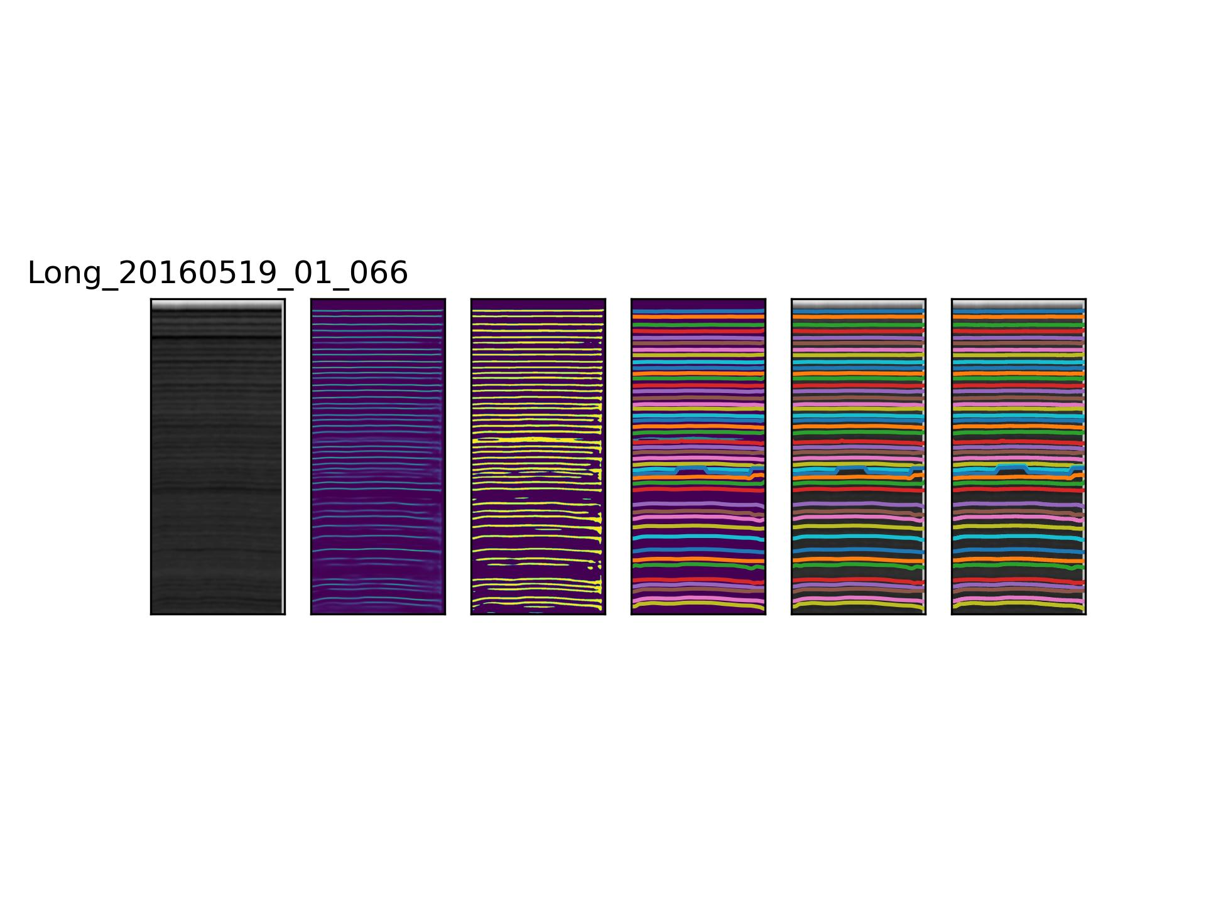
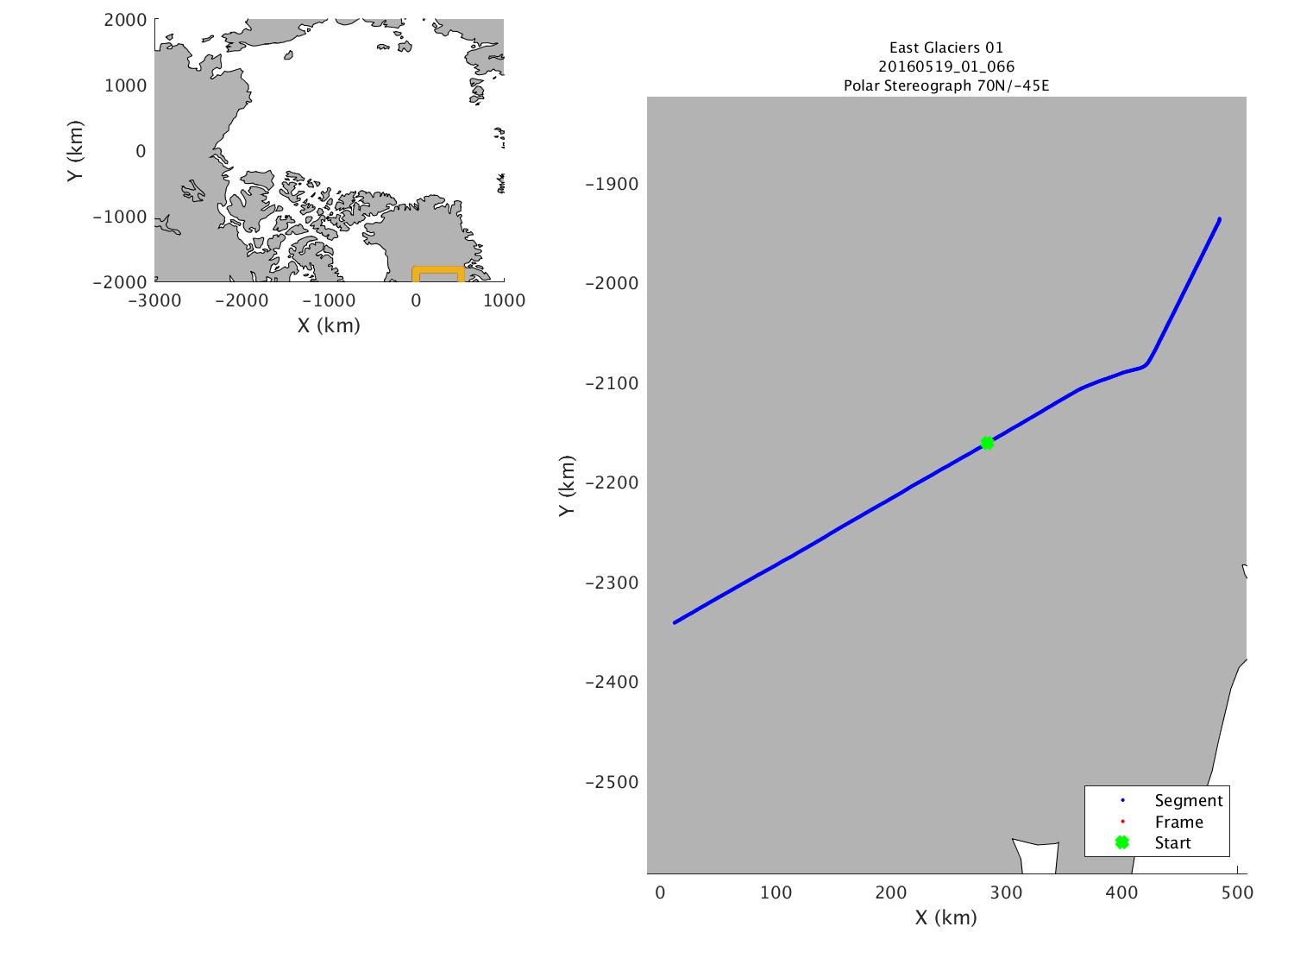
5. Sample tracking results
Greenland
Fig. 3 Sample tracking result from Greenland data in 2016. From left to right, each panel corresponds to 1) input image; 2) probability map; 3) lowest threshold filtered image; 4) sorted label matrix; 5) tracked layers; 6) final filtered tracked layers

Slide 7
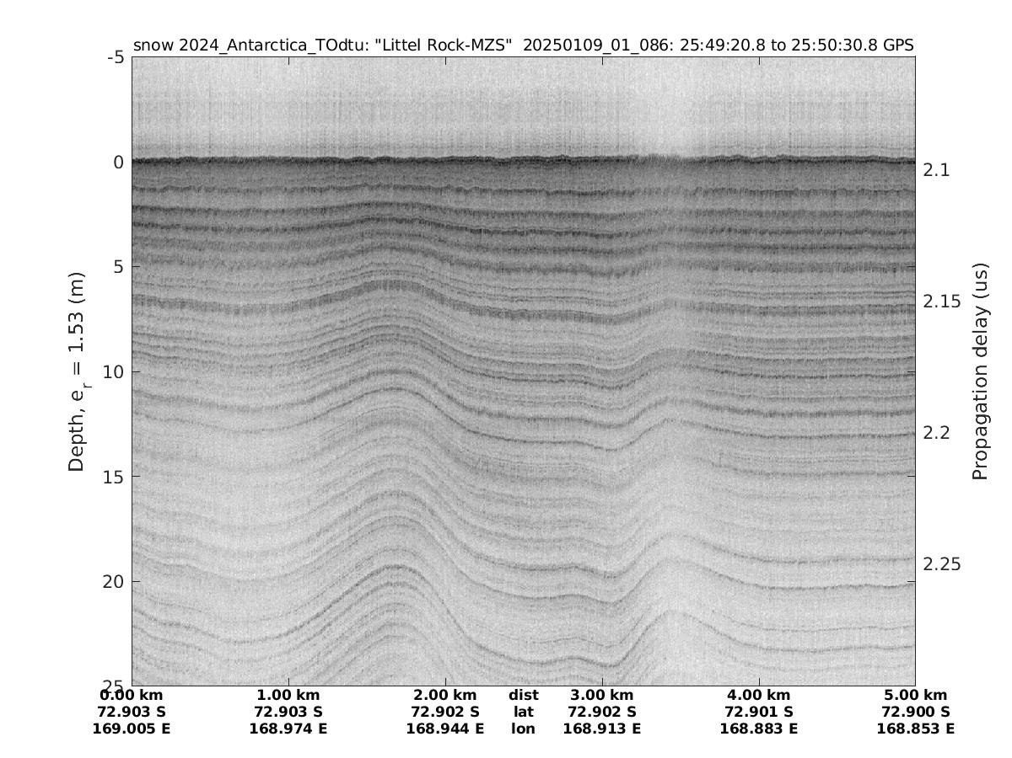
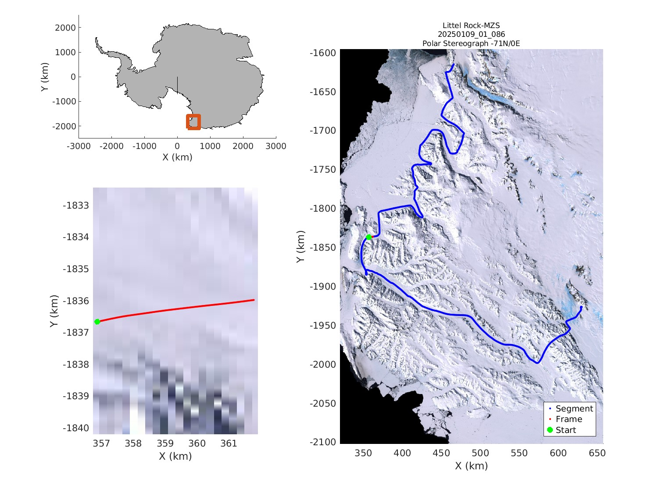
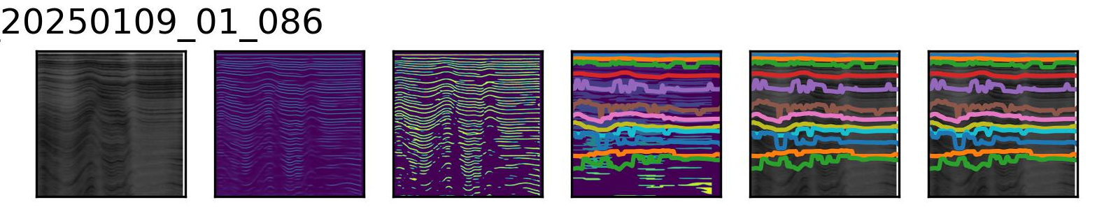
Antarctica
Fig. 4 sample tracking result from Antarctica 2025

Slide 8
5. Future work
Expand the AI training dataset to include Antarctica data and other regions like Alaska.
Improve the ML models with the expanded training dataset.
Archive the training setup and steps so that the OPR toolbox community can contribute to improving the ML tracker.

