Slide 1
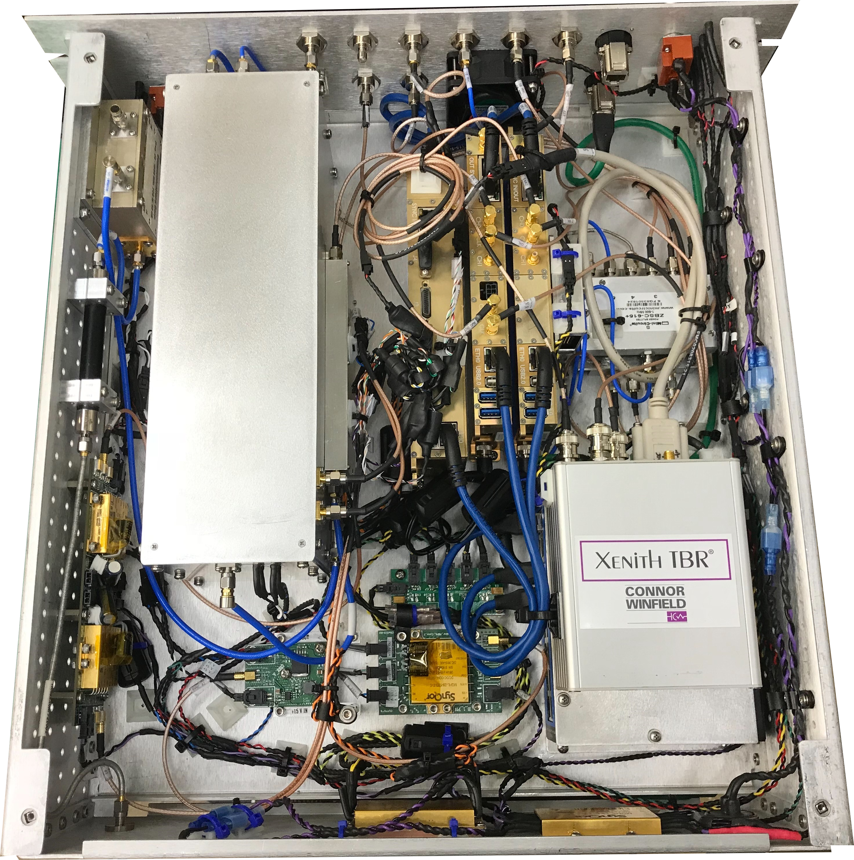
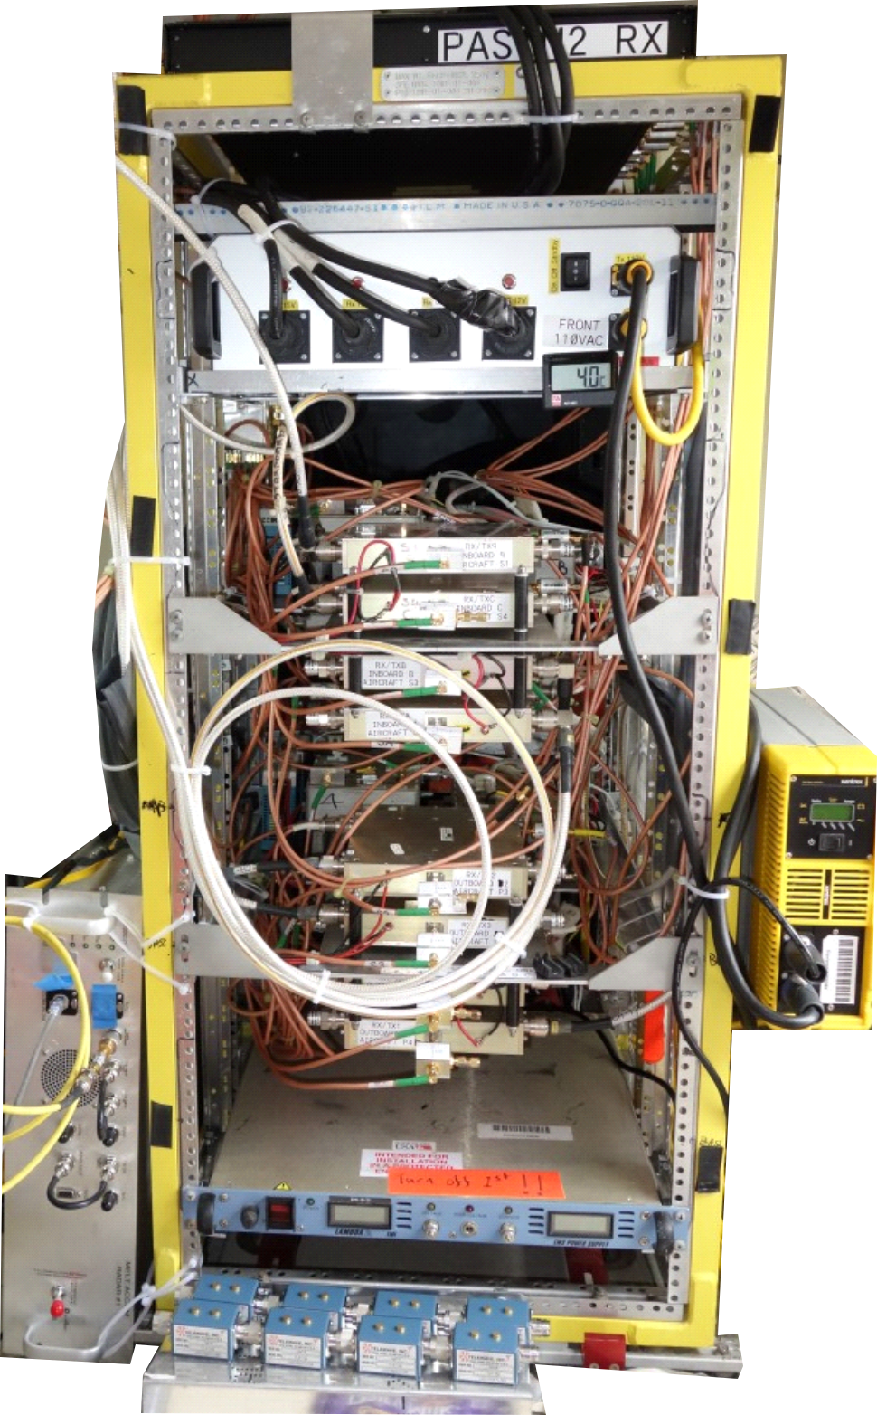
0.47 m
0.13 m
RF
section
High-speed mixed signal section
0.48 m
Power conditioning
(a)
(b)
(c)

Slide 2
(a)
Relative Power [dB]
10 dB
-1
0
+1
Relative time [μs]
(b)
10 dB
Relative Power [dB]
-1
0
+1
Relative time [μs]

