Slide 1
Time Domain Correlation
(Back Projection)
SAR Processor

Slide 2
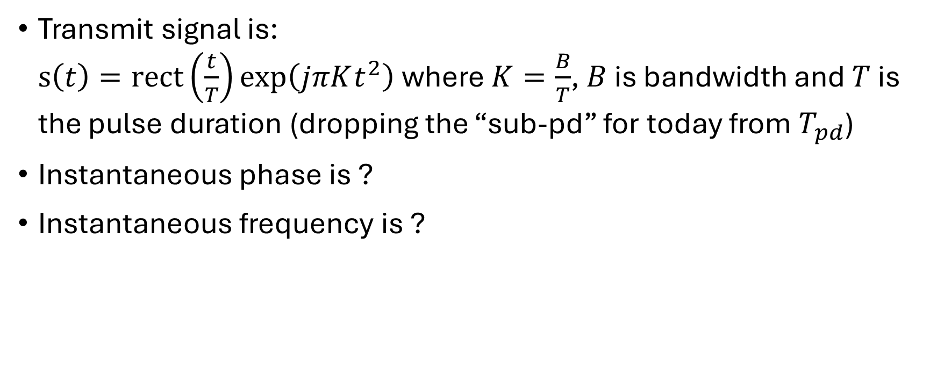
Pulse Compression:
Chirp Signal
Transmit signal is:
$s\left(t\right)=rect\left(\frac{t}{T}\right)exp\left(jπKt^{2}\right)$ where $K=\frac{B}{T}$, $B$ is bandwidth and $T$ is the pulse duration (dropping the “sub-pd” for today from $T_{pd}$)
Instantaneous phase is ?
Instantaneous frequency is ?

Slide 3
Pulse Compression:
Chirp Signal
What do the plots of phase and frequency look like?

Slide 4

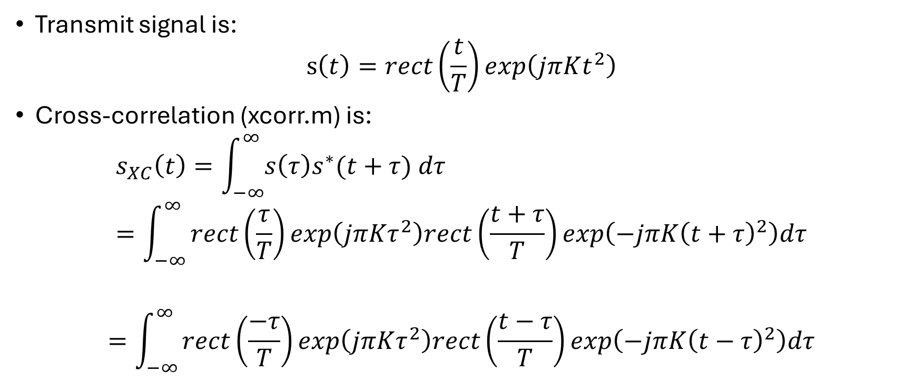
Pulse Compression:
Cross-correlation
Transmit signal is:
$s\left(t\right)=rect\left(\frac{t}{T}\right)exp\left(jπKt^{2}\right)$
Cross-correlation (xcorr.m) is:
$$s_{XC}\left(t\right)=\int_{−∞}^{∞}{s\left(τ\right)s^{∗}(t+τ) dτ} \\ =\int_{−∞}^{∞}{rect\left(\frac{τ}{T}\right)exp\left(jπKτ^{2}\right)rect\left(\frac{t+τ}{T}\right)exp\left(−jπK{\left(t+τ\right)}^{2}\right)dτ}$$
$$=\int_{−∞}^{∞}{rect\left(\frac{−τ}{T}\right)exp\left(jπKτ^{2}\right)rect\left(\frac{t−τ}{T}\right)exp\left(−jπK{\left(t−τ\right)}^{2}\right)dτ}$$
Transmit Signal
Delayed by $t$ Correlation Signal

Slide 5
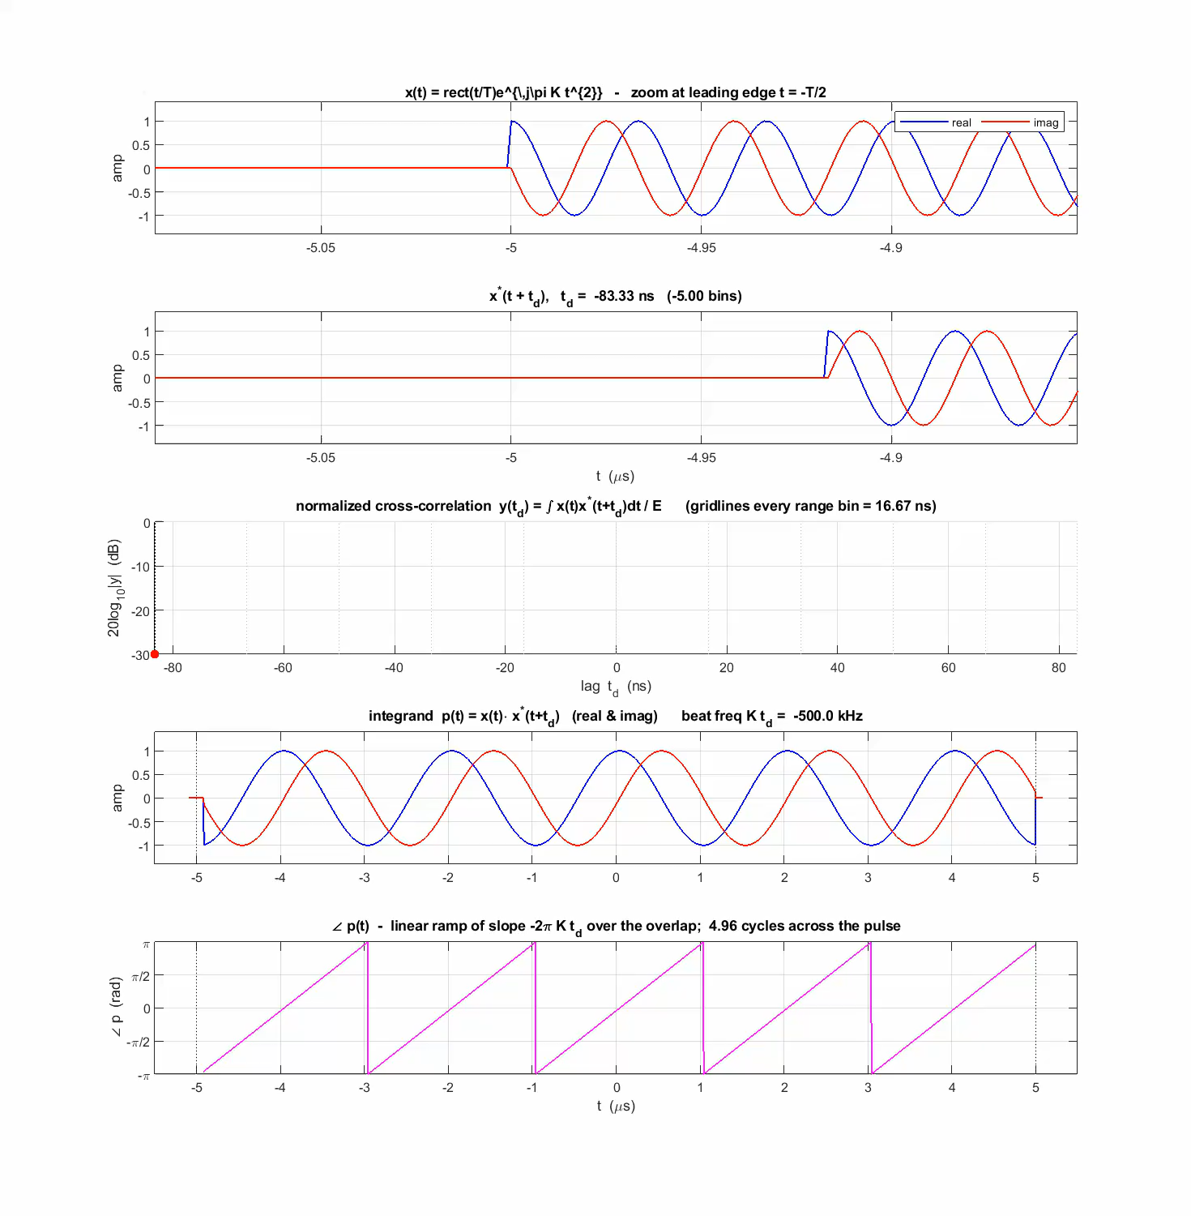
Pulse Compression:
Cross-correlation
Transmit Signal
Delayed Signal
Cross correlation
Integrand
(Transmit * Delayed Signals)
Phase of the integrand

Slide 6
Pulse Compression: Matched Filtering
What is the matched filter in the frequency domain?
  The conjugate of the transmit signal’s Fourier transform

Slide 7
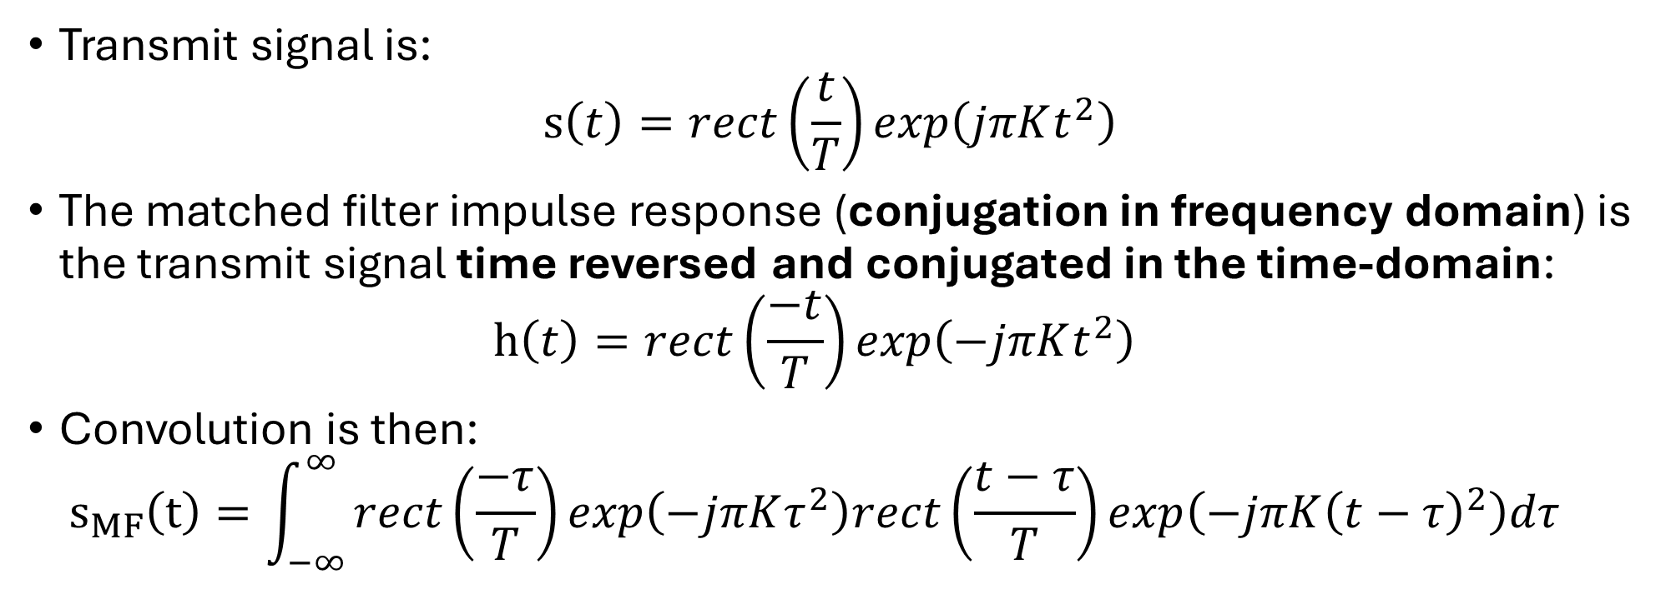
Pulse Compression:
Derive response for boxcar (rect) weighted chirp
Transmit signal is:
$s\left(t\right)=rect\left(\frac{t}{T}\right)exp\left(jπKt^{2}\right)$
The matched filter impulse response (conjugation in frequency domain) is the transmit signal time reversed and conjugated in the time-domain:
$h\left(t\right)=rect\left(\frac{−t}{T}\right)exp\left(−jπKt^{2}\right)$
Convolution is then:
$s_{MF}\left(t\right)=\int_{−∞}^{∞}{rect\left(\frac{−τ}{T}\right)exp\left(−jπKτ^{2}\right)rect\left(\frac{t−τ}{T}\right)exp\left(−jπK{\left(t−τ\right)}^{2}\right)dτ}$
Matched Filter
Transmit Signal (time reversed and delayed)

Slide 8
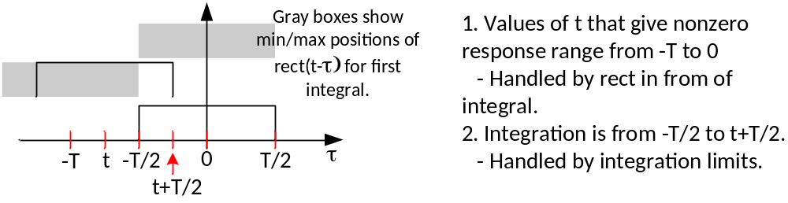
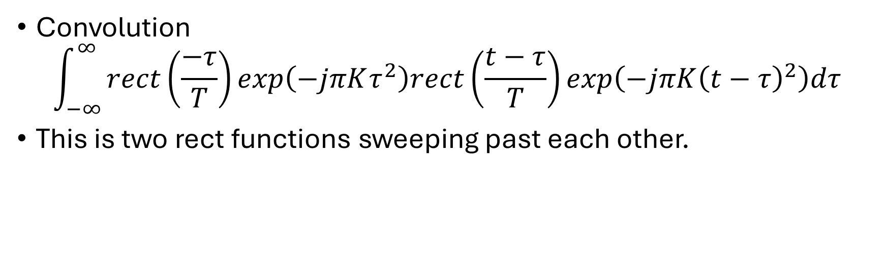
Pulse Compression:
Derive response for boxcar weighted chirps
Convolution
$$\int_{−∞}^{∞}{rect\left(\frac{−τ}{T}\right)exp\left(−jπKτ^{2}\right)rect\left(\frac{t−τ}{T}\right)exp\left(−jπK{\left(t−τ\right)}^{2}\right)dτ}$$
This is two rect functions sweeping past each other.

Slide 9
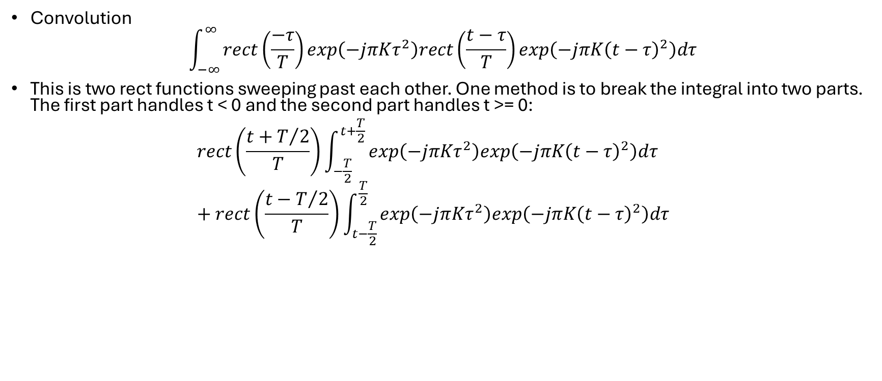
Pulse Compression:
Derive response for boxcar weighted chirps
Convolution
$$\int_{−∞}^{∞}{rect\left(\frac{−τ}{T}\right)exp\left(−jπKτ^{2}\right)rect\left(\frac{t−τ}{T}\right)exp\left(−jπK{\left(t−τ\right)}^{2}\right)dτ}$$
This is two rect functions sweeping past each other. One method is to break the integral into two parts. The first part handles t < 0 and the second part handles t >= 0:
$rect\left(\frac{t+T/2}{T}\right)\int_{−\frac{T}{2}}^{t+\frac{T}{2}}{exp\left(−jπKτ^{2}\right)exp\left(−jπK{\left(t−τ\right)}^{2}\right)dτ}$
$+ rect\left(\frac{t−T/2}{T}\right)\int_{t−\frac{T}{2}}^{\frac{T}{2}}{exp\left(−jπKτ^{2}\right)exp\left(−jπK{\left(t−τ\right)}^{2}\right)dτ}$

Slide 10
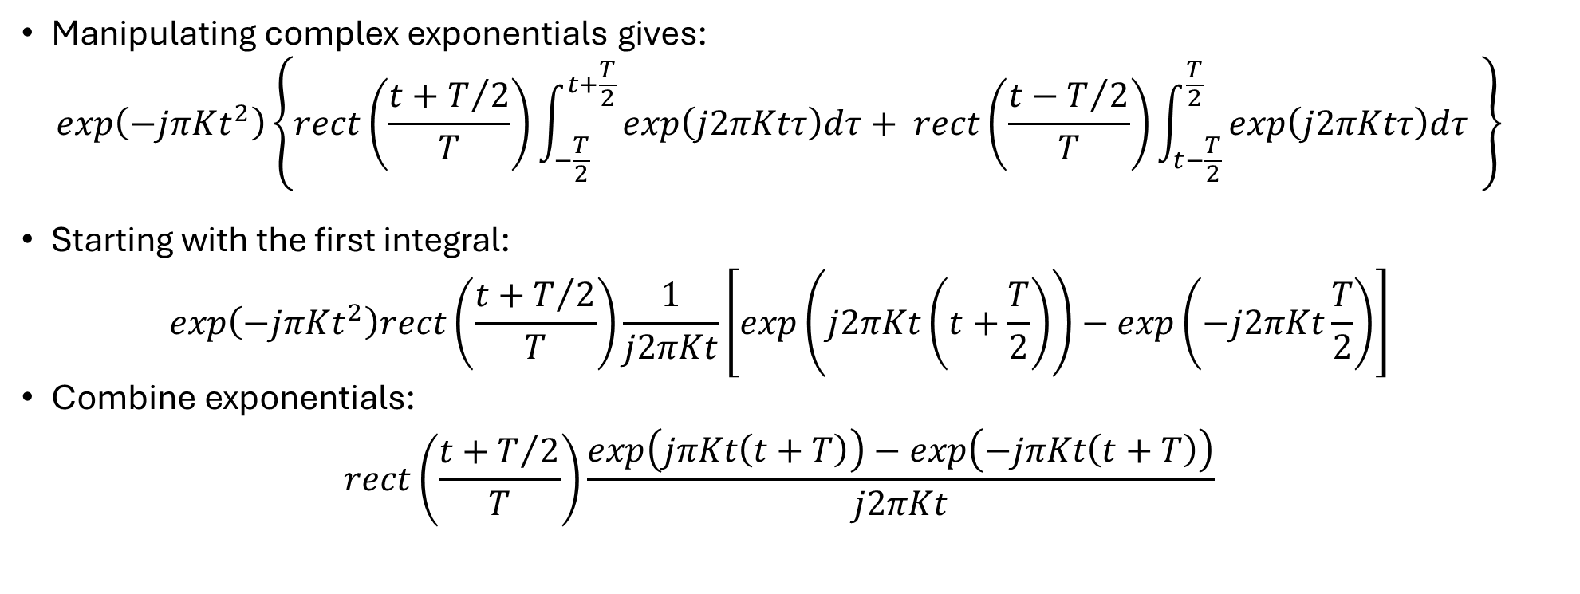
Pulse Compression:
Derive response for boxcar weighted chirps
Manipulating complex exponentials gives:
$exp\left(−jπKt^{2}\right)\left\{rect\left(\frac{t+T/2}{T}\right)\int_{−\frac{T}{2}}^{t+\frac{T}{2}}{exp\left(j2πKtτ\right)dτ}+ rect\left(\frac{t−T/2}{T}\right)\int_{t−\frac{T}{2}}^{\frac{T}{2}}{exp\left(j2πKtτ\right)dτ} \right\}$
Starting with the first integral:
$exp\left(−jπKt^{2}\right)rect\left(\frac{t+T/2}{T}\right)\frac{1}{j2πKt}\left[exp\left(j2πKt\left(t+\frac{T}{2}\right)\right)−exp\left(−j2πKt\frac{T}{2}\right)\right]$
Combine exponentials:
$rect\left(\frac{t+T/2}{T}\right)\frac{exp\left(jπKt\left(t+T\right)\right)−exp\left(−jπKt\left(t+T\right)\right)}{j2πKt}$

Slide 11
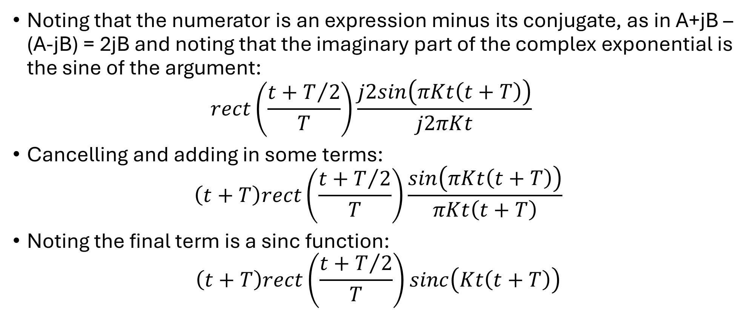
Pulse Compression:
Derive response for boxcar weighted chirps
Noting that the numerator is an expression minus its conjugate, as in A+jB – (A-jB) = 2jB and noting that the imaginary part of the complex exponential is the sine of the argument:
$rect\left(\frac{t+T/2}{T}\right)\frac{j2sin\left(πKt\left(t+T\right)\right)}{j2πKt}$
Cancelling and adding in some terms:
$\left(t+T\right)rect\left(\frac{t+T/2}{T}\right)\frac{sin\left(πKt\left(t+T\right)\right)}{πKt\left(t+T\right)}$
Noting the final term is a sinc function:
$\left(t+T\right)rect\left(\frac{t+T/2}{T}\right)sinc\left(Kt\left(t+T\right)\right)$

Slide 12
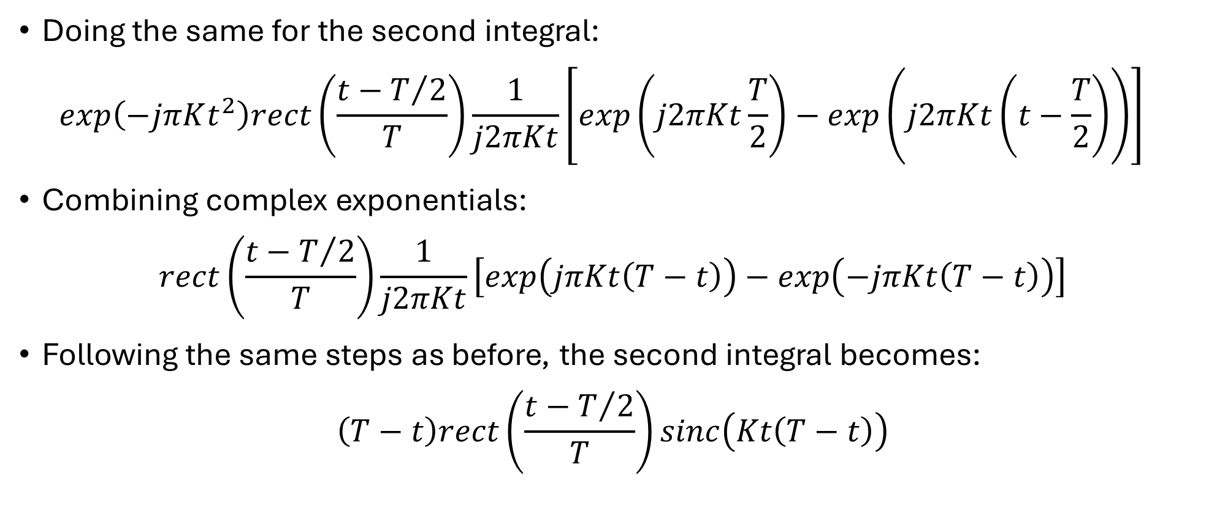
Pulse Compression:
Derive response for boxcar weighted chirps
Doing the same for the second integral:
$exp\left(−jπKt^{2}\right)rect\left(\frac{t−T/2}{T}\right)\frac{1}{j2πKt}\left[exp\left(j2πKt\frac{T}{2}\right)−exp\left(j2πKt\left(t−\frac{T}{2}\right)\right)\right]$
Combining complex exponentials:
$rect\left(\frac{t−T/2}{T}\right)\frac{1}{j2πKt}\left[exp\left(jπKt\left(T−t\right)\right)−exp\left(−jπKt\left(T−t\right)\right)\right]$
Following the same steps as before, the second integral becomes:
$\left(T−t\right)rect\left(\frac{t−T/2}{T}\right)sinc\left(Kt\left(T−t\right)\right)$

Slide 13
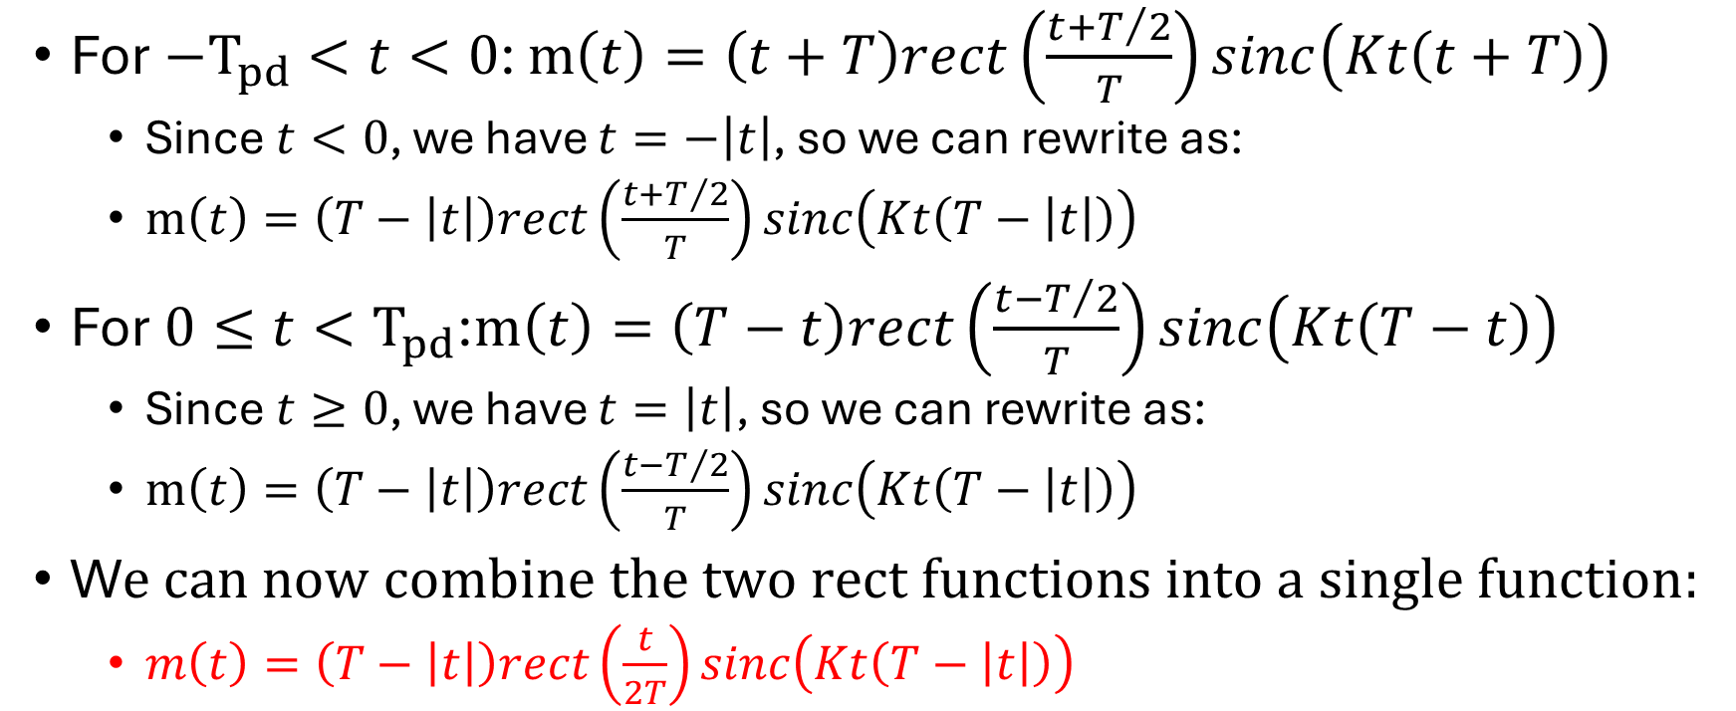
Pulse Compression Output :
Derive response for boxcar weighted chirps
For $−T_{pd}<t<0$: $m\left(t\right)=\left(t+T\right)rect\left(\frac{t+T/2}{T}\right)sinc\left(Kt\left(t+T\right)\right)$
  Since $t<0$, we have $t=−\left|t\right|$, so we can rewrite as:
  $m\left(t\right)=\left(T−\left|t\right|\right)rect\left(\frac{t+T/2}{T}\right)sinc\left(Kt\left(T−\left|t\right|\right)\right)$
For $0≤t<T_{pd}$:$m\left(t\right)=\left(T−t\right)rect\left(\frac{t−T/2}{T}\right)sinc\left(Kt\left(T−t\right)\right)$
  Since $t≥0$, we have $t=\left|t\right|$, so we can rewrite as:
  $m\left(t\right)=\left(T−\left|t\right|\right)rect\left(\frac{t−T/2}{T}\right)sinc\left(Kt\left(T−\left|t\right|\right)\right)$
W$e can now combine the two rect functions into a single function:$
  $m\left(t\right)=\left(T−\left|t\right|\right)rect\left(\frac{t}{2T}\right)sinc\left(Kt\left(T−\left|t\right|\right)\right)$

Slide 14
Pulse Compression:
Side lobes
What are they?
And why do we care?

Slide 15
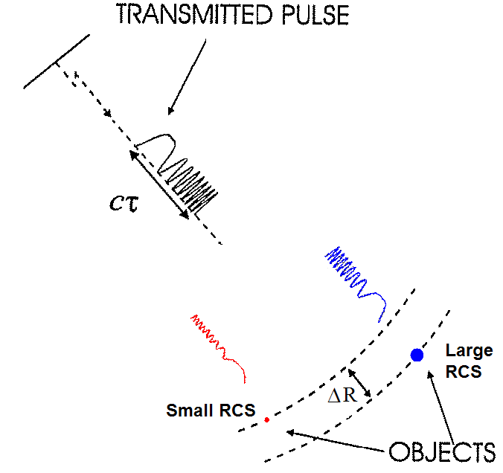
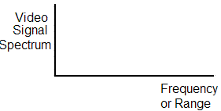
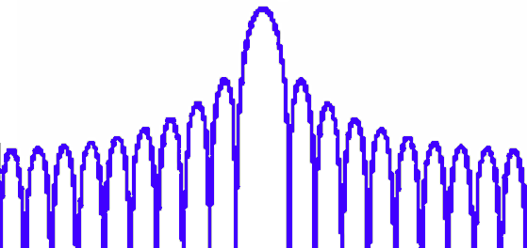
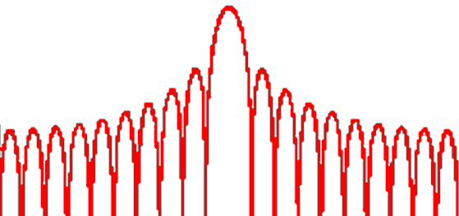
Pulse Compression:
Side lobes
Sidelobes from large-RCS targets with can obscure signals from nearby smaller-RCS targets.
  Time sidelobes are related to pulse duration, τ.
Δf_{b}
Δf_{b} = 2 k ΔR/c

Slide 16
Pulse Compression:
Side lobes
Abrupt changes in one domain require power spread over a wide domain in the Fourier pair (e.g. Fourier pairs like time and frequency, space and wavenumber)
So what can we do?

Slide 17
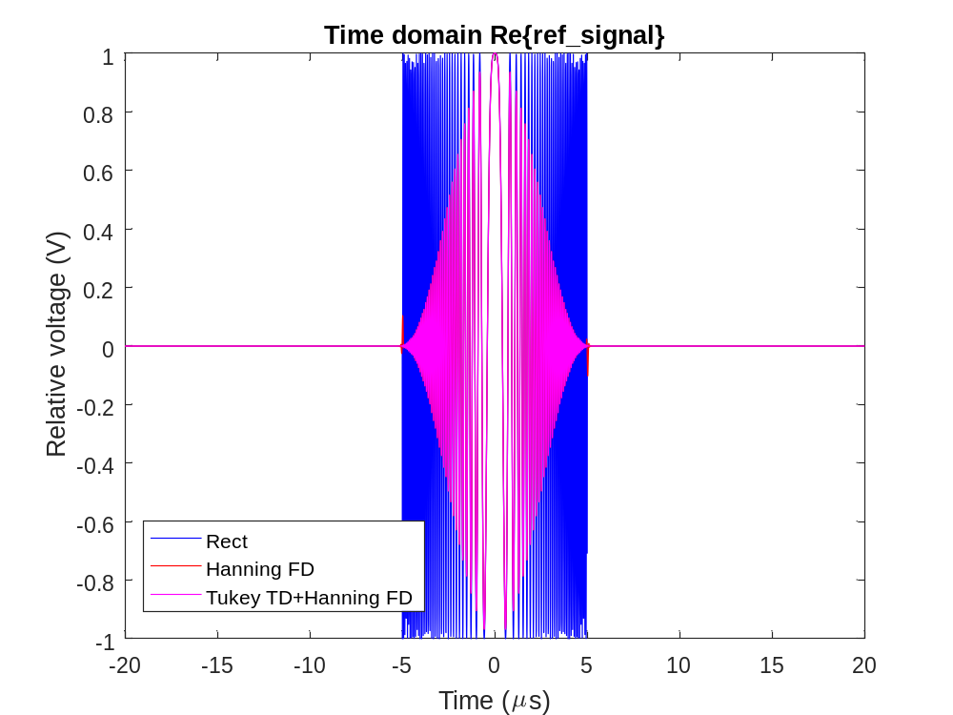
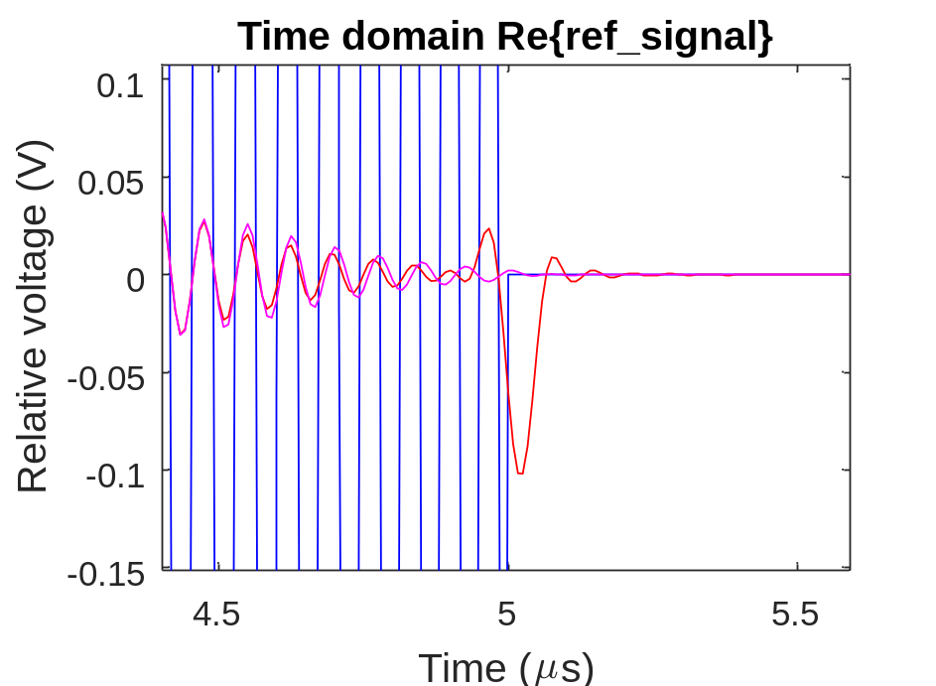
Pulse Compression:
Low Sidelobe Applications
Time-domain Tukey windowing for small time bandwidth products where very low sidelobes are required and for lessening power amplifier distortion of the signal

Slide 18
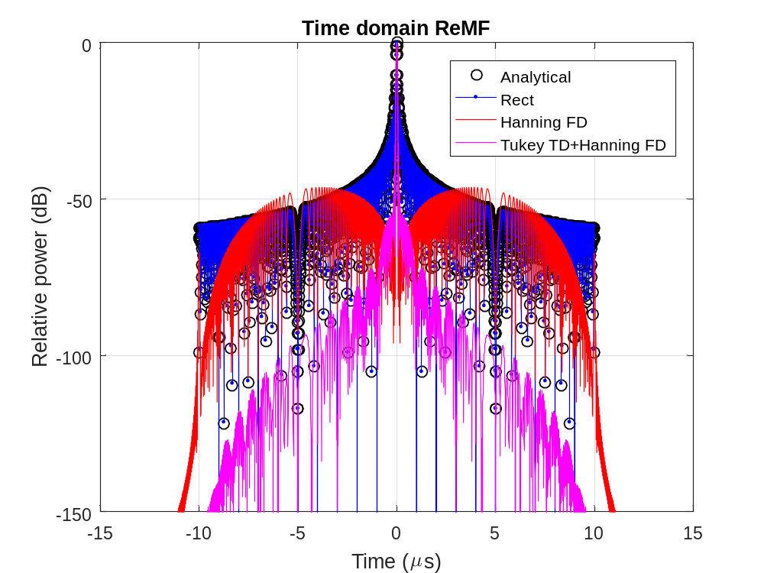
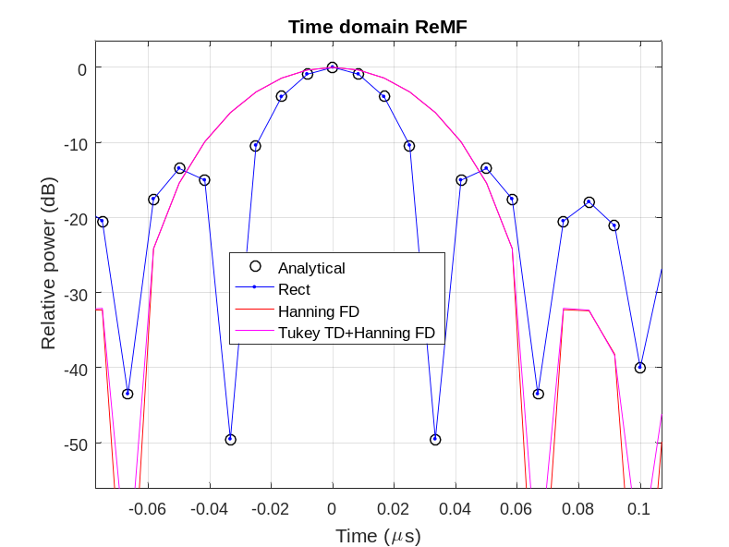
Pulse Compression:
Low Sidelobe Applications
Importance of Tukey windowing for small time bandwidth products where very low sidelobes are required and for lessening power amplifier distortion of the signal

Slide 19
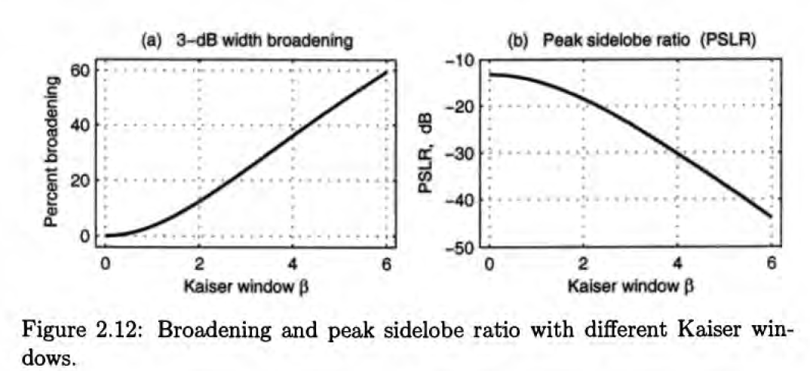
Pulse Compression:
Kaiser window

Slide 20
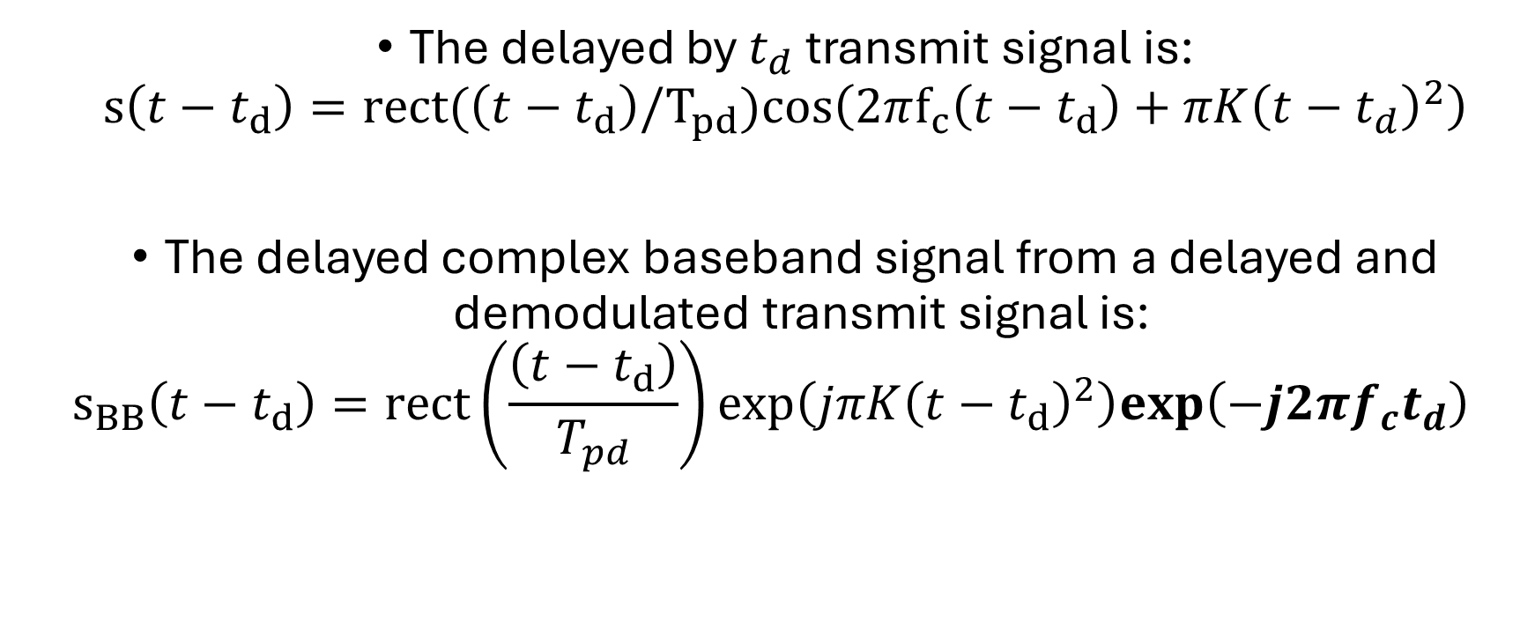
Transmit Signal
The delayed by $t_{d}$ transmit signal is:
$s\left(t−t_{d}\right)=rect(\left(t−t_{d}\right)/T_{pd})cos\left(2πf_{c}\left(t−t_{d}\right)+πK{\left(t−t_{d}\right)}^{2}\right)$
The delayed complex baseband signal from a delayed and demodulated transmit signal is:
$s_{BB}\left(t−t_{d}\right)=rect\left(\frac{\left(t−t_{d}\right)}{T_{pd}}\right)exp\left(jπK{\left(t−t_{d}\right)}^{2}\right)exp\left(−j2πf_{c}t_{d}\right)$

Slide 21
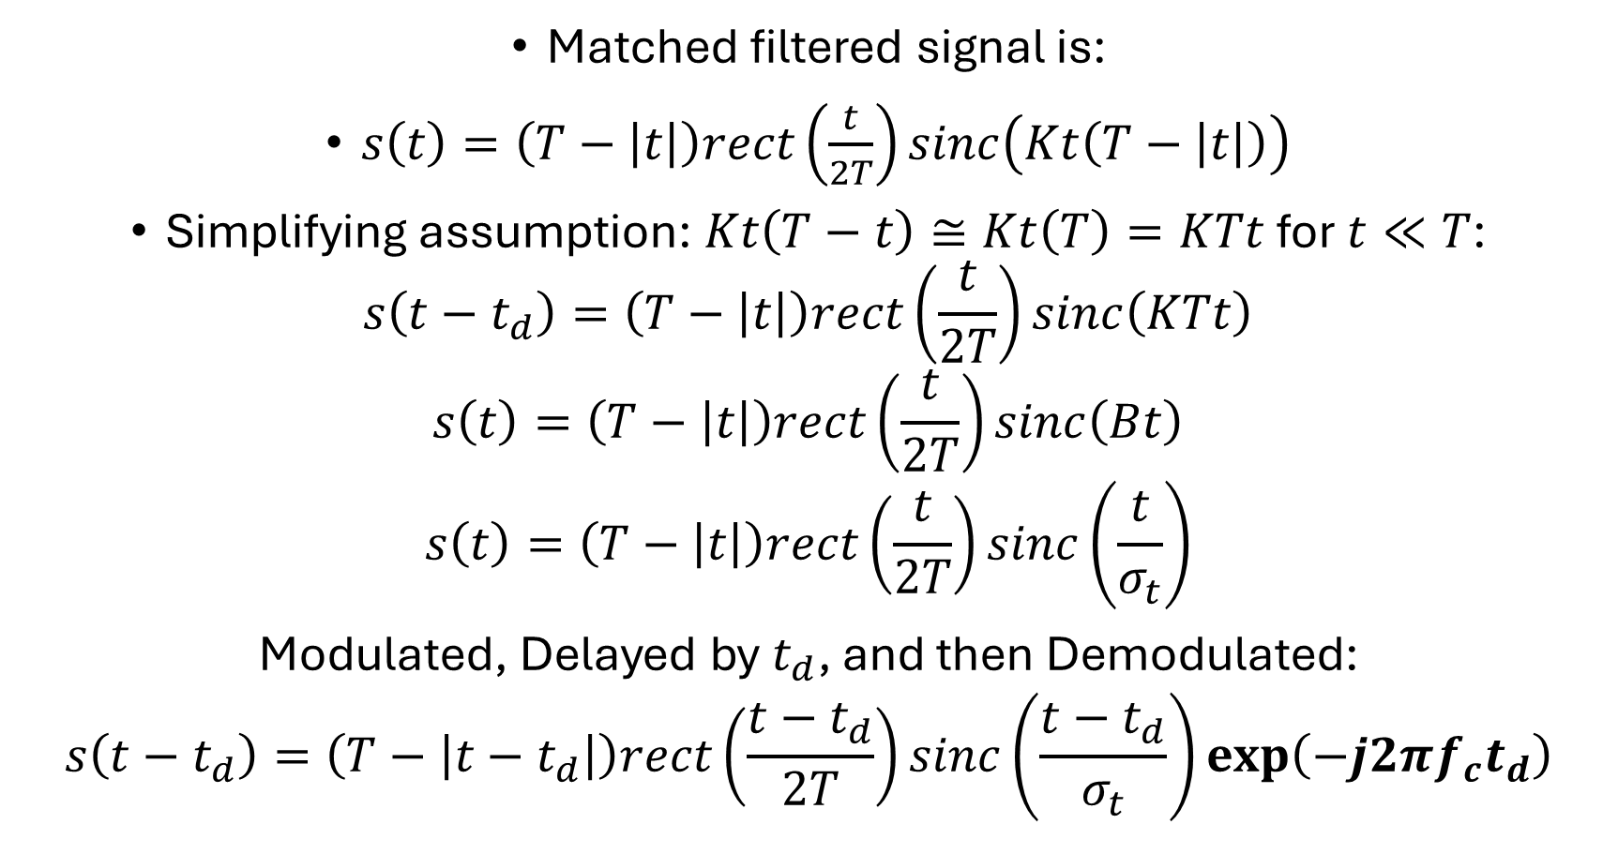
Matched Filter Signal
Matched filtered signal is:
$s\left(t\right)=\left(T−\left|t\right|\right)rect\left(\frac{t}{2T}\right)sinc\left(Kt\left(T−\left|t\right|\right)\right)$
Simplifying assumption: $Kt\left(T−t\right)≅Kt\left(T\right)=KTt$ for $t≪T$:
$s\left(t−t_{d}\right)=\left(T−\left|t\right|\right)rect\left(\frac{t}{2T}\right)sinc\left(KTt\right)$
$$s\left(t\right)=\left(T−\left|t\right|\right)rect\left(\frac{t}{2T}\right)sinc\left(Bt\right)$$
$$s\left(t\right)=\left(T−\left|t\right|\right)rect\left(\frac{t}{2T}\right)sinc\left(\frac{t}{σ_{t}}\right)$$
Modulated, Delayed by $t_{d}$, and then Demodulated:
$$s\left(t−t_{d}\right)=\left(T−\left|t−t_{d}\right|\right)rect\left(\frac{t−t_{d}}{2T}\right)sinc\left(\frac{t−t_{d}}{σ_{t}}\right)\exp\left(−j2πf_{c}t_{d}\right)$$

Slide 22


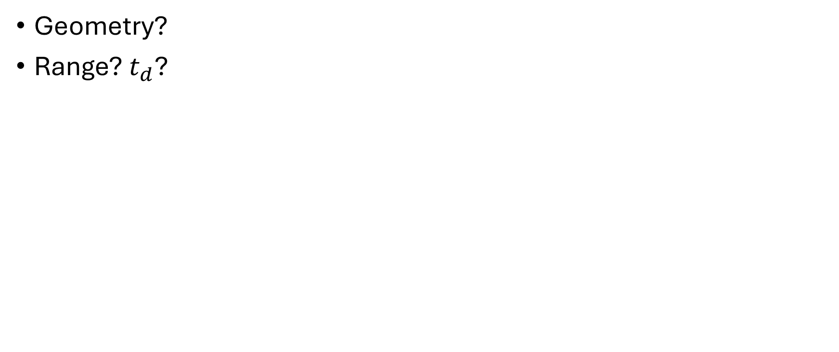
SAR Aperture Signal for Linear Flight Path
Geometry?
Range? $t_{d}$?

Slide 23
SAR Aperture Signal for Linear Flight Path
Phase?
Frequency?

Slide 24
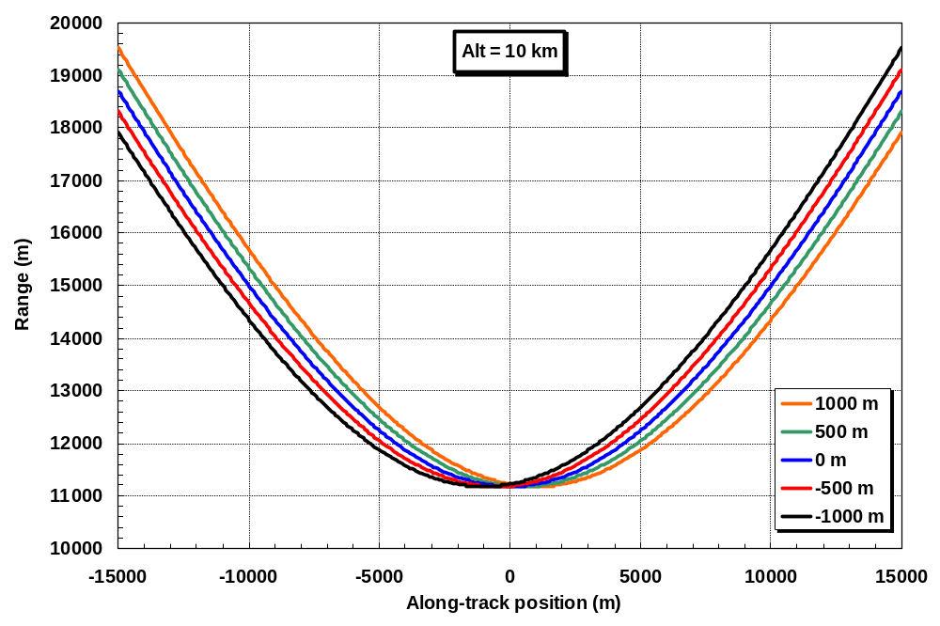
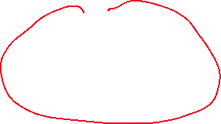
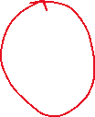


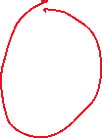
Along-track resolution
Notes:
Chris Allen’s slide

Slide 25
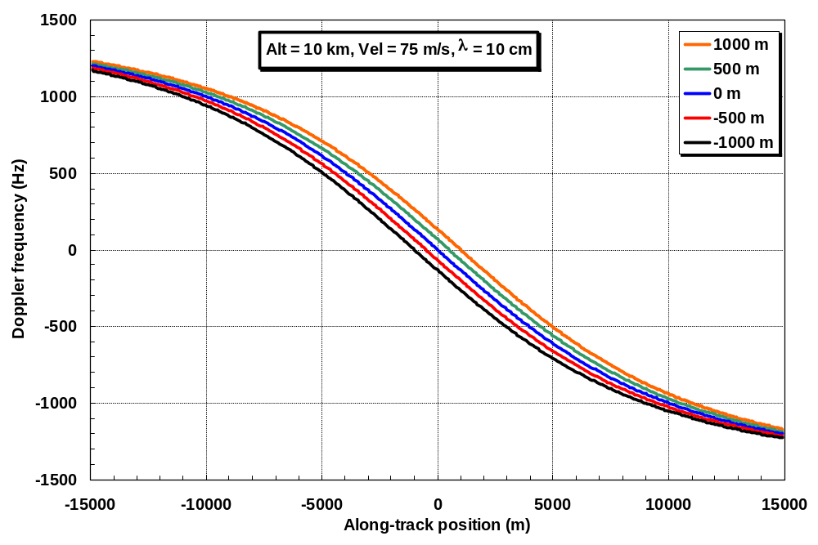
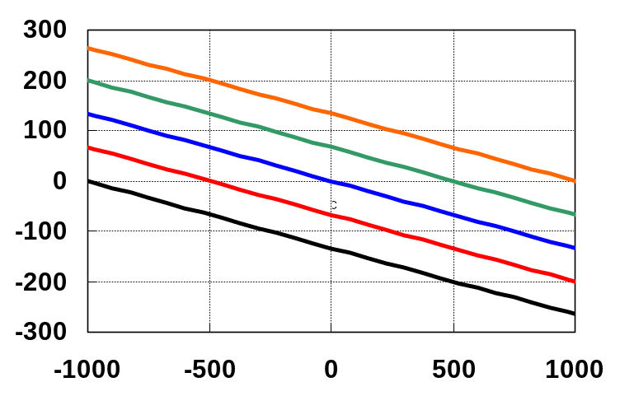
Along-track resolution
Notes:
Chris Allen’s slide

Slide 26
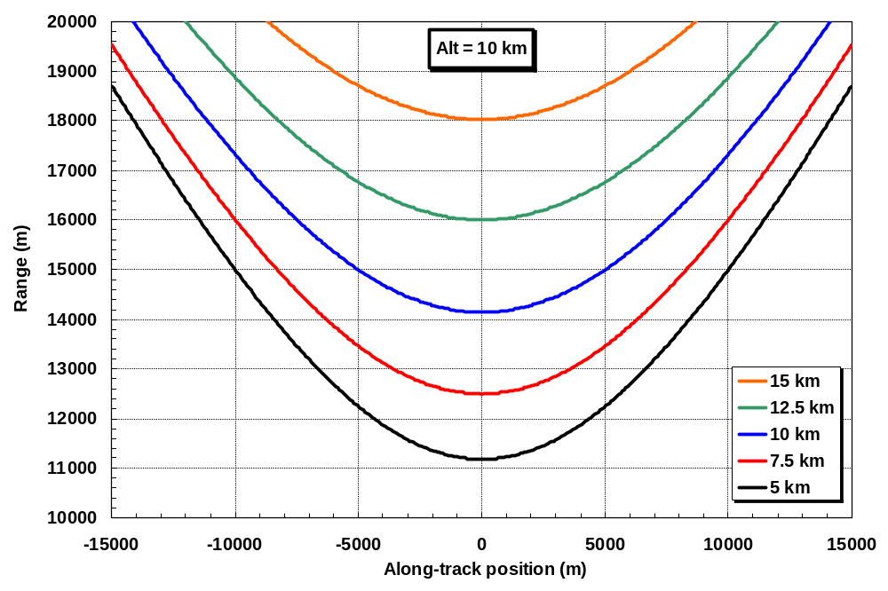
Along-track resolution
Notes:
Chris Allen’s slide

Slide 27
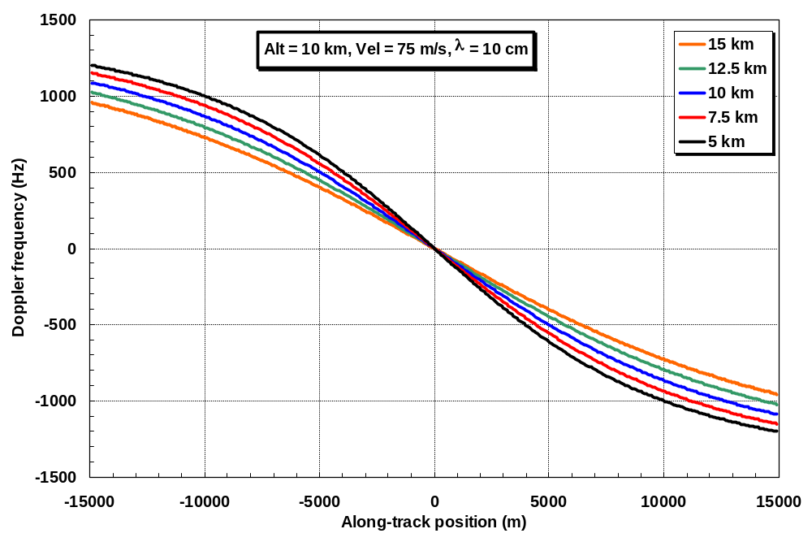
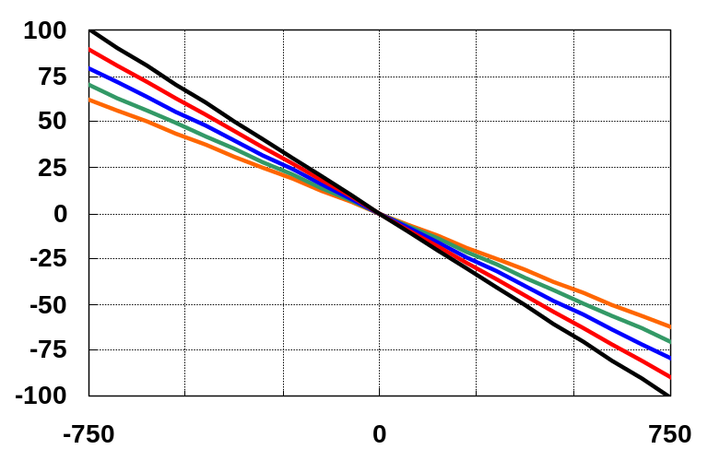
Along-track resolution
Notes:
Chris Allen’s slide

Slide 28
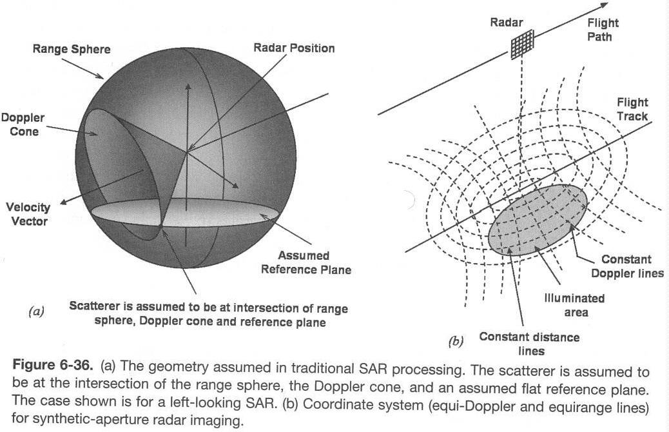
Along-track resolution
Now solve for R and f_{D} for all target locations and plot lines of constant range (isorange) and lines of constant Doppler shift (isodops) on the surface.
Notes:
Chris Allen’s slide

Slide 29
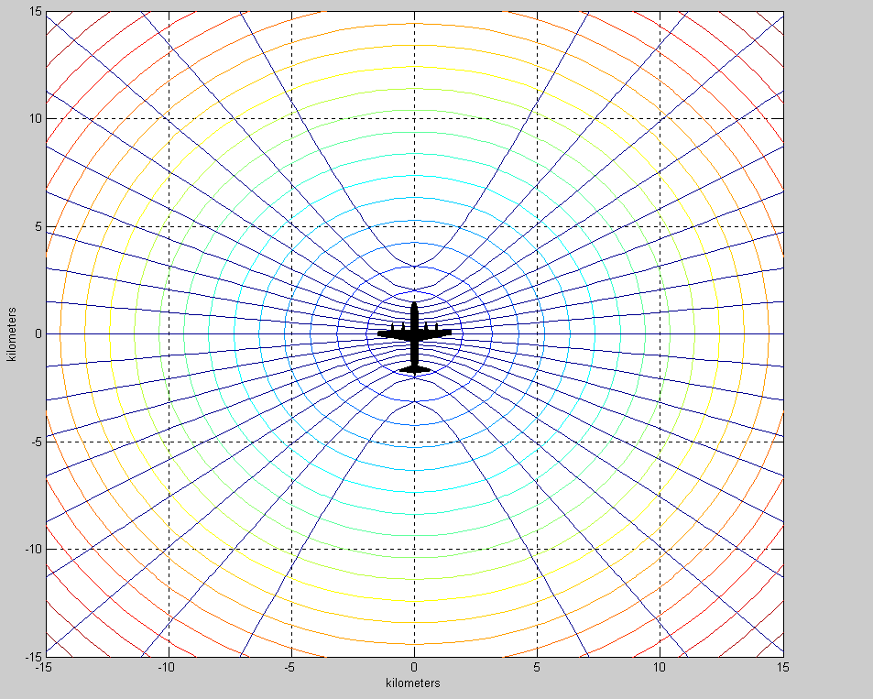
Along-track resolution
Isorange and isodoppler lines for aircraft flying north at 10 m/s at a 1500-m altitude.
ρ_{r} = 2 m, δV = 0.002 m/s, δf_{D} = 0.13 Hz @ f = 10 GHz, λ = 3 cm
Notes:
Chris Allen’s slide

Slide 30

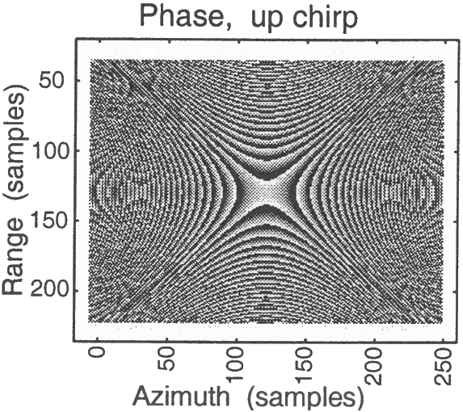

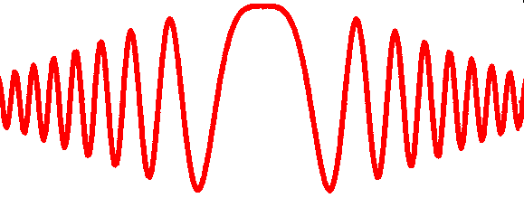
Strip-map SAR signal example (no squint)
Notes:
Chris Allen’s slide

Slide 31
2D (time-space) correlation filter with a time-space varying filter for SAR processing
Just use the point target simulator to generate the matched filter coefficients for each image pixel!
  For loop to simulate a point target in each pixel in the SAR image
    Point target is in the middle of the pixel
  The value for that image pixel is the inner product between the simulated dataset (vector of data) and the measured dataset (vector of data)
    The inner product is a measure of similarity
    The inner product is identical to the correlation operation for one specific time and space lag
    The image pixel value will be a complex number

Slide 32
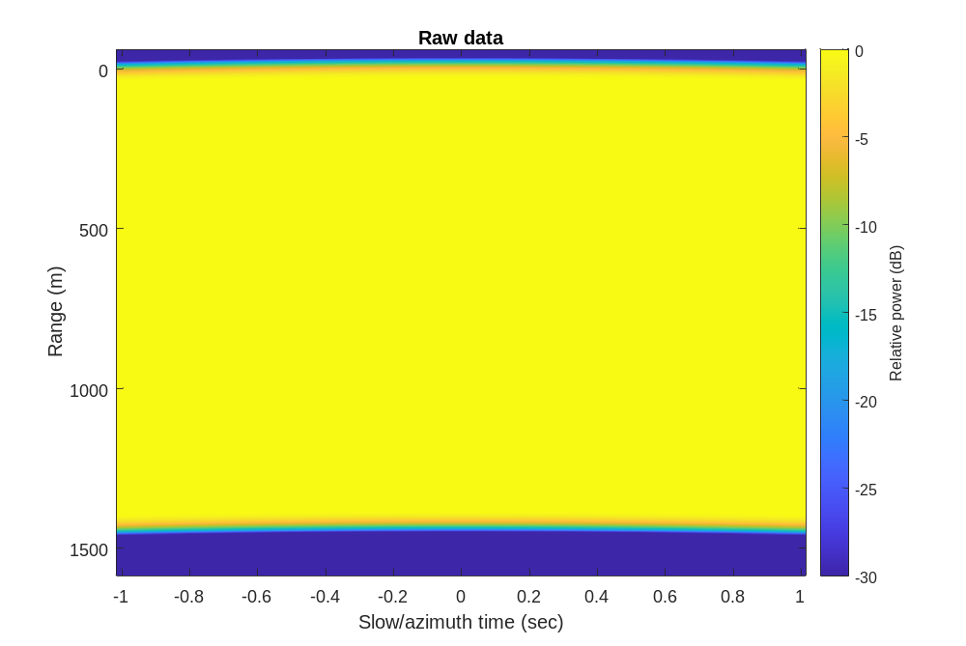
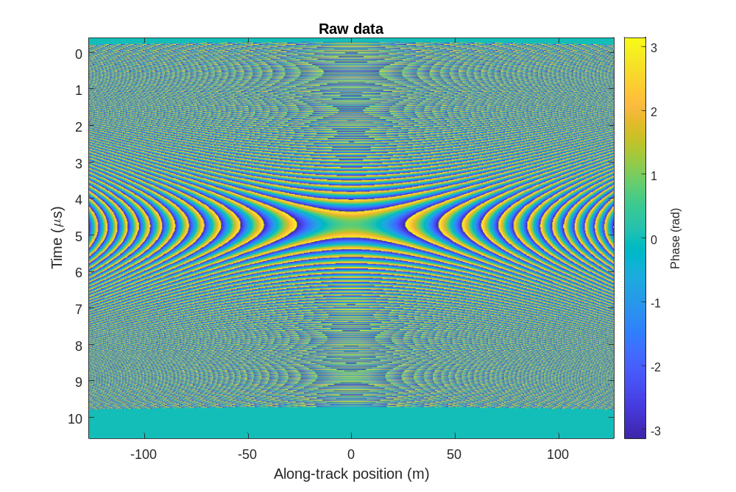
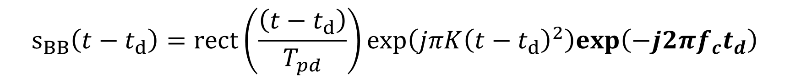
Step 1: Create simulated dataset
$$s_{BB}\left(t−t_{d}\right)=rect\left(\frac{\left(t−t_{d}\right)}{T_{pd}}\right)exp\left(jπK{\left(t−t_{d}\right)}^{2}\right)exp\left(−j2πf_{c}t_{d}\right)$$

Slide 33
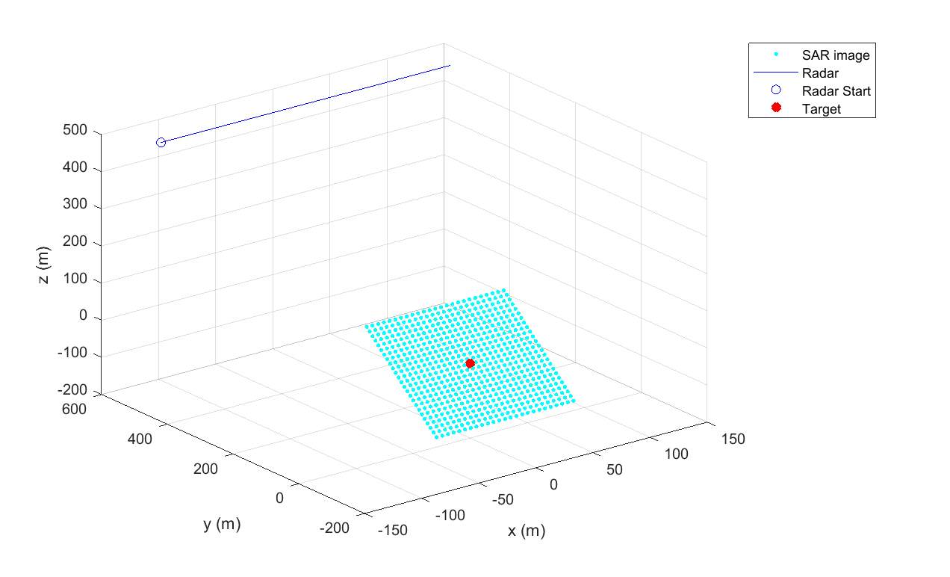
Step 2: Create an image matrix (slant plane or ground plane)

Slide 34
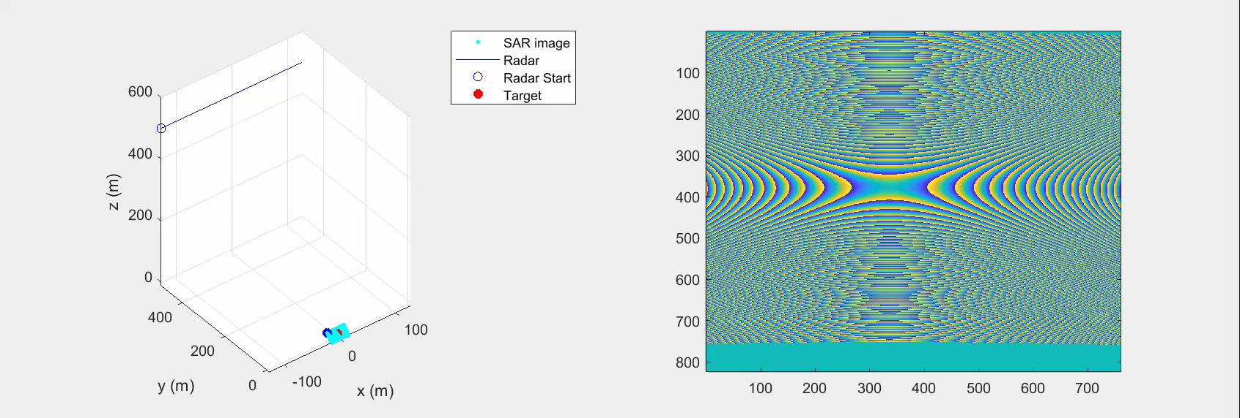
Step 2: For each pixel in the image matrix, compute the scattering simulation for a point target located in the center of the pixel

Slide 35
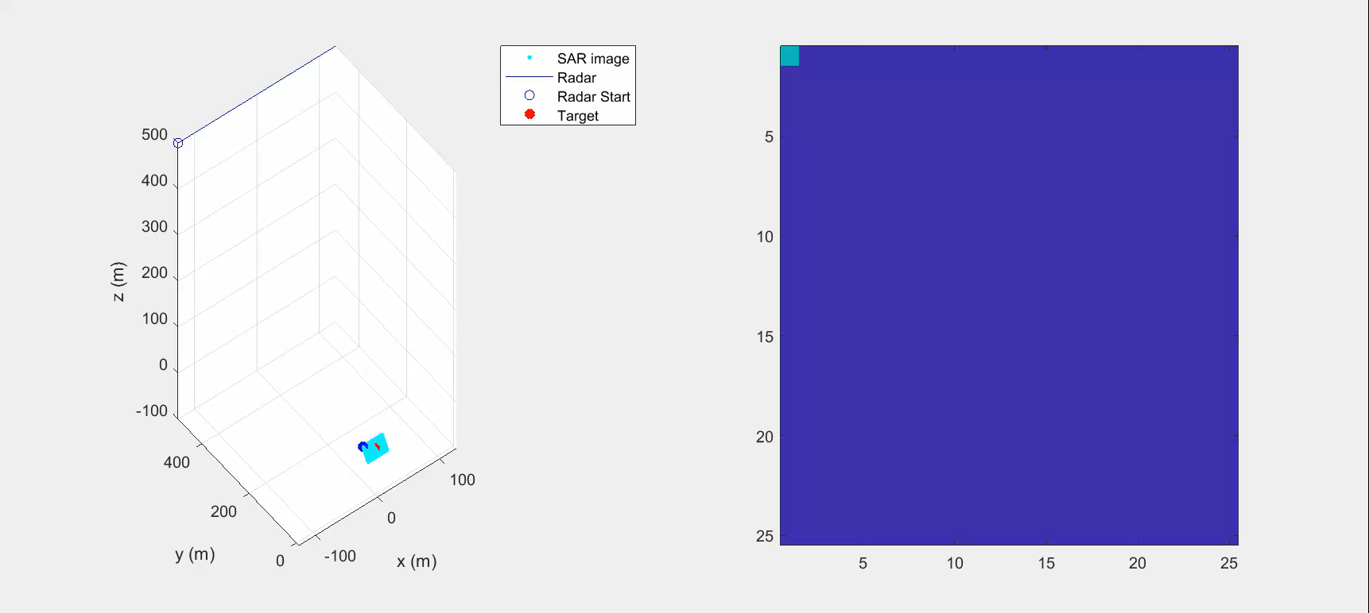
Step 3: Take the inner product of the measurement and the simulated image pixel. Put the resultant value in the image pixel. Move onto the next image pixel.

Slide 36
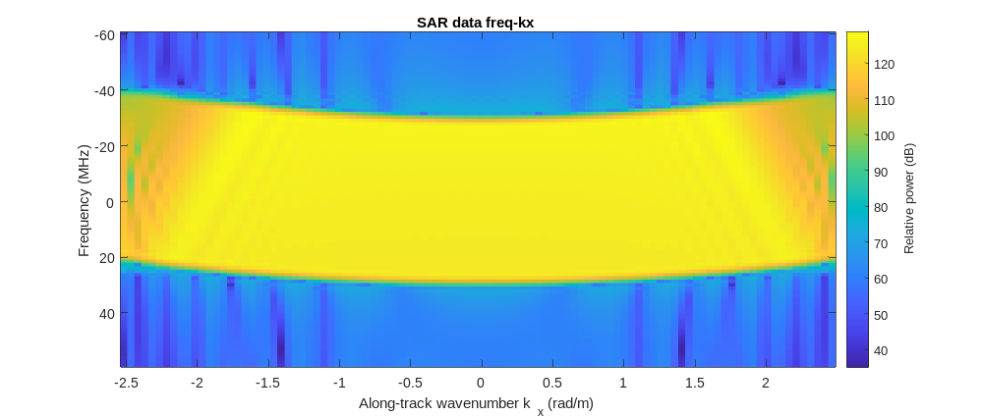
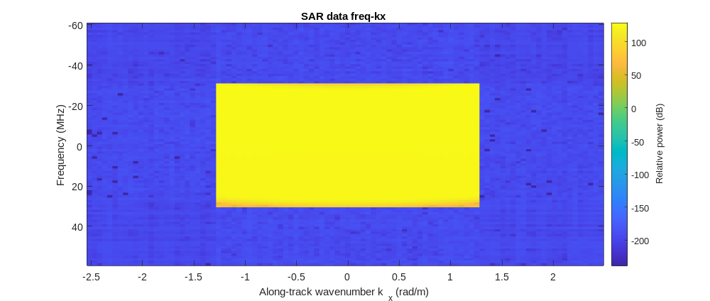
Step 4. Frequency-Wavenumber (f-kx) domain windowing for sidelobes

Slide 37
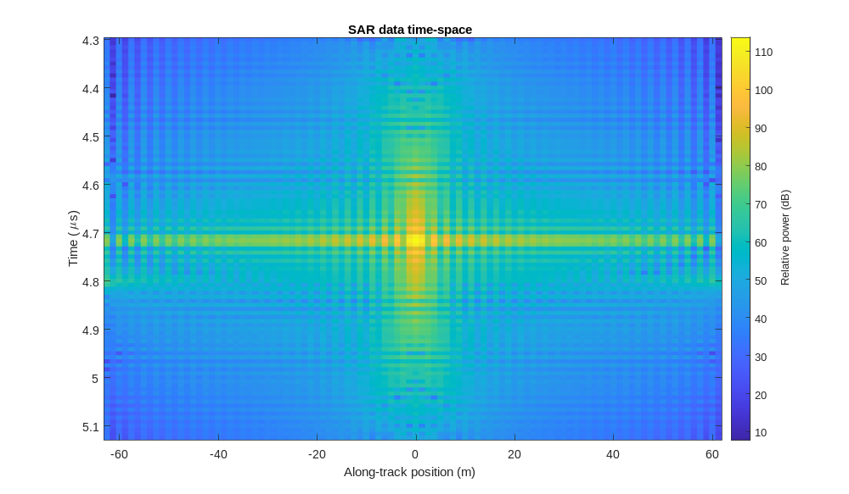
SAR Analysis

Slide 38
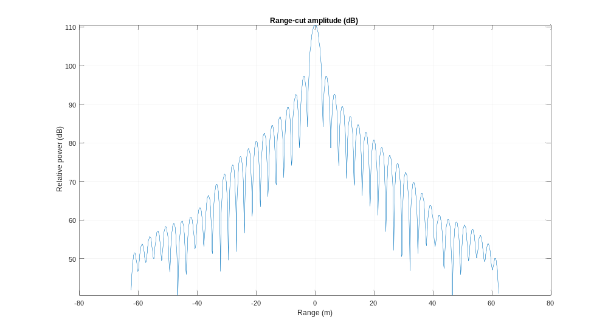

Slide 39
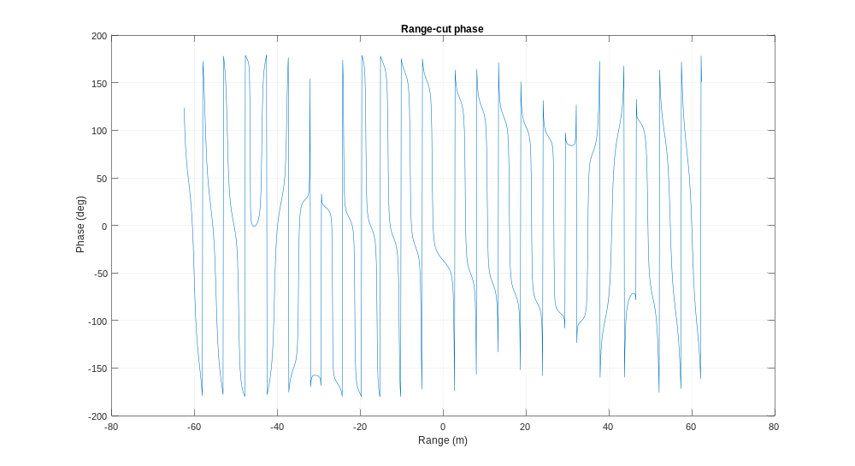

Slide 40
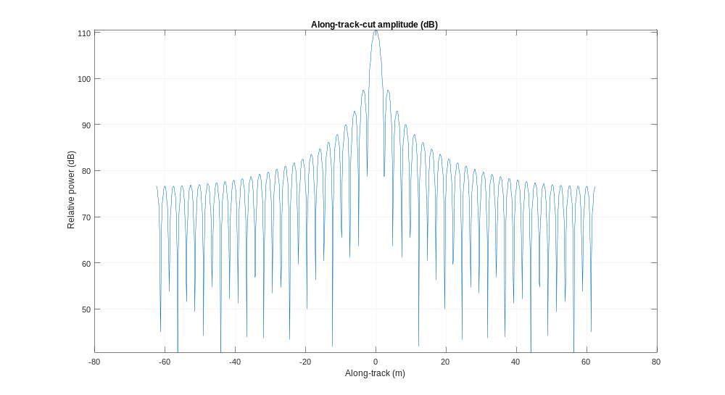

Slide 41
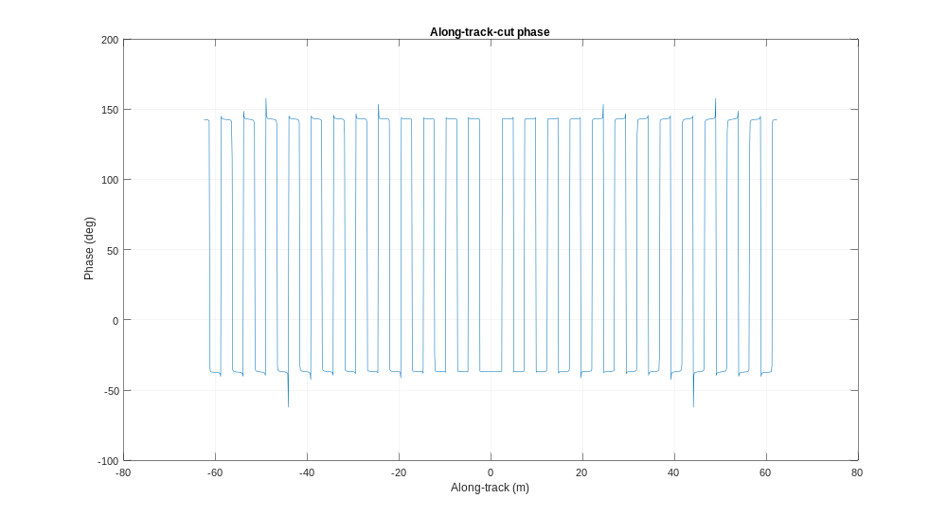

Slide 42
VERY SLOW: How can we speed this up?

Slide 43
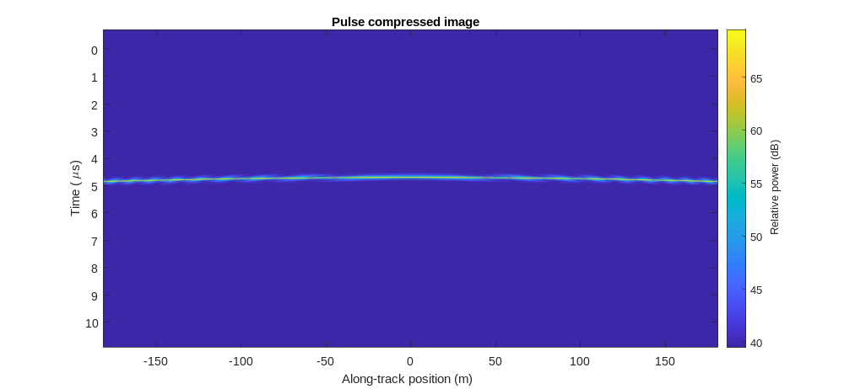
VERY SLOW: How can we speed this up?

Slide 44


2D Matched Filter
Needs to behave like convolution
Linear invariant filter coefficients
  But inner product coefficients using simulator do have a term that varies
  We need to normalize the filter components (weights) to one of the components in the filter.
  Choose the pixel which corresponds to the range of closest approach
  Red term is the problem – depends on absolute $t_{d}$ which is not relative to the current pixel/time $t$ !!!
$$s_{BB}\left(t−t_{d}\right)=rect\left(\frac{\left(t−t_{d}\right)}{T_{pd}}\right)exp\left(jπK{\left(t−t_{d}\right)}^{2}\right)exp\left(−j2πf_{c}t_{d}\right)$$

Slide 45


2D Matched Filter
Needs to behave like convolution
Linear invariant filter coefficients
  But inner product coefficients using simulator do have a term that varies
  We need to normalize the filter components (weights) to one of the components in the filter.
  Choose the pixel which corresponds to the range of closest approach
  Red term makes this a bad… now fixed since it only removes phase offsets relative to the current pixel/time, $t$ !!!
$$s_{BB}\left(t−t_{d}\right)=rect\left(\frac{\left(t−t_{d}\right)}{T_{pd}}\right)exp\left(jπK{\left(t−t_{d}\right)}^{2}\right)exp\left(j2πf_{c}\left(t−t_{d}\right)\right)$$

Slide 46
Resampling
Two algorithms or tools that we will need:
  Non-uniform sampling of uniformly sampled data
  Sampling of non-uniformly sampled data
How can we do this?

Slide 47
Interpolation of Band Limited Signals
We are specifically interested in SAMPLED Band Limited Signals where we want to know a value between currently known samples.
Applications
  Time domain correlation when pulse compression is used.
  Resampling for analyzing SAR processor performance
  Range cell migration correction in the RDA
  Stolt interpolation in FK migration
  Resampling SAR images as part of a co-registration process
  Geocoding SAR imagery or re-projecting into different map coordinates

Slide 48

Interpolation of Band Limited Signals:
Quick thought experiment
Pretend you are only allowed to know the value of a continuous signal at one point (e.g. where you will sample it)
If you could first apply the Fourier time shift property to the signal with a time shift of $∆t$ that you controlled, then you could find the value at any other point offset by $∆t$ from the sampling point:
$f\left(t−∆t\right)=\int_{−∞}^{∞}{F\left(t\right)e^{−j2πf∆t}e^{j2πft}df}$
This is one way to think about band-limited interpolation… we delay the signal to the positions where are samples lie.

Slide 49

Interpolation of Band Limited Signals:
Sampled signal

Slide 50

Interpolation of Band Limited Signals:
Reconstruct and delay

Slide 51

Interpolation of Band Limited Signals:
Resample this reconstructed and delayed signal
If we resample this “convolution with a delayed sinc”, this is:
$\sum_{n=−∞}^{∞}{δ\left(t−nT\right)}\int_{τ=−∞}^{∞}{\sum_{m=−∞}^{∞}{x\left[m\right]δ\left(−τ−mT\right)}sinc\left(\frac{t−τ−∆}{T}\right)dτ}$
Simplifying, we find that it is just convolution with the sampled and delayed sinc function:
$\sum_{n=−∞}^{∞}{\sum_{m=−∞}^{∞}{x\left[m\right]}sinc\left(\left(n−m\right)−\frac{∆}{T}\right)}$

Slide 52
Interpolation of Band Limited Signals:
Non-uniform sampled data
The sinc kernel can be extended to interpolating non-uniformly sampled data. Since the sinc function is analytical, we just need to sample it at the point locations that we have available to us.
This can be used to re-sample data from platforms with varying velocity. If the PRF is constant, the azimuth sampling will be variable in space. By resampling at uniform positions, we can make use of FFT based algorithms.

Slide 53


