Slide 1
Range Doppler Algorithm
SAR Processor

Slide 2
RDA Background
Linear SAR (assume perfectly straight flight path)

Slide 3










RDA Background

Slide 4



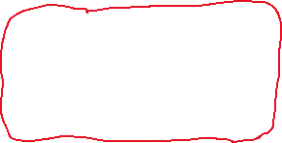


RDA Background

Slide 5
RDA Background
What are the four Fourier domains?
  Time-space (aka “range-space”)
  Frequency-space
  Frequency-wavenumber (aka “f-k” or “frequency-Doppler”)
  Time-wavenumber (aka “range-Doppler”)

Slide 6
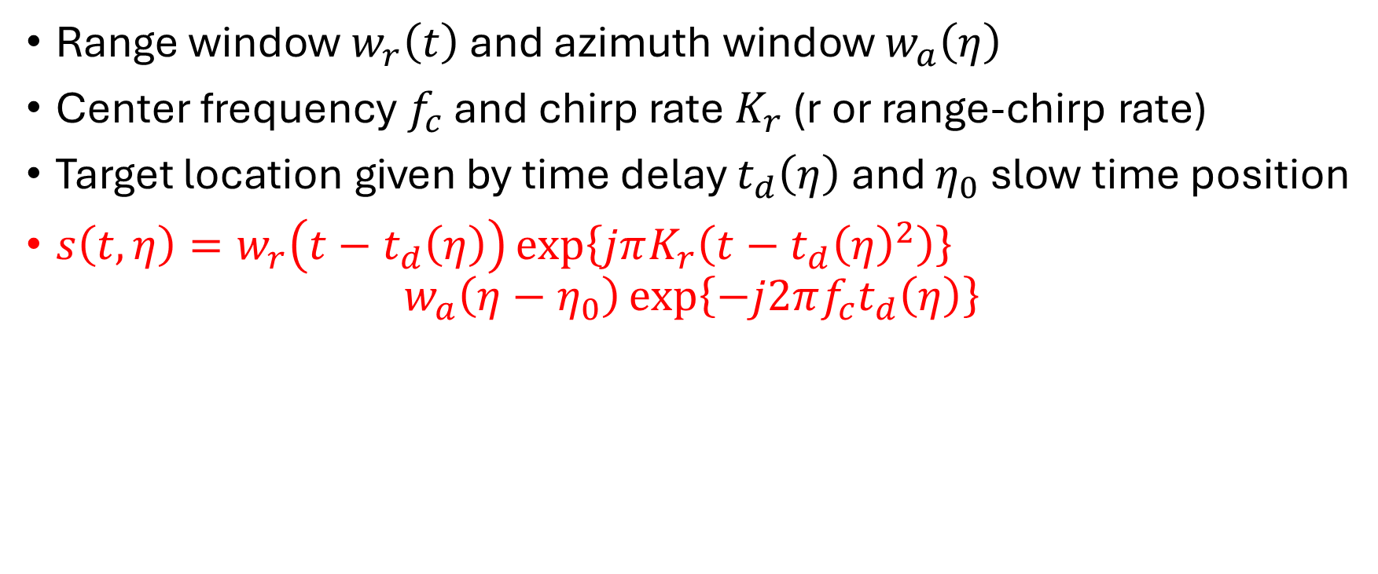

Write out the space-time complex baseband signal for target, $s\left(t,η\right)$
Range window $w_{r}\left(t\right)$ and azimuth window $w_{a}\left(η\right)$
Center frequency $f_{c}$ and chirp rate $K_{r}$ (r or range-chirp rate)
Target location given by time delay $t_{d}\left(η\right)$ and $η_{0}$ slow time position
$s\left(t,η\right)=w_{r}\left(t−t_{d}\left(η\right)\right)\exp\left\{jπK_{r}\left(t−t_{d}{\left(η\right)}^{2}\right)\right\}$
$w_{a}\left(η−η_{0}\right)\exp\left\{−j2πf_{c}t_{d}\left(η\right)\right\}$

Slide 7
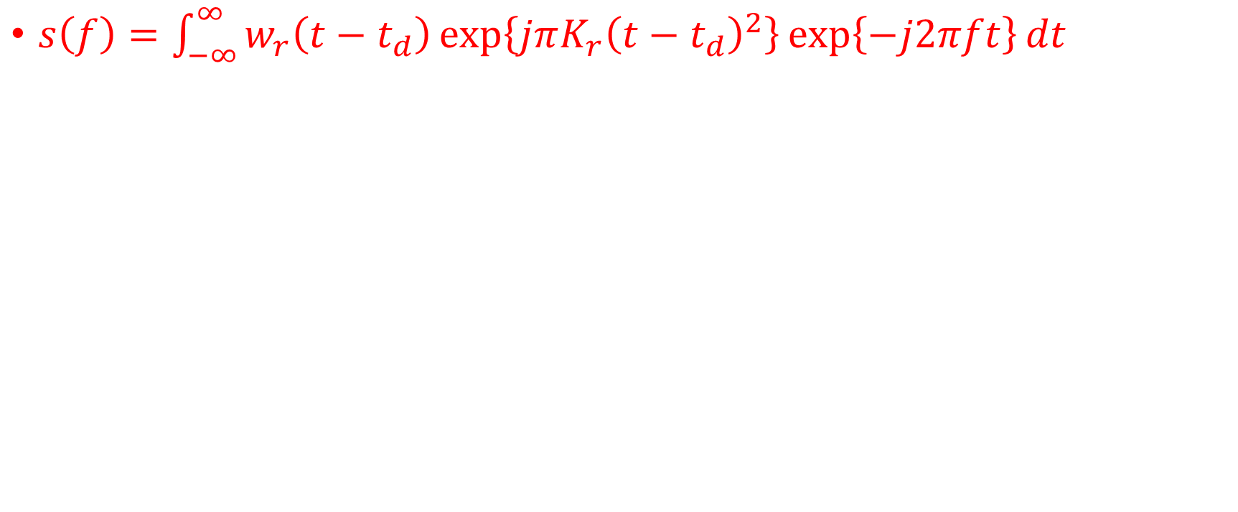

Write out the fast-time Fourier transform and drop terms not dependent on $t$
$s\left(f\right)=\int_{−∞}^{∞}{w_{r}\left(t−t_{d}\right)\exp\left\{jπK_{r}{\left(t−t_{d}\right)}^{2}\right\}\exp\left\{−j2πft\right\}dt}$

Slide 8
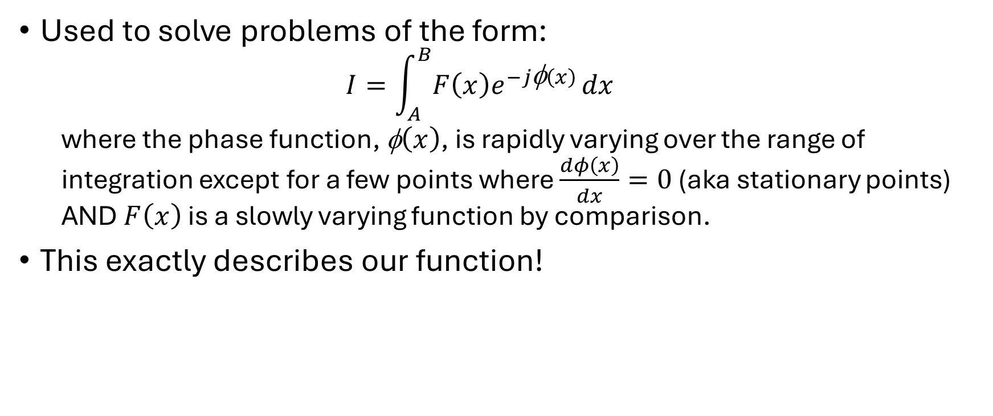
Principle of Stationary Phase (PSOP)
Used to solve problems of the form:
  $$I=\int_{A}^{B}{F\left(x\right)e^{−j\text{φ}\left(x\right)}}dx$$
  where the phase function, $\text{}\left(x\right)$, is rapidly varying over the range of integration except for a few points where $\frac{dφ\left(x\right)}{dx}=0$ (aka stationary points) AND $F\left(x\right)$ is a slowly varying function by comparison.
This exactly describes our function!

Slide 9
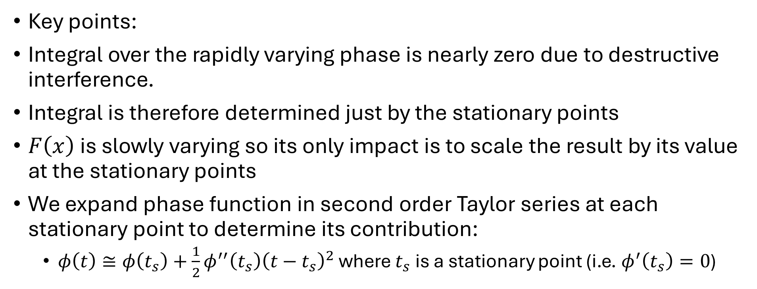
Principle of Stationary Phase (PSOP)
Key points:
Integral over the rapidly varying phase is nearly zero due to destructive interference.
Integral is therefore determined just by the stationary points
$F\left(x\right)$ is slowly varying so its only impact is to scale the result by its value at the stationary points
We expand phase function in second order Taylor series at each stationary point to determine its contribution:
  $φ\left(t\right)≅φ\left(t_{s}\right)+\frac{1}{2}φ^{′′}\left(t_{s}\right){\left(t−t_{s}\right)}^{2}$ where $t_{s}$ is a stationary point (i.e. $φ^{′}\left(t_{s}\right)=0$)

Slide 10
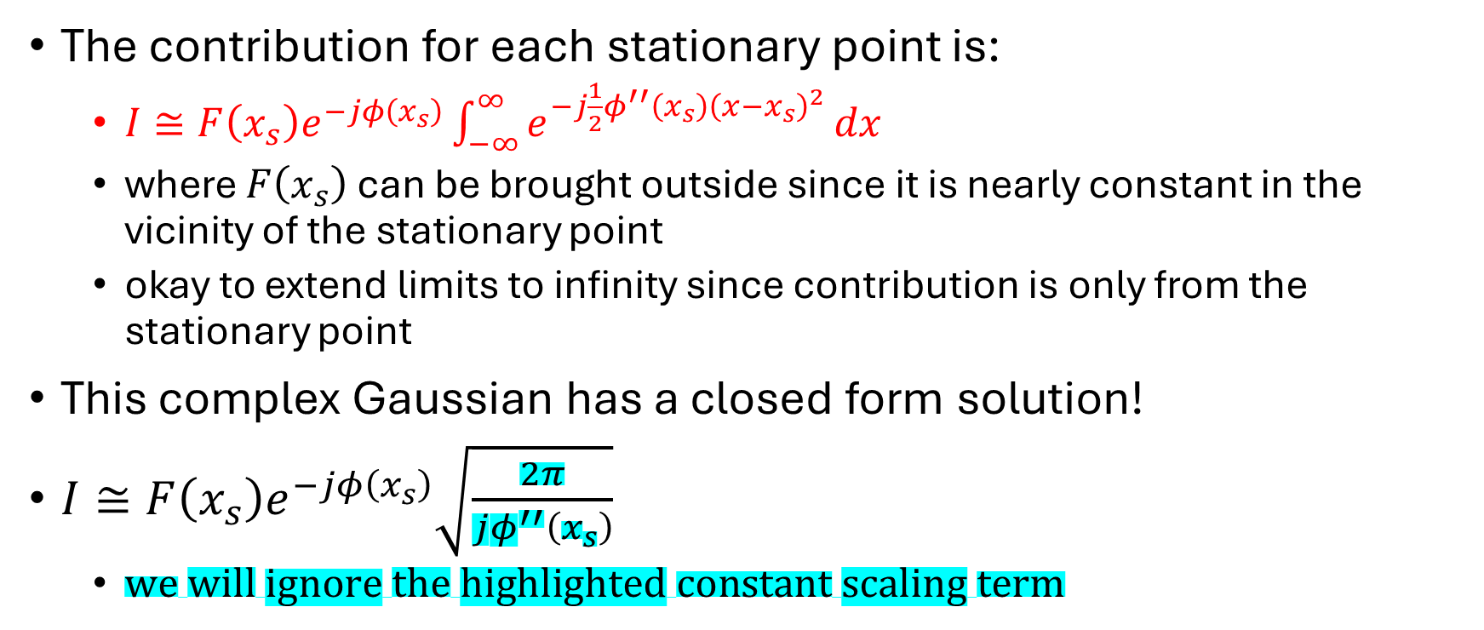
Principle of Stationary Phase (PSOP)
The contribution for each stationary point is:
  $I≅F\left(x_{s}\right)e^{−jφ\left(x_{s}\right)}\int_{−∞}^{∞}{e^{−j\frac{1}{2}φ^{′′}\left(x_{s}\right){\left(x−x_{s}\right)}^{2}}}dx$
  where $F\left(x_{s}\right)$ can be brought outside since it is nearly constant in the vicinity of the stationary point
  okay to extend limits to infinity since contribution is only from the stationary point
This complex Gaussian has a closed form solution!
$I≅F\left(x_{s}\right)e^{−jφ\left(x_{s}\right)}\sqrt{\frac{2π}{jφ^{′′}\left(x_{s}\right)}}$
  $we will ignore the highlighted constant scaling term$

Slide 11
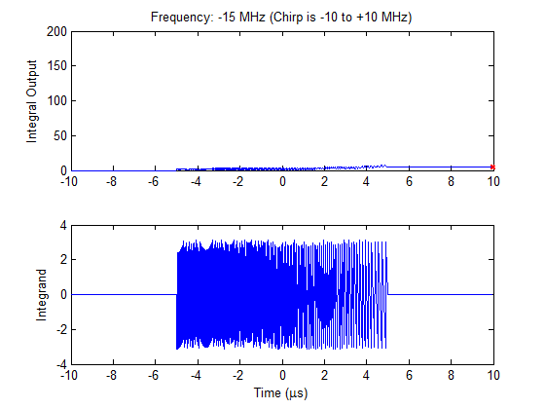
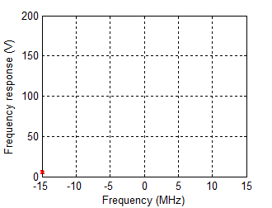
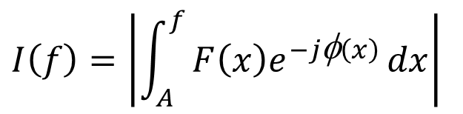
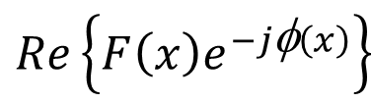
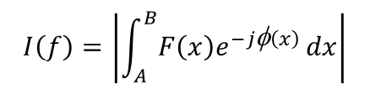
Principle of Stationary Phase (PSOP)
$$I\left(f\right)=\left|\int_{A}^{f}{F\left(x\right)e^{−j\text{φ}\left(x\right)}}dx\right|$$
$$I\left(f\right)=\left|\int_{A}^{B}{F\left(x\right)e^{−j\text{φ}\left(x\right)}}dx\right|$$
$$Re\left\{F\left(x\right)e^{−j\text{φ}\left(x\right)}\right\}$$
Notes:
To illustrate the principle of stationary phase, we show here the Fourier transform of a 20 MHz chirp.
The integrand is shown in the bottom panel for each frequency shown in the title.
The accumulation of the integrand is shown in the top left panel for each frequency where the red star on the right shows the total integration.
The top right panel shows the frequency response at each frequency (this corresponds to the red star on the left).
Note how the integral output is dominated by the contribution at the stationary point of the phase in the lower panel. The stationary point is where the phase function is slowly varying.
The idea behind the principle of stationary phase is to approximate the phase function at the stationary point with a Taylor expansion and ignore contribution elsewhere.

Slide 12
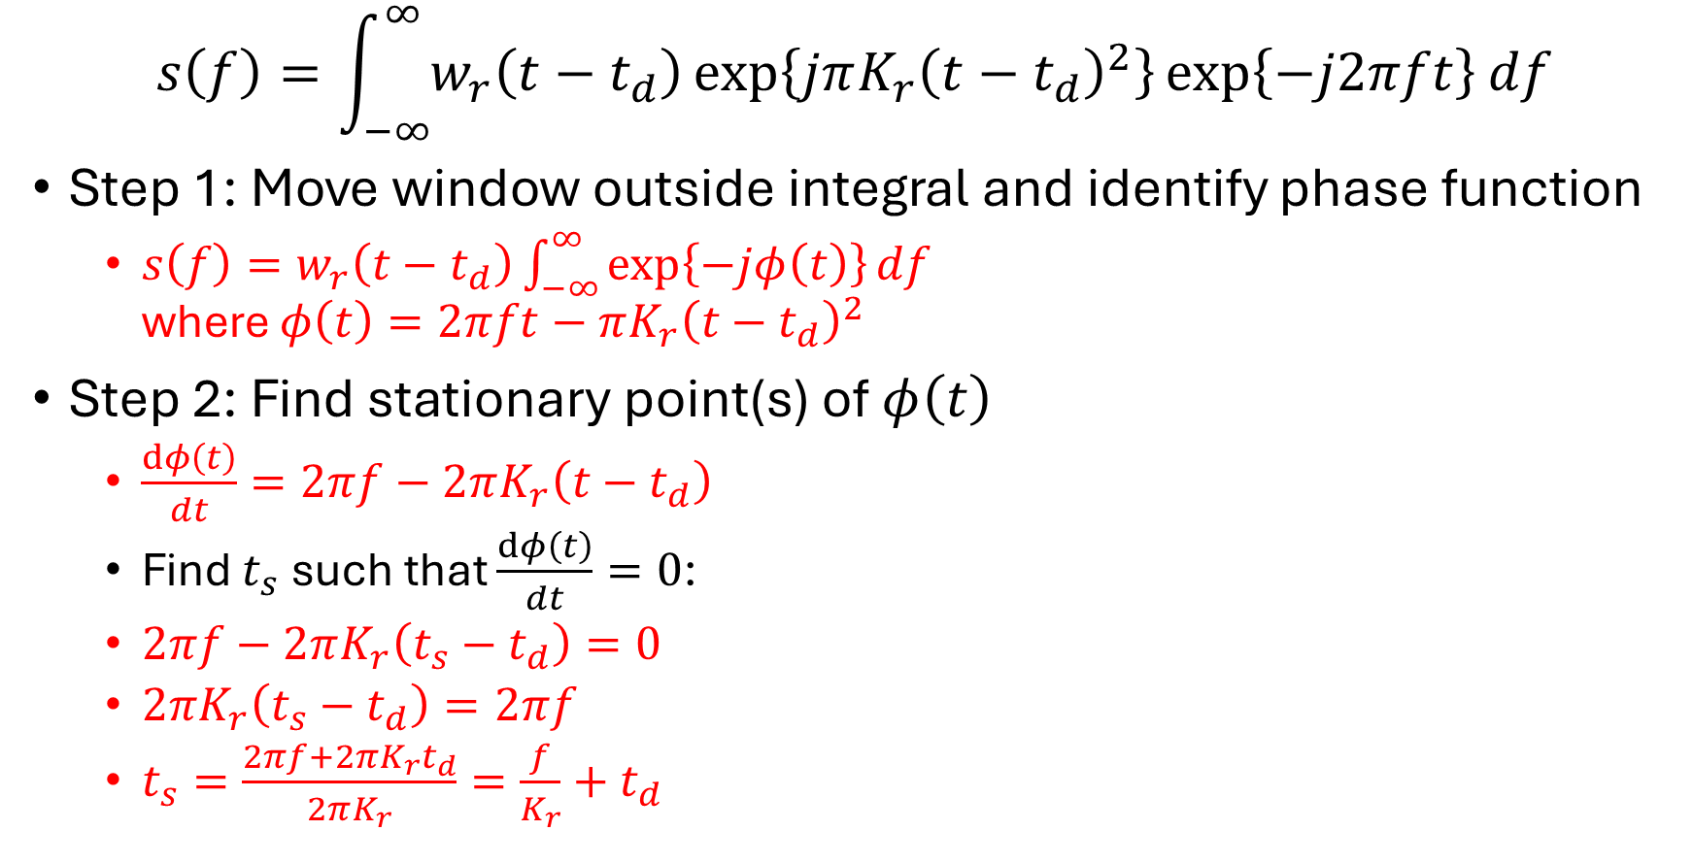
Principle of Stationary Phase (PSOP)
$$s\left(f\right)=\int_{−∞}^{∞}{w_{r}\left(t−t_{d}\right)\exp\left\{jπK_{r}{\left(t−t_{d}\right)}^{2}\right\}\exp\left\{−j2πft\right\}df}$$
Step 1: Move window outside integral and identify phase function
  $s\left(f\right)=w_{r}\left(t−t_{d}\right)\int_{−∞}^{∞}{\exp\left\{−jφ\left(t\right)\right\}df}$
  where $φ\left(t\right)=2πft−πK_{r}{\left(t−t_{d}\right)}^{2}$
Step 2: Find stationary point(s) of $φ\left(t\right)$
  $\frac{dφ\left(t\right)}{dt}=2πf−2πK_{r}\left(t−t_{d}\right)$
  Find $t_{s}$ such that $\frac{dφ\left(t\right)}{dt}=0$:
  $2πf−2πK_{r}\left(t_{s}−t_{d}\right)=0$
  $2πK_{r}\left(t_{s}−t_{d}\right)=2πf$
  $t_{s}=\frac{2πf+2πK_{r}t_{d}}{2πK_{r}}=\frac{f}{K_{r}}+t_{d}$

Slide 13
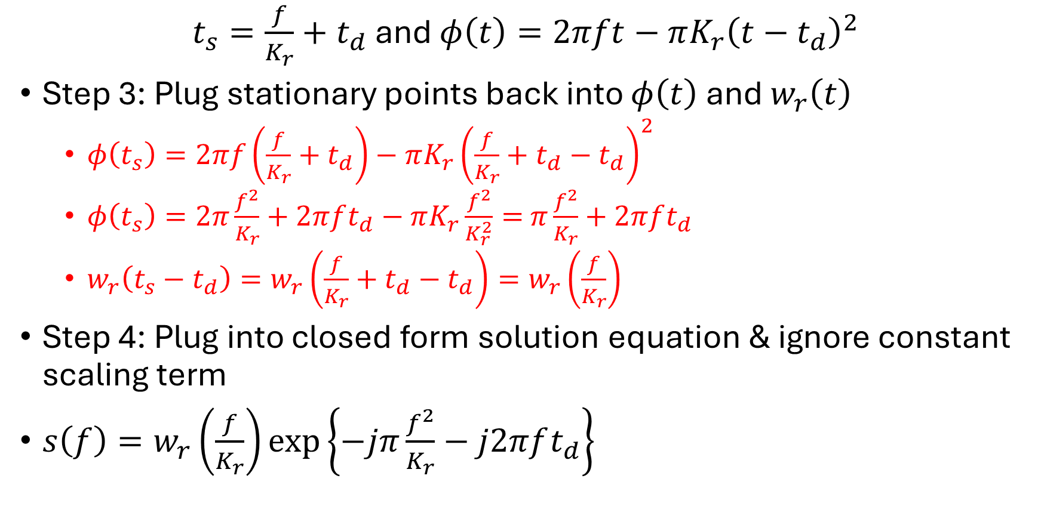
Principle of Stationary Phase (PSOP)
$t_{s}=\frac{f}{K_{r}}+t_{d}$ and $φ\left(t\right)=2πft−πK_{r}{\left(t−t_{d}\right)}^{2}$
Step 3: Plug stationary points back into $φ\left(t\right)$ and $w_{r}\left(t\right)$
  $φ\left(t_{s}\right)=2πf\left(\frac{f}{K_{r}}+t_{d}\right)−πK_{r}{\left(\frac{f}{K_{r}}+t_{d}−t_{d}\right)}^{2}$
  $φ\left(t_{s}\right)=2π\frac{f^{2}}{K_{r}}+2πft_{d}−πK_{r}\frac{f^{2}}{K_{r}^{2}}=$ $π\frac{f^{2}}{K_{r}}+2πft_{d}$
  $w_{r}\left(t_{s}−t_{d}\right)=w_{r}\left(\frac{f}{K_{r}}+t_{d}−t_{d}\right)=w_{r}\left(\frac{f}{K_{r}}\right)$
Step 4: Plug into closed form solution equation & ignore constant scaling term
$s\left(f\right)=w_{r}\left(\frac{f}{K_{r}}\right)\exp\left\{−jπ\frac{f^{2}}{K_{r}}−j2πft_{d}\right\}$

Slide 14
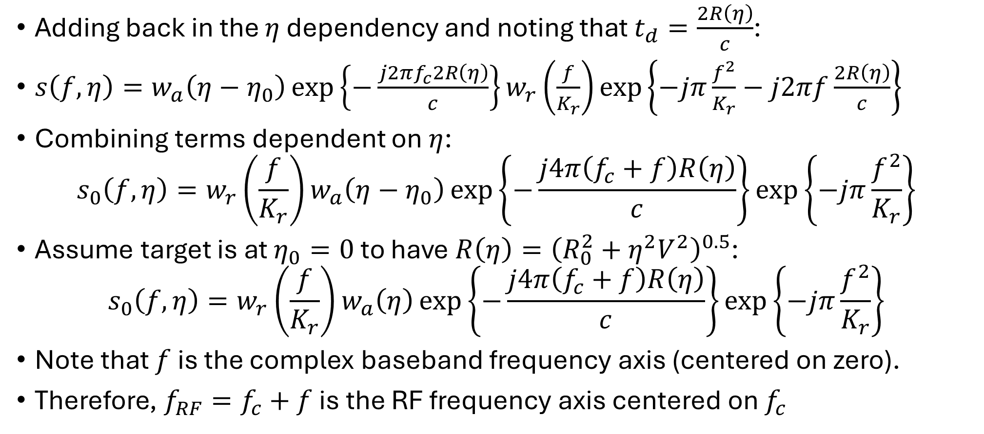
Principle of Stationary Phase (PSOP) 2
Adding back in the $η$ dependency and noting that $t_{d}=\frac{2R\left(η\right)}{c}$:
$s\left(f,η\right)=w_{a}\left(η−η_{0}\right)\exp\left\{−\frac{j2πf_{c}2R\left(η\right)}{c}\right\}w_{r}\left(\frac{f}{K_{r}}\right)\exp\left\{−jπ\frac{f^{2}}{K_{r}}−j2πf\frac{2R\left(η\right)}{c}\right\}$
Combining terms dependent on $η$:
$s_{0}\left(f,η\right)=w_{r}\left(\frac{f}{K_{r}}\right)w_{a}\left(η−η_{0}\right)\exp\left\{−\frac{j4π\left(f_{c}+f\right)R\left(η\right)}{c}\right\}\exp\left\{−jπ\frac{f^{2}}{K_{r}}\right\}$
Assume target is at $η_{0}=0$ to have $R\left(η\right)={\left(R_{0}^{2}+η^{2}V^{2}\right)}^{0.5}$:
$$s_{0}\left(f,η\right)=w_{r}\left(\frac{f}{K_{r}}\right)w_{a}\left(η\right)\exp\left\{−\frac{j4π\left(f_{c}+f\right)R\left(η\right)}{c}\right\}\exp\left\{−jπ\frac{f^{2}}{K_{r}}\right\}$$
Note that $f$ is the complex baseband frequency axis (centered on zero).
Therefore, $f_{RF}=f_{c}+f$ is the RF frequency axis centered on $f_{c}$

Slide 15
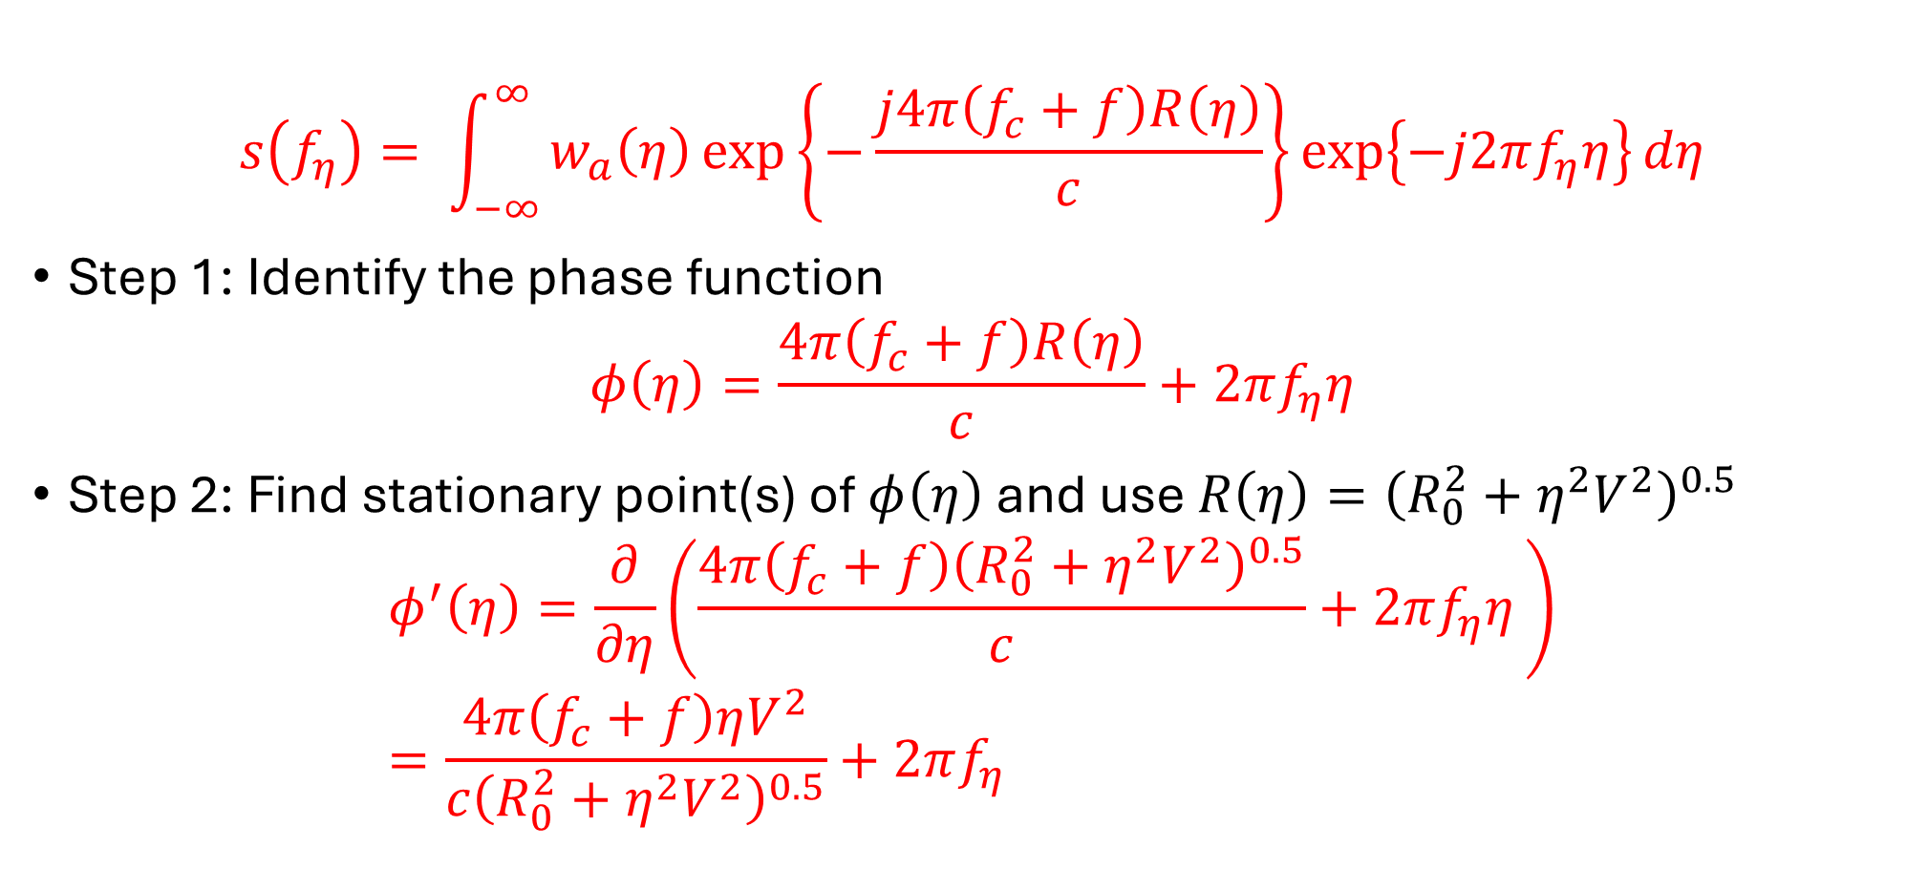

Write out the slow-time Fourier transform transform and drop terms not dependent on $η$
$$s\left(f_{η}\right)= \int_{−∞}^{∞}{w_{a}\left(η\right)\exp\left\{−\frac{j4π\left(f_{c}+f\right)R\left(η\right)}{c}\right\}\exp\left\{−j2πf_{η}η\right\}dη}$$
Step 1: Identify the phase function
$$φ\left(η\right)=\frac{4π\left(f_{c}+f\right)R\left(η\right)}{c}+2πf_{η}η$$
Step 2: Find stationary point(s) of $φ\left(η\right)$ and use $R\left(η\right)={\left(R_{0}^{2}+η^{2}V^{2}\right)}^{0.5}$
$$φ^{′}\left(η\right)=\frac{∂}{∂η}\left(\frac{4π\left(f_{c}+f\right){\left(R_{0}^{2}+η^{2}V^{2}\right)}^{0.5}}{c}+2πf_{η}η \right) \\ =\frac{4π\left(f_{c}+f\right)ηV^{2}}{c{\left(R_{0}^{2}+η^{2}V^{2}\right)}^{0.5}}+2πf_{η}$$

Slide 16
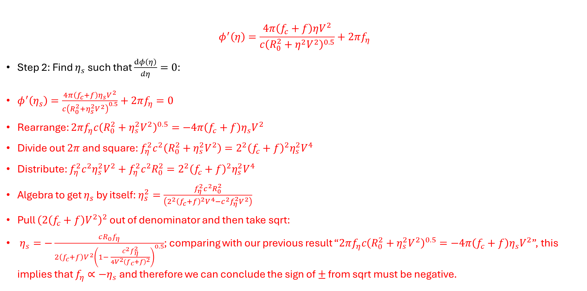

Write out the slow-time Fourier transform transform and drop terms not dependent on $η$
$$φ^{′}\left(η\right)=\frac{4π\left(f_{c}+f\right)ηV^{2}}{c{\left(R_{0}^{2}+η^{2}V^{2}\right)}^{0.5}}+2πf_{η}$$
Step 2: Find $η_{s}$ such that $\frac{dφ\left(η\right)}{dη}=0$:
$φ^{′}\left(η_{s}\right)=\frac{4π\left(f_{c}+f\right)η_{s}V^{2}}{c{\left(R_{0}^{2}+η_{s}^{2}V^{2}\right)}^{0.5}}+2πf_{η}=0$
Rearrange: $2πf_{η}c{\left(R_{0}^{2}+η_{s}^{2}V^{2}\right)}^{0.5}=−4π\left(f_{c}+f\right)η_{s}V^{2}$
Divide out $2π$ and square: $f_{η}^{2}c^{2}\left(R_{0}^{2}+η_{s}^{2}V^{2}\right)=2^{2}{\left(f_{c}+f\right)}^{2}η_{s}^{2}V^{4}$
Distribute: $f_{η}^{2}c^{2}η_{s}^{2}V^{2}+f_{η}^{2}c^{2}R_{0}^{2}=2^{2}{\left(f_{c}+f\right)}^{2}η_{s}^{2}V^{4}$
Algebra to get $η_{s}$ by itself: $η_{s}^{2}=\frac{f_{η}^{2}c^{2}R_{0}^{2}}{\left(2^{2}{\left(f_{c}+f\right)}^{2}V^{4}−c^{2}f_{η}^{2}V^{2}\right)}$
Pull ${\left(2\left(f_{c}+f\right)V^{2}\right)}^{2}$ out of denominator and then take sqrt:
$η_{s}=−\frac{cR_{0}f_{η}}{2\left(f_{c}+f\right)V^{2}{\left(1− \frac{c^{2}f_{η}^{2}}{4V^{2}{\left(f_{c}+f\right)}^{2}}\right)}^{0.5}}$; comparing with our previous result “$2πf_{η}c{\left(R_{0}^{2}+η_{s}^{2}V^{2}\right)}^{0.5}=−4π\left(f_{c}+f\right)η_{s}V^{2}$”, this implies that $f_{η}∝−η_{s}$ and therefore we can conclude the sign of $±$ from sqrt must be negative.

Slide 17
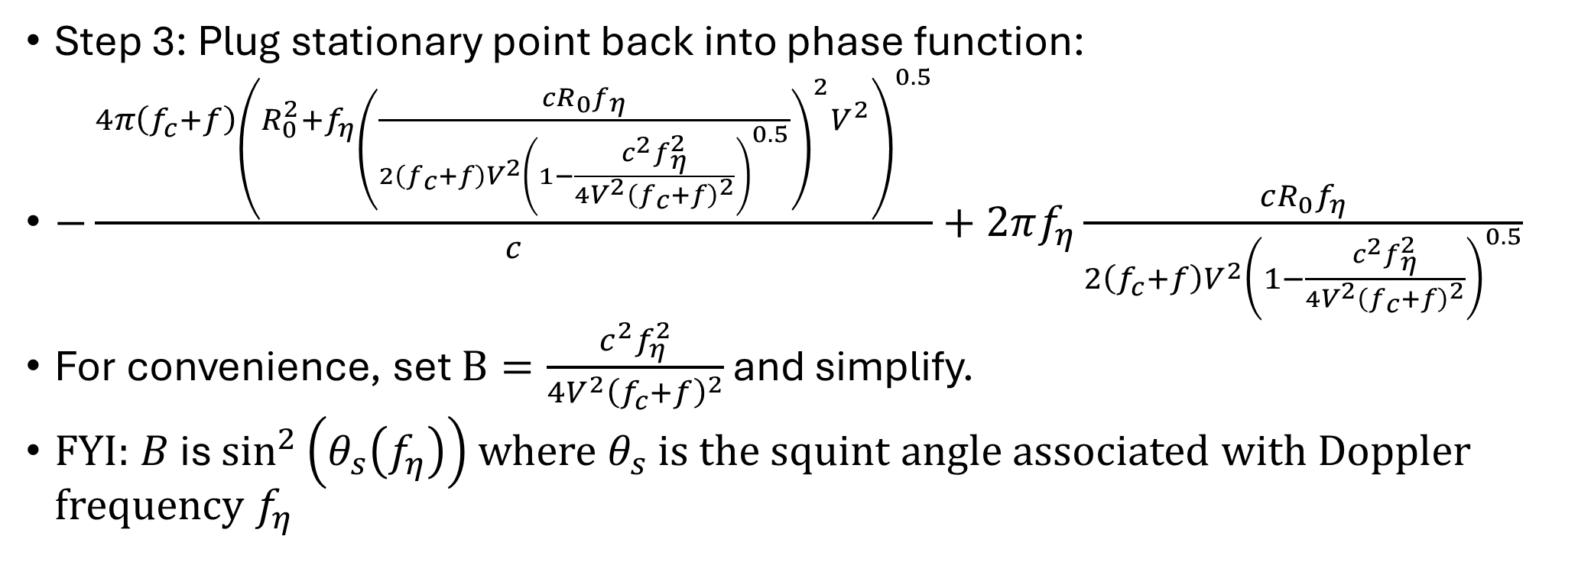
Range Frequency-Doppler (f-k) Domain
Step 3: Plug stationary point back into phase function:
$−\frac{4π\left(f_{c}+f\right){\left(R_{0}^{2}+{f_{η}\left(\frac{cR_{0}f_{η}}{2\left(f_{c}+f\right)V^{2}{\left(1−\frac{c^{2}f_{η}^{2}}{4V^{2}{\left(f_{c}+f\right)}^{2}}\right)}^{0.5}}\right)}^{2}V^{2}\right)}^{0.5}}{c}+2πf_{η}\frac{cR_{0}f_{η}}{2\left(f_{c}+f\right)V^{2}{\left(1−\frac{c^{2}f_{η}^{2}}{4V^{2}{\left(f_{c}+f\right)}^{2}}\right)}^{0.5}}$
For convenience, set $B=\frac{c^{2}f_{η}^{2}}{4V^{2}{\left(f_{c}+f\right)}^{2}}$ and simplify.
FYI: $B$ is $\sin^{2}\left(θ_{s}\left(f_{η}\right)\right)$ where $θ_{s}$ is the squint angle associated with Doppler frequency $f_{η}$

Slide 18
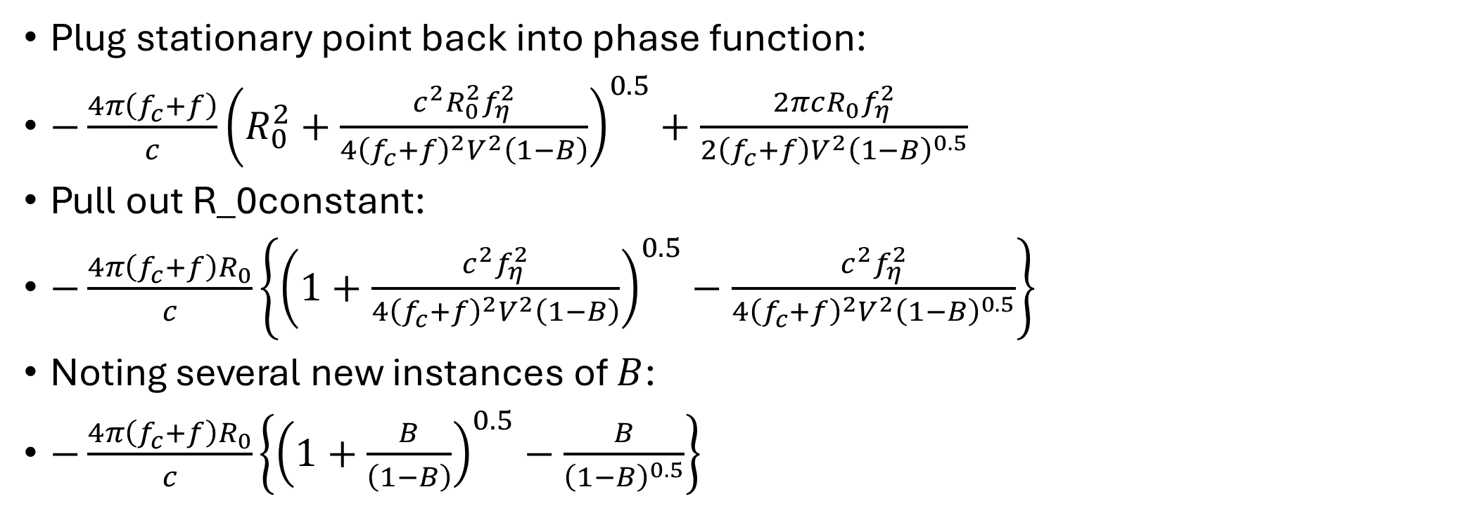
Range Frequency-Doppler (f-k) Domain
Plug stationary point back into phase function:
$−\frac{4π\left(f_{c}+f\right)}{c}{\left(R_{0}^{2}+\frac{c^{2}R_{0}^{2}f_{η}^{2}}{4{\left(f_{c}+f\right)}^{2}V^{2}\left(1−B\right)}\right)}^{0.5}+\frac{2πcR_{0}f_{η}^{2}}{2\left(f_{c}+f\right)V^{2}{\left(1−B\right)}^{0.5}}$
Pull out R_0constant:
$−\frac{4π\left(f_{c}+f\right)R_{0}}{c}\left\{{\left(1+\frac{c^{2}f_{η}^{2}}{4{\left(f_{c}+f\right)}^{2}V^{2}\left(1−B\right)}\right)}^{0.5}−\frac{c^{2}f_{η}^{2}}{4{\left(f_{c}+f\right)}^{2}V^{2}{\left(1−B\right)}^{0.5}}\right\}$
Noting several new instances of $B$:
$−\frac{4π\left(f_{c}+f\right)R_{0}}{c}\left\{{\left(1+\frac{B}{\left(1−B\right)}\right)}^{0.5}−\frac{B}{{\left(1−B\right)}^{0.5}}\right\}$

Slide 19
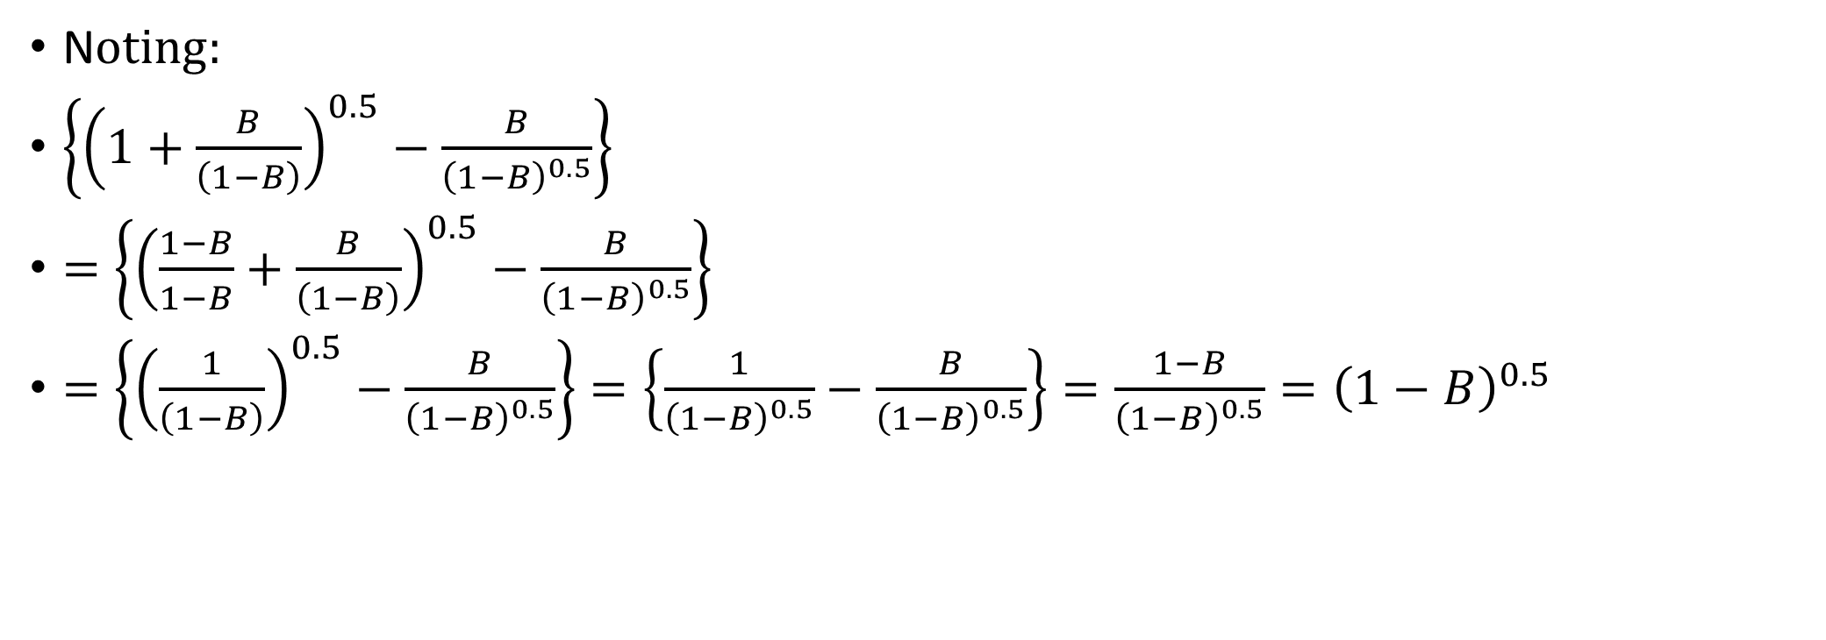
Range Frequency-Doppler (f-k) Domain
N$oting:$
$\left\{{\left(1+\frac{B}{\left(1−B\right)}\right)}^{0.5}−\frac{B}{{\left(1−B\right)}^{0.5}}\right\}$
$=\left\{{\left(\frac{1−B}{1−B}+\frac{B}{\left(1−B\right)}\right)}^{0.5}−\frac{B}{{\left(1−B\right)}^{0.5}}\right\}$
$=\left\{{\left(\frac{1}{\left(1−B\right)}\right)}^{0.5}−\frac{B}{{\left(1−B\right)}^{0.5}}\right\}=\left\{\frac{1}{{\left(1−B\right)}^{0.5}}−\frac{B}{{\left(1−B\right)}^{0.5}}\right\}=\frac{1−B}{{\left(1−B\right)}^{0.5}}={\left(1−B\right)}^{0.5}$

Slide 20
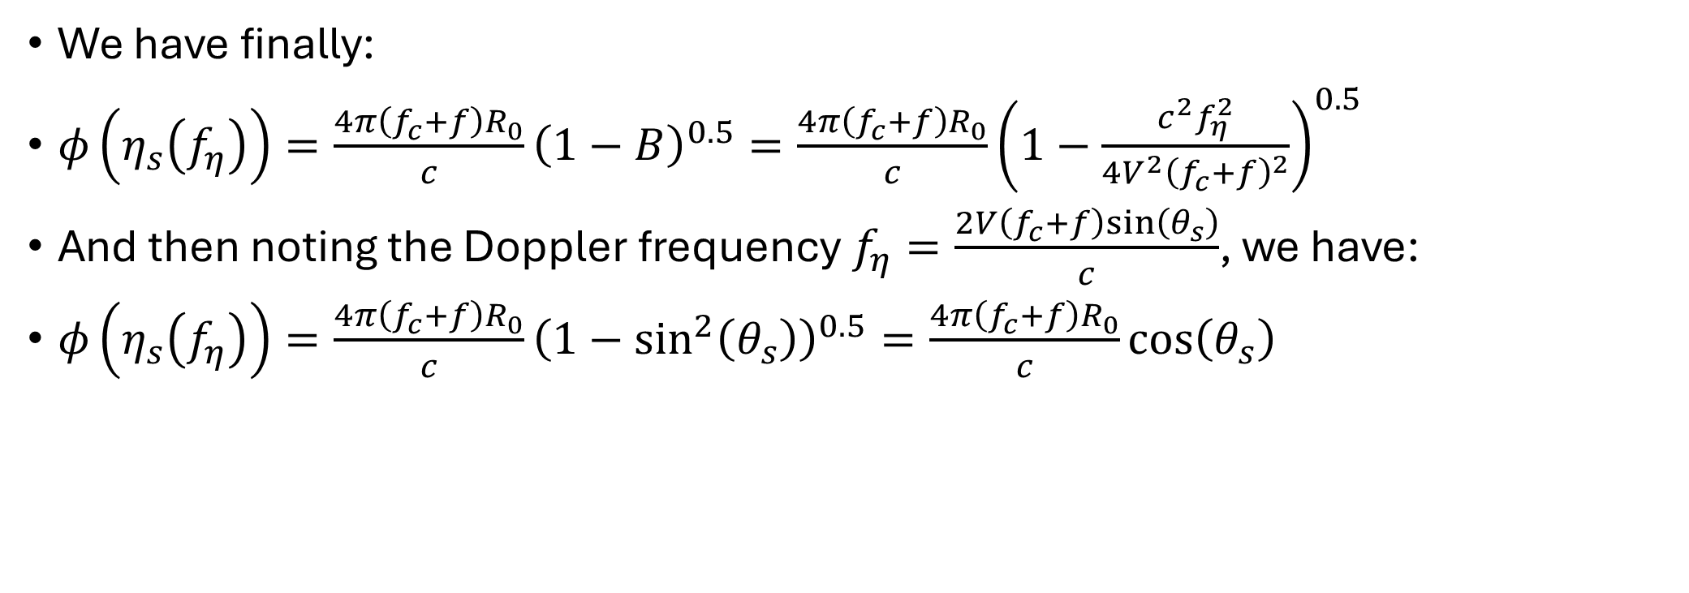
Range Frequency-Doppler (f-k) Domain
We have finally:
$φ\left(η_{s}\left(f_{η}\right)\right)=\frac{4π\left(f_{c}+f\right)R_{0}}{c}{\left(1−B\right)}^{0.5}=\frac{4π\left(f_{c}+f\right)R_{0}}{c}{\left(1−\frac{c^{2}f_{η}^{2}}{4V^{2}{\left(f_{c}+f\right)}^{2}}\right)}^{0.5}$
And then noting the Doppler frequency $f_{η}=\frac{2V\left(f_{c}+f\right)sin\left(θ_{s}\right)}{c}$, we have:
$φ\left(η_{s}\left(f_{η}\right)\right)=\frac{4π\left(f_{c}+f\right)R_{0}}{c}{\left(1−\sin^{2}\left(θ_{s}\right)\right)}^{0.5}=\frac{4π\left(f_{c}+f\right)R_{0}}{c}\cos\left(θ_{s}\right)$

Slide 21
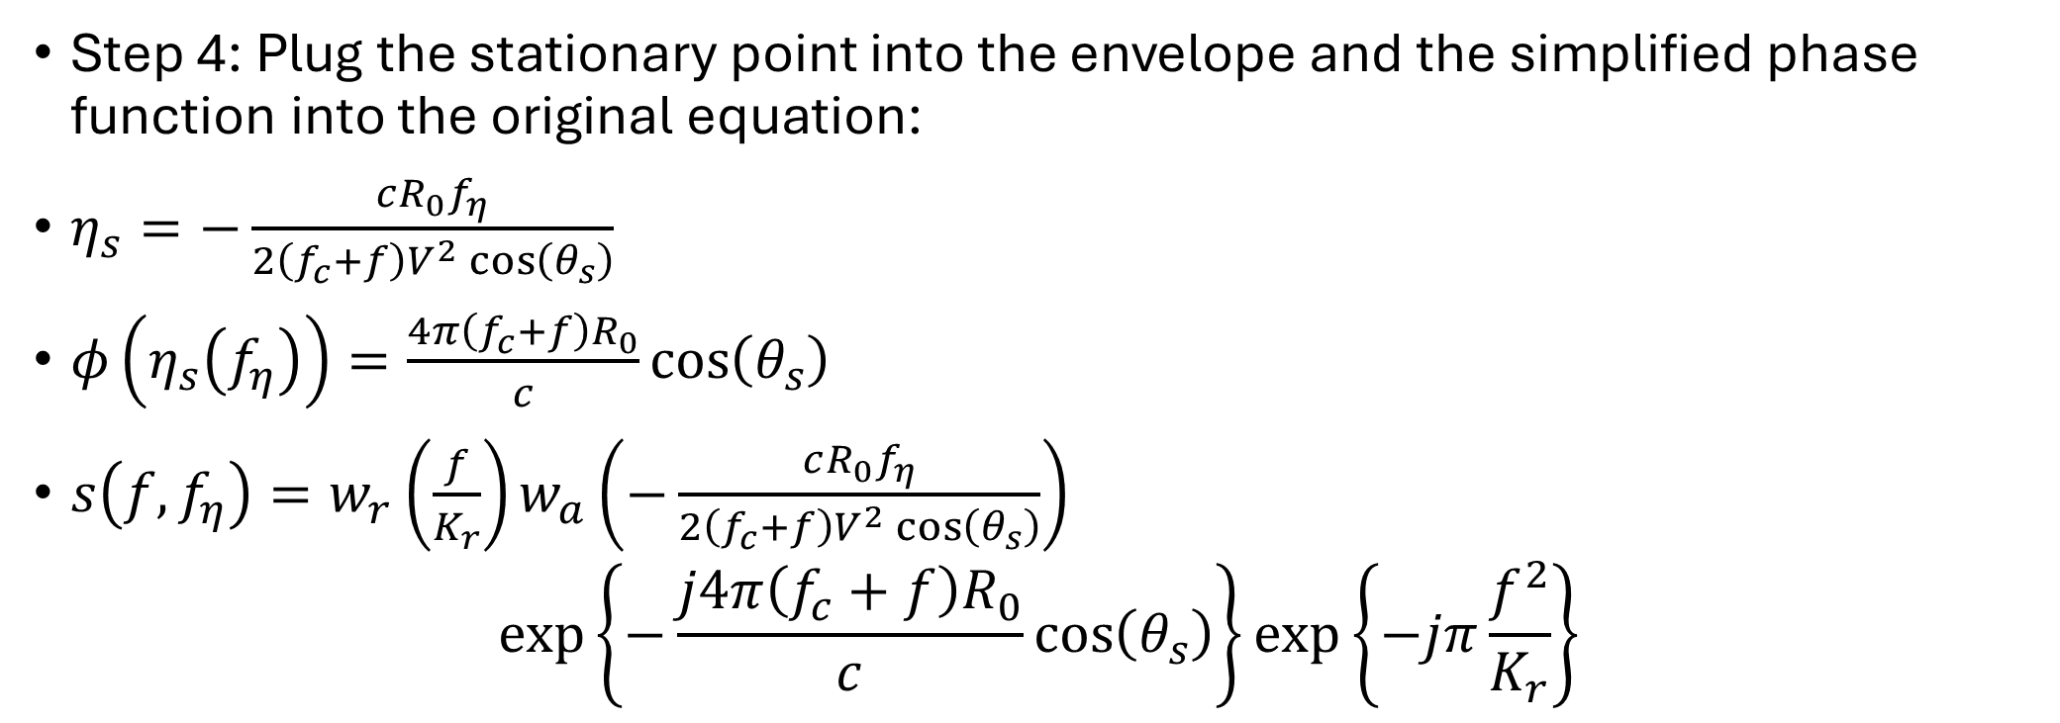
Range Frequency-Doppler (f-k) Domain
Step 4: Plug the stationary point into the envelope and the simplified phase function into the original equation:
$η_{s}=−\frac{cR_{0}f_{η}}{2\left(f_{c}+f\right)V^{2}\cos\left(θ_{s}\right)}$
$φ\left(η_{s}\left(f_{η}\right)\right)=\frac{4π\left(f_{c}+f\right)R_{0}}{c}\cos\left(θ_{s}\right)$
$s\left(f,f_{η}\right)=w_{r}\left(\frac{f}{K_{r}}\right)w_{a}\left(−\frac{cR_{0}f_{η}}{2\left(f_{c}+f\right)V^{2}\cos\left(θ_{s}\right)}\right)$
$$\exp\left\{−\frac{j4π\left(f_{c}+f\right)R_{0}}{c}\cos\left(θ_{s}\right)\right\}\exp\left\{−jπ\frac{f^{2}}{K_{r}}\right\}$$

Slide 22
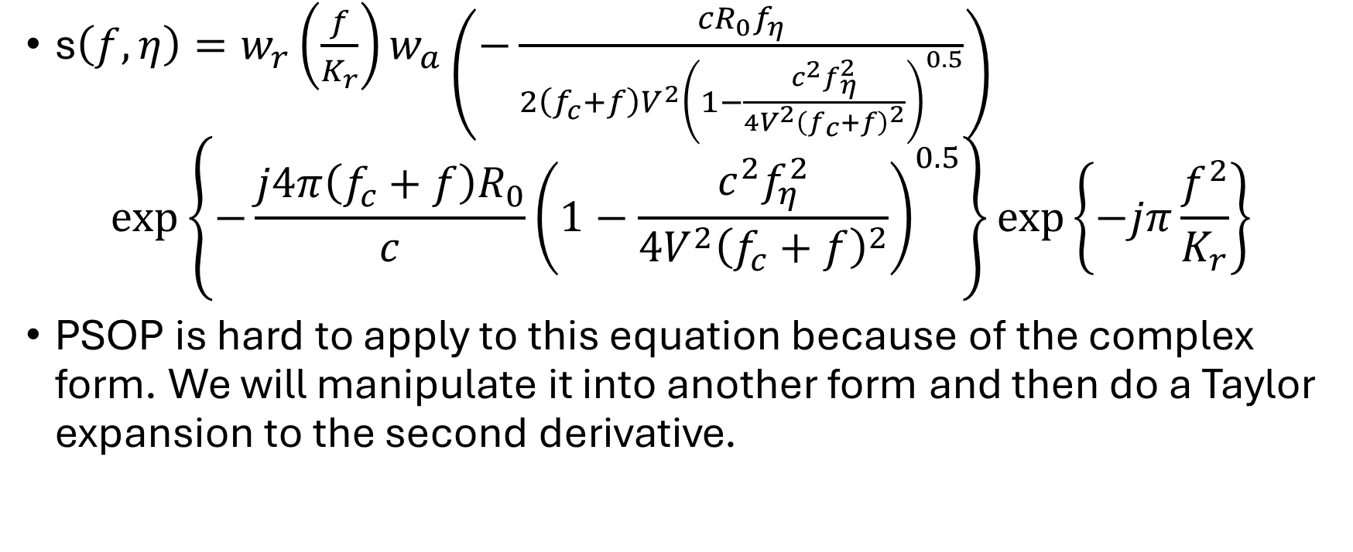
Range-Doppler (Wavenumber) Domain
s$\left(f,η\right)=w_{r}\left(\frac{f}{K_{r}}\right)w_{a}\left(−\frac{cR_{0}f_{η}}{2\left(f_{c}+f\right)V^{2}{\left(1−\frac{c^{2}f_{η}^{2}}{4V^{2}{\left(f_{c}+f\right)}^{2}}\right)}^{0.5}}\right)$
$$\exp\left\{−\frac{j4π\left(f_{c}+f\right)R_{0}}{c}{\left(1−\frac{c^{2}f_{η}^{2}}{4V^{2}{\left(f_{c}+f\right)}^{2}}\right)}^{0.5}\right\}\exp\left\{−jπ\frac{f^{2}}{K_{r}}\right\}$$
PSOP is hard to apply to this equation because of the complex form. We will manipulate it into another form and then do a Taylor expansion to the second derivative.

Slide 23
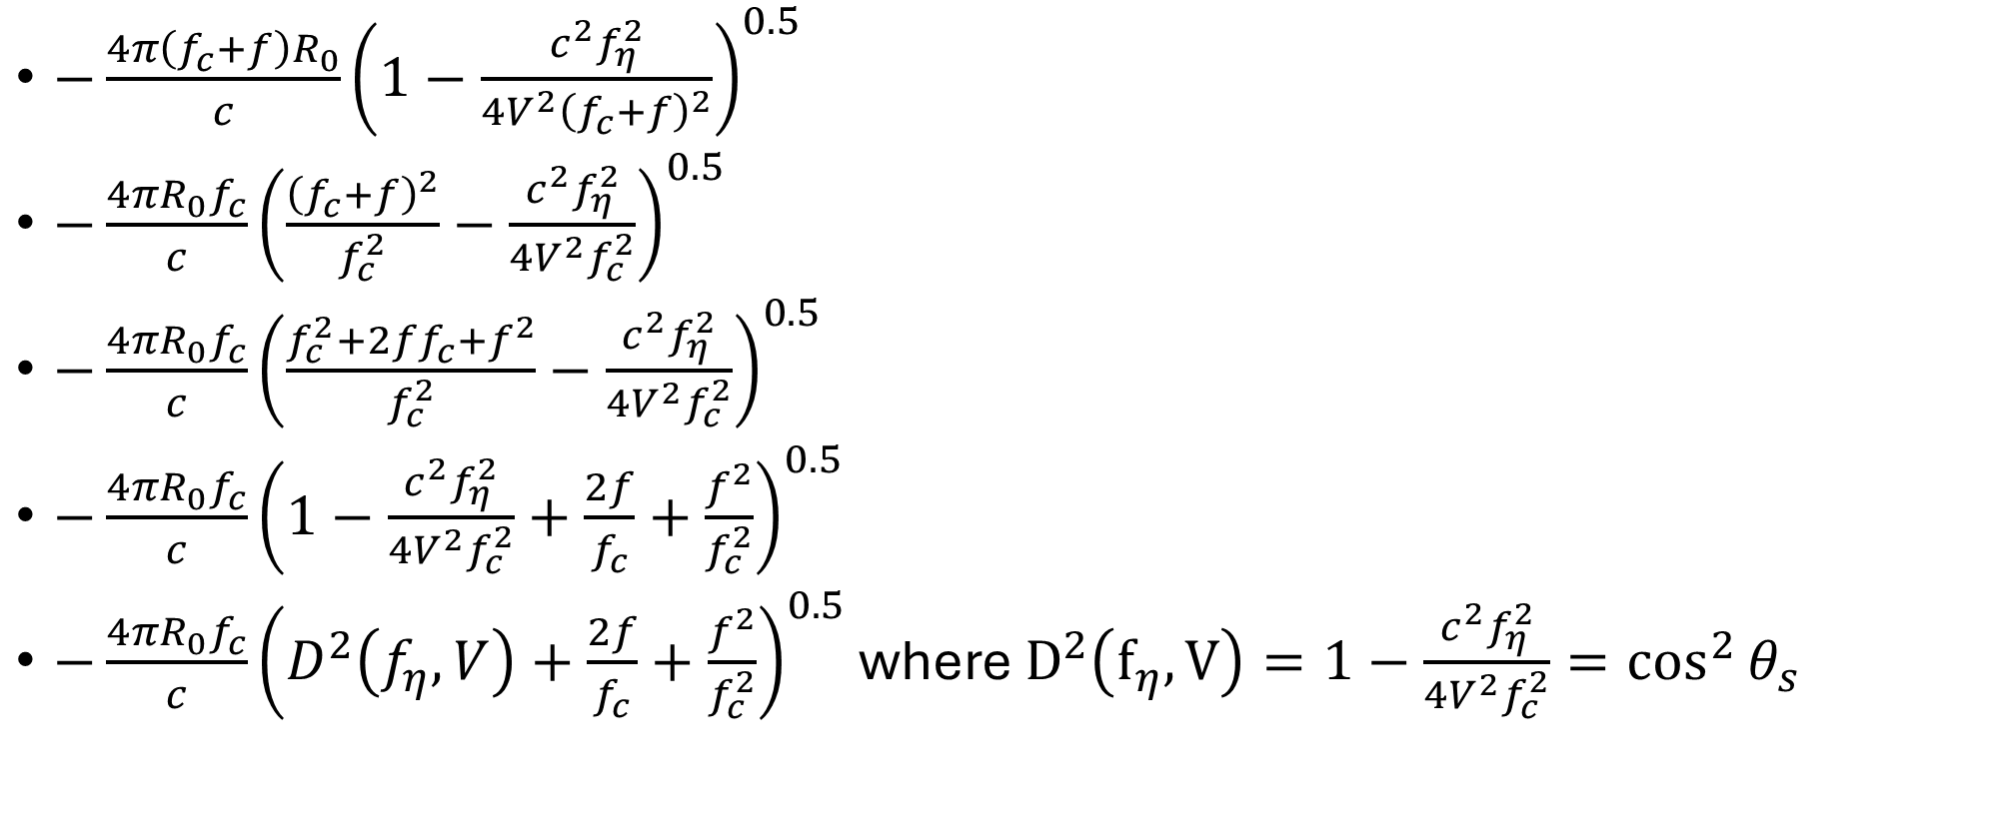
Range-Doppler (Wavenumber) Domain:
Simplify part of the phase term
$−\frac{4π\left(f_{c}+f\right)R_{0}}{c}{\left(1−\frac{c^{2}f_{η}^{2}}{4V^{2}{\left(f_{c}+f\right)}^{2}}\right)}^{0.5}$
$−\frac{4πR_{0}f_{c}}{c}{\left(\frac{{\left(f_{c}+f\right)}^{2}}{f_{c}^{2}}−\frac{c^{2}f_{η}^{2}}{4V^{2}f_{c}^{2}}\right)}^{0.5}$
$−\frac{4πR_{0}f_{c}}{c}{\left(\frac{f_{c}^{2}+2ff_{c}+f^{2}}{f_{c}^{2}}−\frac{c^{2}f_{η}^{2}}{4V^{2}f_{c}^{2}}\right)}^{0.5}$
$−\frac{4πR_{0}f_{c}}{c}{\left(1−\frac{c^{2}f_{η}^{2}}{4V^{2}f_{c}^{2}}+\frac{2f}{f_{c}}+\frac{f^{2}}{f_{c}^{2}}\right)}^{0.5}$
$−\frac{4πR_{0}f_{c}}{c}{\left(D^{2}\left(f_{η},V\right)+\frac{2f}{f_{c}}+\frac{f^{2}}{f_{c}^{2}}\right)}^{0.5}$ where $D^{2}\left(f_{η},V\right)=1−\frac{c^{2}f_{η}^{2}}{4V^{2}f_{c}^{2}}=\cos^{2}{θ_{s}}$

Slide 24
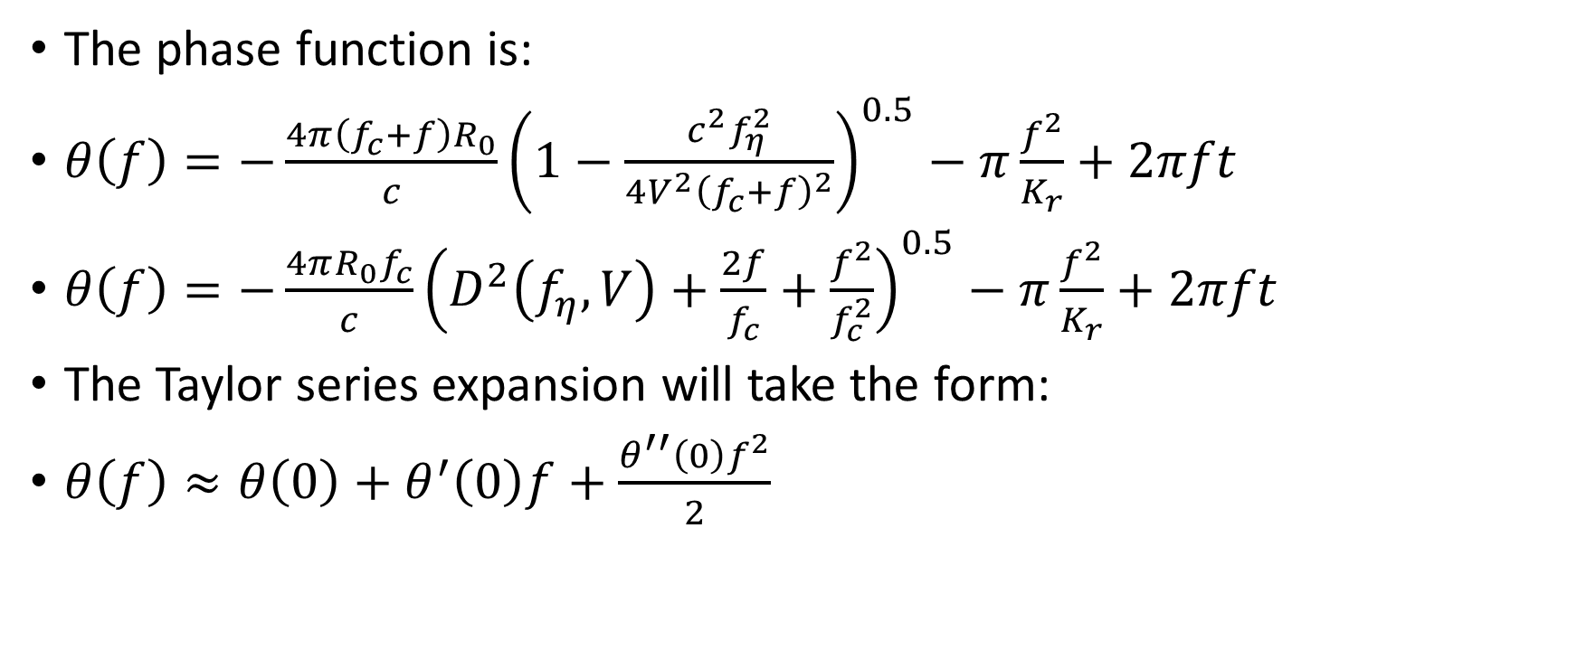
Range-Doppler (Wavenumber) Domain
The phase function is:
$θ\left(f\right)=−\frac{4π\left(f_{c}+f\right)R_{0}}{c}{\left(1−\frac{c^{2}f_{η}^{2}}{4V^{2}{\left(f_{c}+f\right)}^{2}}\right)}^{0.5}−π\frac{f^{2}}{K_{r}}+2πft$
$θ\left(f\right)=−\frac{4πR_{0}f_{c}}{c}{\left(D^{2}\left(f_{η},V\right)+\frac{2f}{f_{c}}+\frac{f^{2}}{f_{c}^{2}}\right)}^{0.5}−π\frac{f^{2}}{K_{r}}+2πft$
The Taylor series expansion will take the form:
$θ\left(f\right)≈θ\left(0\right)+θ^{′}\left(0\right)f+\frac{θ^{′′}\left(0\right)f^{2}}{2}$

Slide 25
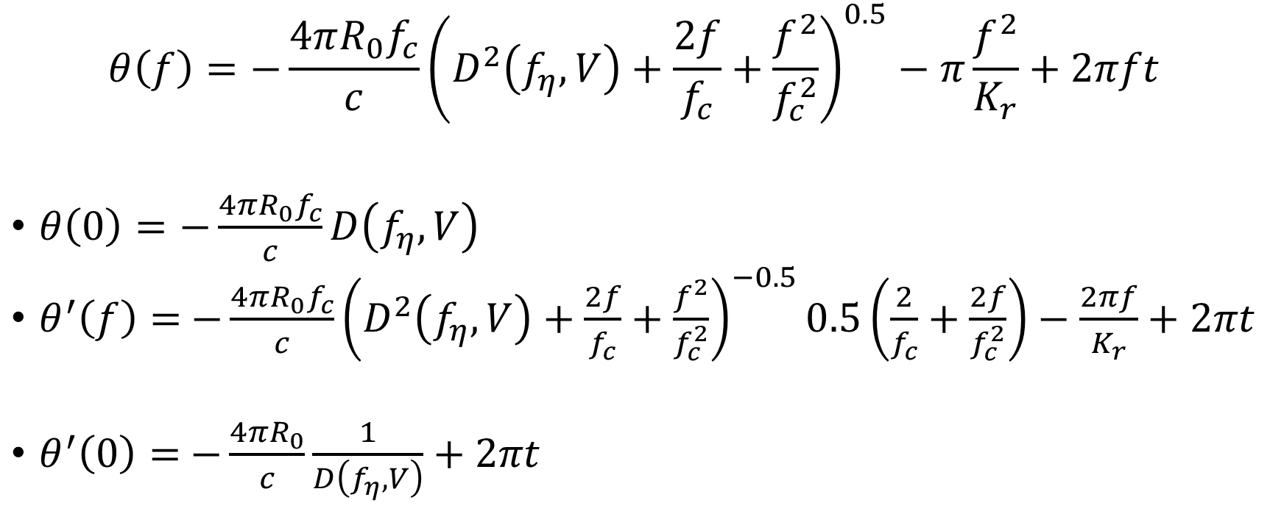
Range-Doppler (Wavenumber) Domain
$$θ\left(f\right)=−\frac{4πR_{0}f_{c}}{c}{\left(D^{2}\left(f_{η},V\right)+\frac{2f}{f_{c}}+\frac{f^{2}}{f_{c}^{2}}\right)}^{0.5}−π\frac{f^{2}}{K_{r}}+2πft$$
$θ\left(0\right)=−\frac{4πR_{0}f_{c}}{c}D\left(f_{η},V\right)$
$θ^{′}\left(f\right)=$ $−\frac{4πR_{0}f_{c}}{c}{\left(D^{2}\left(f_{η},V\right)+\frac{2f}{f_{c}}+\frac{f^{2}}{f_{c}^{2}}\right)}^{−0.5}0.5\left(\frac{2}{f_{c}}+\frac{2f}{f_{c}^{2}}\right)−\frac{2πf}{K_{r}}+2πt$
$θ^{′}\left(0\right)=$ $−\frac{4πR_{0}}{c}\frac{1}{D\left(f_{η},V\right)}+2πt$

Slide 26
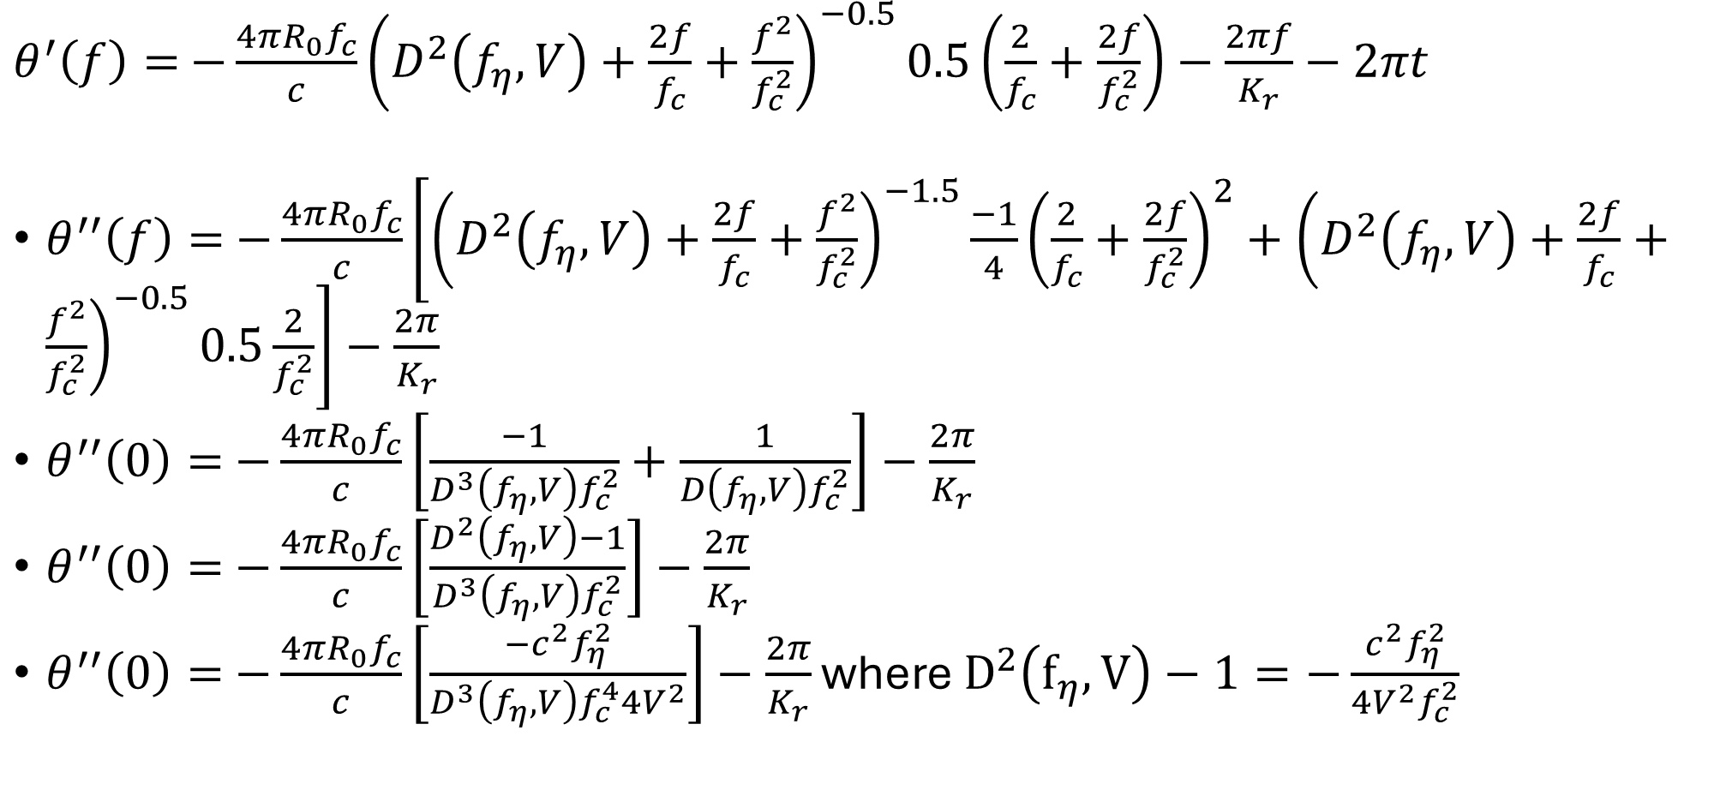
Range-Doppler (Wavenumber) Domain
$θ^{′}\left(f\right)=$ $−\frac{4πR_{0}f_{c}}{c}{\left(D^{2}\left(f_{η},V\right)+\frac{2f}{f_{c}}+\frac{f^{2}}{f_{c}^{2}}\right)}^{−0.5}0.5\left(\frac{2}{f_{c}}+\frac{2f}{f_{c}^{2}}\right)−\frac{2πf}{K_{r}}−2πt$
$θ^{′′}\left(f\right)=$ $−\frac{4πR_{0}f_{c}}{c}\left[{\left(D^{2}\left(f_{η},V\right)+\frac{2f}{f_{c}}+\frac{f^{2}}{f_{c}^{2}}\right)}^{−1.5}\frac{−1}{4}{\left(\frac{2}{f_{c}}+\frac{2f}{f_{c}^{2}}\right)}^{2}+{\left(D^{2}\left(f_{η},V\right)+\frac{2f}{f_{c}}+\frac{f^{2}}{f_{c}^{2}}\right)}^{−0.5}0.5\frac{2}{f_{c}^{2}}\right]−\frac{2π}{K_{r}}$
$θ^{′′}\left(0\right)=$ $−\frac{4πR_{0}f_{c}}{c}\left[\frac{−1}{D^{3}\left(f_{η},V\right)f_{c}^{2}}+\frac{1}{D\left(f_{η},V\right)f_{c}^{2}}\right]−\frac{2π}{K_{r}}$
$θ^{′′}\left(0\right)=$ $−\frac{4πR_{0}f_{c}}{c}\left[\frac{D^{2}\left(f_{η},V\right)−1}{D^{3}\left(f_{η},V\right)f_{c}^{2}}\right]−\frac{2π}{K_{r}}$
$θ^{′′}\left(0\right)=$ $−\frac{4πR_{0}f_{c}}{c}\left[\frac{−c^{2}f_{η}^{2}}{D^{3}\left(f_{η},V\right)f_{c}^{4}4V^{2}}\right]−\frac{2π}{K_{r}}$ where $D^{2}\left(f_{η},V\right)−1=−\frac{c^{2}f_{η}^{2}}{4V^{2}f_{c}^{2}}$

Slide 27
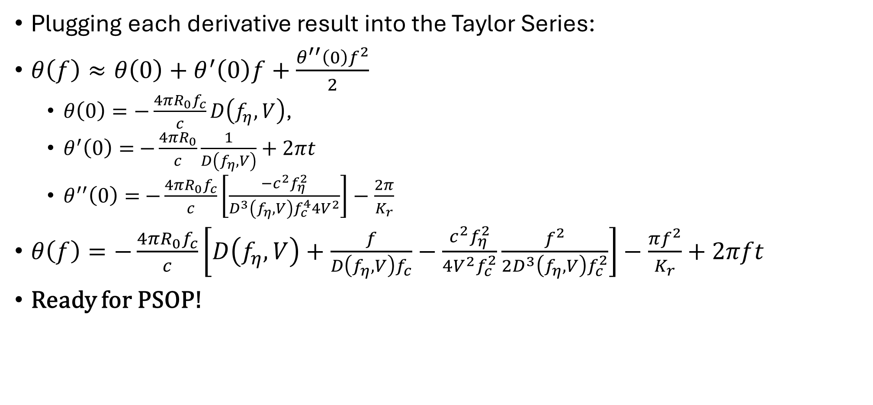
Range-Doppler (Wavenumber) Domain
Plugging each derivative result into the Taylor Series:
$θ\left(f\right)≈θ\left(0\right)+θ^{′}\left(0\right)f+\frac{θ^{′′}\left(0\right)f^{2}}{2}$
  $θ\left(0\right)=−\frac{4πR_{0}f_{c}}{c}D\left(f_{η},V\right)$,
  $θ^{′}\left(0\right)=$ $−\frac{4πR_{0}}{c}\frac{1}{D\left(f_{η},V\right)}+2πt$
  $θ^{′′}\left(0\right)=$ $−\frac{4πR_{0}f_{c}}{c}\left[\frac{−c^{2}f_{η}^{2}}{D^{3}\left(f_{η},V\right)f_{c}^{4}4V^{2}}\right]−\frac{2π}{K_{r}}$
$θ\left(f\right)=−\frac{4πR_{0}f_{c}}{c}\left[D\left(f_{η},V\right)+\frac{f}{D\left(f_{η},V\right)f_{c}}−\frac{c^{2}f_{η}^{2}}{4V^{2}f_{c}^{2}}\frac{f^{2}}{2D^{3}\left(f_{η},V\right)f_{c}^{2}}\right]−\frac{πf^{2}}{K_{r}}+2πft$
Ready for PSOP!

Slide 28
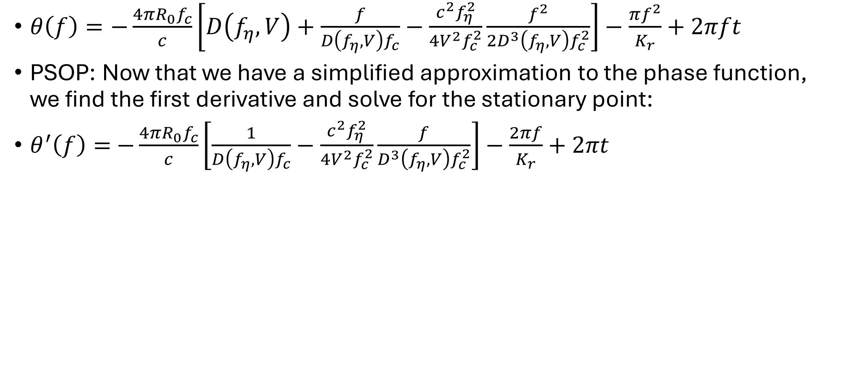
Range-Doppler (Wavenumber) Domain
$θ\left(f\right)=−\frac{4πR_{0}f_{c}}{c}\left[D\left(f_{η},V\right)+\frac{f}{D\left(f_{η},V\right)f_{c}}−\frac{c^{2}f_{η}^{2}}{4V^{2}f_{c}^{2}}\frac{f^{2}}{2D^{3}\left(f_{η},V\right)f_{c}^{2}}\right]−\frac{πf^{2}}{K_{r}}+2πft$
PSOP: Now that we have a simplified approximation to the phase function, we find the first derivative and solve for the stationary point:
$θ^{′}\left(f\right)=$ $−\frac{4πR_{0}f_{c}}{c}\left[\frac{1}{D\left(f_{η},V\right)f_{c}}−\frac{c^{2}f_{η}^{2}}{4V^{2}f_{c}^{2}}\frac{f}{D^{3}\left(f_{η},V\right)f_{c}^{2}}\right]−\frac{2πf}{K_{r}}+2πt$

Slide 29
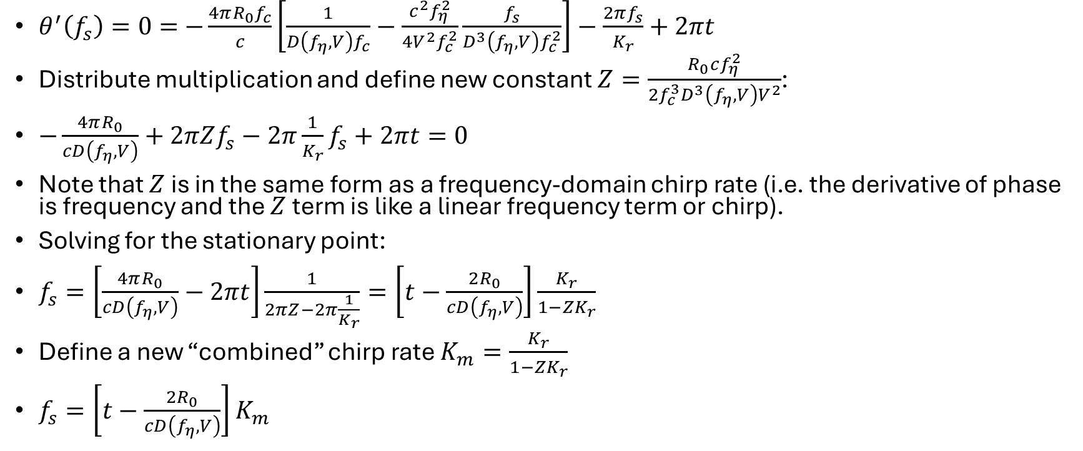
Range-Doppler (Wavenumber) Domain
$θ^{′}\left(f_{s}\right)=0=$ $−\frac{4πR_{0}f_{c}}{c}\left[\frac{1}{D\left(f_{η},V\right)f_{c}}−\frac{c^{2}f_{η}^{2}}{4V^{2}f_{c}^{2}}\frac{f_{s}}{D^{3}\left(f_{η},V\right)f_{c}^{2}}\right]−\frac{2πf_{s}}{K_{r}}+2πt$
Distribute multiplication and define new constant $Z=\frac{R_{0}cf_{η}^{2}}{2f_{c}^{3}D^{3}\left(f_{η},V\right)V^{2}}$:
$−\frac{4πR_{0}}{cD\left(f_{η},V\right)}+2πZf_{s}−2π\frac{1}{K_{r}}f_{s}+2πt=0$
Note that $Z$ is in the same form as a frequency-domain chirp rate (i.e. the derivative of phase is frequency and the $Z$ term is like a linear frequency term or chirp).
Solving for the stationary point:
$f_{s}=\left[\frac{4πR_{0}}{cD\left(f_{η},V\right)}−2πt\right]\frac{1}{2πZ−2π\frac{1}{K_{r}}}=\left[t−\frac{2R_{0}}{cD\left(f_{η},V\right)}\right]\frac{K_{r}}{1−{ZK}_{r}}$
Define a new “combined” chirp rate $K_{m}=\frac{K_{r}}{1−{ZK}_{r}}$
$f_{s}=\left[t−\frac{2R_{0}}{cD\left(f_{η},V\right)}\right]K_{m}$

Slide 30
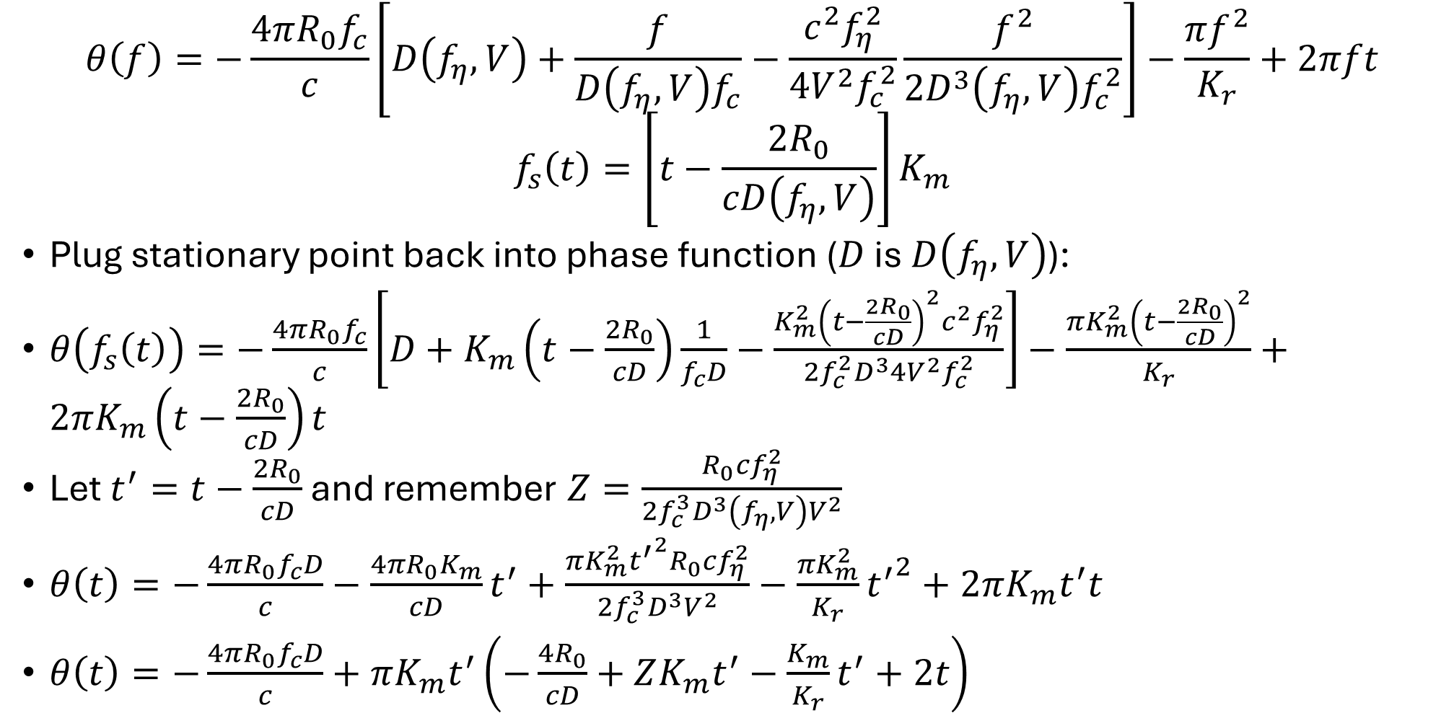
Range-Doppler (Wavenumber) Domain
$$θ\left(f\right)=−\frac{4πR_{0}f_{c}}{c}\left[D\left(f_{η},V\right)+\frac{f}{D\left(f_{η},V\right)f_{c}}−\frac{c^{2}f_{η}^{2}}{4V^{2}f_{c}^{2}}\frac{f^{2}}{2D^{3}\left(f_{η},V\right)f_{c}^{2}}\right]−\frac{πf^{2}}{K_{r}}+2πft$$
$$f_{s}\left(t\right)=\left[t−\frac{2R_{0}}{cD\left(f_{η},V\right)}\right]K_{m}$$
Plug stationary point back into phase function ($D$ is $D\left(f_{η},V\right)$):
$θ\left(f_{s}\left(t\right)\right)=−\frac{4πR_{0}f_{c}}{c}\left[D+K_{m}\left(t−\frac{2R_{0}}{cD}\right)\frac{1}{f_{c}D}−\frac{K_{m}^{2}{\left(t−\frac{2R_{0}}{cD}\right)}^{2}c^{2}f_{η}^{2}}{2f_{c}^{2}D^{3}4V^{2}f_{c}^{2}}\right]−\frac{πK_{m}^{2}{\left(t−\frac{2R_{0}}{cD}\right)}^{2}}{K_{r}}+2πK_{m}\left(t−\frac{2R_{0}}{cD}\right)t$
Let $t^{′}=t−\frac{2R_{0}}{cD}$ and remember $Z=\frac{R_{0}cf_{η}^{2}}{2f_{c}^{3}D^{3}\left(f_{η},V\right)V^{2}}$
$θ\left(t\right)=−\frac{4πR_{0}f_{c}D}{c}−\frac{4πR_{0}K_{m}}{cD}t^{′}+\frac{πK_{m}^{2}{t^{′}}^{2}R_{0}cf_{η}^{2}}{2f_{c}^{3}D^{3}V^{2}}−\frac{πK_{m}^{2}}{K_{r}}{t^{′}}^{2}+2πK_{m}t^{′}t$
$θ\left(t\right)=−\frac{4πR_{0}f_{c}D}{c}+πK_{m}t^{′}\left(−\frac{4R_{0}}{cD}+ZK_{m}t^{′}−\frac{K_{m}}{K_{r}}t^{′}+2t\right)$

Slide 31
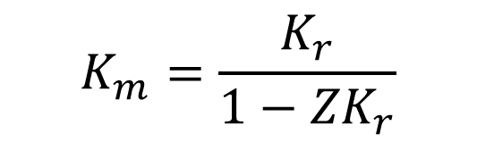
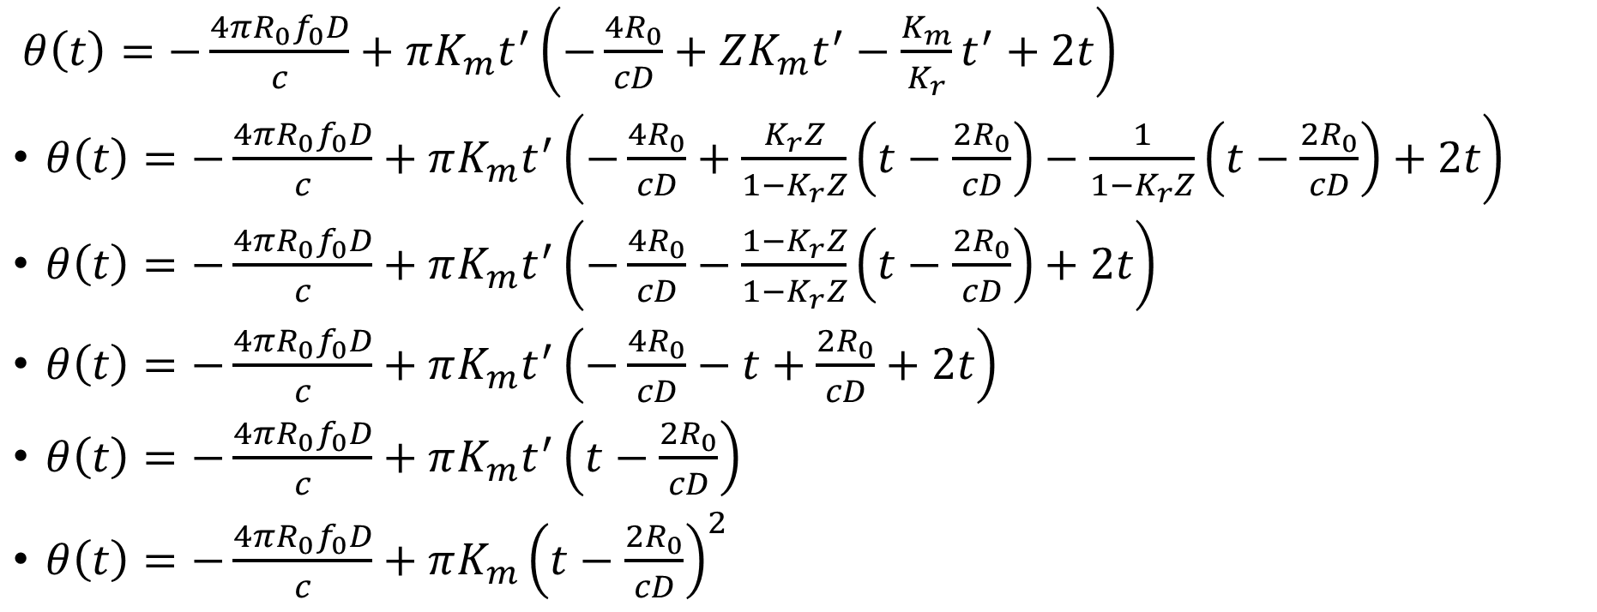
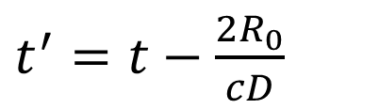
Range-Doppler (Wavenumber) Domain
$$K_{m}=\frac{K_{r}}{1−{ZK}_{r}}$$
$t^{′}=t−\frac{2R_{0}}{cD}$
$θ\left(t\right)=−\frac{4πR_{0}f_{0}D}{c}+πK_{m}t^{′}\left(−\frac{4R_{0}}{cD}+ZK_{m}t^{′}−\frac{K_{m}}{K_{r}}t^{′}+2t\right)$
$θ\left(t\right)=−\frac{4πR_{0}f_{0}D}{c}+πK_{m}t^{′}\left(−\frac{4R_{0}}{cD}+\frac{K_{r}Z}{1−K_{r}Z}\left(t−\frac{2R_{0}}{cD}\right)−\frac{1}{{1−K}_{r}Z}\left(t−\frac{2R_{0}}{cD}\right)+2t\right)$
$θ\left(t\right)=−\frac{4πR_{0}f_{0}D}{c}+πK_{m}t^{′}\left(−\frac{4R_{0}}{cD}−\frac{1−K_{r}Z}{1−K_{r}Z}\left(t−\frac{2R_{0}}{cD}\right)+2t\right)$
$θ\left(t\right)=−\frac{4πR_{0}f_{0}D}{c}+πK_{m}t^{′}\left(−\frac{4R_{0}}{cD}−t+\frac{2R_{0}}{cD}+2t\right)$
$θ\left(t\right)=−\frac{4πR_{0}f_{0}D}{c}+πK_{m}t^{′}\left(t−\frac{2R_{0}}{cD}\right)$
$θ\left(t\right)=−\frac{4πR_{0}f_{0}D}{c}+πK_{m}{\left(t−\frac{2R_{0}}{cD}\right)}^{2}$

Slide 32
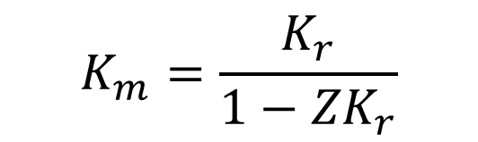
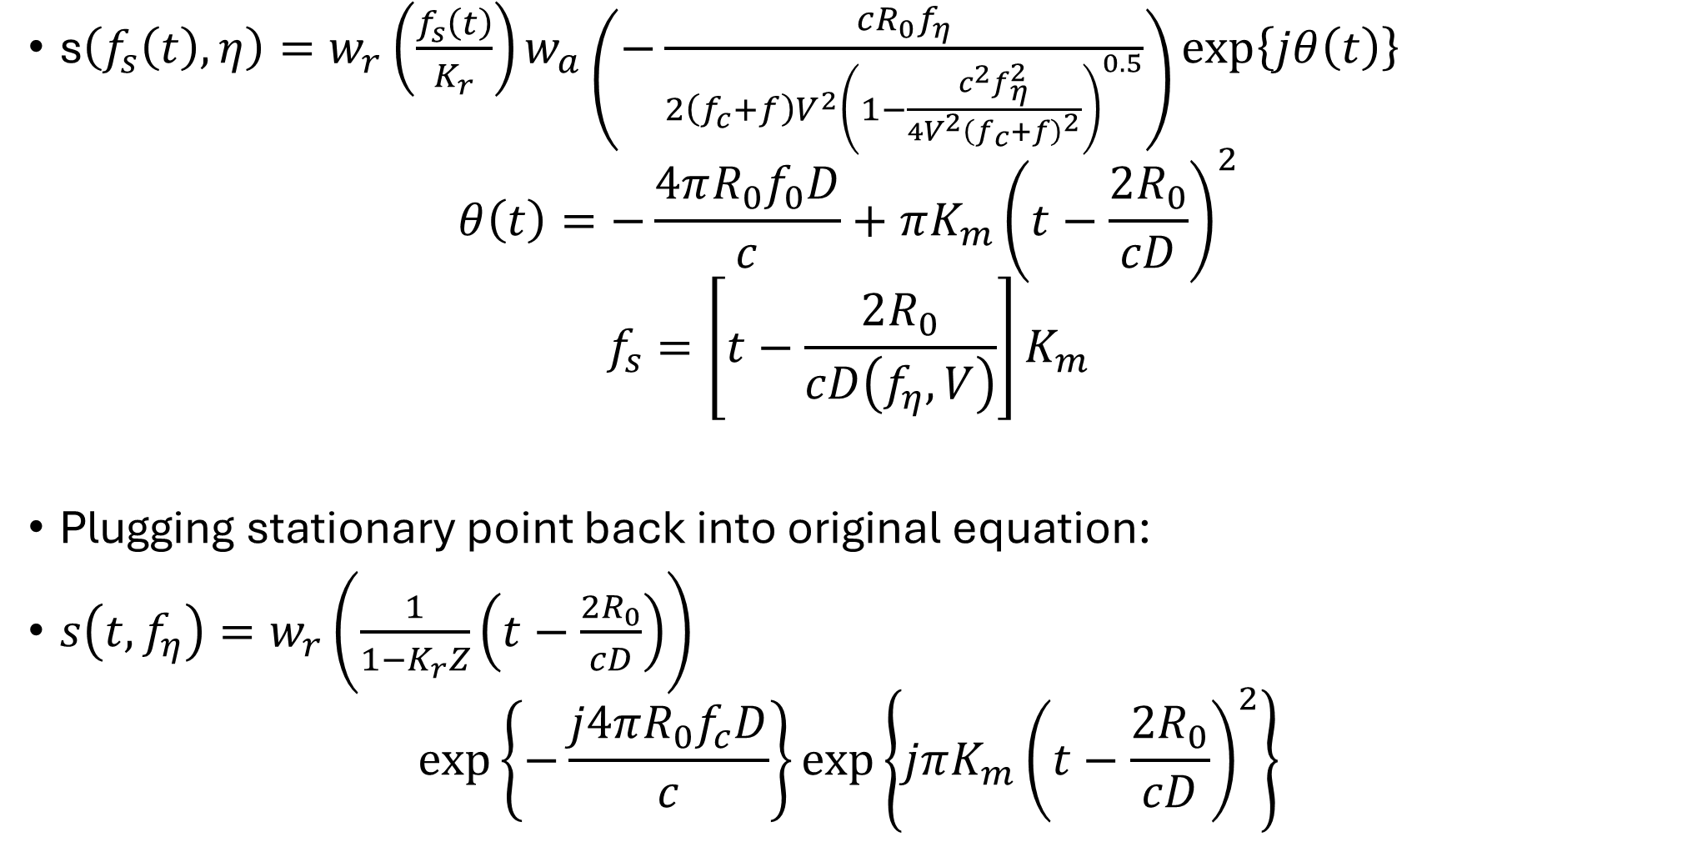

Range-Doppler (Wavenumber) Domain
s$\left(f_{s}\left(t\right),η\right)=w_{r}\left(\frac{f_{s}\left(t\right)}{K_{r}}\right)w_{a}\left(−\frac{cR_{0}f_{η}}{2\left(f_{c}+f\right)V^{2}{\left(1−\frac{c^{2}f_{η}^{2}}{4V^{2}{\left(f_{c}+f\right)}^{2}}\right)}^{0.5}}\right)\exp\left\{jθ\left(t\right)\right\}$
$$θ\left(t\right)=−\frac{4πR_{0}f_{0}D}{c}+πK_{m}{\left(t−\frac{2R_{0}}{cD}\right)}^{2}$$
$$f_{s}=\left[t−\frac{2R_{0}}{cD\left(f_{η},V\right)}\right]K_{m}$$
Plugging stationary point back into original equation:
$s\left(t,f_{η}\right)=w_{r}\left(\frac{1}{1−K_{r}Z}\left(t−\frac{2R_{0}}{cD}\right)\right)$
$$\exp\left\{−\frac{j4πR_{0}f_{c}D}{c}\right\}\exp\left\{jπK_{m}{\left(t−\frac{2R_{0}}{cD}\right)}^{2}\right\}$$
$$K_{m}=\frac{K_{r}}{1−{ZK}_{r}}$$
$$Ignore azimuth \\ window!$$

Slide 33
Range Doppler Algorithm (RDA) STEP 1
Pulse compression in frequency–space domain.
Do not take the IFFT in the fast-time dimension when finished.

Slide 34
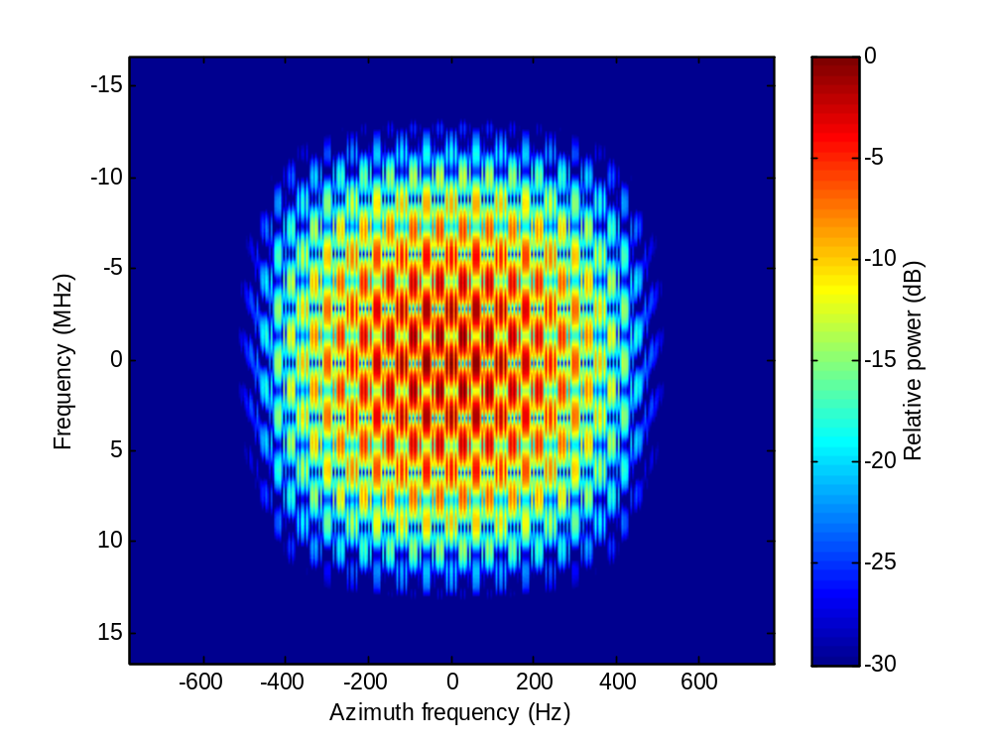
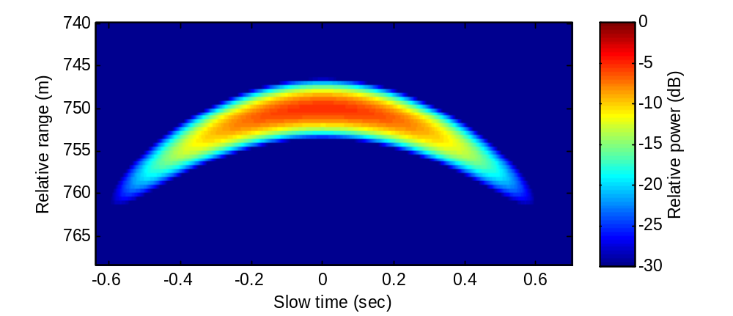
Range Doppler Algorithm (RDA) STEP 2
Azimuth FFT
  Transform to range-frequency / Doppler domain
2D Fourier Domain (3 targets)
Raw Data (single target)

Slide 35
Range Doppler Algorithm (RDA): STEP 3
Blurring occurs in the range-Doppler domain so that the point target “1D-contour” is broadened. This effect is worse for large squint angles.
This blurring can be approximated by a frequency-domain chirp in the range domain… so we can correct with pulse compression.
This process is called Secondary Range Compression

Slide 36
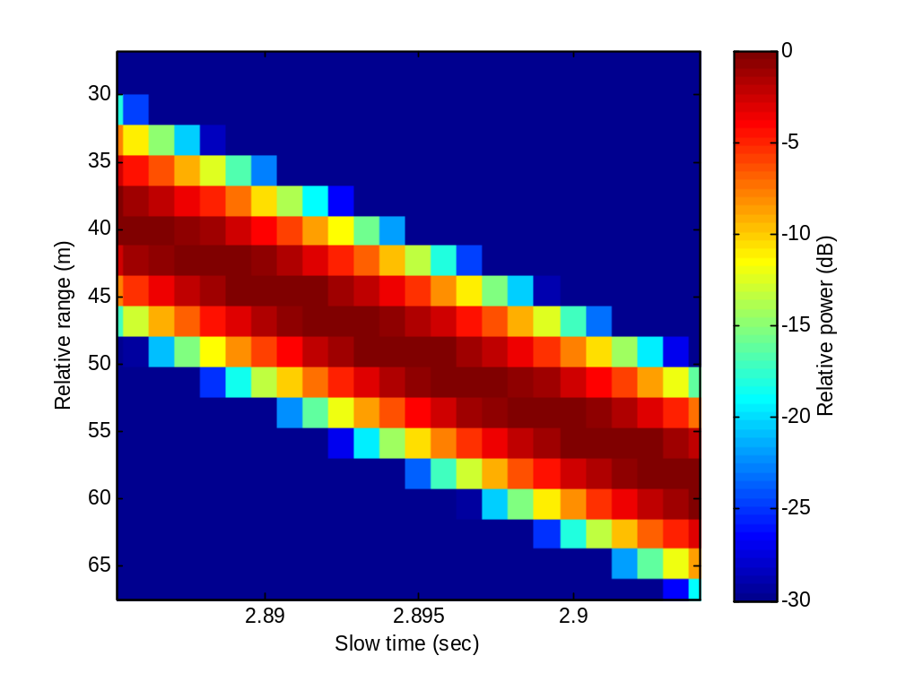
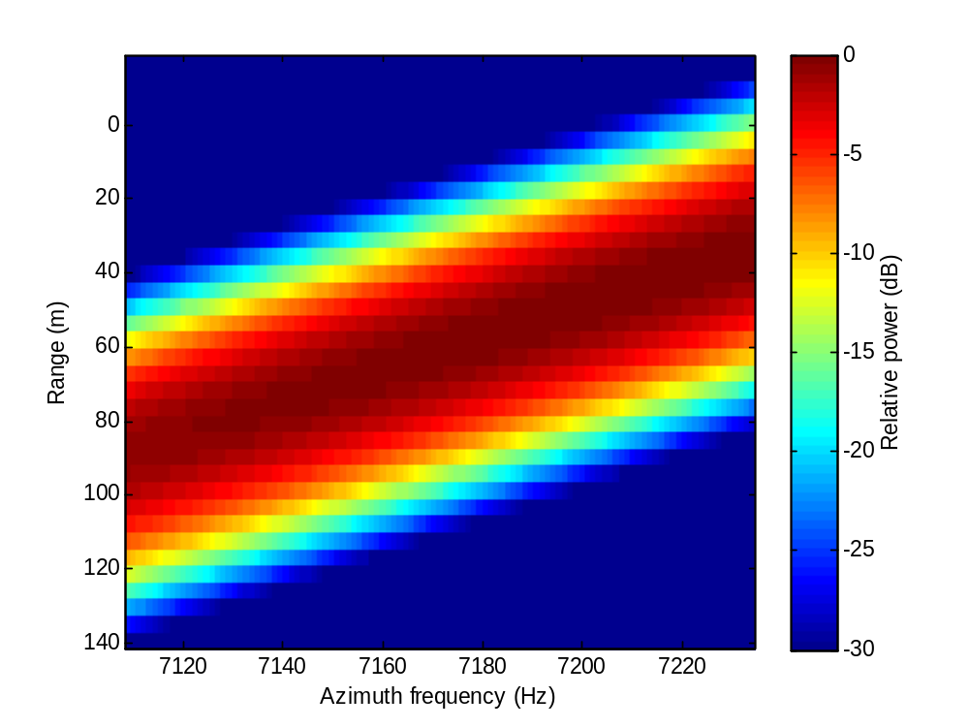
Range Doppler Algorithm (RDA): STEP 3
Range Space Domain (i.e. Raw Data)
Range Doppler Domain
(note the blurring)

Slide 37

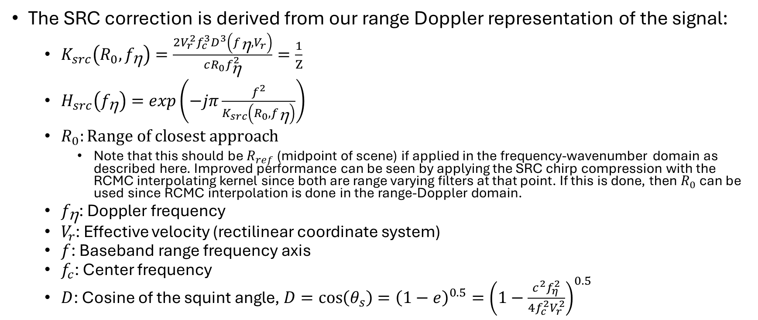
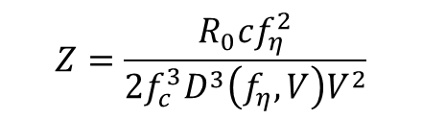
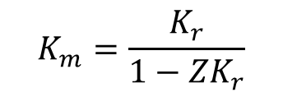
Range Doppler Algorithm (RDA): STEP 3
The SRC correction is derived from our range Doppler representation of the signal:
  $K_{src}\left(R_{0},f_{\text{h}}\right)=\frac{2V_{r}^{2}f_{c}^{3}D^{3}\left(f_{\text{h}},V_{r}\right)}{cR_{0}f_{\text{h}}^{2}}=\frac{1}{Z}$
  $H_{src}\left(f_{\text{h}}\right)=exp\left(−jπ\frac{f^{2}}{K_{src}\left(R_{0},f_{\text{h}}\right)}\right)$
  $R_{0}:Range of closest approach$
    Note that this should be $R_{ref}$ (midpoint of scene) if applied in the frequency-wavenumber domain as described here. Improved performance can be seen by applying the SRC chirp compression with the RCMC interpolating kernel since both are range varying filters at that point. If this is done, then $R_{0}$ can be used since RCMC interpolation is done in the range-Doppler domain.
  $f_{\text{h}}$: Doppler frequency
  $V_{r}$: Effective velocity (rectilinear coordinate system)
  $f$: Baseband range frequency axis
  $f_{c}$: Center frequency
  $D$: Cosine of the squint angle, $D=\cos\left(θ_{s}\right)={\left(1−e\right)}^{0.5}={\left(1−\frac{c^{2}f_{η}^{2}}{4f_{c}^{2}V_{r}^{2}}\right)}^{0.5}$
$$\exp\left\{jπK_{m}{\left(t−\frac{2R_{0}}{cD}\right)}^{2}\right\}$$
$$K_{m}=\frac{K_{r}}{1−{ZK}_{r}}$$
$$Z=\frac{R_{0}cf_{η}^{2}}{2f_{c}^{3}D^{3}\left(f_{η},V\right)V^{2}}$$

Slide 38
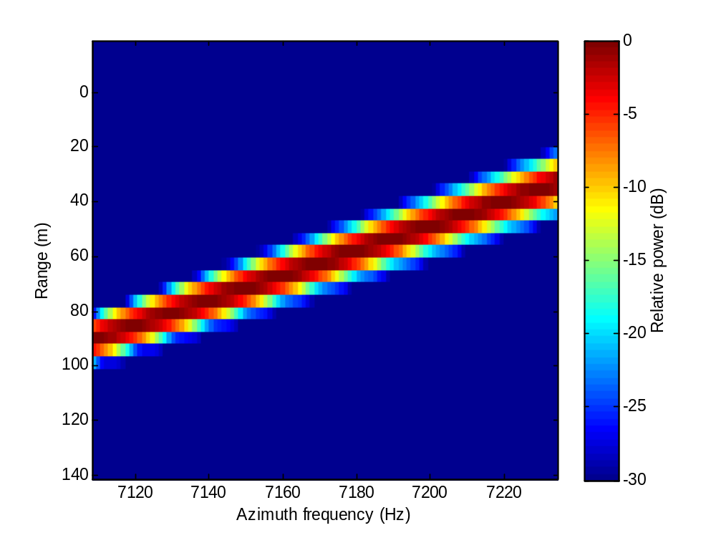
Range Doppler Algorithm (RDA): STEP 3
Range Doppler Domain
(After Secondary Range Compression)
Range Doppler Domain
(note the blurring)

Slide 39
Range Doppler Algorithm (RDA): STEP 4
Range or fast-time IFFT
  Transform to range / Doppler domain

Slide 40
Range Doppler Algorithm (RDA): STEP 5
Range Cell Migration Correction (RCMC) in Doppler domain
  SAR processing is a 2-D filter, but the energy is focused along a single hyperbolic contour.
    Contour is range dependent
  The idea is to flatten the contour using a process called RCMC
Example point target response:
RCMC easy to apply for a single
point target.

Slide 41
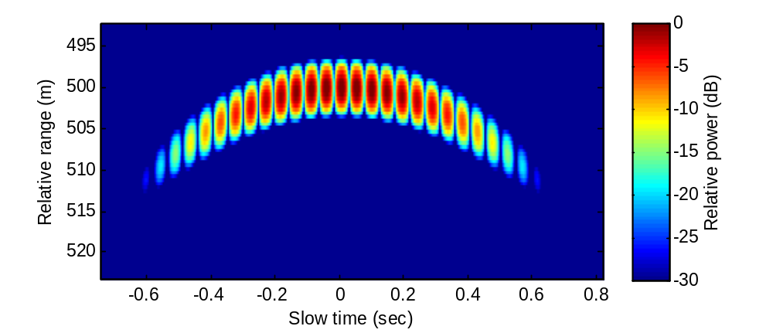
Range Doppler Algorithm (RDA): STEP 5
Example of two point targets at the same range and next to each other. Envelope is about the same for both but the phases are offset (think of two tones and what you see is the beat frequency… double side band suppressed carrier).
Could apply RCMC for this case as well.

Slide 42
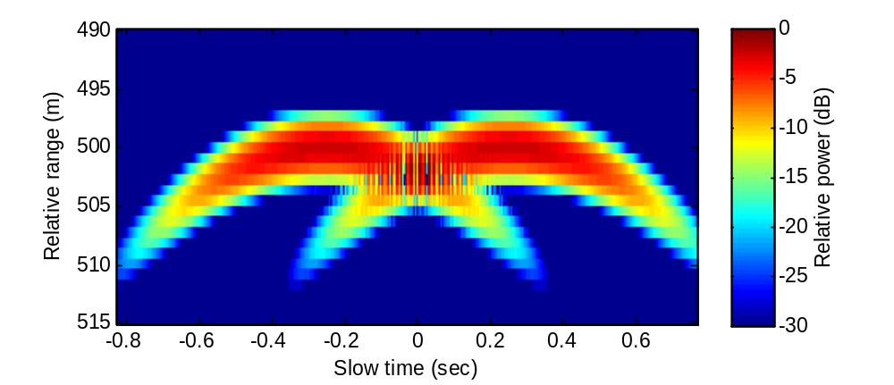
Range Doppler Algorithm (RDA): STEP 5
Example of two point targets far apart from each other… RCMC not possible because each target needs a different correction.

Slide 43
Range Doppler Algorithm (RDA): STEP 5
RCMC cannot be applied in the range-space domain because RCMC is dependent on the relative along-track position rather than the absolute along-track position.
Hmmm… we know that the range cell migration is a function of incidence angle (i.e. Doppler).
RCMC can be applied in the range-Doppler domain because RCMC only depends on the Doppler.
Every target at the same range has the same envelope in the range-Doppler domain!!!

Slide 44
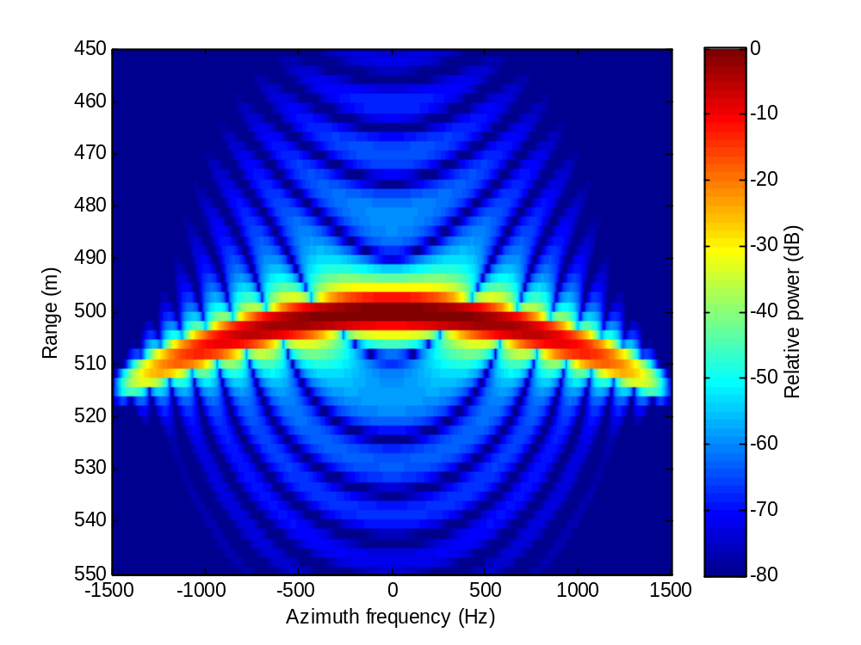
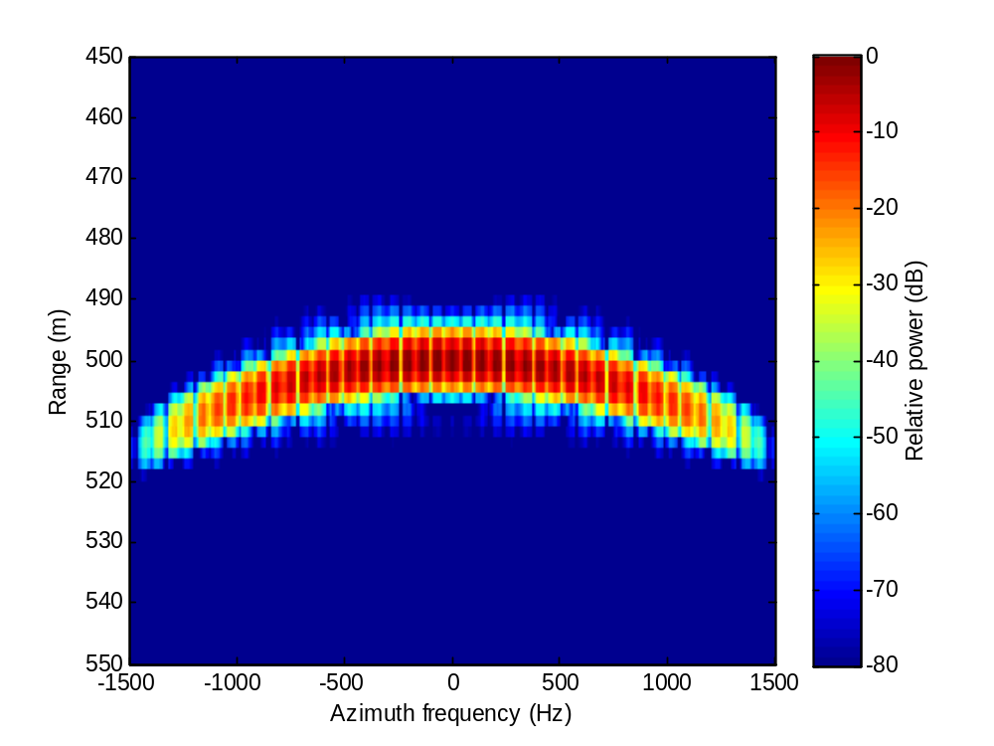
Range Doppler Algorithm (RDA): STEP 5
Single Target
Both Targets… envelope has not changed, but interference pattern has.

Slide 45
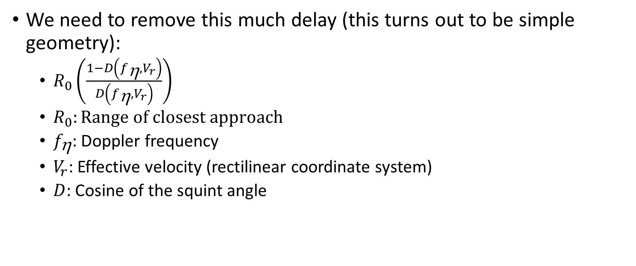
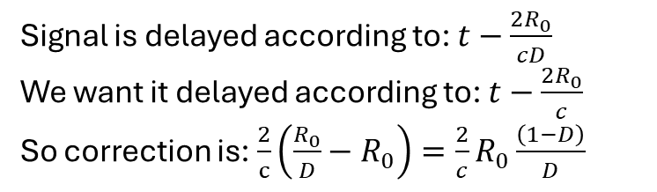
Range Doppler Algorithm (RDA): STEP 5
We need to remove this much delay (this turns out to be simple geometry):
  $R_{0}\left(\frac{1−D\left(f_{\text{h}},V_{r}\right)}{D\left(f_{\text{h}},V_{r}\right)}\right)$
  $R_{0}:Range of closest approach$
  $f_{\text{h}}$: Doppler frequency
  $V_{r}$: Effective velocity (rectilinear coordinate system)
  $D$: Cosine of the squint angle
Signal is delayed according to: $t−\frac{2R_{0}}{cD}$
We want it delayed according to: $t−\frac{2R_{0}}{c}$
So correction is: $\frac{2}{c}\left(\frac{R_{0}}{D}−R_{0}\right)=\frac{2}{c}R_{0}\frac{\left(1−D\right)}{D}$

Slide 46
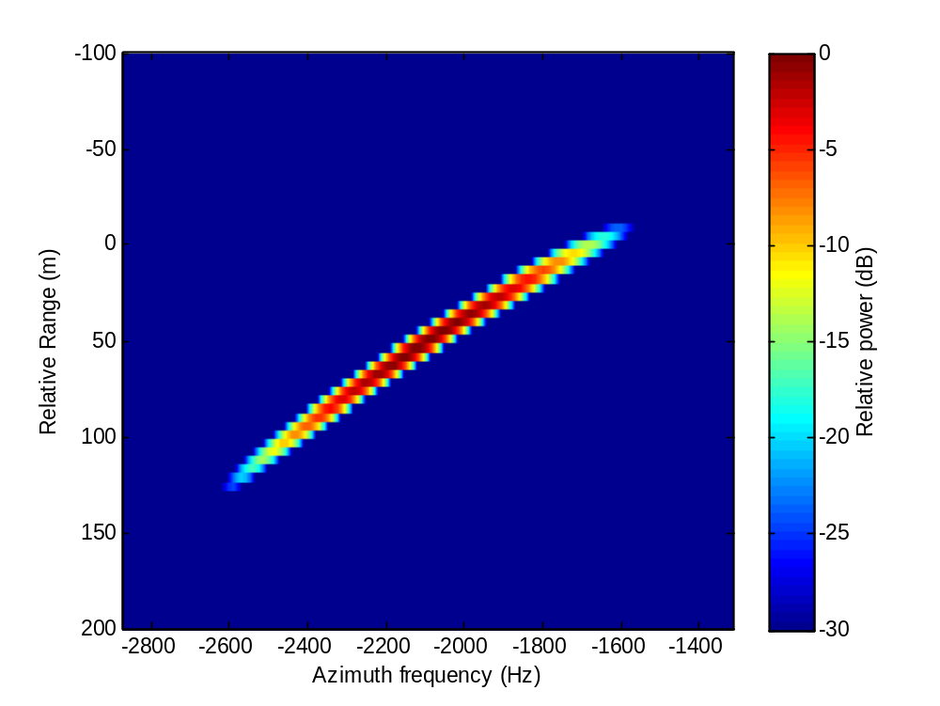

Range Doppler Algorithm (RDA): STEP 5
Use the truncated and windowed sinc interpolation method to do the time shift. Example of 3 deg squint:

Slide 47


Range Doppler Algorithm (RDA): STEP 5
Use the truncated and windowed sinc interpolation method to do the time shift. Example of 10 deg squint:

Slide 48
Range Doppler Algorithm (RDA): STEP 6
All targets have been interpolated so that they occupy a single range bin in the range-Doppler domain.
Originally the problem was that the range cell migration changed as a function of range → This prevented a simple application of Fourier methods since the response was space-variant.
Now it is no longer a 2-D filter so the space variance does not matter and we only need to apply a 1-D azimuth filter.

Slide 49

Range Doppler Algorithm (RDA): STEP 6
Using the range-Doppler representation of the signal after RCMC, the azimuth compression filter is:
  $exp\left\{j\frac{4πR_{0}D\left(f_{\text{h}},V_{r}\right)f_{c}}{c}\right\}$
  $R_{0}:Range of closest approach$
  $f_{\text{h}}$: Doppler frequency
  $V_{r}$: Effective velocity (rectilinear coordinate system)
  $D$: Cosine of the squint angle
  $f_{c}$: Center frequency
  $c$: Speed of light
Notes:
Note this azimuth filter is based strictly on the geometry (i.e. you can prove it using the Fourier analysis but the answer is a hyperbola and relates directly to the geometry).

Slide 50
Range Doppler Algorithm (RDA): STEP 7
Azimuth IFFT
  Transform into range / azimuth-space domain

Slide 51

Range Doppler Algorithm (RDA): STEP 7
Example

