Slide 1
Radar Simulator

Slide 2
Synthetic Aperture Radar Applications
Brainstorm examples
Notes:
Side looking imaging through clouds/etc., surface and thickness sounders for snow/ice, ship wake detection, target recognition, MTI, polarimetric SAR, multi-frequency, DInSAR, SAR-tomography and InSAR, Velocity, inverse SAR

Slide 3
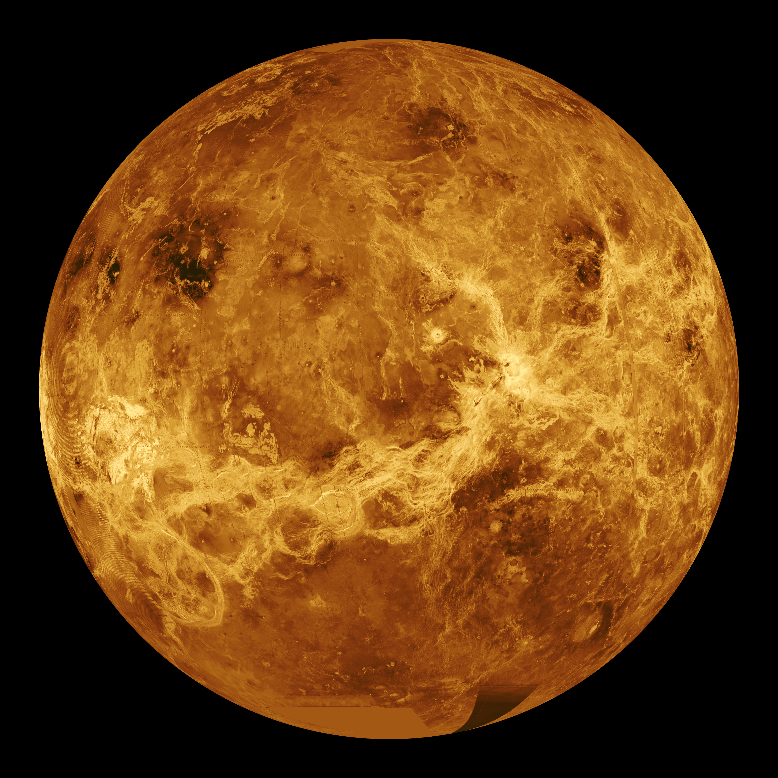
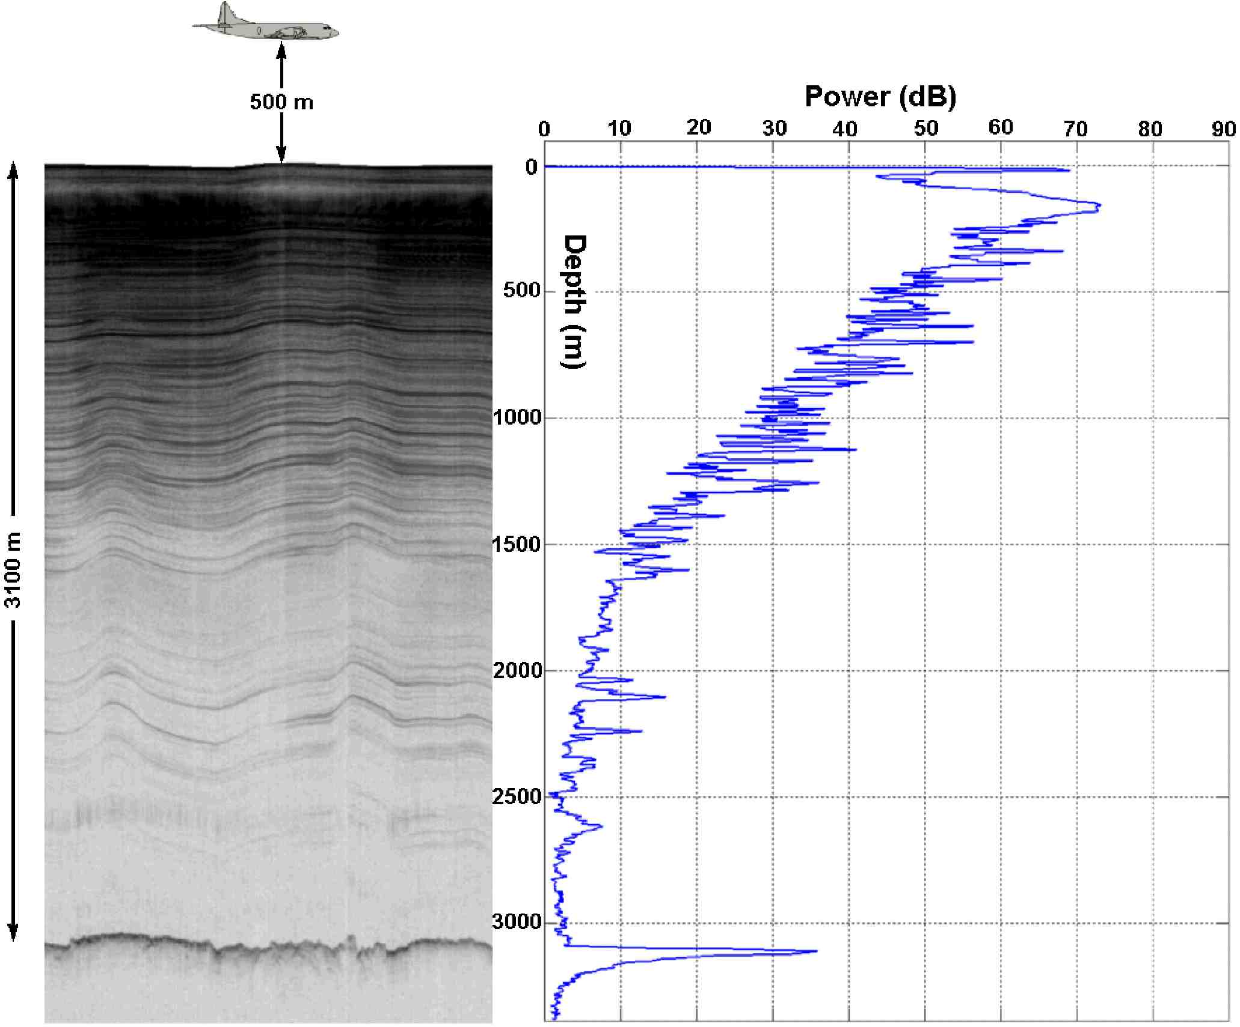
Notes:
Radar imaging side looking of Venus
Radar imaging sounding system geometry of Greenland Ice Sheet

Slide 4
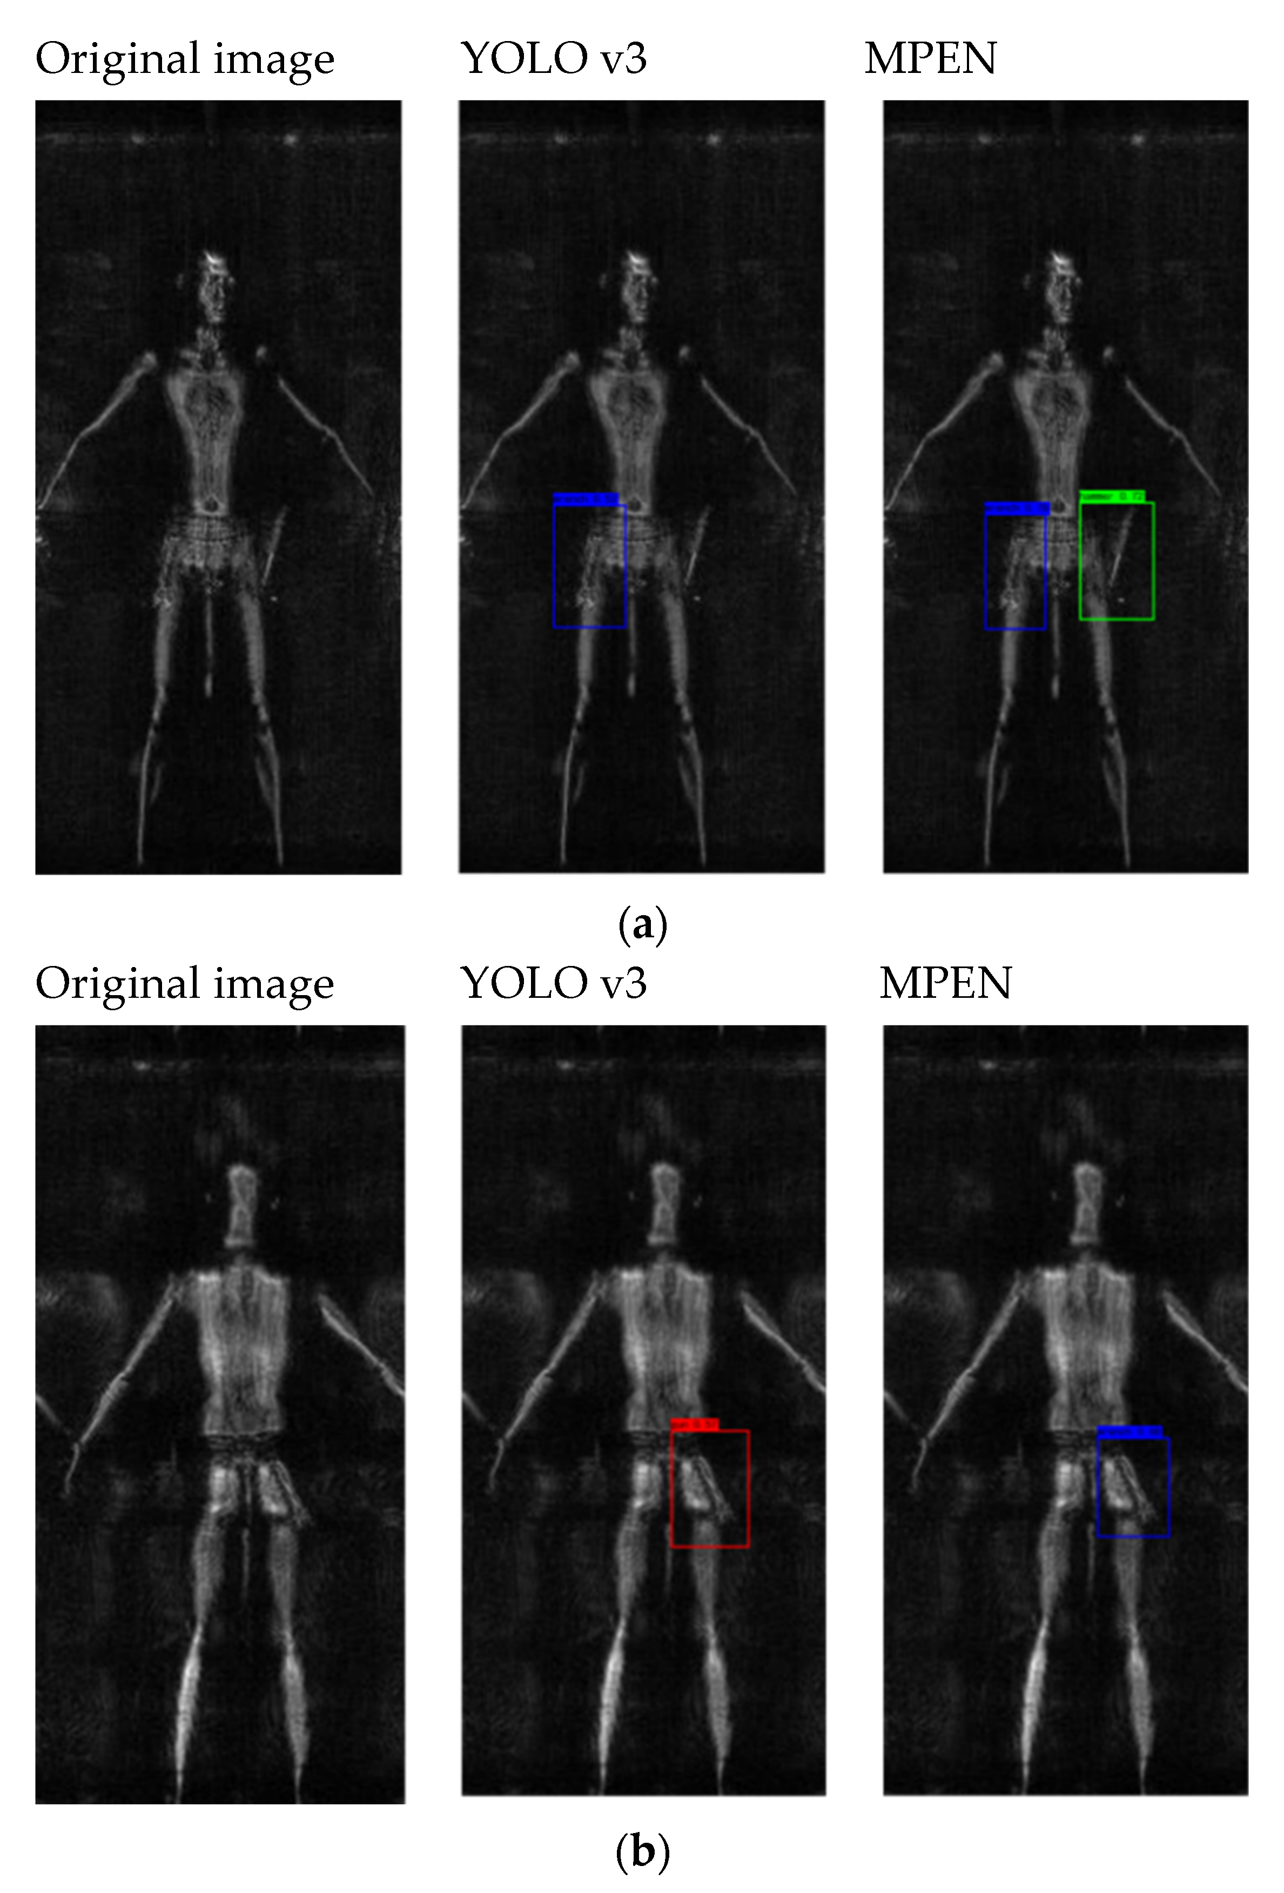
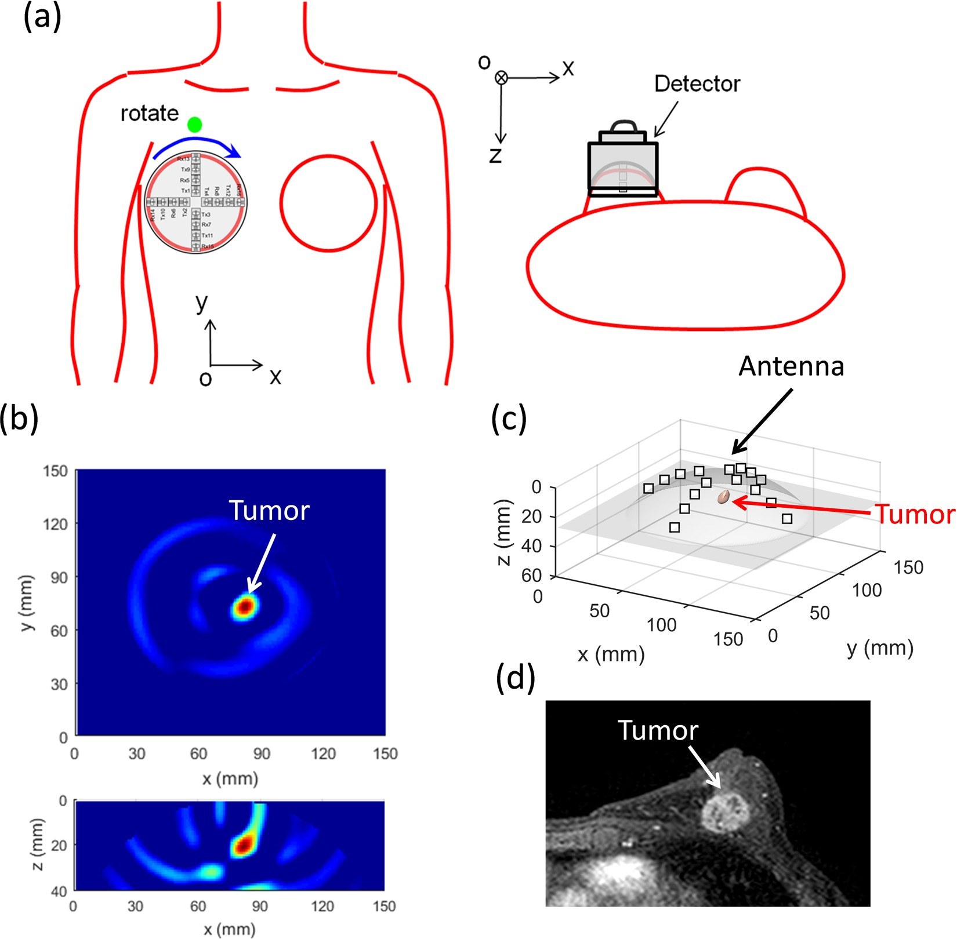
Notes:
Breast cancer tumor radar imaging on left, full body security radar imaging

Slide 5
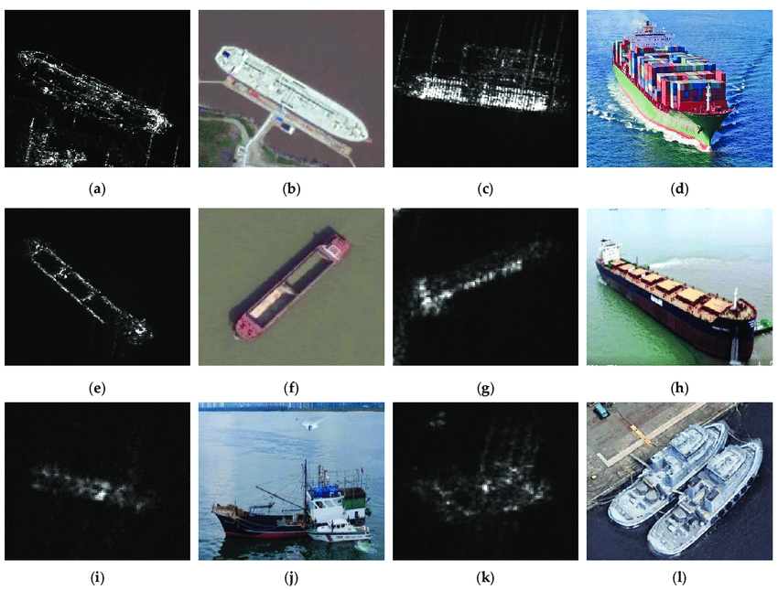
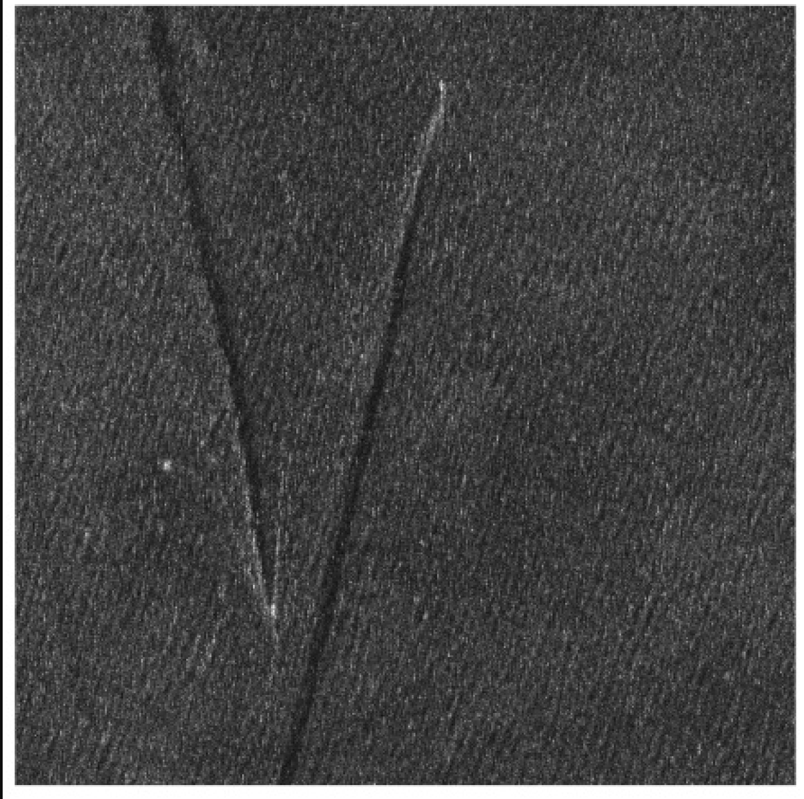
Notes:
Ship “wake” detection on left, target detection on right

Slide 6
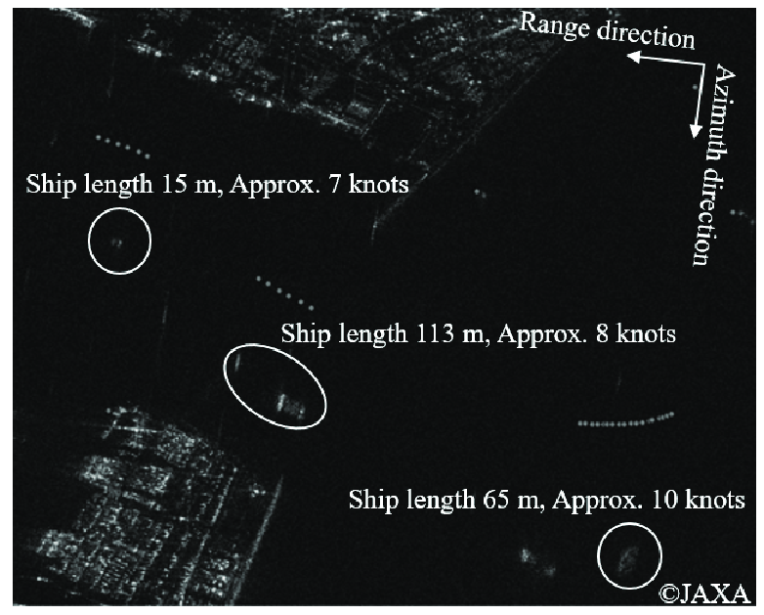
Notes:
Moving Target Indication (MTI). Ship radial velocity causes offset in along-track SAR position. Offset is directly proportional to the radial velocity.

Slide 7
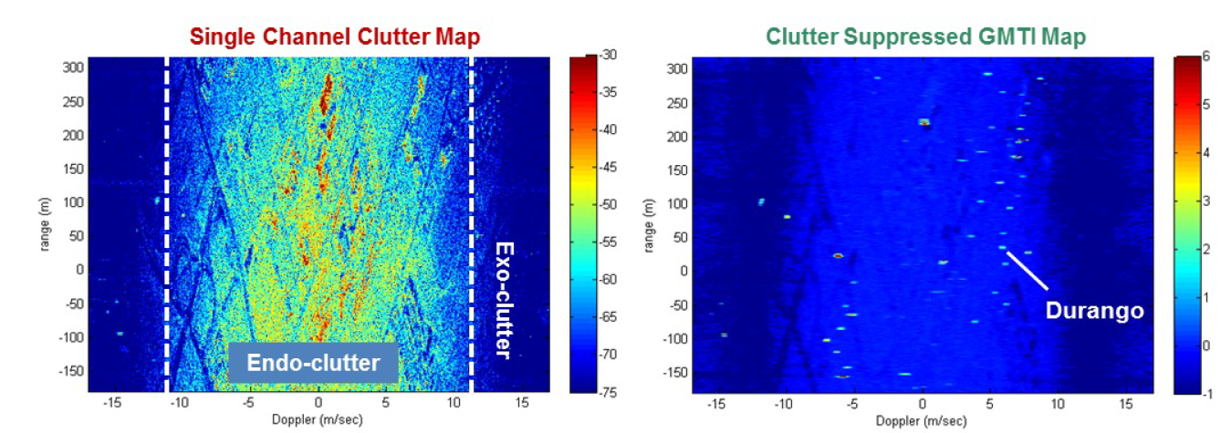
Notes:
Another MTI example. Left image with horizontal SAR azimuth dimension. The Endo-clutter is where all the stationary data shows up. The Exo-clutter should only have noise and moving targets (and occurs outside the “visible/physical” region of the beam). Along-track antennas can be used to do array processing to suppress Endo-clutter from stationary targets. Example of this suppression algorithm applied to a city with one moving target (Durango truck) identified, but many other moving targets in the urban scene.

Slide 8
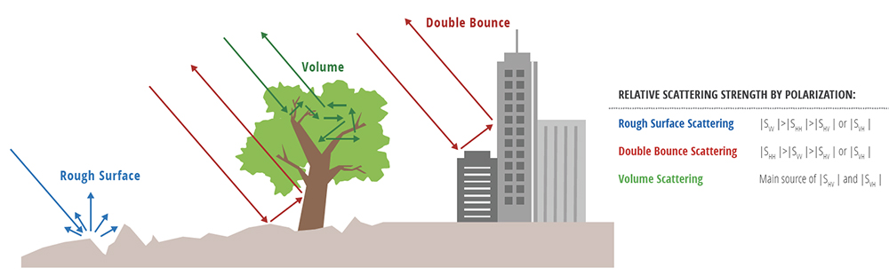
Notes:
Polarimetric SAR: VV dominates rough/diffuse surface scattering on average (except at the Brewster angle). HH dominates surface scattering for double bounce. HV is relatively stronger for volume scattering. So polarization can be used to determine the cause of the scattering and help identify targets and estimate parameters.

Slide 9
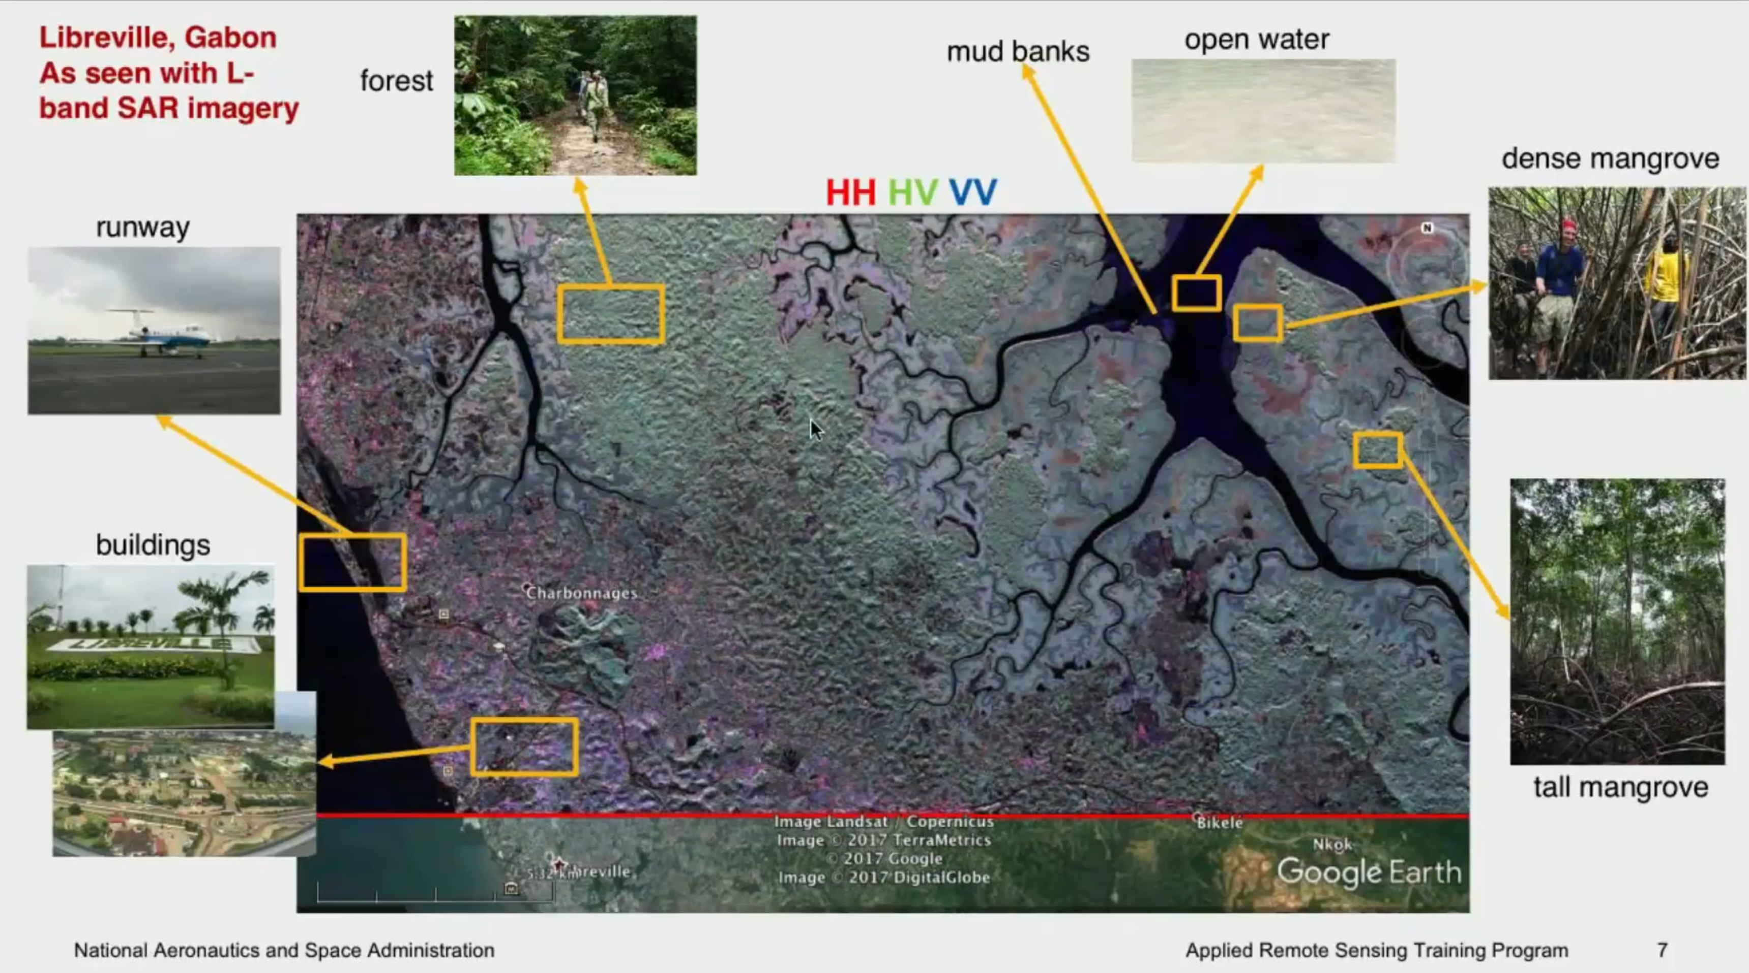
Notes:
Polarimetric false color image. Green is cross-polarized and shows forested (volumetric) scattering regions.

Slide 10
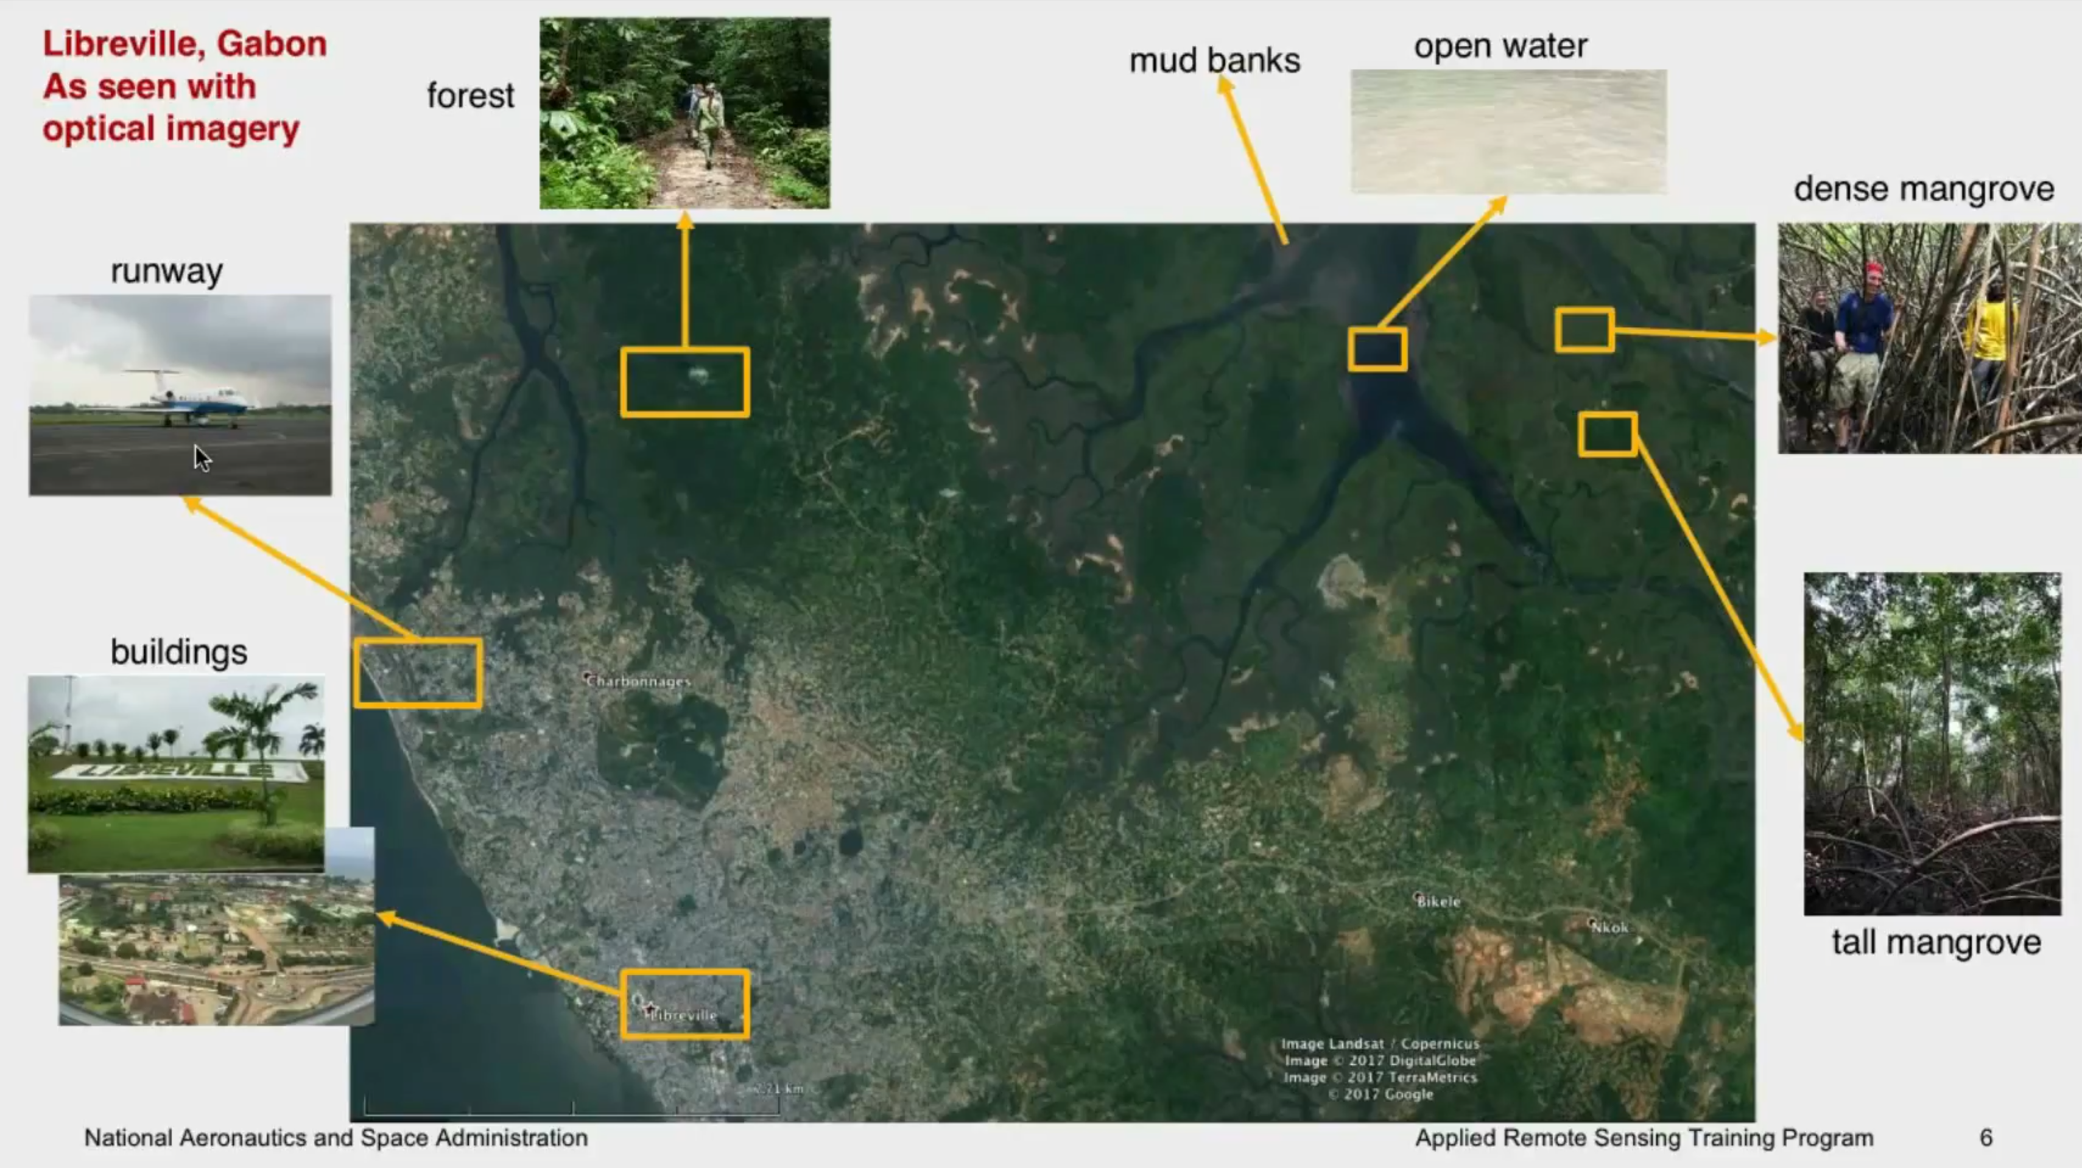
Notes:
Corresponding optical imagery. Note how the estuary branching is more detailed with the radar.

Slide 11
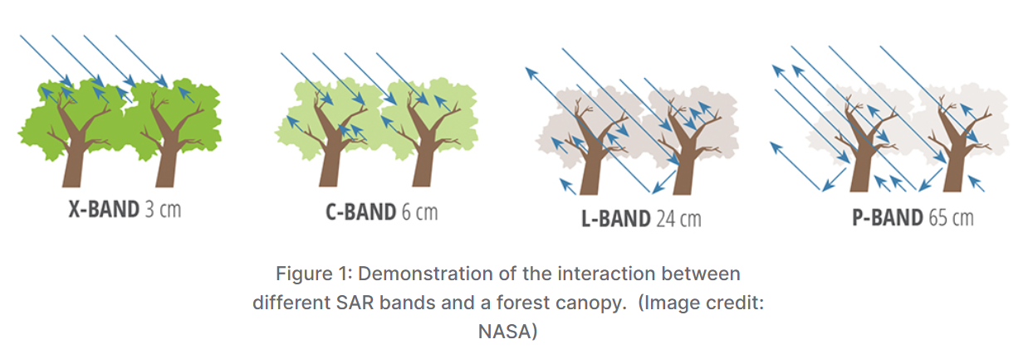
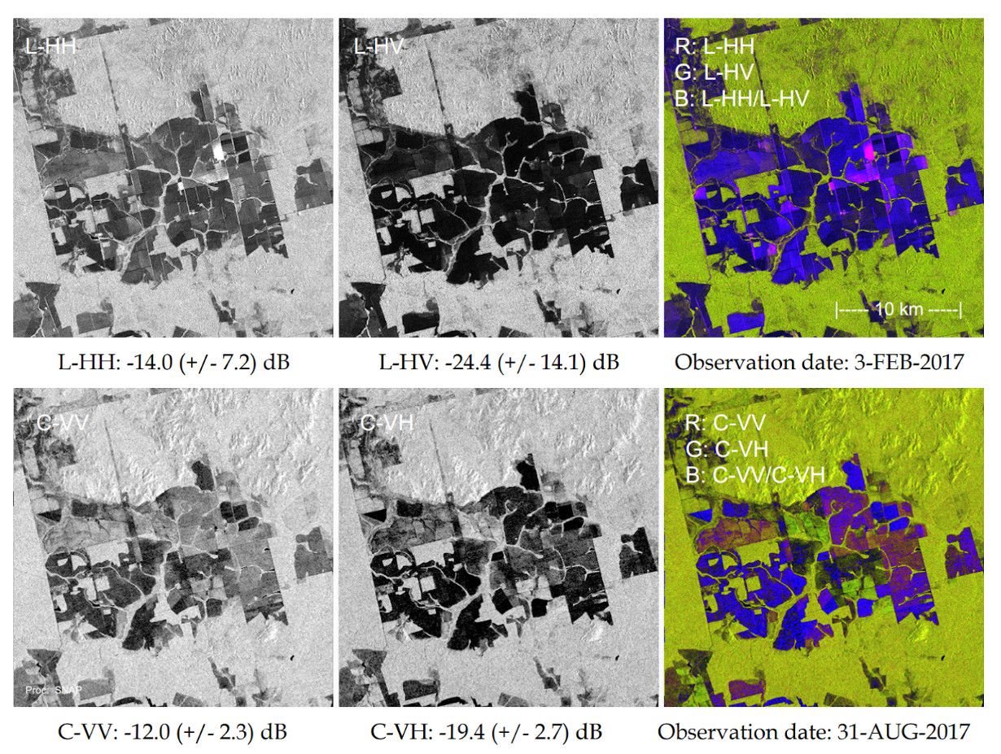
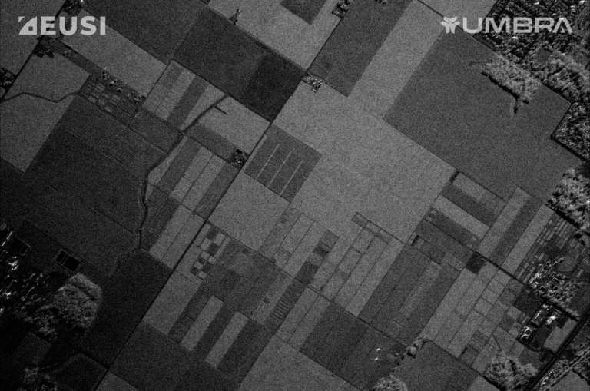
Notes:
As with polarimetric SAR, increasing the number of frequency bands can help estimate the sources of scattering and improve parameter estimation. This is common in soil moisture, biomass, and snow water equivalent measurements.

Slide 12
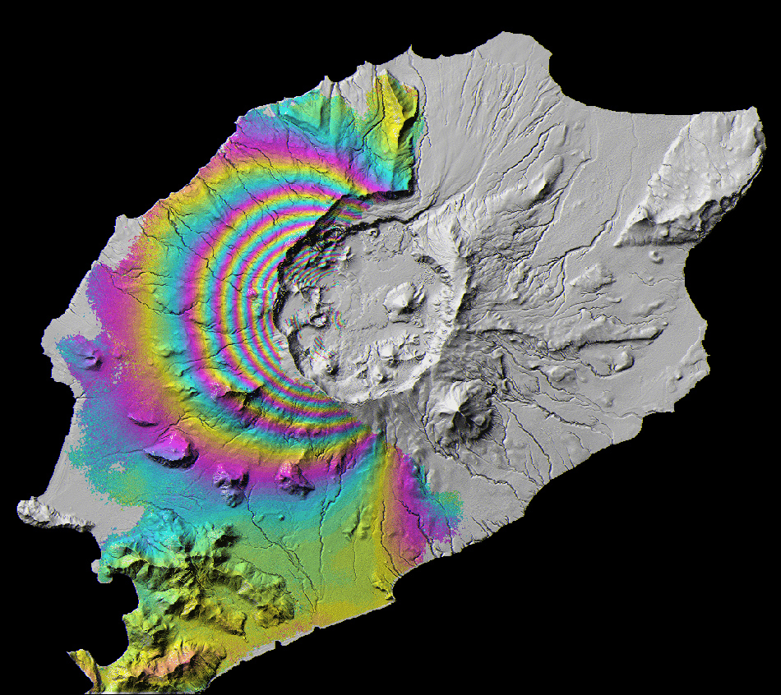
Notes:
Differential interferometric map to measure subsidence. Common uses are with volcanoes, earthquakes, mining, and ground water changes.

Slide 13
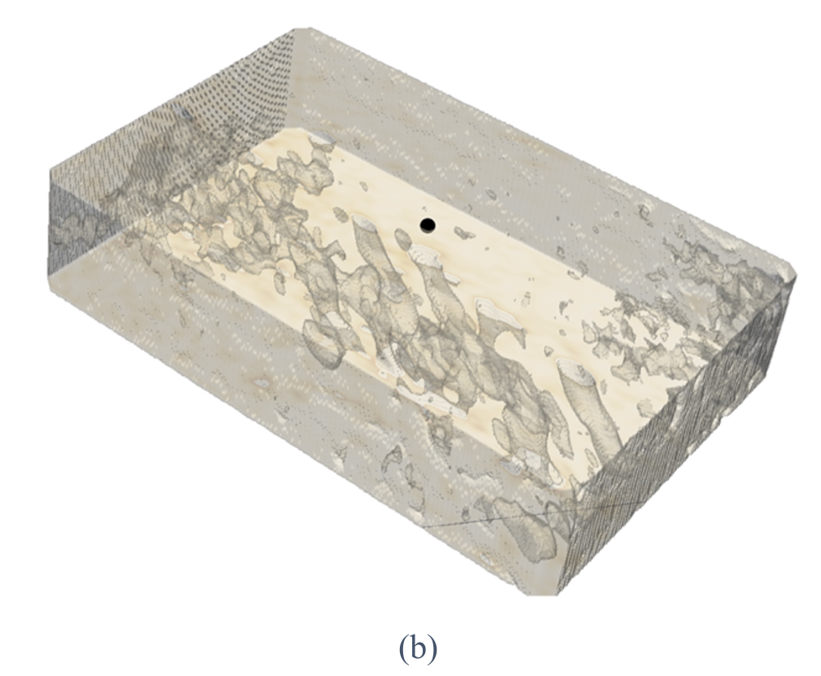
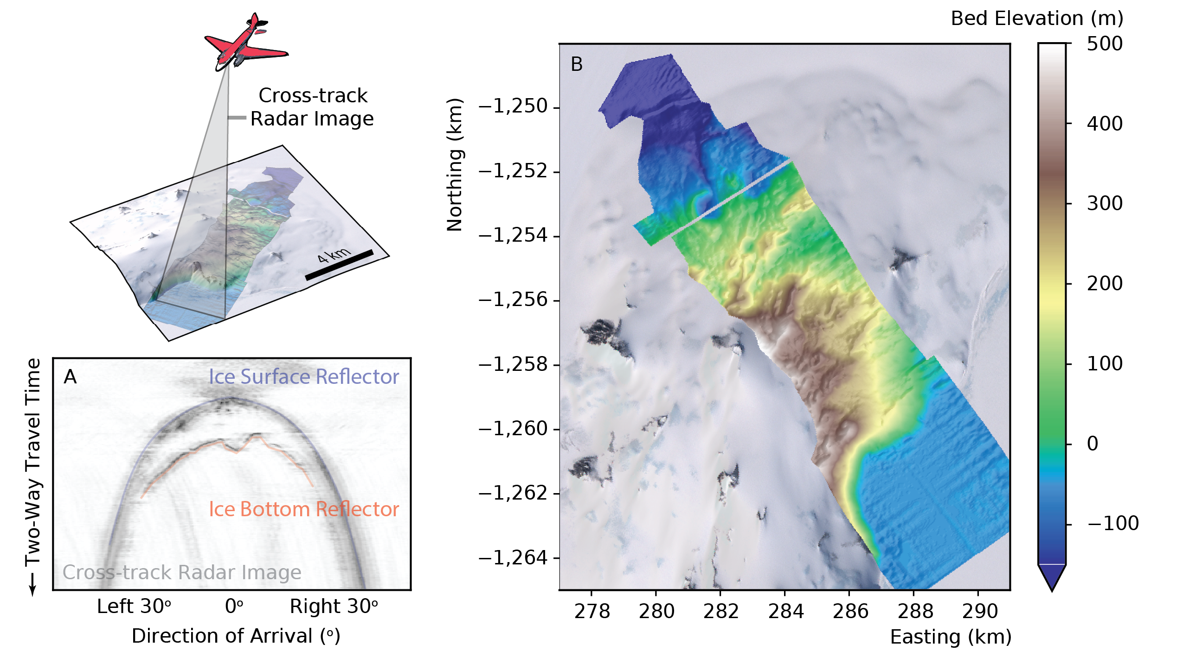
Notes:
SAR tomography or 3D imaging examples. Left is 3D imaging of an ice sheet with P-band 22-channel radar. Right is 3D imaging of wells in sandy/dry area in UAE with P-band drone flown in 2D grid.

Slide 14
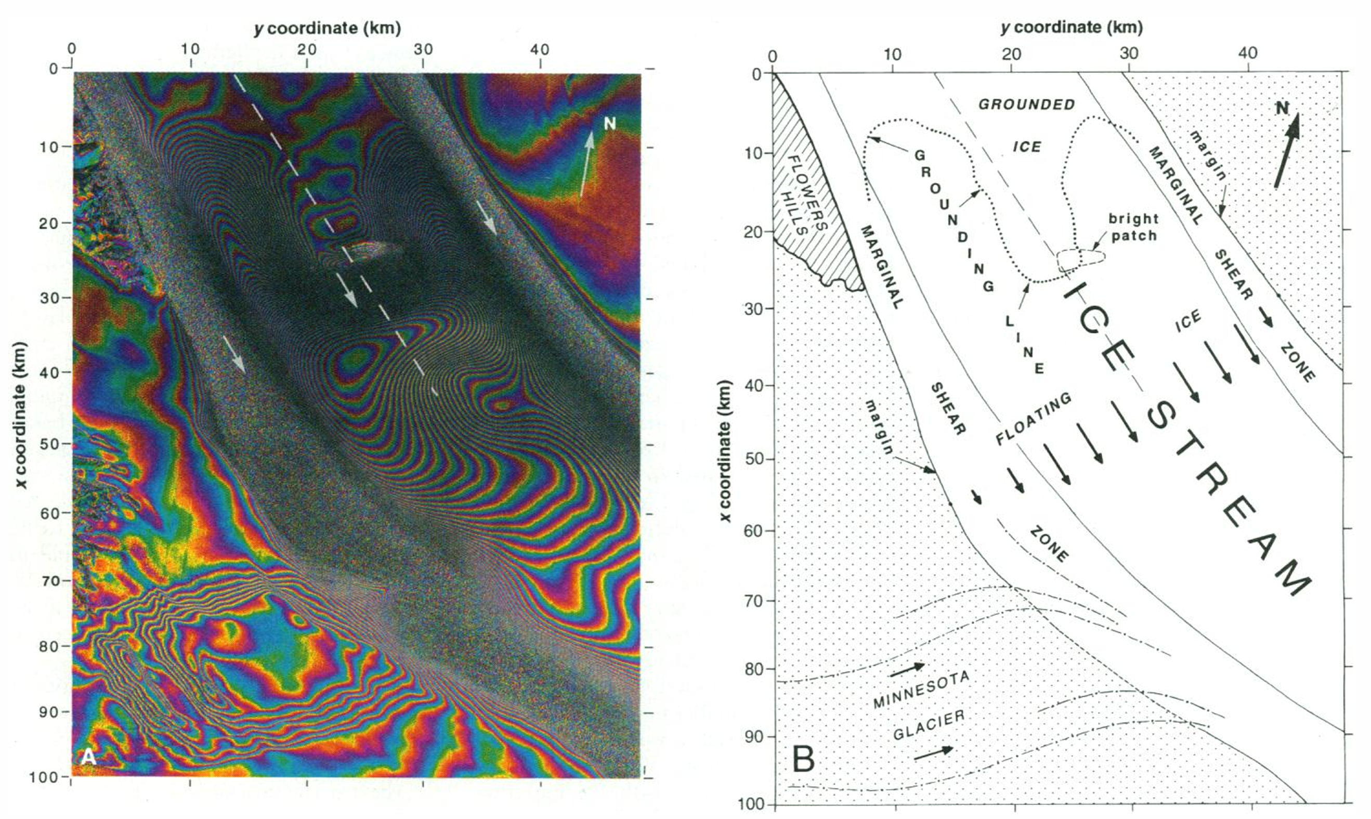
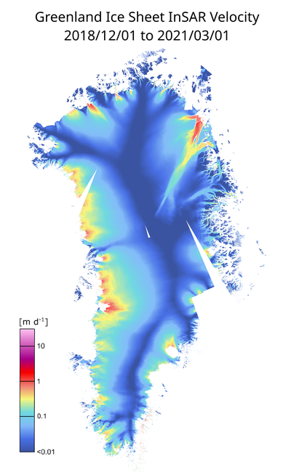
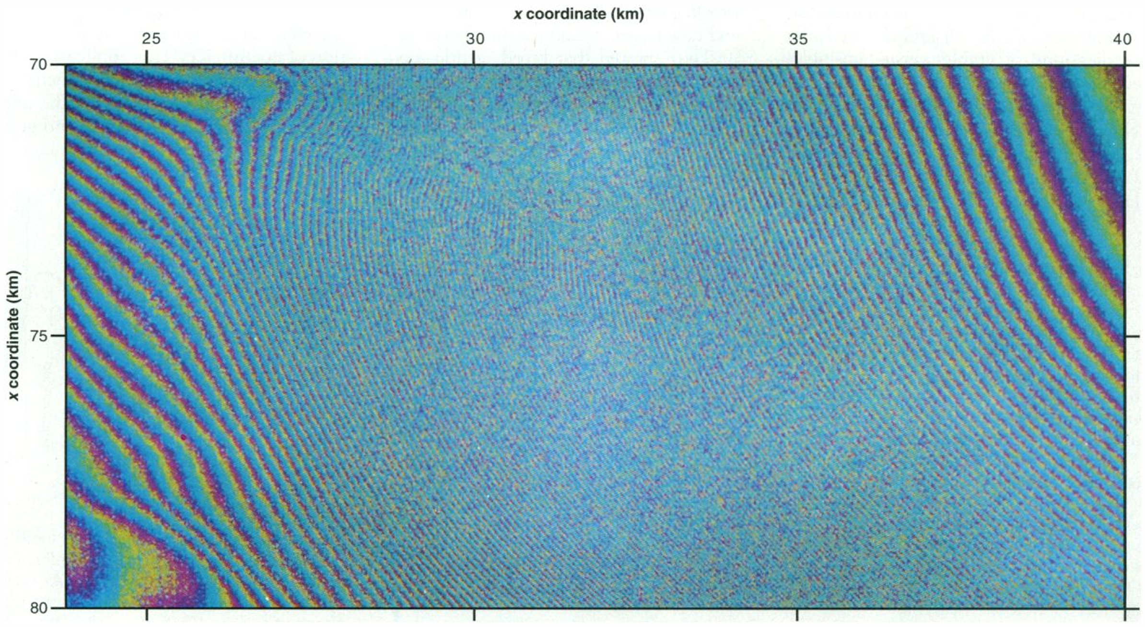
Notes:
Differential InSAR can also be used to infer horizontal velocity. Image of a flowing glacier are shown here. These velocity results can be stitched together to produce a map of the entire ice sheet as shown on the right.

Slide 15
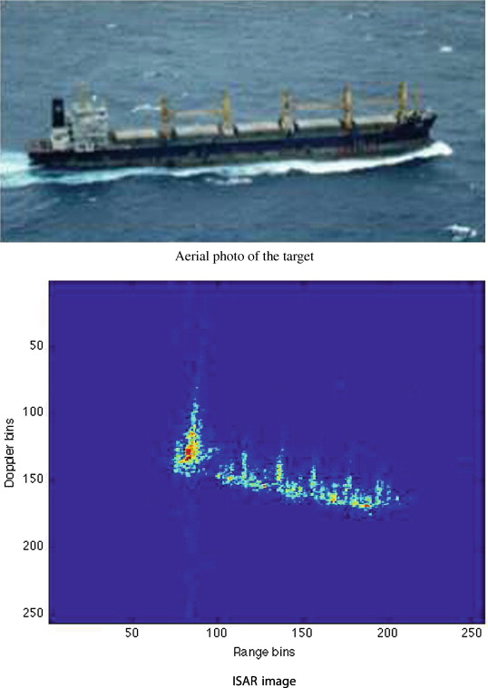
Notes:
“Inverse” SAR (ISAR). In this case, the radar is stationary and the ship moved past the radar. The relative motion (and different look angles) can be used to form SAR imagery.

Slide 16
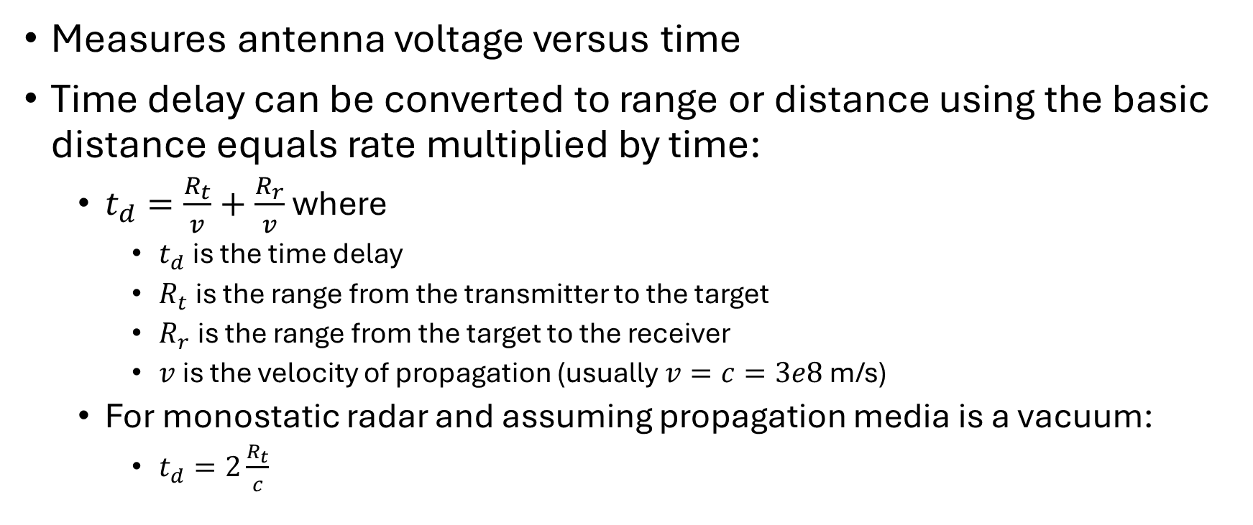
Radar Measures Voltage versus Time
Measures antenna voltage versus time
Time delay can be converted to range or distance using the basic distance equals rate multiplied by time:
  $t_{d}=\frac{R_{t}}{v}+\frac{R_{r}}{v}$ where
    $t_{d}$ is the time delay
    $R_{t}$ is the range from the transmitter to the target
    $R_{r}$ is the range from the target to the receiver
    $v$ is the velocity of propagation (usually $v=c=3e8$ m/s)
  For monostatic radar and assuming propagation media is a vacuum:
    $t_{d}=2\frac{R_{t}}{c}$

Slide 17
Radar Measures Voltage versus Time
Time can be measured using the bandwidth of the signal
Why bandwidth – what is its relationship with time resolution?
What is the challenge of making a very fine time resolution radar?
Notes:
Why bandwidth? Bandwidth controls the minimum time duration that is possible Time duration and bandwidth have a reciprocal relationship.
What is the problem with bandwidth? Hard to create wide bandwidth signals.

Slide 18
Radar Measures Voltage versus Time
Time can be measured using the carrier phase of the signal
What is the advantage of carrier phase over bandwidth?
What is the problem with phase?
Notes:
What is the problem with phase? 2 pi ambiguity

Slide 19
Radars Compare Voltage versus Time from Multiple Antenna Phase Centers
Measure azimuth angle (along-track, Doppler, wavenumber) by comparing voltage versus time at two different along-track positions.
Measure elevation angle (cross-track) by comparing voltage versus time at two different cross-track positions.

Slide 20
This class will explore algorithms to apply each of these resolving methods.
Measure Voltage versus Time
Measure azimuth angle (along-track, Doppler, wavenumber)
Measure elevation angle (cross-track)

Slide 21
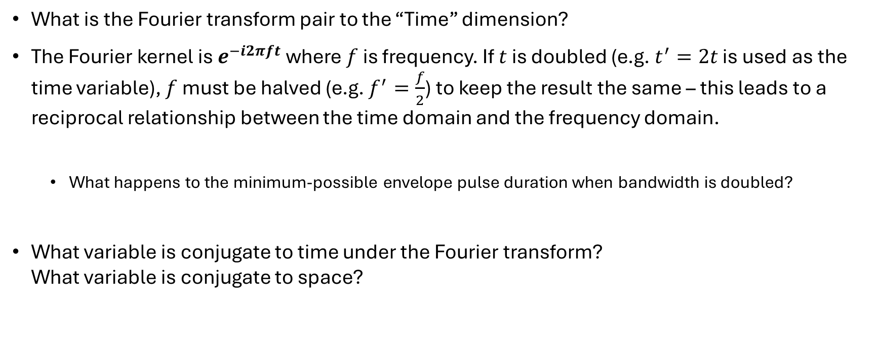
Fourier Thoughts
What is the Fourier transform pair to the “Time” dimension?
The Fourier kernel is $e^{−i2πft}$ where $f$ is frequency. If $t$ is doubled (e.g. $t^{′}=2t$ is used as the time variable), $f$ must be halved (e.g. $f^{′}=\frac{f}{2}$) to keep the result the same – this leads to a reciprocal relationship between the time domain and the frequency domain.
  What happens to the minimum-possible envelope pulse duration when bandwidth is doubled?
What variable is conjugate to time under the Fourier transform?
What variable is conjugate to space?
Notes:
What is the Fourier transform pair to the “Time” dimension? Frequency
What happens to the minimum-possible envelope pulse duration when bandwidth is doubled? Time duration of pulse can be halved.
What variable is conjugate to time under the Fourier transform? f or frequency
What variable is conjugate to space? k (or spatial frequency f)

Slide 22
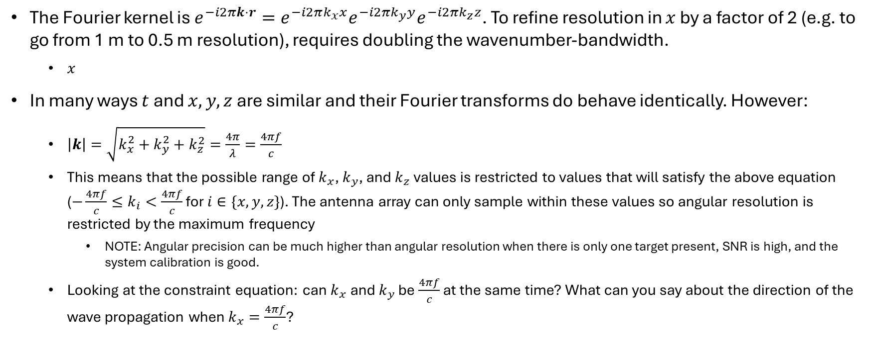
Fourier Thoughts
The Fourier kernel is $e^{−i2πk⋅r}=e^{−i2πk_{x}x}e^{−i2πk_{y}y}e^{−i2πk_{z}z}$. To refine resolution in $x$ by a factor of 2 (e.g. to go from 1 m to 0.5 m resolution), requires doubling the wavenumber-bandwidth.
  $x$
In many ways $t$ and $x,y,z$ are similar and their Fourier transforms do behave identically. However:
  $\left|k\right|=\sqrt{k_{x}^{2}+k_{y}^{2}+k_{z}^{2}}=\frac{4π}{λ}=\frac{4πf}{c}$
  This means that the possible range of $k_{x}$, $k_{y}$, and $k_{z}$ values is restricted to values that will satisfy the above equation ($−\frac{4πf}{c}≤k_{i}<\frac{4πf}{c}$ for $i∈\{x,y,z\}$). The antenna array can only sample within these values so angular resolution is restricted by the maximum frequency
    NOTE: Angular precision can be much higher than angular resolution when there is only one target present, SNR is high, and the system calibration is good.
  Looking at the constraint equation: can $k_{x}$ and $k_{y}$ be $\frac{4πf}{c}$ at the same time? What can you say about the direction of the wave propagation when $k_{x}=\frac{4πf}{c}$?
Notes:
Looking at the constraint equation: can $k_{x}$ and $k_{y}$ be $\frac{2πf}{c}$ at the same time? NO. If $k_{x}=\frac{2πf}{c}$, then $k_{y}=k_{z}=0$. What can you say about the direction of the wave propagation when $k_{x}=\frac{2πf}{c}$? The wave is travelling only in the x-direction with no y or z component.

Slide 23
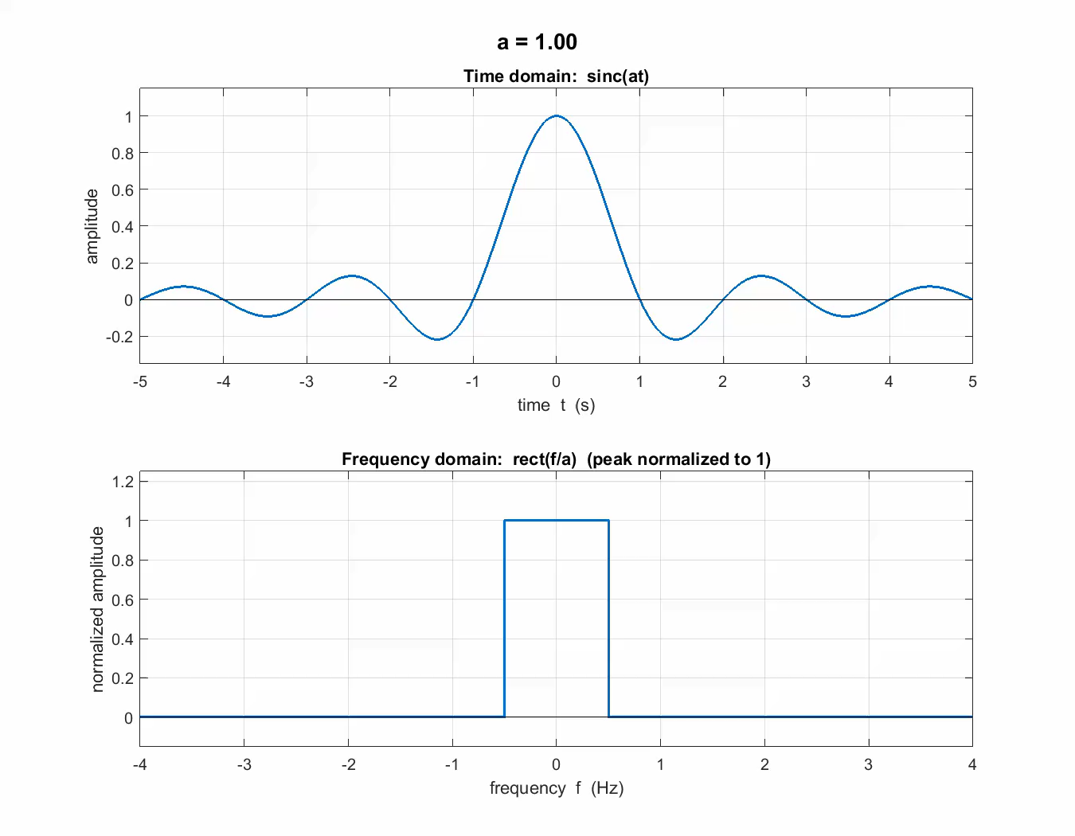
Fourier Thoughts

Slide 24
Fourier Thoughts: Antenna Aperture
So, how do we make an antenna aperture so that it can sample the required (hopefully large) wavenumber bandwidth?
Notes:
Antenna phase centers need to sample the entire wavenumber space of the target scattering function (i.e. the antenna phase centers need to be placed so that they sample the space which covers the full wavenumber bandwidth… show graphically)

Slide 25
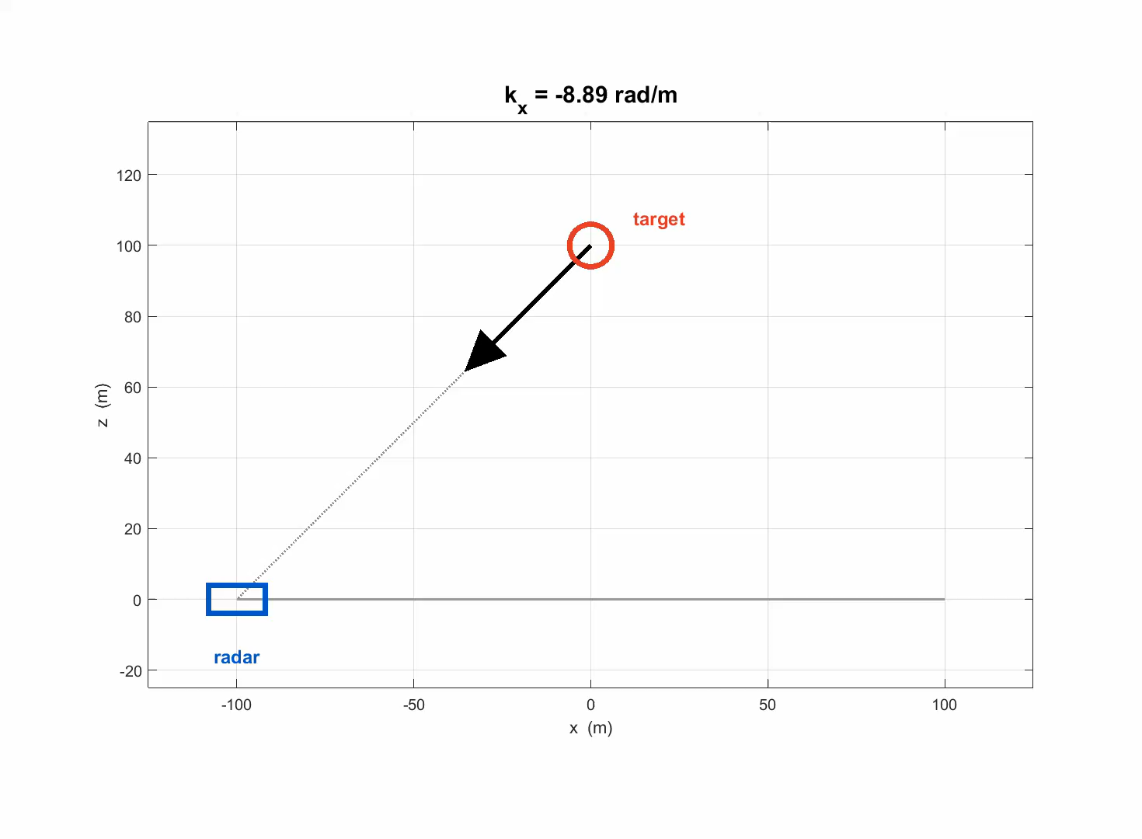
Fourier Thoughts: Antenna Aperture
Notes:
Antenna phase centers need to sample the entire wavenumber space of the target scattering function (i.e. the antenna phase centers need to be placed so that they sample the space which covers the full wavenumber bandwidth… show graphically)

Slide 26
Fourier Thoughts: Antenna Aperture
What if the required resolution means a 200 meter or 2000 m aperture?
How do we make such a big antenna aperture?
Notes:
What if the required resolution means a 200 meter or 2000 m aperture? SWAP or Size Weight and Power problem!
If the targets are stationary (or at least have predictable motion), use a small subset of antennas (could be 1 antenna) and move it around to each position. Slower and generally requires targets to be stationary.
Other interesting ideas to form a big aperture?

Slide 27


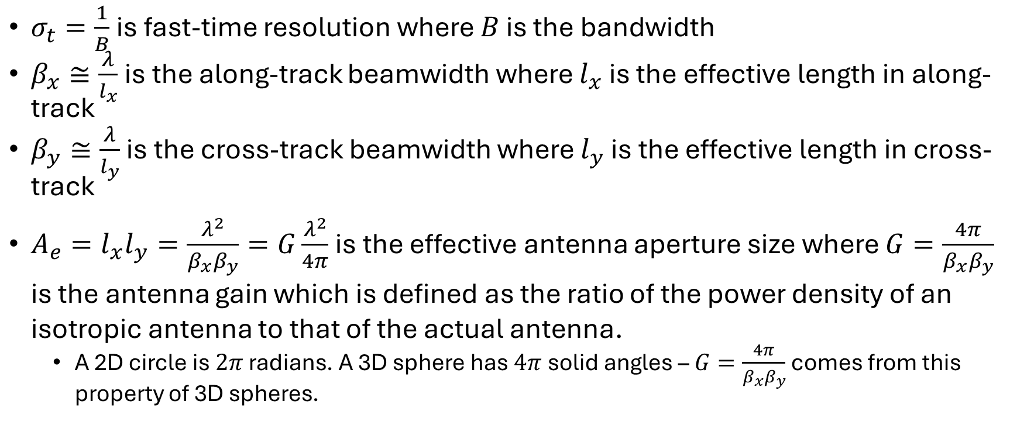
Fourier Thoughts
$σ_{t}=\frac{1}{B}$ is fast-time resolution where $B$ is the bandwidth
$β_{x}≅\frac{λ}{l_{x}}$ is the along-track beamwidth where $l_{x}$ is the effective length in along-track
$β_{y}≅\frac{λ}{l_{y}}$ is the cross-track beamwidth where $l_{y}$ is the effective length in cross-track
$A_{e}=l_{x}l_{y}=\frac{λ^{2}}{β_{x}β_{y}}=G\frac{λ^{2}}{4π}$ is the effective antenna aperture size where $G=\frac{4π}{β_{x}β_{y}}$ is the antenna gain which is defined as the ratio of the power density of an isotropic antenna to that of the actual antenna.
  A 2D circle is $2π$ radians. A 3D sphere has $4π$ solid angles – $G=\frac{4π}{β_{x}β_{y}}$ comes from this property of 3D spheres.

Slide 28
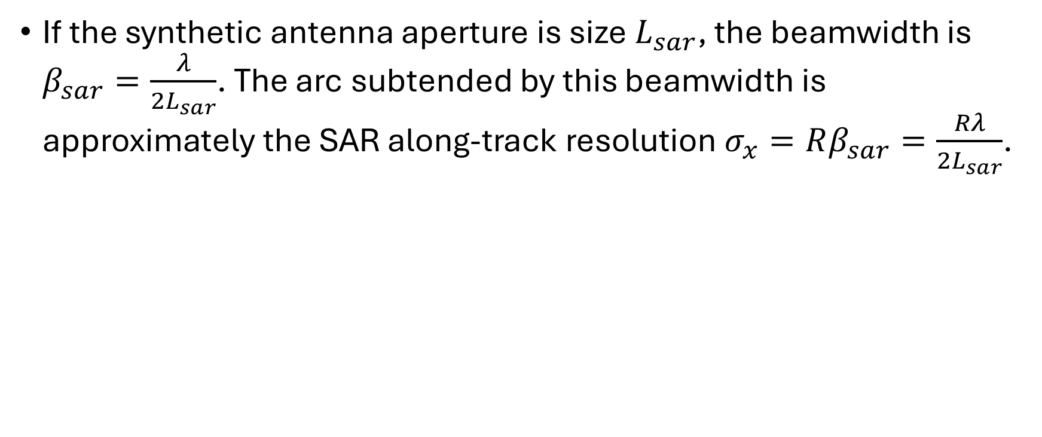
Fourier Thoughts
If the synthetic antenna aperture is size $L_{sar}$, the beamwidth is $β_{sar}=\frac{λ}{2L_{sar}}$. The arc subtended by this beamwidth is approximately the SAR along-track resolution $σ_{x}=Rβ_{sar}=\frac{Rλ}{2L_{sar}}$.

Slide 29
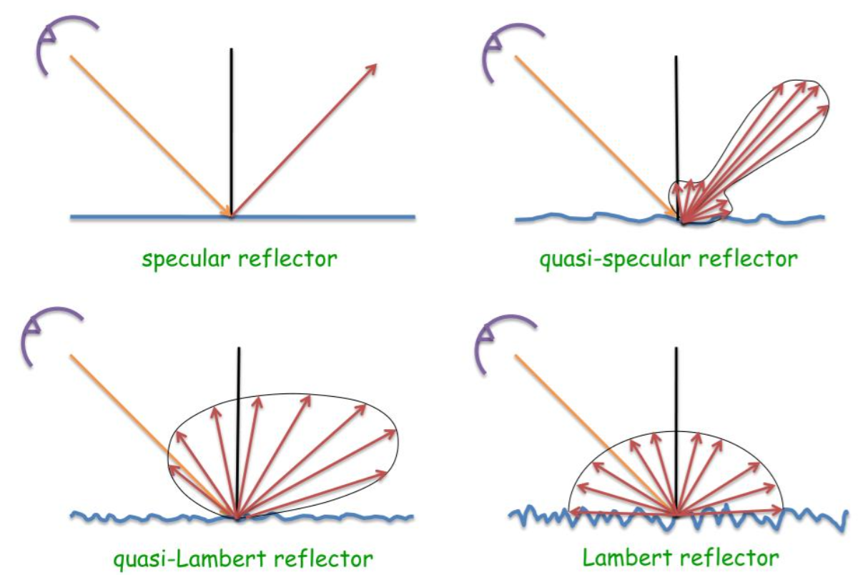
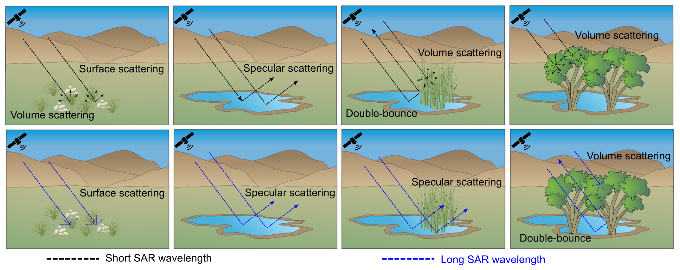
Scattering
What is forward scatter?
What is backscatter?
What is specular scattering?
What is nonspecular scattering?
What is coherent scattering?
What is incoherent scattering?
Notes:
Specular scattering is like a mirror
Rough surface, volume, and double bounce are all non-specular scattering.
Coherent means scattering is predictable as a function of angle
Incoherent or diffuse means scattering is not predictable as a function of angle
Specular scattering and double bounce are coherent scattering
Rough surface and volume scattering are incoherent scattering

Slide 30


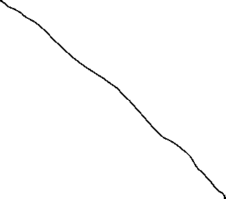


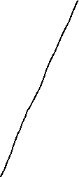
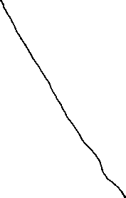




System Geometry: Before SAR

Slide 31





System Geometry: After SAR

Slide 32


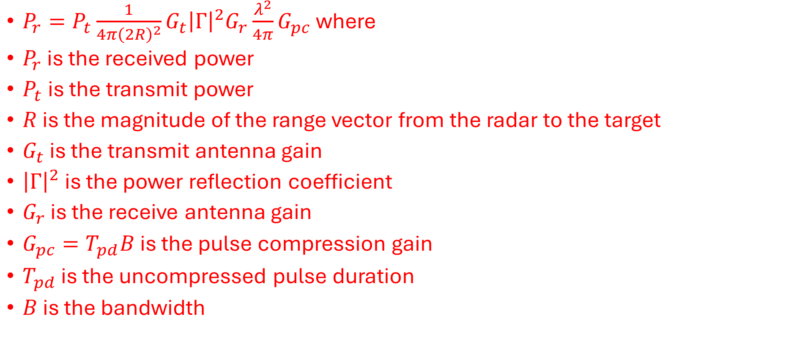



Radar Equation: Specular Target → What is received power?
$P_{r}=P_{t}\frac{1}{4π{\left(2R\right)}^{2}}G_{t}{\left|Γ\right|}^{2}G_{r}\frac{λ^{2}}{4π}G_{pc}$ where
$P_{r}$ is the received power
$P_{t}$ is the transmit power
$R$ is the magnitude of the range vector from the radar to the target
$G_{t}$ is the transmit antenna gain
${\left|Γ\right|}^{2}$ is the power reflection coefficient
$G_{r}$ is the receive antenna gain
$G_{pc}=T_{pd}B$ is the pulse compression gain
$T_{pd}$ is the uncompressed pulse duration
$B$ is the bandwidth

Slide 33
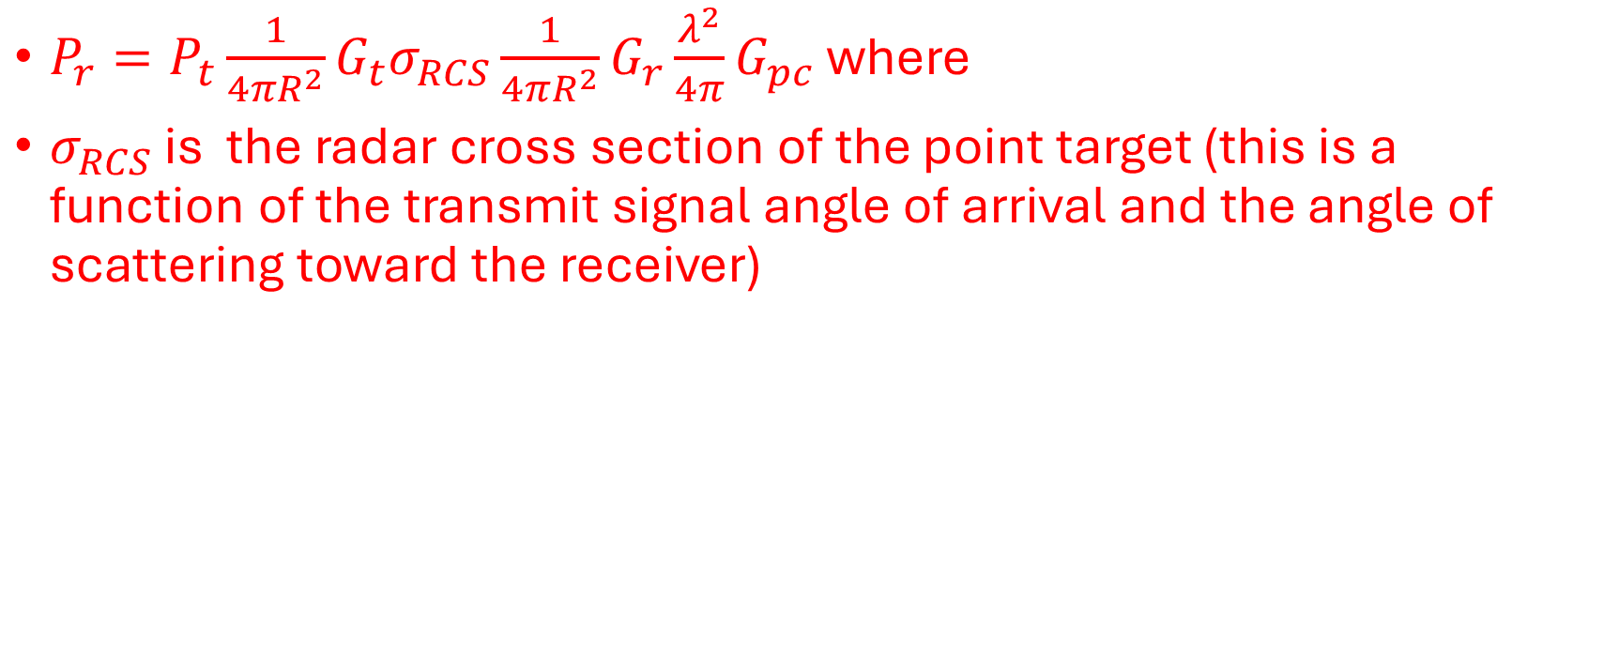
Radar Equation: Point Target
$P_{r}=P_{t}\frac{1}{4πR^{2}}G_{t}σ_{RCS}\frac{1}{4πR^{2}}G_{r}\frac{λ^{2}}{4π}G_{pc}$ where
$σ_{RCS}$ is the radar cross section of the point target (this is a function of the transmit signal angle of arrival and the angle of scattering toward the receiver)

Slide 34


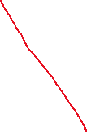


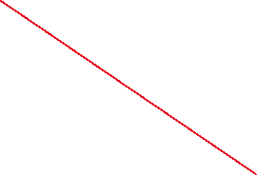



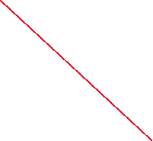
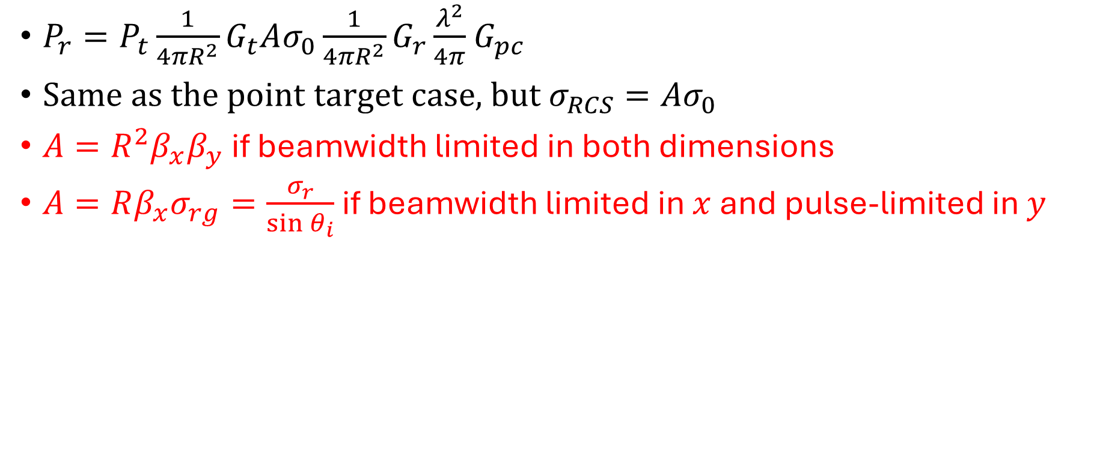


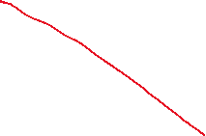


Radar Equation: Area or Distributed Target
$P_{r}=P_{t}\frac{1}{4πR^{2}}G_{t}Aσ_{0}\frac{1}{4πR^{2}}G_{r}\frac{λ^{2}}{4π}$ $G_{pc}$
Same as the point target case, but $σ_{RCS}=Aσ_{0}$
$A=R^{2}β_{x}β_{y}$ if beamwidth limited in both dimensions
$A=Rβ_{x}σ_{rg}=\frac{σ_{r}}{\sin{θ_{i}}}$ if beamwidth limited in $x$ and pulse-limited in $y$

Slide 35
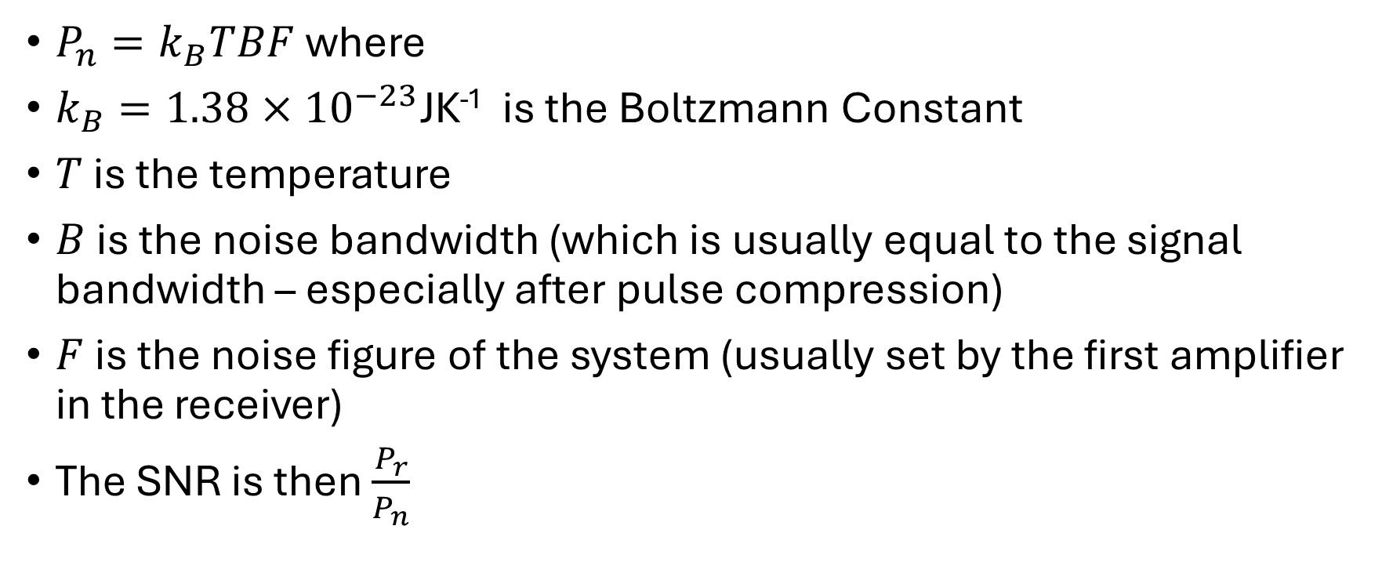
Radar Equation: Link Budget
$P_{n}=k_{B}TBF$ where
$k_{B}=1.38×{10}^{−23}$JK⁻¹ is the Boltzmann Constant
$T$ is the temperature
$B$ is the noise bandwidth (which is usually equal to the signal bandwidth – especially after pulse compression)
$F$ is the noise figure of the system (usually set by the first amplifier in the receiver)
The SNR is then $\frac{P_{r}}{P_{n}}$

Slide 36
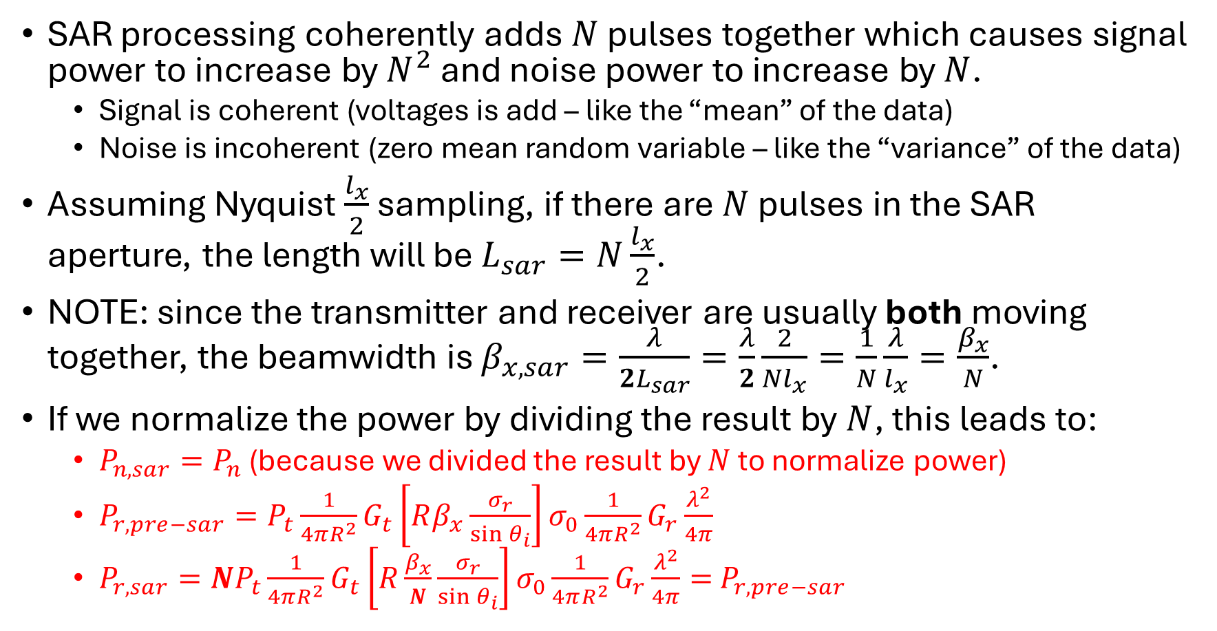

Radar Equation: Link Budget SAR
SAR processing coherently adds $N$ pulses together which causes signal power to increase by $N^{2}$ and noise power to increase by $N$.
  Signal is coherent (voltages is add – like the “mean” of the data)
  Noise is incoherent (zero mean random variable – like the “variance” of the data)
Assuming Nyquist $\frac{l_{x}}{2}$ sampling, if there are $N$ pulses in the SAR aperture, the length will be $L_{sar}=N\frac{l_{x}}{2}$.
NOTE: since the transmitter and receiver are usually both moving together, the beamwidth is $β_{x,sar}=\frac{λ}{2L_{sar}}=\frac{λ}{2}\frac{2}{Nl_{x}}=\frac{1}{N}\frac{λ}{l_{x}}=\frac{β_{x}}{N}$.
If we normalize the power by dividing the result by $N$, this leads to:
  $P_{n,sar}=P_{n}$ (because we divided the result by $N$ to normalize power)
  $P_{r,pre−sar}=P_{t}\frac{1}{4πR^{2}}G_{t}\left[Rβ_{x}\frac{σ_{r}}{\sin{θ_{i}}}\right]σ_{0}\frac{1}{4πR^{2}}G_{r}\frac{λ^{2}}{4π}$
  $P_{r,sar}=NP_{t}\frac{1}{4πR^{2}}G_{t}\left[R\frac{β_{x}}{N}\frac{σ_{r}}{\sin{θ_{i}}}\right]σ_{0}\frac{1}{4πR^{2}}G_{r}\frac{λ^{2}}{4π}=$ $P_{r,pre−sar}$

Slide 37
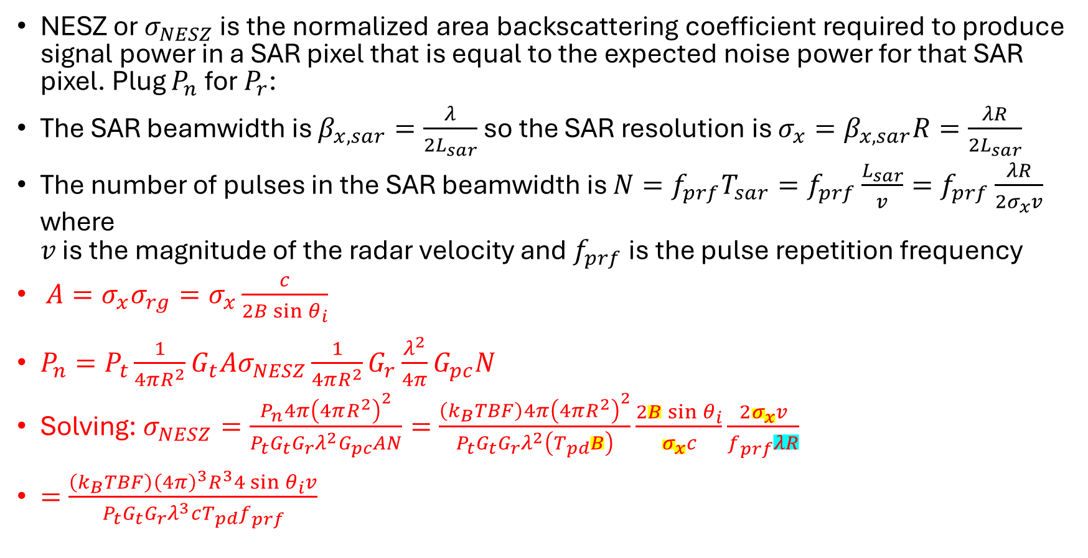
Radar Equation: Noise Equivalent Sigma Zero
NESZ or $σ_{NESZ}$ is the normalized area backscattering coefficient required to produce signal power in a SAR pixel that is equal to the expected noise power for that SAR pixel. Plug $P_{n}$ for $P_{r}$:
The SAR beamwidth is $β_{x,sar}=\frac{λ}{2L_{sar}}$ so the SAR resolution is $σ_{x}=β_{x,sar}R=\frac{λR}{2L_{sar}}$
The number of pulses in the SAR beamwidth is $N=f_{prf}T_{sar}=f_{prf}\frac{L_{sar}}{v}=f_{prf}\frac{λR}{2σ_{x}v}$ where
$v$ is the magnitude of the radar velocity and $f_{prf}$ is the pulse repetition frequency
$A=σ_{x}σ_{rg}=σ_{x}\frac{c}{2B\sin{θ_{i}}}$
$P_{n}=P_{t}\frac{1}{4πR^{2}}G_{t}Aσ_{NESZ}\frac{1}{4πR^{2}}G_{r}\frac{λ^{2}}{4π}G_{pc}N$
Solving:$σ_{NESZ}=\frac{P_{n}4π{\left(4πR^{2}\right)}^{2}}{P_{t}G_{t}G_{r}λ^{2}G_{pc}AN}=\frac{\left(k_{B}TBF\right)4π{\left(4πR^{2}\right)}^{2}}{P_{t}G_{t}G_{r}λ^{2}\left(T_{pd}B\right)}\frac{2B\sin{θ_{i}}}{σ_{x}c}\frac{2σ_{x}v}{f_{prf}λR}$
$=\frac{\left(k_{B}TBF\right){\left(4π\right)}^{3}R^{3}4\sin{θ_{i}}v}{P_{t}G_{t}G_{r}λ^{3}cT_{pd}f_{prf}}$

Slide 38
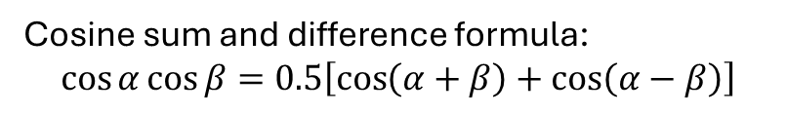
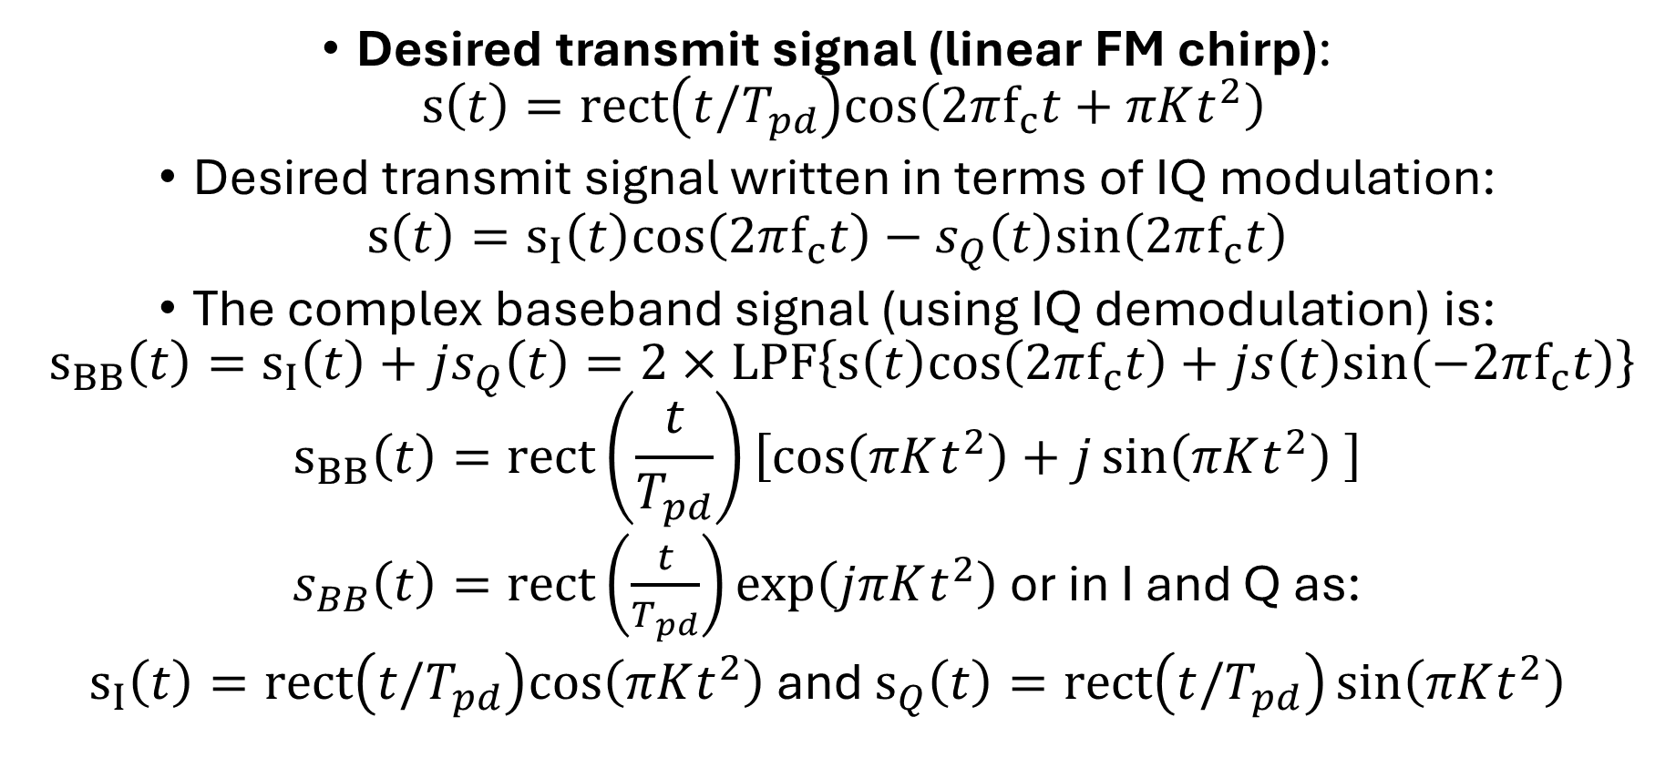
Complex Baseband Representation
Cosine sum and difference formula:
$$\cos{α}\cos{β}=0.5\left[\cos\left(α+β\right)+\cos\left(α−β\right)\right]$$
Desired transmit signal (linear FM chirp):
$s\left(t\right)=rect\left(t/T_{pd}\right)cos\left(2πf_{c}t+πKt^{2}\right)$
Desired transmit signal written in terms of IQ modulation:
$$s\left(t\right)=s_{I}\left(t\right)cos\left(2πf_{c}t\right)−s_{Q}\left(t\right)sin\left(2πf_{c}t\right)$$
The complex baseband signal (using IQ demodulation) is:
$s_{BB}\left(t\right)=s_{I}\left(t\right)+js_{Q}\left(t\right)=2×LPF\left\{s\left(t\right)cos\left(2πf_{c}t\right)+js\left(t\right)sin\left(−2πf_{c}t\right)\right\}$
$$s_{BB}\left(t\right)=rect\left(\frac{t}{T_{pd}}\right)\left[cos\left(πKt^{2}\right)+j\sin\left(πKt^{2}\right) \right]$$
$s_{BB}\left(t\right)=\text{rect}\left(\frac{t}{T_{pd}}\right)\exp\left(jπKt^{2}\right)$ or in I and Q as:
$s_{I}\left(t\right)=rect\left(t/T_{pd}\right)cos\left(πKt^{2}\right)$ and $s_{Q}\left(t\right)=rect\left(t/T_{pd}\right)\sin\left(πKt^{2}\right)$

Slide 39
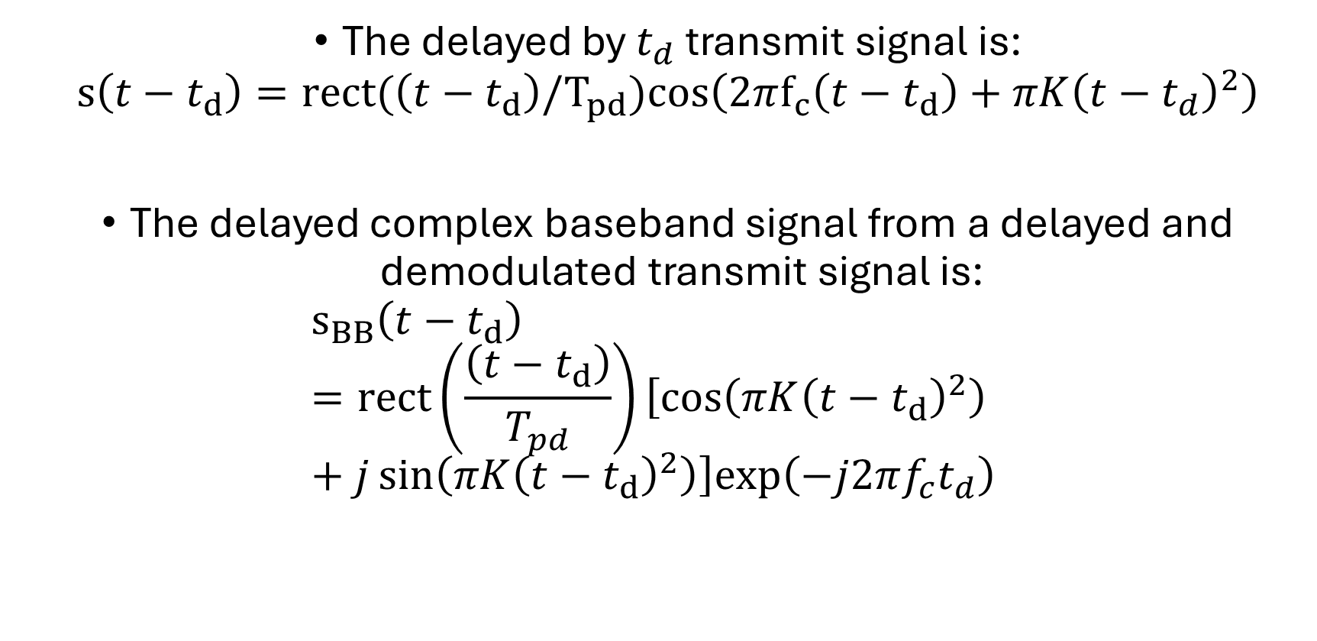
Complex Baseband Representation
The delayed by $t_{d}$ transmit signal is:
$s\left(t−t_{d}\right)=rect(\left(t−t_{d}\right)/T_{pd})cos\left(2πf_{c}\left(t−t_{d}\right)+πK{\left(t−t_{d}\right)}^{2}\right)$
The delayed complex baseband signal from a delayed and demodulated transmit signal is:
$s_{BB}\left(t−t_{d}\right)=rect\left(\frac{\left(t−t_{d}\right)}{T_{pd}}\right)\left[cos\left(πK{\left(t−t_{d}\right)}^{2}\right)+j\sin\left(πK{\left(t−t_{d}\right)}^{2}\right)\right]exp\left(−j2πf_{c}t_{d}\right)$

Slide 40
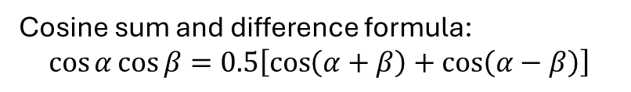
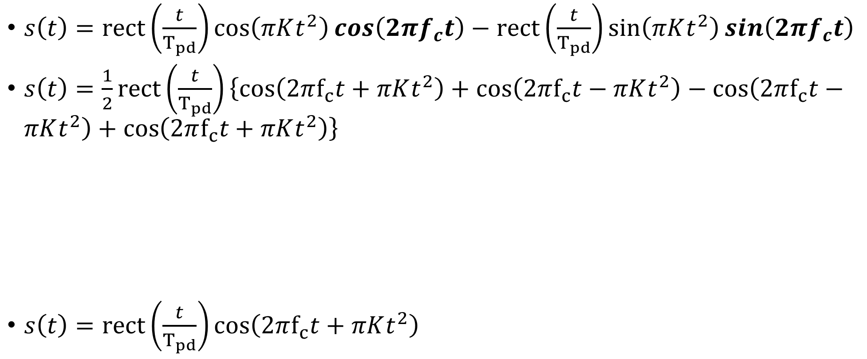
Complex Baseband Representation:
RF signal from Baseband (IQ modulation)
$s\left(t\right)=rect\left(\frac{t}{T_{pd}}\right)cos\left(πKt^{2}\right)\cos\left(2πf_{c}t\right)−rect\left(\frac{t}{T_{pd}}\right)sin\left(πKt^{2}\right)\sin\left(2πf_{c}t\right)$
$s\left(t\right)=\frac{1}{2}rect\left(\frac{t}{T_{pd}}\right)\left\{cos\left(2πf_{c}t+πKt^{2}\right)+cos\left(2πf_{c}t−πKt^{2}\right)−\cos\left(2πf_{c}t−πKt^{2}\right)+\cos\left(2πf_{c}t+πKt^{2}\right)\right\}$
$s\left(t\right)=rect\left(\frac{t}{T_{pd}}\right)cos\left(2πf_{c}t+πKt^{2}\right)$
Cosine sum and difference formula:
$$\cos{α}\cos{β}=0.5\left[\cos\left(α+β\right)+\cos\left(α−β\right)\right]$$

Slide 41
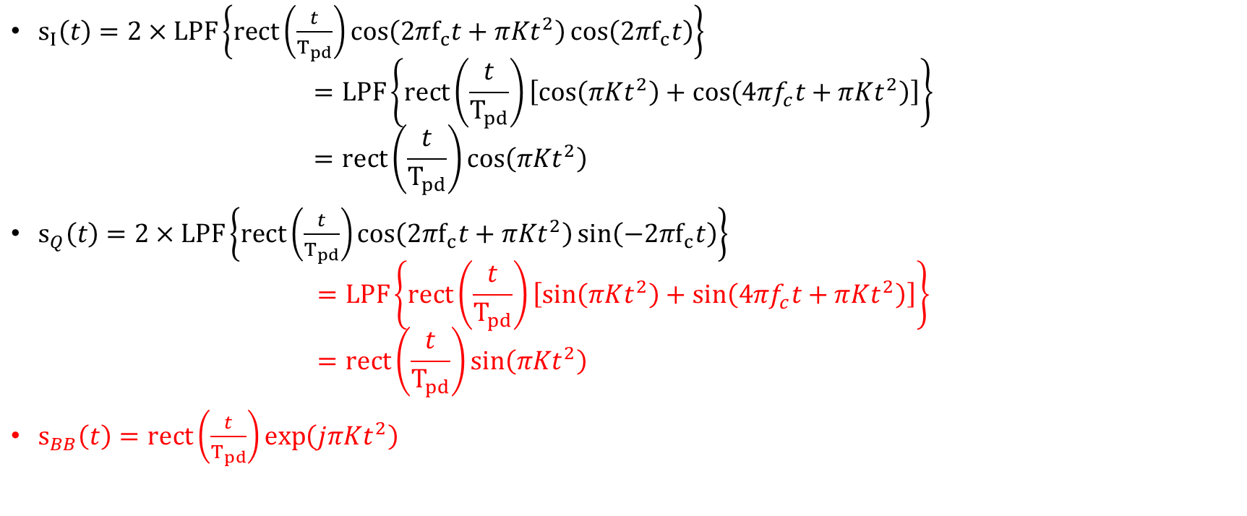
Complex Baseband Representation:
Baseband from RF signal (IQ demodulation)
$s_{I}\left(t\right)=2×LPF\left\{rect\left(\frac{t}{T_{pd}}\right)cos\left(2πf_{c}t+πKt^{2}\right)\cos\left(2πf_{c}t\right)\right\}$
$=LPF\left\{rect\left(\frac{t}{T_{pd}}\right)\left[cos\left(πKt^{2}\right)+cos\left(4πf_{c}t+πKt^{2}\right)\right]\right\}$
$=rect\left(\frac{t}{T_{pd}}\right)cos\left(πKt^{2}\right)$
$s_{Q}\left(t\right)=2×LPF\left\{rect\left(\frac{t}{T_{pd}}\right)cos\left(2πf_{c}t+πKt^{2}\right)\sin\left(−2πf_{c}t\right)\right\}$
$=LPF\left\{rect\left(\frac{t}{T_{pd}}\right)\left[sin\left(πKt^{2}\right)+sin\left(4πf_{c}t+πKt^{2}\right)\right]\right\}$
$=rect\left(\frac{t}{T_{pd}}\right)sin\left(πKt^{2}\right)$
$s_{BB}\left(t\right)=rect\left(\frac{t}{T_{pd}}\right)\exp\left(jπKt^{2}\right)$

Slide 42
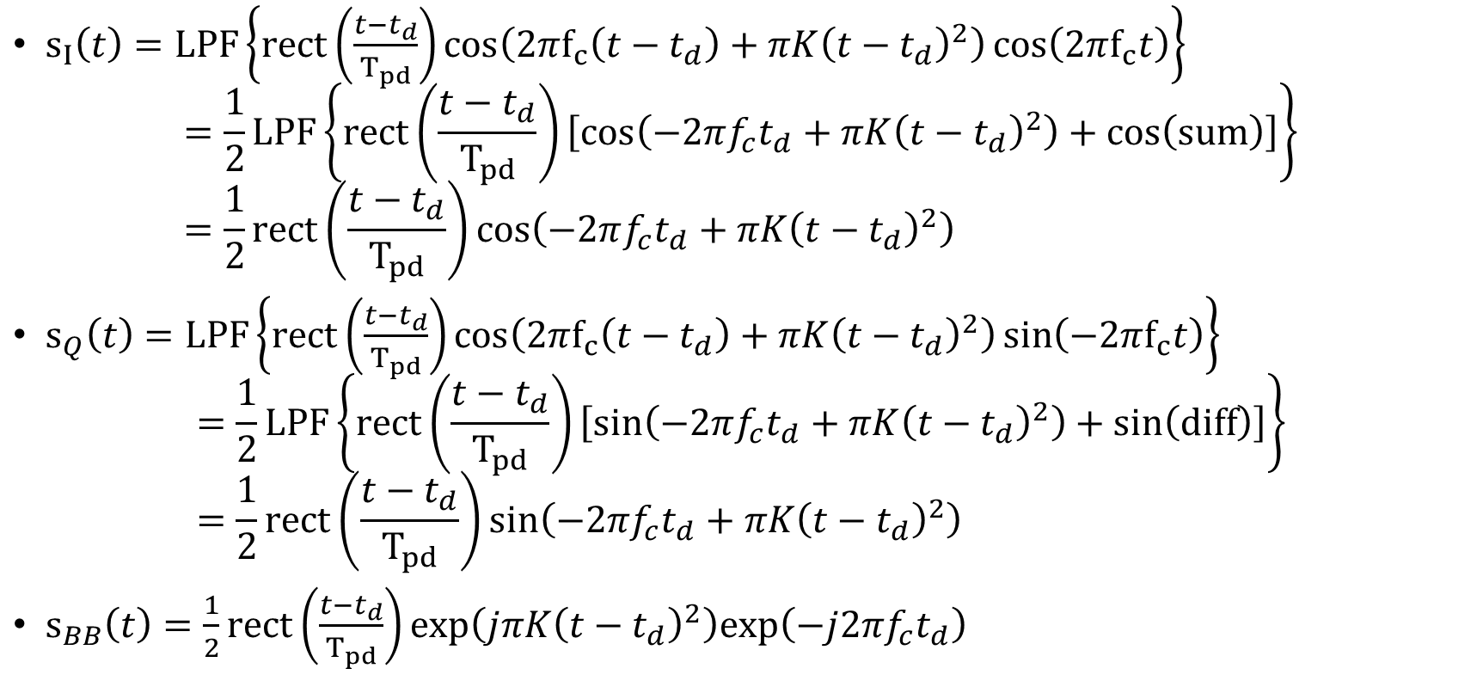
Complex Baseband Representation:
Baseband from delayed RF signal (IQ demodulation)
$s_{I}\left(t\right)=LPF\left\{rect\left(\frac{t−t_{d}}{T_{pd}}\right)cos\left(2πf_{c}\left(t−t_{d}\right)+πK{\left(t−t_{d}\right)}^{2}\right)\cos\left(2πf_{c}t\right)\right\}$
$=\frac{1}{2}LPF\left\{rect\left(\frac{t−t_{d}}{T_{pd}}\right)\left[cos\left(−2πf_{c}t_{d}+πK{\left(t−t_{d}\right)}^{2}\right)+cos\left(sum\right)\right]\right\}$
$=\frac{1}{2}rect\left(\frac{t−t_{d}}{T_{pd}}\right)cos\left(−2πf_{c}t_{d}+πK{\left(t−t_{d}\right)}^{2}\right)$
$s_{Q}\left(t\right)=LPF\left\{rect\left(\frac{t−t_{d}}{T_{pd}}\right)cos\left(2πf_{c}\left(t−t_{d}\right)+πK{\left(t−t_{d}\right)}^{2}\right)\sin\left(−2πf_{c}t\right)\right\}$
$=\frac{1}{2}LPF\left\{rect\left(\frac{t−t_{d}}{T_{pd}}\right)\left[sin\left(−2πf_{c}t_{d}+πK{\left(t−t_{d}\right)}^{2}\right)+sin\left(diff\right)\right]\right\}$
$=\frac{1}{2}rect\left(\frac{t−t_{d}}{T_{pd}}\right)sin\left(−2πf_{c}t_{d}+πK{\left(t−t_{d}\right)}^{2}\right)$
$s_{BB}\left(t\right)=\frac{1}{2}rect\left(\frac{t−t_{d}}{T_{pd}}\right)exp\left(jπK{\left(t−t_{d}\right)}^{2}\right)exp\left(−j2πf_{c}t_{d}\right)$

Slide 43


Generalized signal $A\left(t\right)cos\left(2πf_{c}t+θ\left(t\right)\right)$:
Baseband from RF signal (IQ demodulation)
System Geometry and Signal Model:
$s_{I}\left(t\right)=LPF\left\{A\left(t\right)cos\left(2πf_{c}t+θ\left(t\right)\right)\cos\left(2πf_{c}t\right)\right\}$
$=\frac{1}{2}LPF\left\{A\left(t\right)\left[cos\left(θ\left(t\right)\right)+cos\left(4πf_{c}t+θ\left(t\right)\right)\right]\right\}$
$=\frac{1}{2}A\left(t\right)cos\left(θ\left(t\right)\right)$
$s_{Q}\left(t\right)=LPF\left\{A\left(t\right)cos\left(2πf_{c}t+θ\left(t\right)\right)\sin\left(−2πf_{c}t\right)\right\}$
$=\frac{1}{2}LPF\left\{A\left(t\right)\left[sin\left(θ\left(t\right)\right)−sin\left(4πf_{c}t+θ\left(t\right)\right)\right]\right\}$
$=\frac{1}{2}A\left(t\right)sin\left(θ\left(t\right)\right)$
$s_{BB}\left(t\right)=\frac{1}{2}A\left(t\right)\exp\left(jθ\left(t\right)\right)$

Slide 44


Generalized delayed signal $A\left(t−t_{d}\right)cos\left(2πf_{c}\left(t−t_{d}\right)+θ\left(t−t_{d}\right)\right)$:
Baseband from RF signal (IQ demodulation)
System Geometry and Signal Model:
$s_{I}\left(t\right)=LPF\left\{A\left(t−t_{d}\right)cos\left(2πf_{c}\left(t−t_{d}\right)+θ\left(t−t_{d}\right)\right)\cos\left(2πf_{c}t\right)\right\}$
$=\frac{1}{2}LPF\left\{A\left(t−t_{d}\right)\left[cos\left(−2πf_{c}t_{d}+θ\left(t−t_{d}\right)\right)+cos\left(sum\right)\right]\right\}$
$=\frac{1}{2}A\left(t−t_{d}\right)cos\left(−2πf_{c}t_{d}+θ\left(t−t_{d}\right)\right)$
$s_{Q}\left(t\right)=LPF\left\{A\left(t−t_{d}\right)cos\left(2πf_{c}\left(t−t_{d}\right)+θ\left(t−t_{d}\right)\right)\sin\left(−2πf_{c}t\right)\right\}$
$=\frac{1}{2}LPF\left\{A\left(t−t_{d}\right)\left[sin\left(−2πf_{c}t_{d}+θ\left(t−t_{d}\right)\right)+sin\left(diff\right)\right]\right\}$
$=\frac{1}{2}A\left(t−t_{d}\right)sin\left(−2πf_{c}t_{d}+θ\left(t−t_{d}\right)\right)$
$s_{BB}\left(t\right)=\frac{1}{2}A\left(t−t_{d}\right)\exp\left(jθ\left(t−t_{d}\right)\right)\exp\left(−j2πf_{c}t_{d}\right)$

Slide 45

For array processing and narrowband assumption and InSAR
System Geometry and Signal Model:
For InSAR and SAR tomography (narrowband array processing): $\text{We assume envelope and phase functions are slowly varying relative to the time delays between array elements}\text{.}$
$A\left(t−t_{d}\right)≅A\left(t\right)$ and $θ\left(t−t_{d}\right)=θ\left(t\right)$
$s_{BB}\left(t\right)=\frac{1}{2}A\left(t−t_{d}\right)\exp\left(jθ\left(t−t_{d}\right)\right)\exp\left(−j2πf_{c}t_{d}\right)$
$s_{BB}\left(t\right)≅\frac{1}{2}A\left(t\right)\exp\left(jθ\left(t\right)\right)\exp\left(−j2πf_{c}t_{d}\right)$
Time delays can be modeled by multiplication by an exponential!
We make the same assumption after two SAR images have been coregistered for InSAR or SAR tomography: coregistration aligns the baseband signals leaving only the carrier phase!
  Spatial and temporal decorrelation mean that $A\left(t\right)$ and $θ\left(t\right)$ undergo more than just a time shift and instead the functions themselves change between SAR data collections.

Slide 46


Sampling Theorem
Spacing is $Δ_{f}=\frac{1}{Δ_{t}}$
Band-limited signal
NOTE: signal does NOT need to be at baseband (e.g. “bandpass sampling” or “offset video” or “direct sampling”)
Nyquist-sampled means that there is no overlap of the aliases

Slide 47

Sampling Theorem

Slide 48






Sampling Theorem

Slide 49

Sampling Theorem
Side note: phase unwrapping does not work when signal is not Nyquist sampled
  Phase unwrapping is the process of reconstructing absolute phase $θ_{abs}∈ℝ$ from relative phase $θ_{rel}∈[−180,180)$.
Let’s say we did not sample quite high enough for a baseband signal (so less than twice per period of the shortest period) and our absolute phase was 0 deg and 185 deg for a tone at the highest frequency
This would lead to ambiguity because the sampled signal would look like the phase wrapped -175 deg instead of +185 deg (since our signal is supposed to be at baseband)!

