Slide 1
Polar Format Algorithm
SAR Processor
  Follows (then extends for z-dimension):
  Armin W. Doerry, Synthetic Aperture Radar Processing with Tiered Subapertures, Sandia Report SAND94-1390, 1994.
  PFA originally developed by:
  Jack L. Walker, "Range-Doppler Imaging of Rotating Objects," Ph.D. dissertation, University of Michigan, Ann Arbor, MI, 1974.
  Jack L. Walker, Range-Doppler Imaging of Rotating Objects, IEEE Transactions on Aerospace and Electronic Systems, vol. 16, no. 1, Jan 1980.

Slide 2
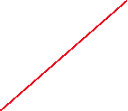
Deramp on Receive

Slide 3


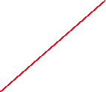
Deramp on Receive

Slide 4




Deramp on Receive
How do we create a frequency shift?
Complex exponential
How do we create the specific frequency shift versus time along the dashed “reference/scene-center” that we need here?
A chirp!

Slide 5
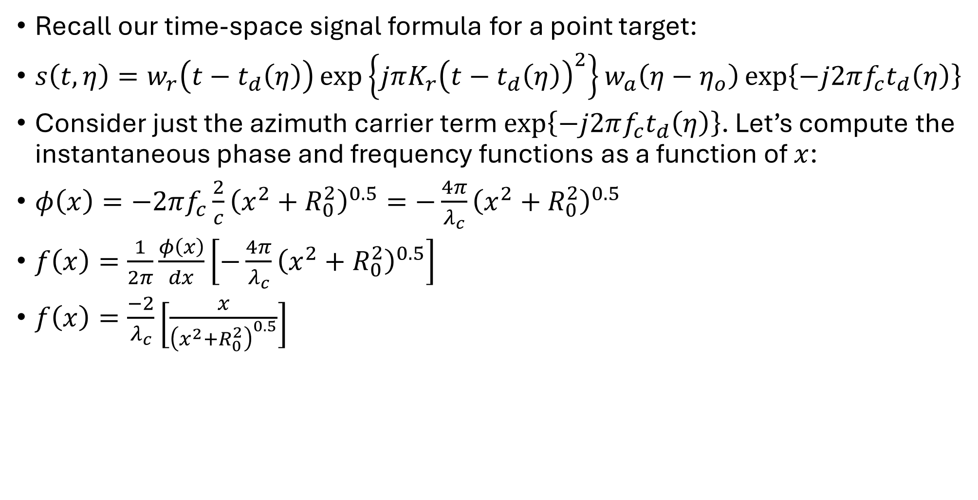
Deramp on Receive
Recall our time-space signal formula for a point target:
$s\left(t,η\right)=w_{r}\left(t−t_{d}\left(η\right)\right)\exp\left\{jπK_{r}{\left(t−t_{d}\left(η\right)\right)}^{2}\right\}w_{a}\left(η−η_{o}\right)\exp\left\{−j2πf_{c}t_{d}\left(η\right)\right\}$
Consider just the azimuth carrier term $\exp\left\{−j2πf_{c}t_{d}\left(η\right)\right\}$. Let’s compute the instantaneous phase and frequency functions as a function of $x$:
$φ\left(x\right)=−2πf_{c}\frac{2}{c}{\left(x^{2}+R_{0}^{2}\right)}^{0.5}=−\frac{4π}{λ_{c}}{\left(x^{2}+R_{0}^{2}\right)}^{0.5}$
$f\left(x\right)=\frac{1}{2π}\frac{φ\left(x\right)}{dx}\left[−\frac{4π}{λ_{c}}{\left(x^{2}+R_{0}^{2}\right)}^{0.5}\right]$
$f\left(x\right)=\frac{−2}{λ_{c}}\left[\frac{x}{{\left(x^{2}+R_{0}^{2}\right)}^{0.5}}\right]$

Slide 6
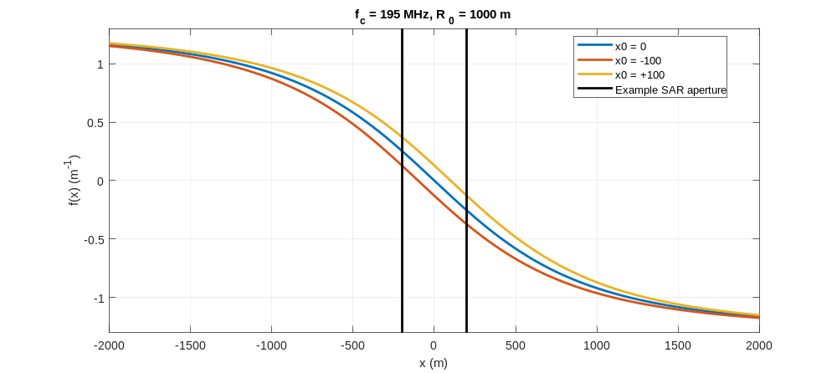
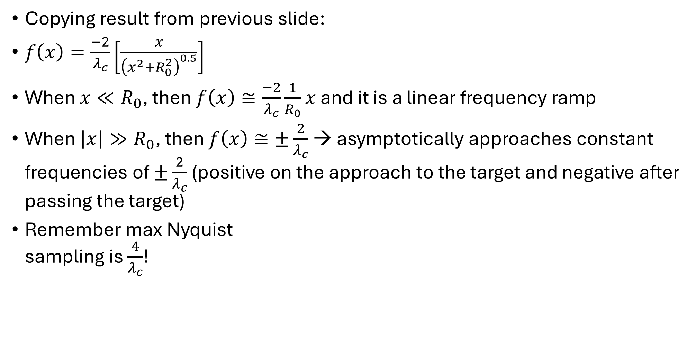
Deramp on Receive
Copying result from previous slide:
$f\left(x\right)=\frac{−2}{λ_{c}}\left[\frac{x}{{\left(x^{2}+R_{0}^{2}\right)}^{0.5}}\right]$
When $x≪R_{0}$, then $f\left(x\right)≅\frac{−2}{λ_{c}}\frac{1}{R_{0}}x$ and it is a linear frequency ramp
When $\left|x\right|≫R_{0}$, then $f\left(x\right)≅±\frac{2}{λ_{c}}$ → asymptotically approaches constant frequencies of $±\frac{2}{λ_{c}}$ (positive on the approach to the target and negative after passing the target)
Remember max Nyquist
sampling is $\frac{4}{λ_{c}}$!

Slide 7
Deramp on receive
Deramping spotlight SAR keeps the instantaneous bandwidth in both time and space small
  This is great for spotlight SAR where the time-gate (time-window) and the Doppler-gate (Doppler bandwidth) are restricted
Deramping is also a fundamental/first step of the polar format algorithm.

Slide 8
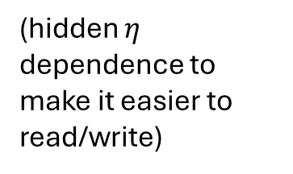
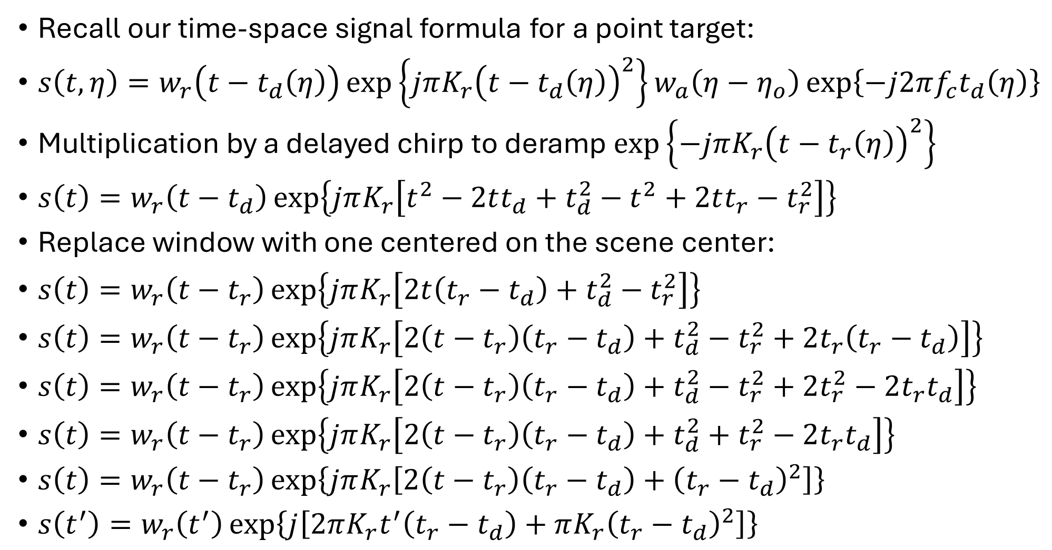

Deramp on Receive
Recall our time-space signal formula for a point target:
$s\left(t,η\right)=w_{r}\left(t−t_{d}\left(η\right)\right)\exp\left\{jπK_{r}{\left(t−t_{d}\left(η\right)\right)}^{2}\right\}w_{a}\left(η−η_{o}\right)\exp\left\{−j2πf_{c}t_{d}\left(η\right)\right\}$
Multiplication by a delayed chirp to deramp $\exp\left\{−jπK_{r}{\left(t−t_{r}\left(η\right)\right)}^{2}\right\}$
$s\left(t\right)=w_{r}\left(t−t_{d}\right)\exp\left\{jπK_{r}\left[t^{2}−2tt_{d}+t_{d}^{2}−t^{2}+2tt_{r}−t_{r}^{2}\right]\right\}$
Replace window with one centered on the scene center:
$s\left(t\right)=w_{r}\left(t−t_{r}\right)\exp\left\{jπK_{r}\left[2t\left(t_{r}−t_{d}\right)+t_{d}^{2}−t_{r}^{2}\right]\right\}$
$s\left(t\right)=w_{r}\left(t−t_{r}\right)\exp\left\{jπK_{r}\left[2\left(t−t_{r}\right)\left(t_{r}−t_{d}\right)+t_{d}^{2}−t_{r}^{2}+2t_{r}\left(t_{r}−t_{d}\right)\right]\right\}$
$s\left(t\right)=w_{r}\left(t−t_{r}\right)\exp\left\{jπK_{r}\left[2\left(t−t_{r}\right)\left(t_{r}−t_{d}\right)+t_{d}^{2}−t_{r}^{2}+2t_{r}^{2}−2t_{r}t_{d}\right]\right\}$
$s\left(t\right)=w_{r}\left(t−t_{r}\right)\exp\left\{jπK_{r}\left[2\left(t−t_{r}\right)\left(t_{r}−t_{d}\right)+t_{d}^{2}+t_{r}^{2}−2t_{r}t_{d}\right]\right\}$
$s\left(t\right)=w_{r}\left(t−t_{r}\right)\exp\left\{jπK_{r}\left[2\left(t−t_{r}\right)\left(t_{r}−t_{d}\right)+{\left(t_{r}−t_{d}\right)}^{2}\right]\right\}$
$s\left(t^{′}\right)=w_{r}\left(t^{′}\right)\exp\left\{j\left[2πK_{r}t^{′}\left(t_{r}−t_{d}\right)+πK_{r}{\left(t_{r}−t_{d}\right)}^{2}\right]\right\}$
(hidden $η$ dependence to make it easier to read/write)
Define $t^{′}=t−t_{r}$

Slide 9
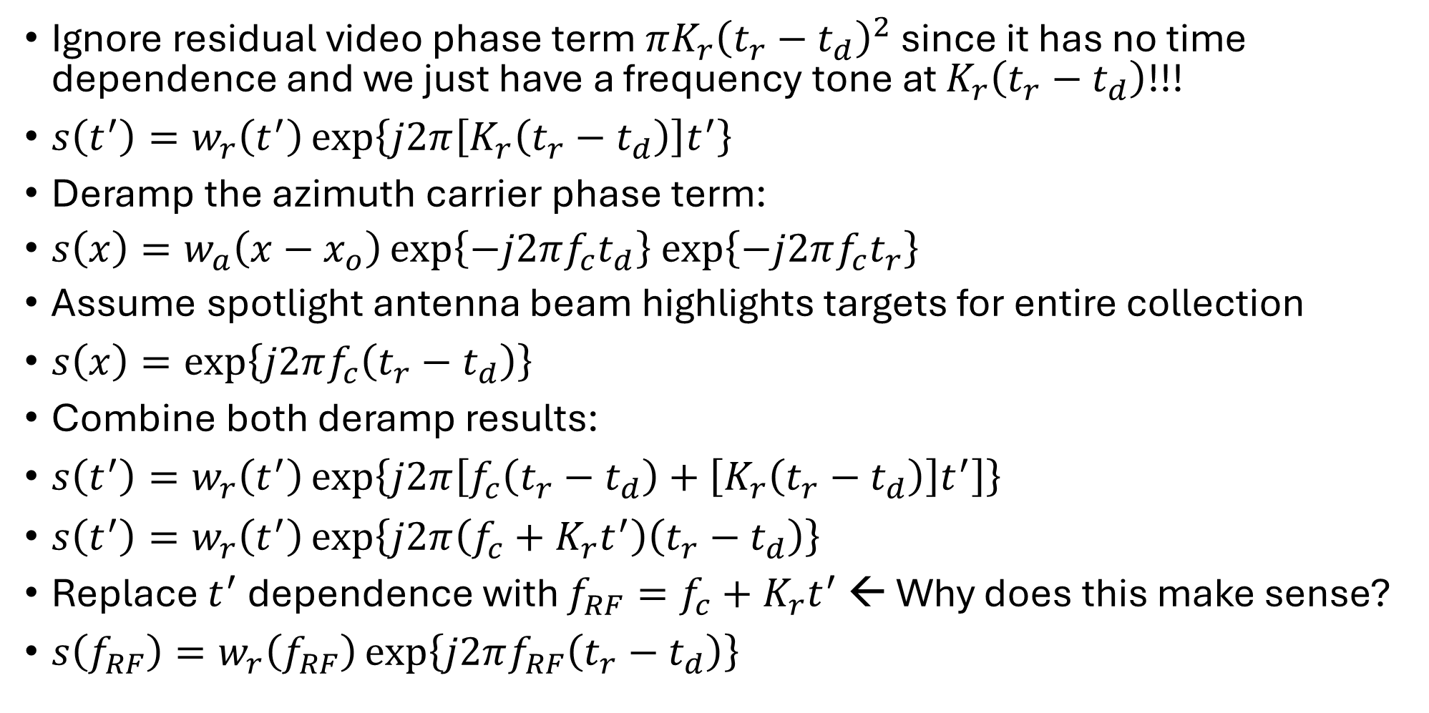
Deramp…
$$s\left(t^{′}\right)=w_{r}\left(t^{′}\right)\exp\left\{j\left[2πK_{r}t^{′}\left(t_{r}−t_{d}\right)+πK_{r}{\left(t_{r}−t_{d}\right)}^{2}\right]\right\}$$
Ignore residual video phase term $πK_{r}{\left(t_{r}−t_{d}\right)}^{2}$ since it has no time dependence and we just have a frequency tone at $K_{r}\left(t_{r}−t_{d}\right)$!!!
$s\left(t^{′}\right)=w_{r}\left(t^{′}\right)\exp\left\{j2π\left[K_{r}\left(t_{r}−t_{d}\right)\right]t^{′}\right\}$
Deramp the azimuth carrier phase term:
$s\left(x\right)=w_{a}\left(x−x_{o}\right)\exp\left\{−j2πf_{c}t_{d}\right\}$ $\exp\left\{−j2πf_{c}t_{r}\right\}$
Assume spotlight antenna beam highlights targets for entire collection
$s\left(x\right)=\exp\left\{j2πf_{c}\left(t_{r}−t_{d}\right)\right\}$
Combine both deramp results:
$s\left(t^{′}\right)=w_{r}\left(t^{′}\right)\exp\left\{j2π\left[f_{c}\left(t_{r}−t_{d}\right)+\left[K_{r}\left(t_{r}−t_{d}\right)\right]t^{′}\right]\right\}$
$s\left(t^{′}\right)=w_{r}\left(t^{′}\right)\exp\left\{j2π\left(f_{c}+K_{r}t^{′}\right)\left(t_{r}−t_{d}\right)\right\}$
Replace $t^{′}$ dependence with $f_{RF}=f_{c}+K_{r}t^{′}$ ← Why does this make sense?
$s\left(f_{RF}\right)=w_{r}\left(f_{RF}\right)\exp\left\{j2πf_{RF}\left(t_{r}−t_{d}\right)\right\}$

Slide 10
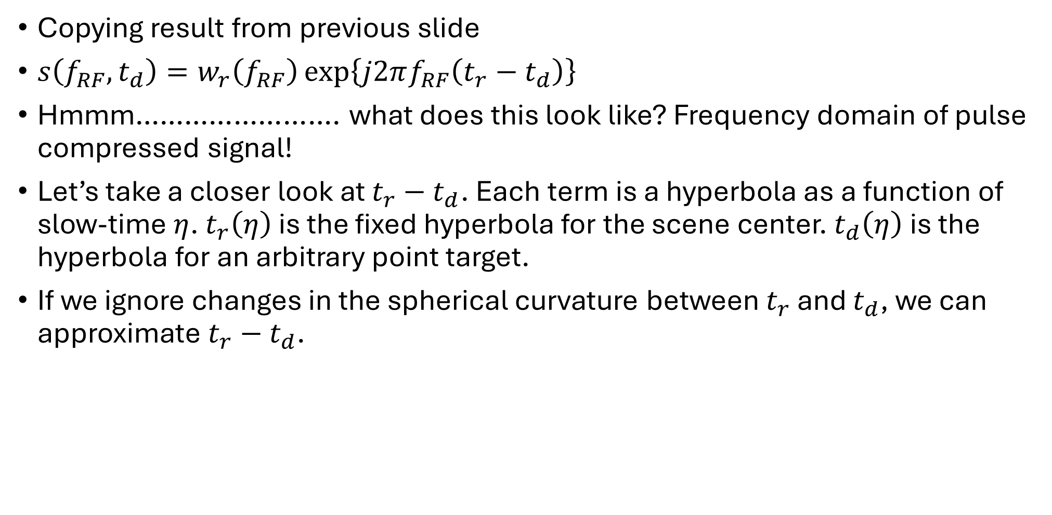
Deramp on Receive
Copying result from previous slide
$s\left(f_{RF},t_{d}\right)=w_{r}\left(f_{RF}\right)\exp\left\{j2πf_{RF}\left(t_{r}−t_{d}\right)\right\}$
Hmmm……………………. what does this look like? Frequency domain of pulse compressed signal!
Let’s take a closer look at $t_{r}−t_{d}$. Each term is a hyperbola as a function of slow-time $η$. $t_{r}\left(η\right)$ is the fixed hyperbola for the scene center. $t_{d}\left(η\right)$ is the hyperbola for an arbitrary point target.
If we ignore changes in the spherical curvature between $t_{r}$ and $t_{d}$, we can approximate $t_{r}−t_{d}$.

Slide 11

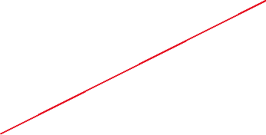

Deramp on Receive

Slide 12


Deramp on Receive

Slide 13
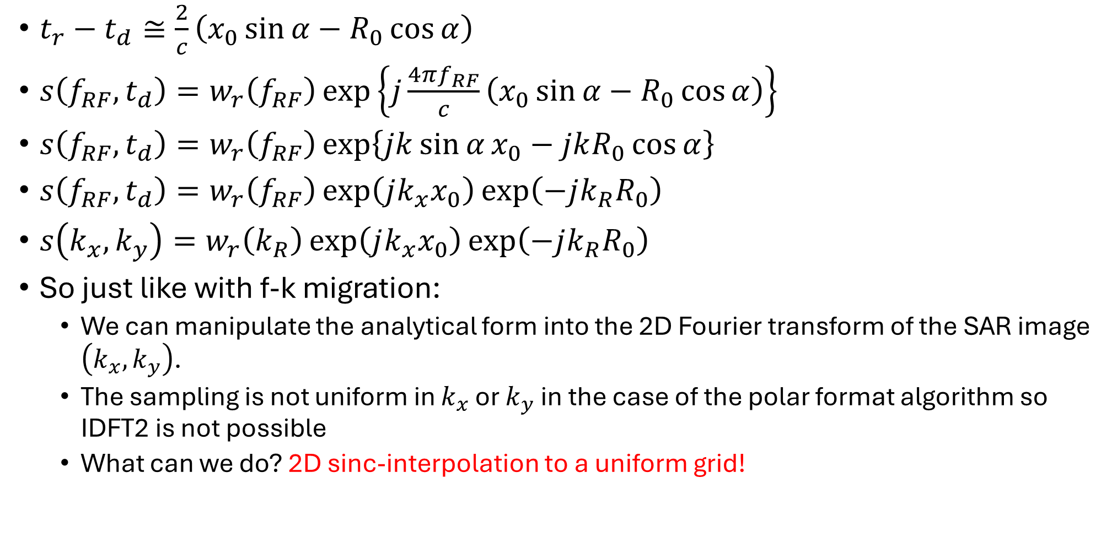
Deramp on Receive
$t_{r}−t_{d}≅\frac{2}{c}\left(x_{0}\sin{α}−R_{0}\cos{α}\right)$
$s\left(f_{RF},t_{d}\right)=w_{r}\left(f_{RF}\right)\exp\left\{j\frac{4πf_{RF}}{c}\left(x_{0}\sin{α}−R_{0}\cos{α}\right)\right\}$
$s\left(f_{RF},t_{d}\right)=w_{r}\left(f_{RF}\right)\exp\left\{jk\sin{α}x_{0}−jkR_{0}\cos{α}\right\}$
$s\left(f_{RF},t_{d}\right)=w_{r}\left(f_{RF}\right)\exp\left(jk_{x}x_{0}\right)\exp\left(−jk_{R}R_{0}\right)$
$s\left(k_{x},k_{y}\right)=w_{r}\left(k_{R}\right)\exp\left(jk_{x}x_{0}\right)\exp\left(−jk_{R}R_{0}\right)$
So just like with f-k migration:
  We can manipulate the analytical form into the 2D Fourier transform of the SAR image $\left(k_{x},k_{y}\right)$.
  The sampling is not uniform in $k_{x}$ or $k_{y}$ in the case of the polar format algorithm so IDFT2 is not possible
  What can we do? 2D sinc-interpolation to a uniform grid!

Slide 14
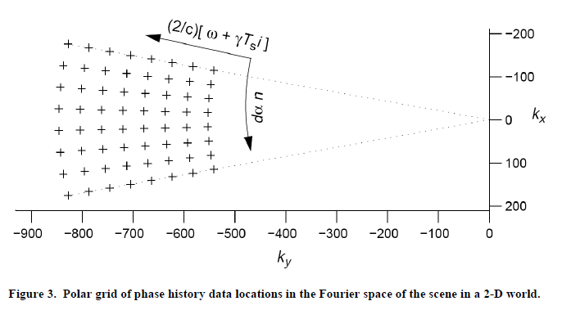

After deramping, $k_{x}$ and $k_{y}$ samples:
Notes:
Armin W. Doerry, Synthetic Aperture Radar Processing with Tiered Subapertures, Sandia Report SAND94-1390, 1994.

Slide 15
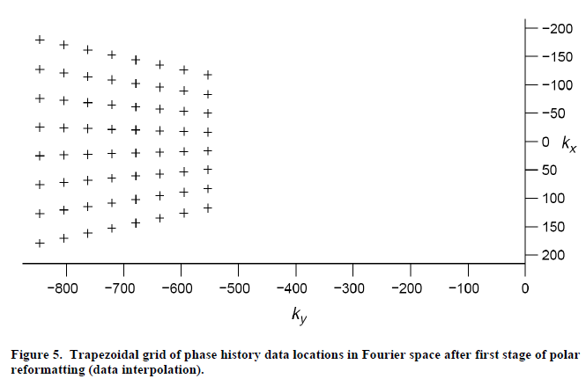

After $k_{y}$ resampling, $k_{x}$ and $k_{y}$ samples:
Notes:
Armin W. Doerry, Synthetic Aperture Radar Processing with Tiered Subapertures, Sandia Report SAND94-1390, 1994.

Slide 16
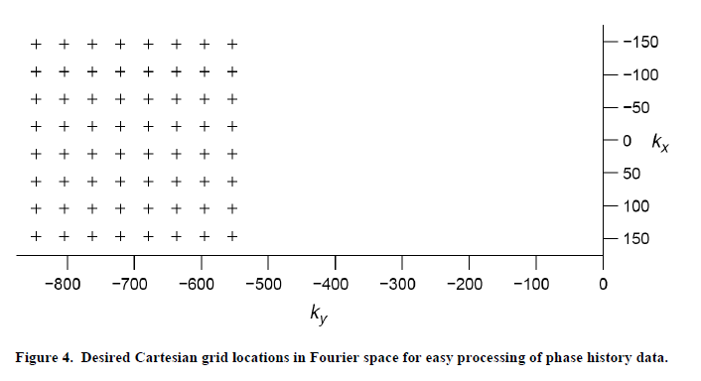

After $k_{x}$ resampling, $k_{x}$ and $k_{y}$ samples:
(and now we are ready to apply IFFT2!)
Notes:
Armin W. Doerry, Synthetic Aperture Radar Processing with Tiered Subapertures, Sandia Report SAND94-1390, 1994.

Slide 17

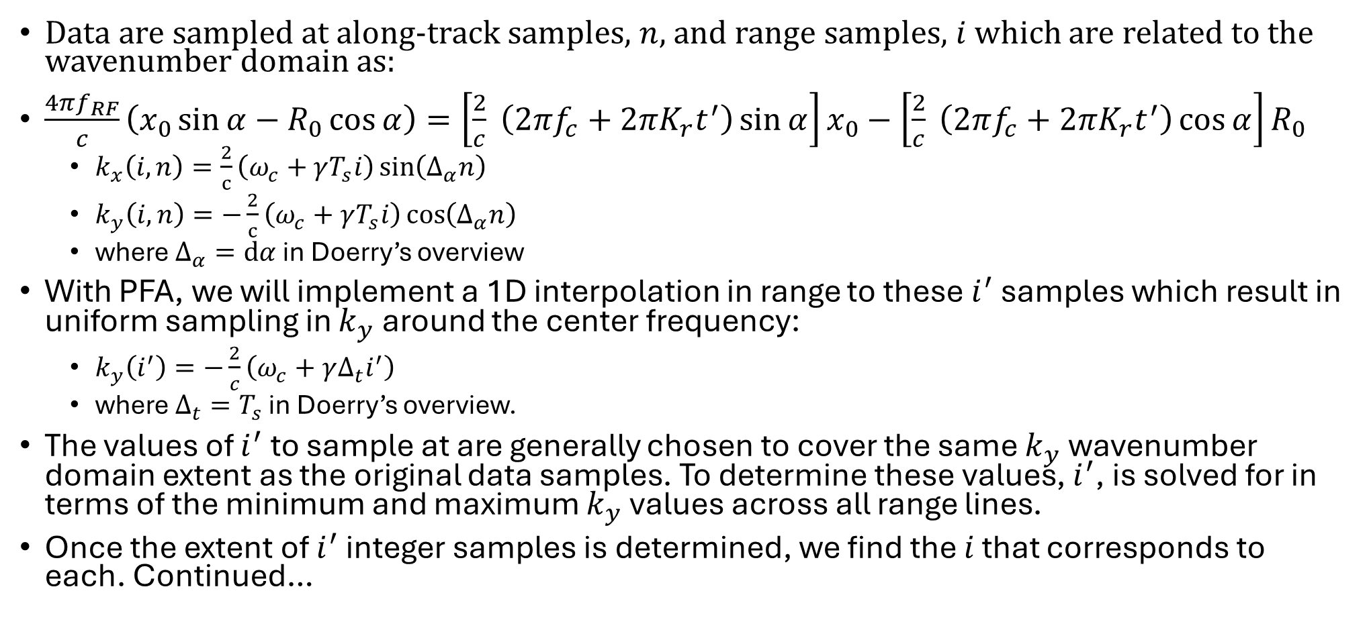
Polar Format Algorithm: Resampling
(connection to Doerry’s publication)
Data are sampled at along-track samples, $n$, and range samples, $i$ which are related to the wavenumber domain as:
$\frac{4πf_{RF}}{c}\left(x_{0}\sin{α}−R_{0}\cos{α}\right)=\left[\frac{2}{c} \left(2πf_{c}+2πK_{r}t^{′}\right)\sin{α}\right]x_{0}−\left[\frac{2}{c} \left(2πf_{c}+2πK_{r}t^{′}\right)\cos{α}\right]R_{0}$
  $k_{x}\left(i,n\right)=\frac{2}{c}\left(ω_{c}+γT_{s}i\right)\sin\left(Δ_{α}n\right)$
  $k_{y}\left(i,n\right)=−\frac{2}{c}\left(ω_{c}+γT_{s}i\right)\cos\left(Δ_{α}n\right)$
  where $Δ_{α}=dα$ in Doerry’s overview
With PFA, we will implement a 1D interpolation in range to these $i^{′}$samples which result in uniform sampling in $k_{y}$ around the center frequency:
  $k_{y}\left(i^{′}\right)=−\frac{2}{c}\left(ω_{c}+γΔ_{t}i^{′}\right)$
  where $Δ_{t}=T_{s}$ in Doerry’s overview.
The values of $i^{′}$ to sample at are generally chosen to cover the same $k_{y}$wavenumber domain extent as the original data samples. To determine these values, $i^{′}$, is solved for in terms of the minimum and maximum $k_{y}$values across all range lines.
Once the extent of $i^{′}$ integer samples is determined, we find the $i$ that corresponds to each. Continued…
$$γ=2πK_{r}$$

Slide 18
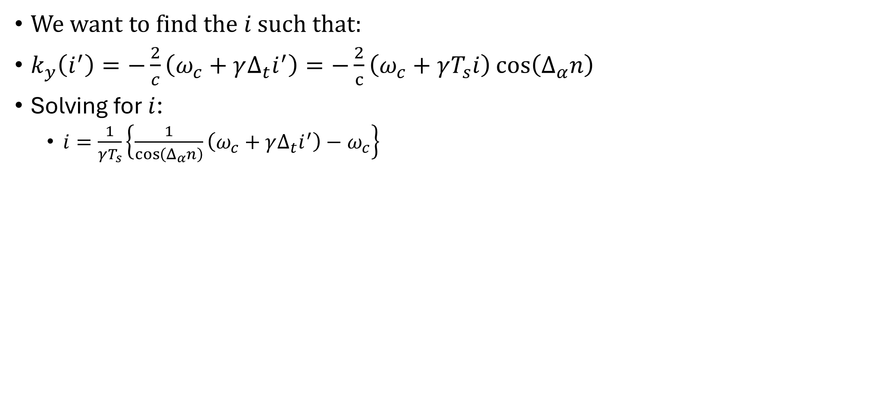
Polar Format Algorithm: Resampling
(connection to Doerry’s publication)
We want to find the $i$ such that:
$k_{y}\left(i^{′}\right)=−\frac{2}{c}\left(ω_{c}+γΔ_{t}i^{′}\right)=−\frac{2}{c}\left(ω_{c}+γT_{s}i\right)\cos\left(Δ_{α}n\right)$
Solving for $i$:
  $i=\frac{1}{γT_{s}}\left\{\frac{1}{\cos\left(Δ_{α}n\right)}\left(ω_{c}+γΔ_{t}i^{′}\right)−ω_{c}\right\}$

Slide 19
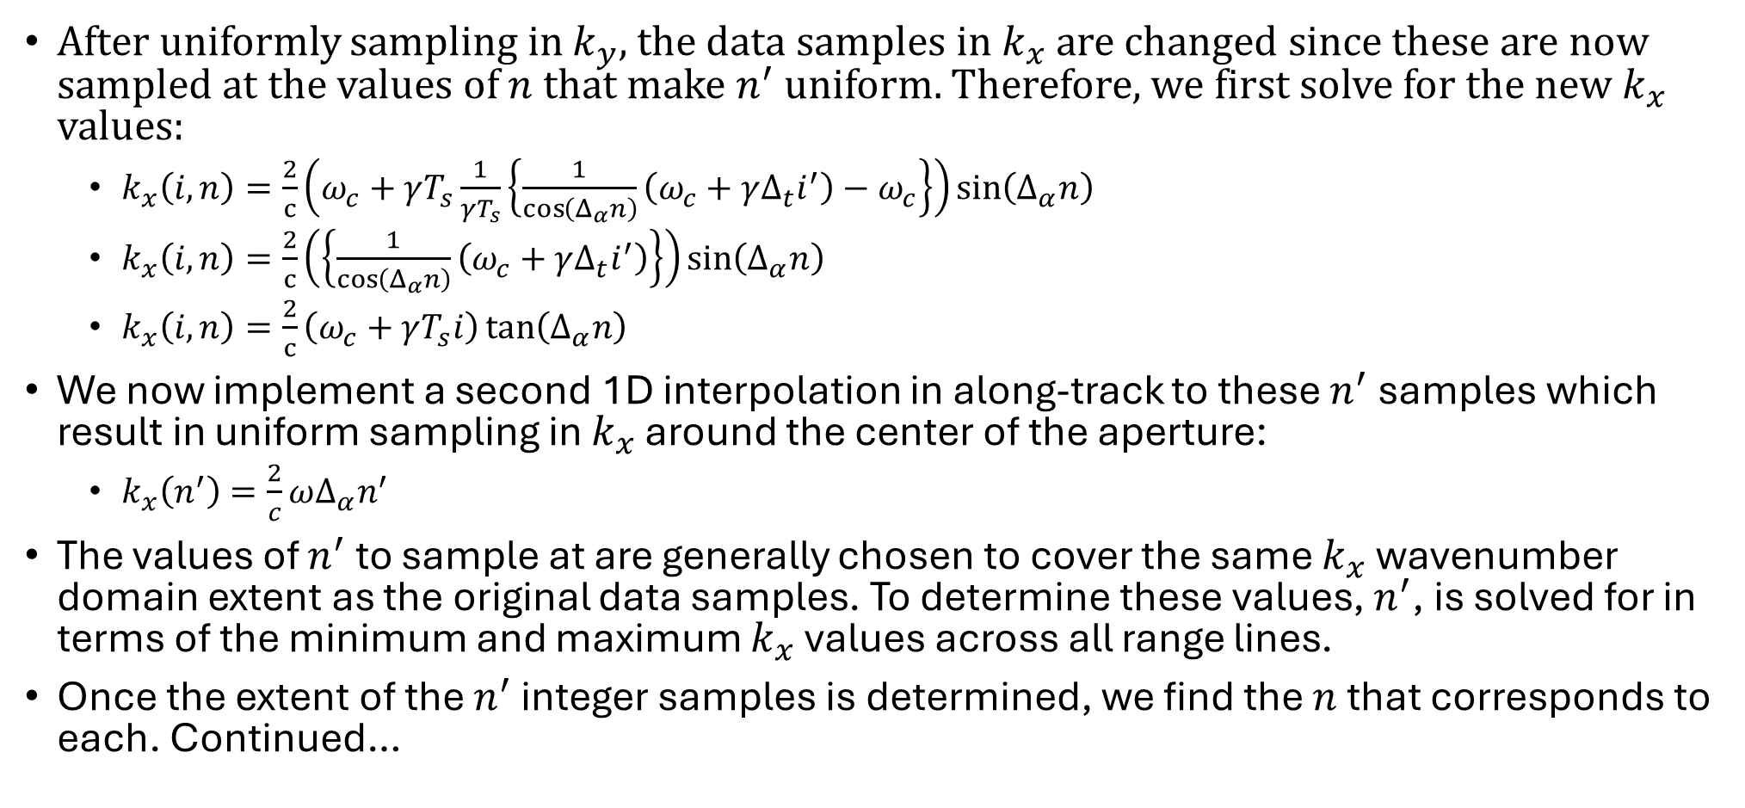
Polar Format Algorithm: Resampling
(connection to Doerry’s publication)
After uniformly sampling in $k_{y}$, the data samples in $k_{x}$ are changed since these are now sampled at the values of $n$ that make $n^{′}$ uniform. Therefore, we first solve for the new $k_{x}$ values:
  $k_{x}\left(i,n\right)=\frac{2}{c}\left(ω_{c}+γT_{s}\frac{1}{γT_{s}}\left\{\frac{1}{\cos\left(Δ_{α}n\right)}\left(ω_{c}+γΔ_{t}i^{′}\right)−ω_{c}\right\}\right)\sin\left(Δ_{α}n\right)$
  $k_{x}\left(i,n\right)=\frac{2}{c}\left(\left\{\frac{1}{\cos\left(Δ_{α}n\right)}\left(ω_{c}+γΔ_{t}i^{′}\right)\right\}\right)\sin\left(Δ_{α}n\right)$
  $k_{x}\left(i,n\right)=\frac{2}{c}\left(ω_{c}+γT_{s}i\right)\tan\left(Δ_{α}n\right)$
We now implement a second 1D interpolation in along-track to these $n^{′}$samples which result in uniform sampling in $k_{x}$ around the center of the aperture:
  $k_{x}\left(n^{′}\right)=\frac{2}{c}ωΔ_{α}n^{′}$
The values of $n^{′}$ to sample at are generally chosen to cover the same $k_{x}$wavenumber domain extent as the original data samples. To determine these values, $n^{′}$, is solved for in terms of the minimum and maximum $k_{x}$values across all range lines.
Once the extent of the $n^{′}$ integer samples is determined, we find the $n$ that corresponds to each. Continued…

Slide 20
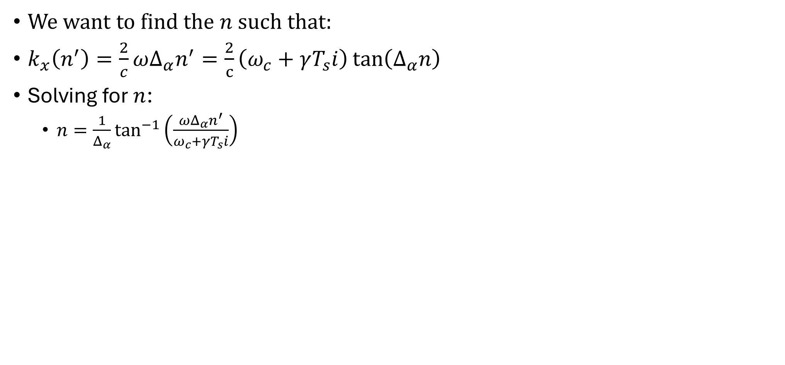
Polar Format Algorithm: Resampling
(connection to Doerry’s publication)
We want to find the $n$ such that:
$k_{x}\left(n^{′}\right)=\frac{2}{c}ωΔ_{α}n^{′}=\frac{2}{c}\left(ω_{c}+γT_{s}i\right)\tan\left(Δ_{α}n\right)$
Solving for $n$:
  $n=\frac{1}{Δ_{α}}\tan^{−1}\left(\frac{ωΔ_{α}n^{′}}{ω_{c}+γT_{s}i}\right)$

Slide 21
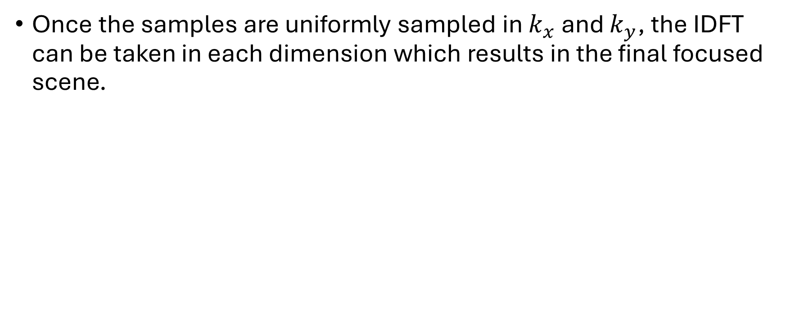
Polar Format Algorithm: IFFT2
Once the samples are uniformly sampled in $k_{x}$ and $k_{y}$, the IDFT can be taken in each dimension which results in the final focused scene.

Slide 22
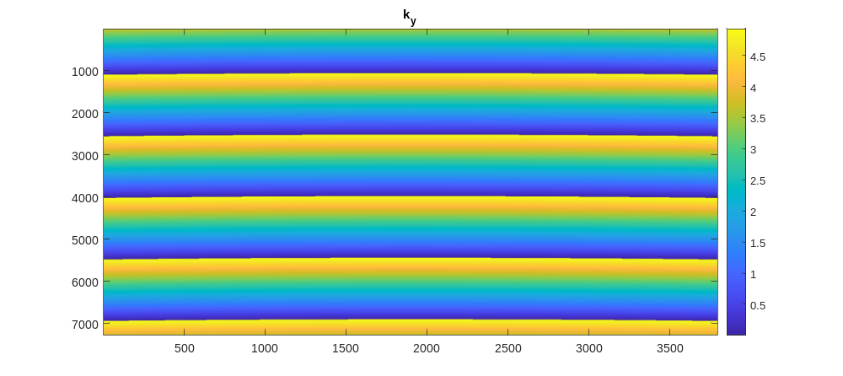
PFA Steps: Deramp in time and space
$k_{y}$ distortion at this stage is the first step (note the slight curvature in the along-track dimension)

Slide 23
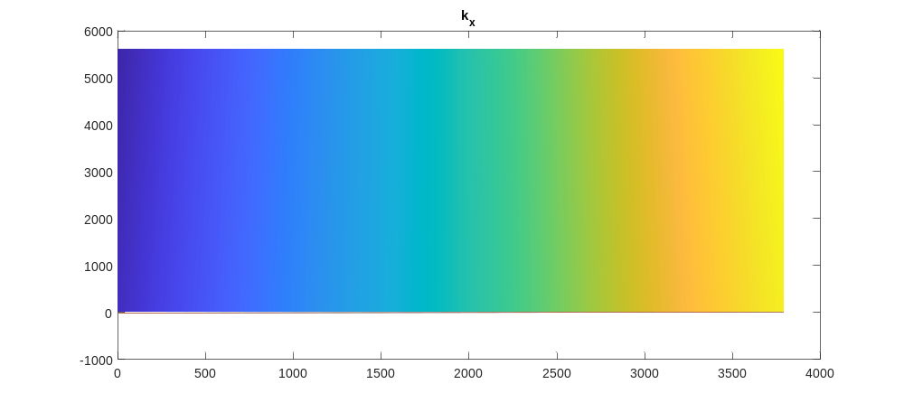

PFA Steps: Resample $k_{y}$
$k_{x}$ distortion in this example is hard to see…
Notes:
k_x distortion in this example is hard to see at this stage

Slide 24
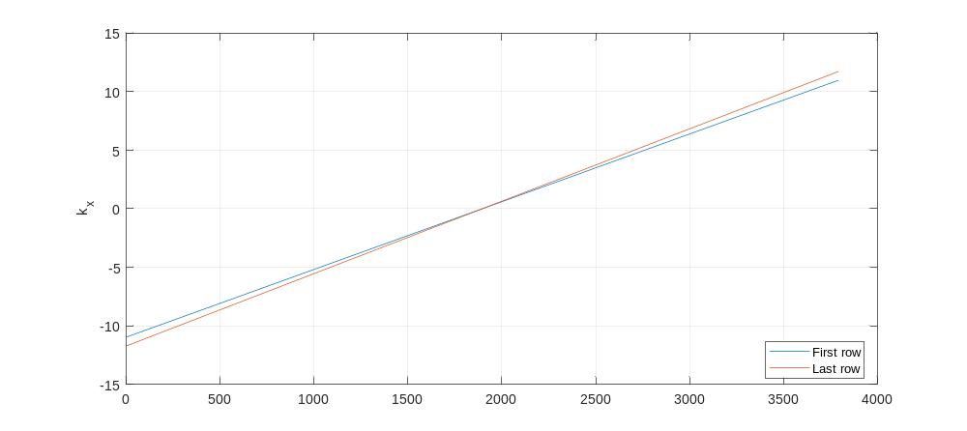

PFA Steps: Resample $k_{y}$
$k_{x}$ distortion in this example is hard to see… but it is there

Slide 25
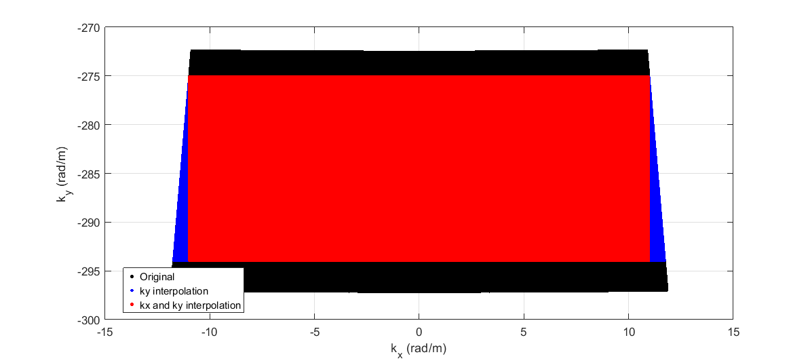

PFA Steps: Resample $k_{x}$
$k_{x}$ and $k_{y}$ sampling at each step

Slide 26
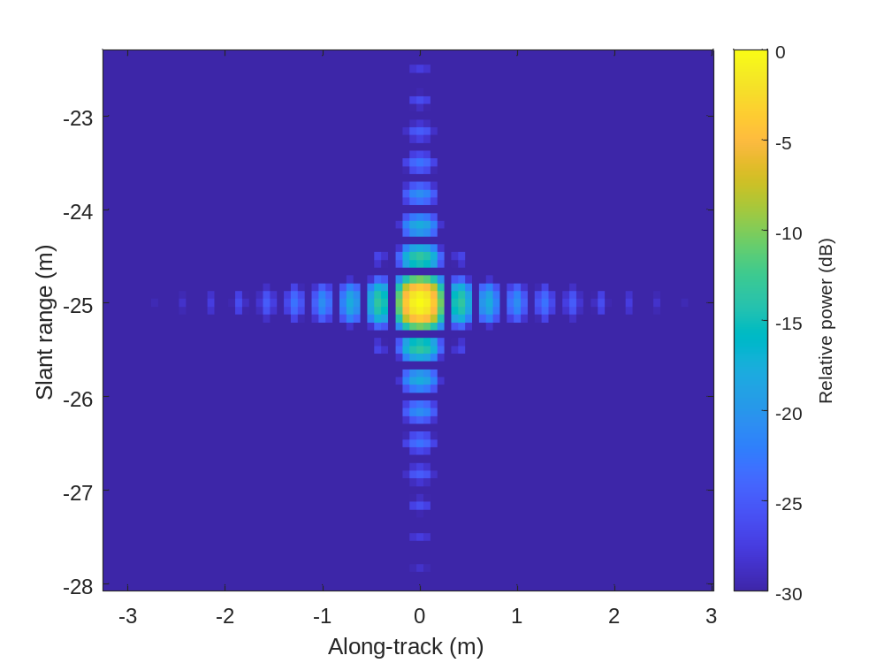
PFA Steps: IFFT2
SAR focused image

Slide 27
PFA spot-size limitations
The spot-size is limited because we ignored spherical wavefront deviations relative to the scene center.
  It does take care of the spherical wavefront at the scene center!
  We can remove the residual video phase term after step 1.
We already discussed that deramping keeps the instantaneous bandwidth small
PFA's polar-to-rectangular mapping is a genuine 2-D remap, but in practice it is done as two separable 1-D passes (range, then azimuth/keystone). Fielded systems often avoid explicit interpolation almost entirely. The range pass can be absorbed by varying the chirp rate or ADC sample timing per pulse, and the azimuth pass is done with a chirp-z transform.

Slide 28
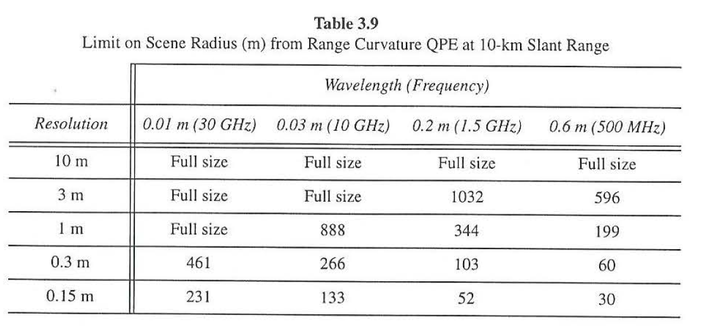
PFA spot-size limitations
Example for 1200 m spot at 10km range. “Full size” means the 1200 m spot can be achieved.
Walter C. Carrara, Ron S. Goodman, and Ronald M. Majewski, Spotlight Synthetic Aperture Radar: Signal Processing Algorithms, 1995

Slide 29
Example methods for extending the spot size
N. E. Doren, C. V. Jakowatz, Jr., D. E. Wahl, and P. A. Thompson, "General formulation for wavefront curvature correction in polar-formatted spotlight-mode SAR images using space-variant post-filtering," Proceedings of the International Conference on Image Processing (ICIP), 1997.
N. E. Doren, Space-Variant Post-Filtering for Wavefront Curvature Correction in Polar-Formatted Spotlight-Mode SAR Imagery, Sandia National Laboratories report SAND99-2706, 1999.
A. W. Doerry, Wavefront Curvature Limitations and Compensation to Polar Format Processing for Synthetic Aperture Radar Images, Sandia National Laboratories report SAND2007-0046, 2007.

