Slide 1

$ω$-$k$ Algorithm
SAR Processor
AKA f-k migration, range migration algorithm (RMA)

Slide 2
Range Migration Algorithm (RMA)
Linear SAR (assume perfectly straight flight path)
  Same as for RDA and CSA
f-k migration (range migration algorithm) was developed by the seismic community who often used very large wavenumber bandwidths where approximations would not work
  Stolt, Robert H. "Migration by Fourier Transform." Geophysics 43, no. 1 (1978): 23–48. doi.org.
Does not use the range-Doppler expression and so is not limited by the 2nd order Taylor Series expansion

Slide 3
Range Migration Algorithm (RMA)
SAR relies on the Borne approximation
  Media scattering can be treated as linear addition (superposition) of individual scatterers.
    This is always true for sources in linear media, but it is NOT true for the media the the waves interact with.
    Can you think of a radar target that violates the Borne approximation?
      My favorite example: corner reflectors
Exploding reflector model
  The linear target model is equivalent to the exploding reflector model
  In this model, rather than the radar transmitting a pulse at time zero, each target is replaced by an isotropic source that radiates a pulse starting at time zero and the velocity of propagation is halved to account for the two-way travel time.
  This terminology is used in seismic literature where f-k migration was originally developed
  Image theory for specular reflections is similar
Notes:
See animation.

Slide 4
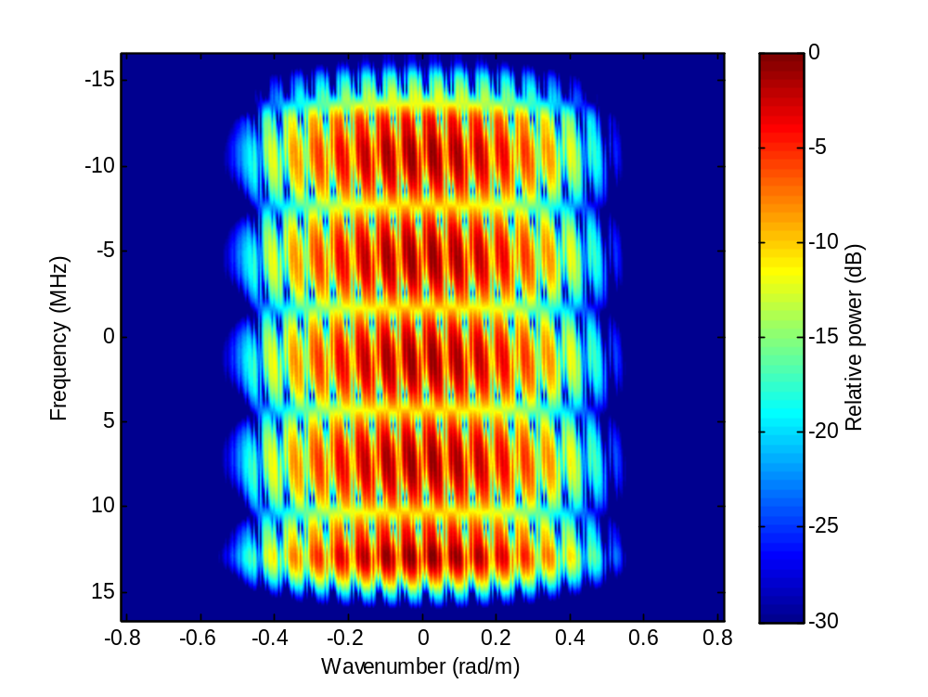
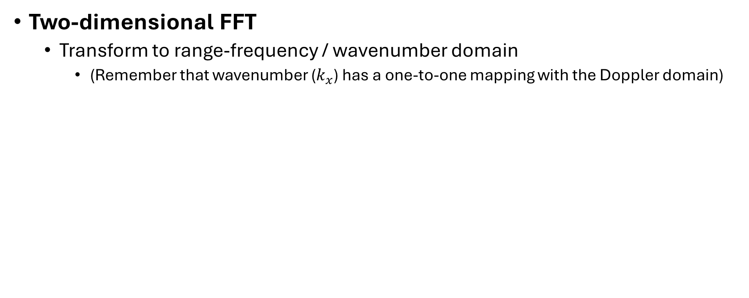
F-k migration: Step 1
Two-dimensional FFT
  Transform to range-frequency / wavenumber domain
    (Remember that wavenumber ($k_{x}$) has a one-to-one mapping with the Doppler domain)

Slide 5
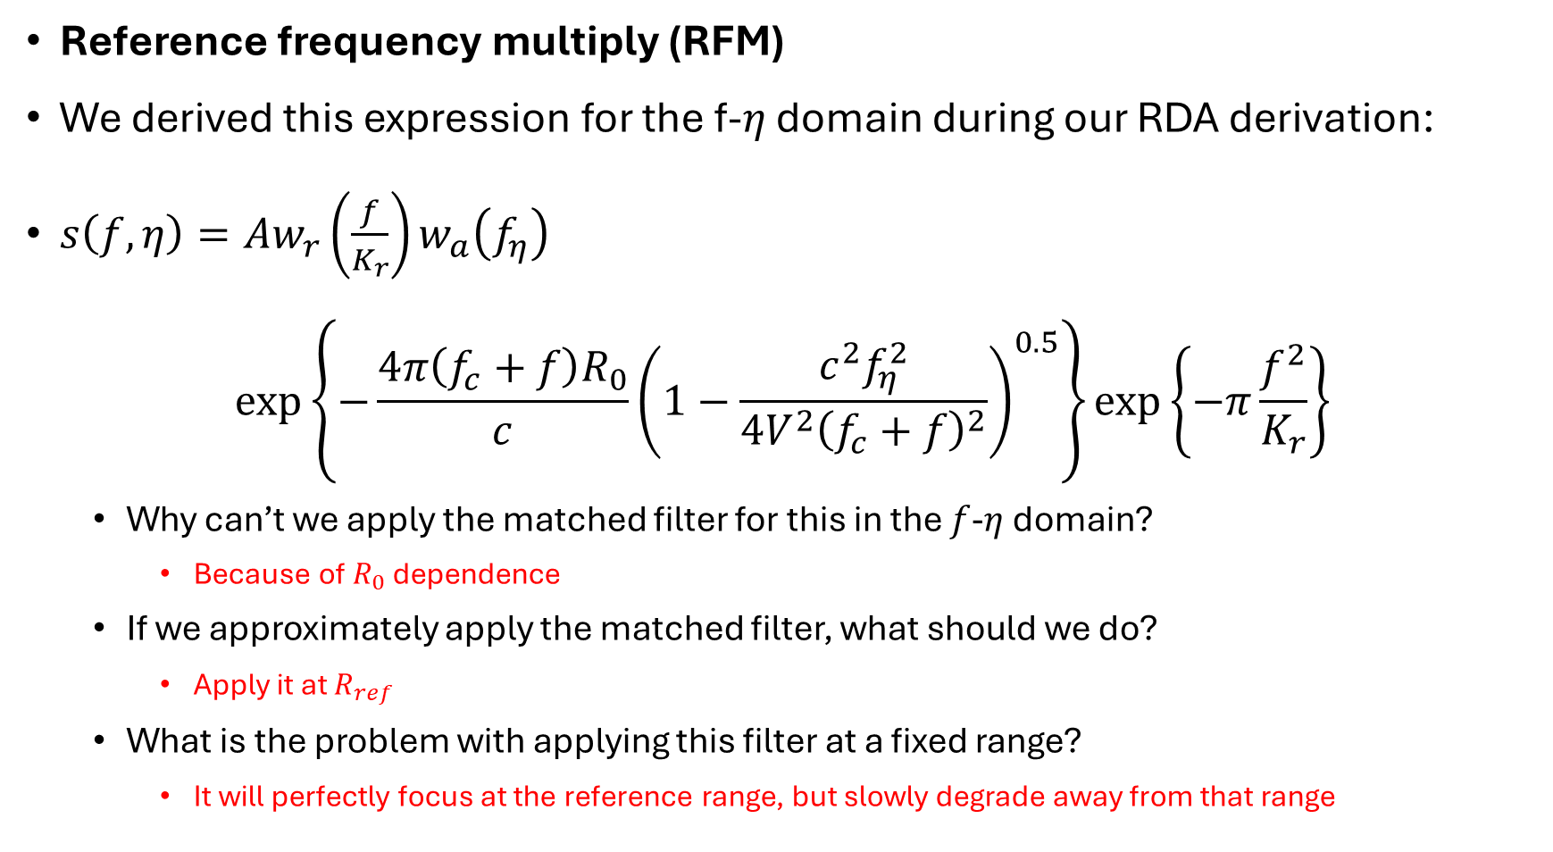
F-k migration: Step 2
Reference frequency multiply (RFM)
We derived this expression for the f-$η$ domain during our RDA derivation:
$s\left(f,η\right)=Aw_{r}\left(\frac{f}{K_{r}}\right)w_{a}\left(f_{η}\right)$
$$\exp\left\{−\frac{4π\left(f_{c}+f\right)R_{0}}{c}{\left(1−\frac{c^{2}f_{η}^{2}}{4V^{2}{\left(f_{c}+f\right)}^{2}}\right)}^{0.5}\right\}\exp\left\{−π\frac{f^{2}}{K_{r}}\right\}$$
  Why can’t we apply the matched filter for this in the $f$-$η$ domain?
    Because of $R_{0}$ dependence
  If we approximately apply the matched filter, what should we do?
    Apply it at $R_{ref}$
  What is the problem with applying this filter at a fixed range?
    It will perfectly focus at the reference range, but slowly degrade away from that range

Slide 6
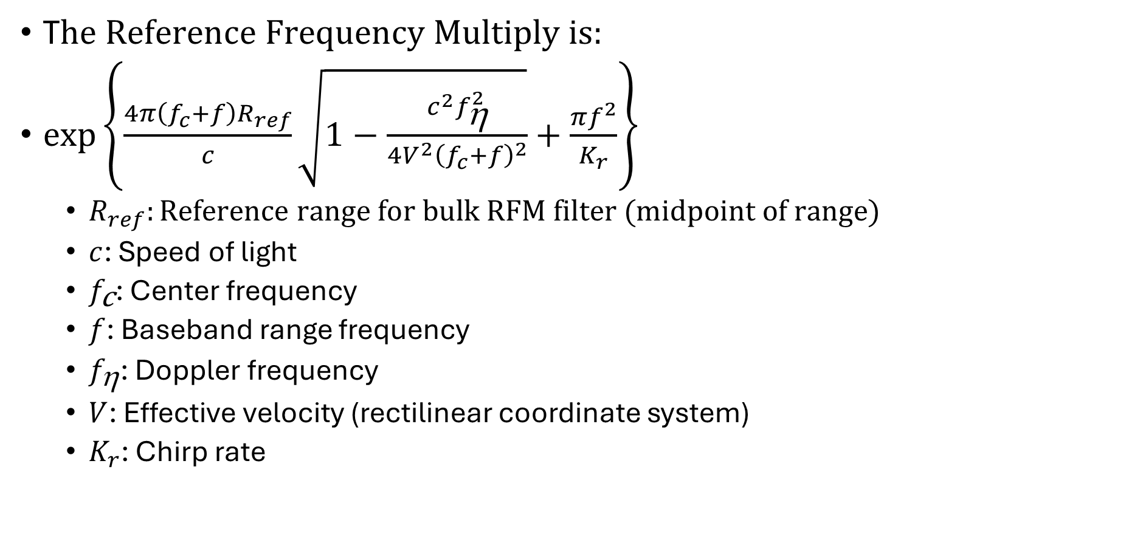
F-k migration: Step 2
T$he Reference Frequency Multiply is:$
$\exp\left\{\frac{4π\left(f_{c}+f\right)R_{ref}}{c}\sqrt{1−\frac{c^{2}f_{\text{h}}^{2}}{4V^{2}{\left(f_{c}+f\right)}^{2}}}+\frac{πf^{2}}{K_{r}}\right\}$
  $R_{ref}:Reference range for bulk RFM filter (midpoint of range)$
  $c$: Speed of light
  $f_{\text{c}}\text{: Center frequency}$
  $f$: Baseband range frequency
  $f_{\text{h}}$: Doppler frequency
  $V$: Effective velocity (rectilinear coordinate system)
  $K_{r}$: Chirp rate

Slide 7
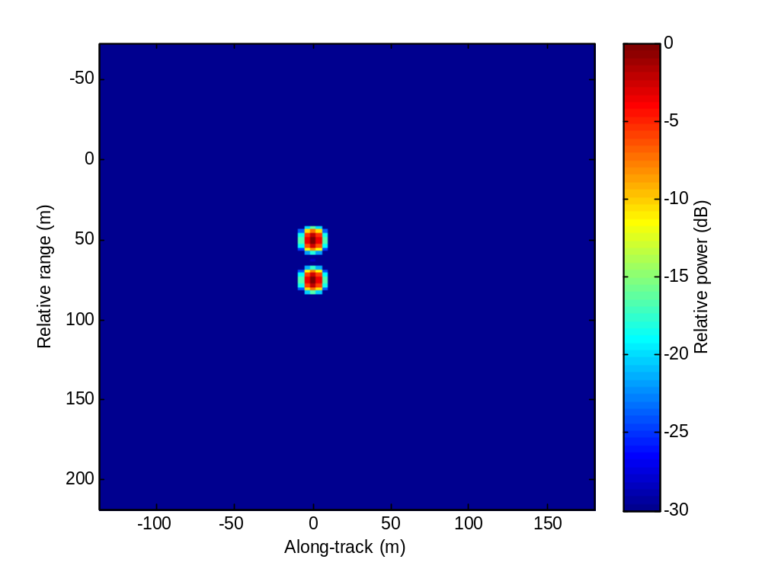
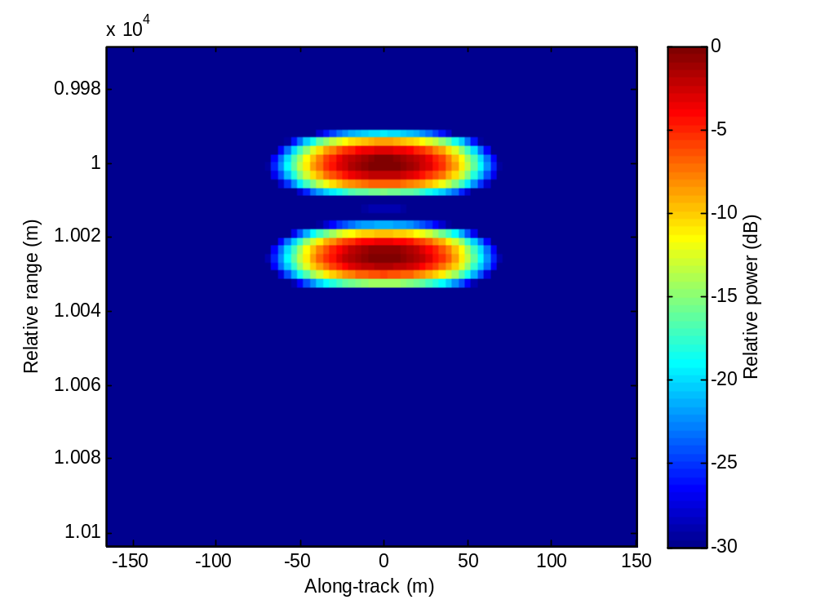
F-k migration: Step 2
Examples of reference range and away from reference range
Notes:
Note how the right image has a much wider impulse response width. The right image shows why the filter needs to be range dependent.

Slide 8
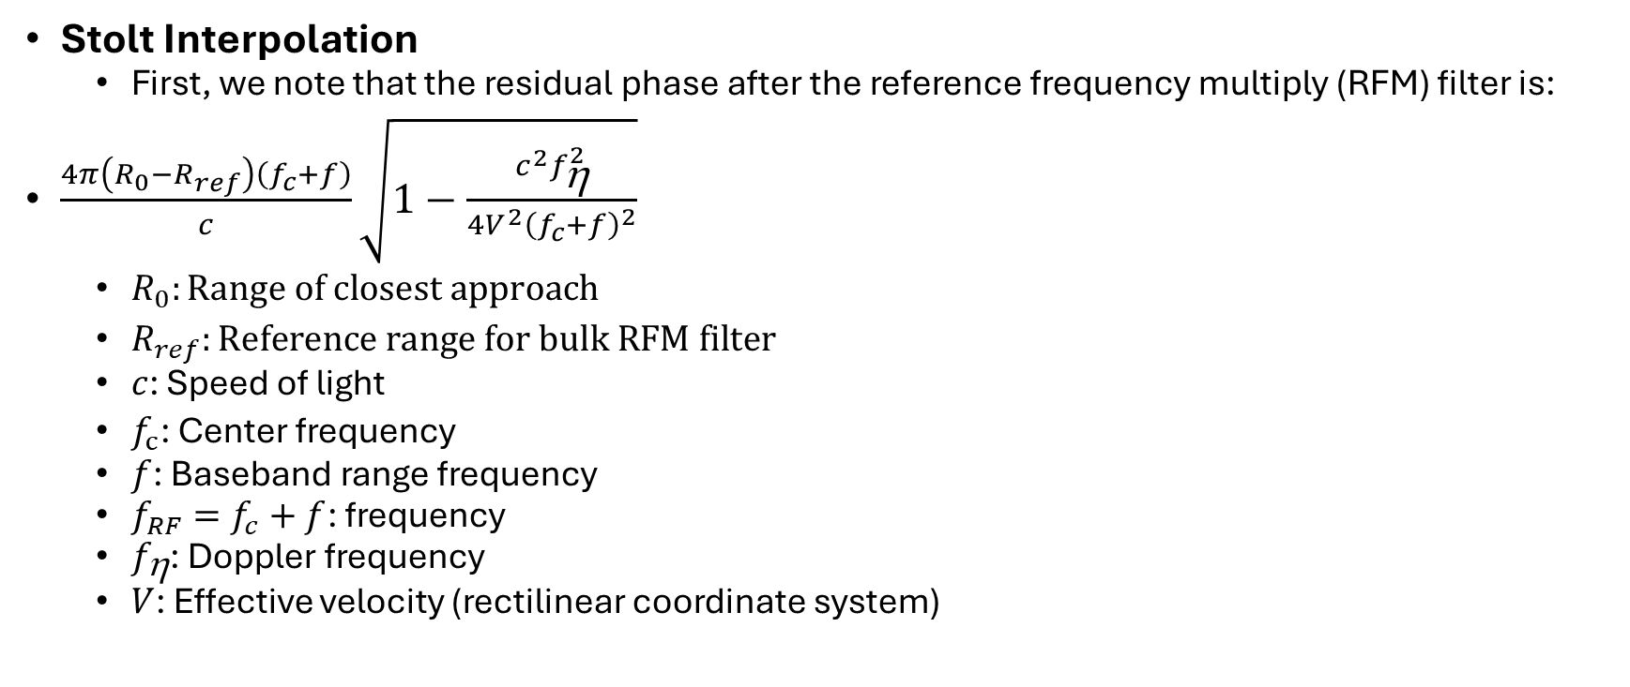
F-k migration: Step 3
Stolt Interpolation
  First, we note that the residual phase after the reference frequency multiply (RFM) filter is:
$\frac{4π\left(R_{0}−R_{ref}\right)\left(f_{c}+f\right)}{c}\sqrt{1−\frac{c^{2}f_{\text{h}}^{2}}{4V^{2}{\left(f_{c}+f\right)}^{2}}}$
  $R_{0}:Range of closest approach$
  $R_{ref}:Reference range for bulk RFM filter$
  $c$: Speed of light
  $f_{c}\text{: }\text{Center }\text{frequency}$
  $f$: Baseband range frequency
  $f_{RF}=f_{c}+f$: frequency
  $f_{\text{h}}$: Doppler frequency
  $V$: Effective velocity (rectilinear coordinate system)

Slide 9
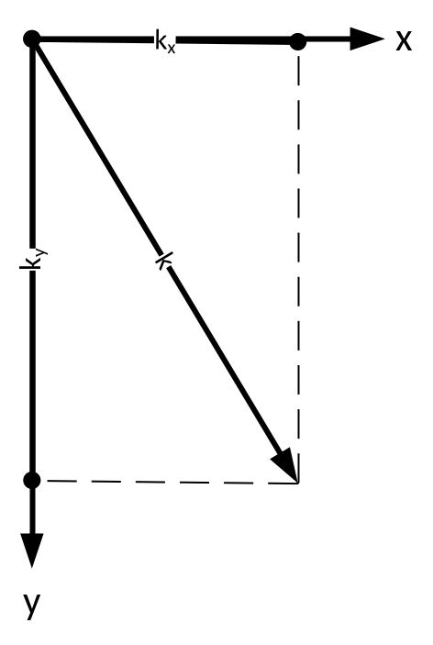
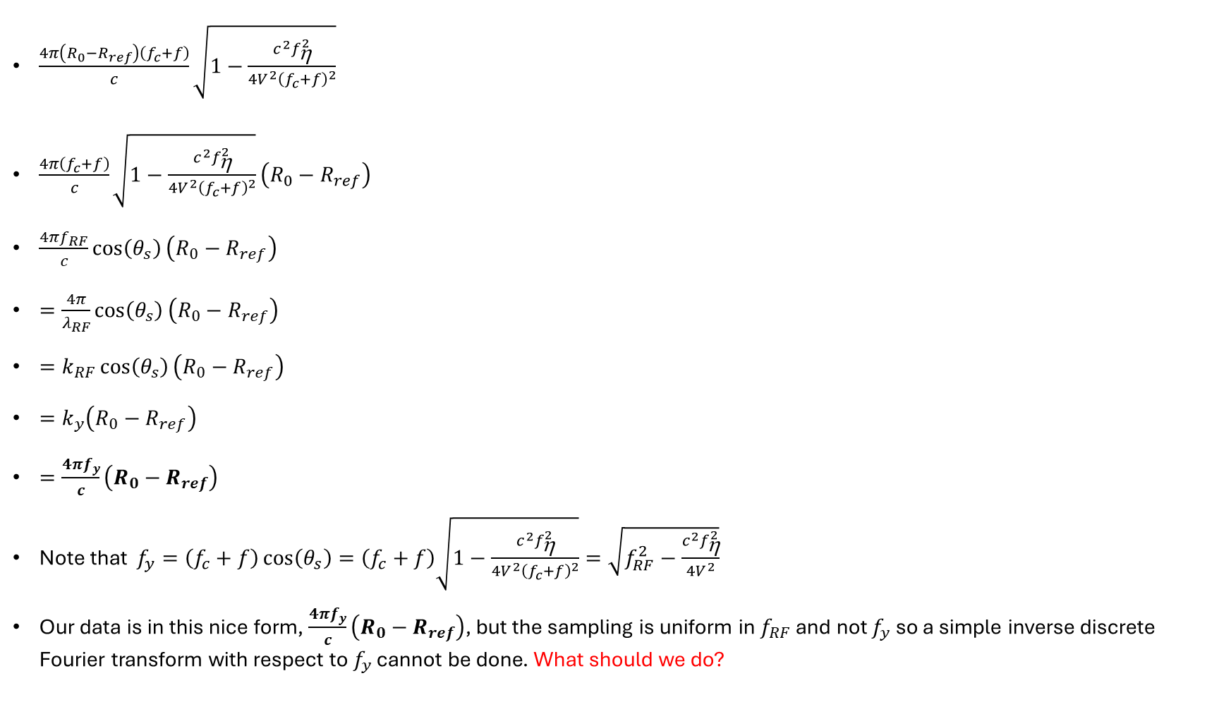
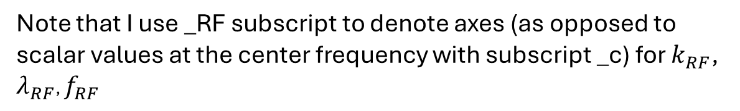


F-k migration: Step 3
$$k_{x}=k\sin\left(θ_{s}\right)$$
$\frac{4π\left(R_{0}−R_{ref}\right)\left(f_{c}+f\right)}{c}\sqrt{1−\frac{c^{2}f_{\text{h}}^{2}}{4V^{2}{\left(f_{c}+f\right)}^{2}}}$
$\frac{4π\left(f_{c}+f\right)}{c}\sqrt{1−\frac{c^{2}f_{\text{h}}^{2}}{4V^{2}{\left(f_{c}+f\right)}^{2}}}\left(R_{0}−R_{ref}\right)$
$\frac{4πf_{RF}}{c}\cos\left(θ_{s}\right)\left(R_{0}−R_{ref}\right)$
$=\frac{4π}{λ_{RF}}\cos\left(θ_{s}\right)\left(R_{0}−R_{ref}\right)$
$=k_{RF}\cos\left(θ_{s}\right)\left(R_{0}−R_{ref}\right)$
$=k_{y}\left(R_{0}−R_{ref}\right)$
$=\frac{4πf_{y}}{c}\left(R_{0}−R_{ref}\right)$
Note that $f_{y}=\left(f_{c}+f\right)\cos\left(θ_{s}\right)=\left(f_{c}+f\right)\sqrt{1−\frac{c^{2}f_{\text{h}}^{2}}{4V^{2}{\left(f_{c}+f\right)}^{2}}}=\sqrt{f_{RF}^{2}−\frac{c^{2}f_{\text{h}}^{2}}{4V^{2}}}$
Our data is in this nice form, $\frac{4πf_{y}}{c}\left(R_{0}−R_{ref}\right)$, but the sampling is uniform in $f_{RF}$ and not $f_{y}$ so a simple inverse discrete Fourier transform with respect to $f_{y}$ cannot be done. What should we do?
$$k_{y}=k\cos\left(θ_{s}\right)$$
Note that I use _RF subscript to denote axes (as opposed to scalar values at the center frequency with subscript _c) for $k_{RF}$, $λ_{RF}$, $f_{RF}$

Slide 10
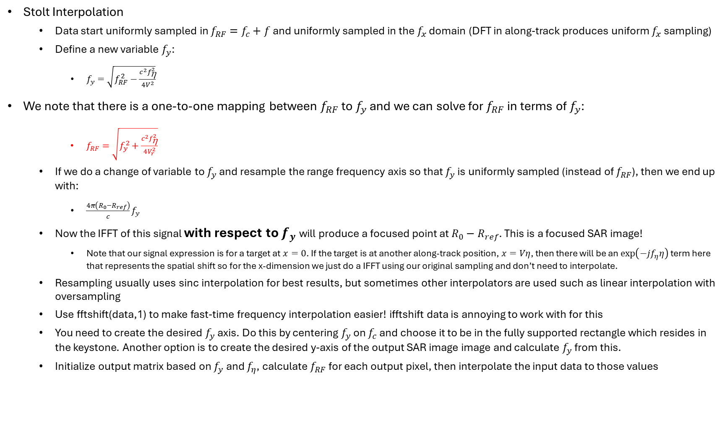
F-k migration: Step 3
Stolt Interpolation
  Data start uniformly sampled in $f_{RF}=f_{c}+f$ and uniformly sampled in the $f_{x}$ domain (DFT in along-track produces uniform $f_{x}$ sampling)
  Define a new variable $f_{y}$:
    $f_{y}=\sqrt{f_{RF}^{2}−\frac{c^{2}f_{\text{h}}^{2}}{4V^{2}}}$
We note that there is a one-to-one mapping between $f_{RF}$ to $f_{y}$ and we can solve for $f_{RF}$ in terms of $f_{y}$:
    $f_{RF}=\sqrt{f_{y}^{2}+\frac{c^{2}f_{\text{h}}^{2}}{4V_{r}^{2}}}$
  If we do a change of variable to $f_{y}$ and resample the range frequency axis so that $f_{y}$ is uniformly sampled (instead of $f_{RF}$), then we end up with:
    $\frac{4π\left(R_{0}−R_{ref}\right)}{c}f_{y}$
  Now the IFFT of this signal with respect to $f_{y}$ will produce a focused point at $R_{0}−R_{ref}$. This is a focused SAR image!
    Note that our signal expression is for a target at $x=0$. If the target is at another along-track position, $x=Vη$, then there will be an $\exp\left(−jf_{η}η\right)$ term here that represents the spatial shift so for the x-dimension we just do a IFFT using our original sampling and don’t need to interpolate.
  Resampling usually uses sinc interpolation for best results, but sometimes other interpolators are used such as linear interpolation with oversampling
  Use fftshift(data,1) to make fast-time frequency interpolation easier! ifftshift data is annoying to work with for this
  You need to create the desired $f_{y}$ axis. Do this by centering $f_{y}$ on $f_{c}$ and choose it to be in the fully supported rectangle which resides in the keystone. Another option is to create the desired y-axis of the output SAR image image and calculate $f_{y}$ from this.
  Initialize output matrix based on $f_{y}$ and $f_{η}$, calculate $f_{RF}$ for each output pixel, then interpolate the input data to those values

Slide 11
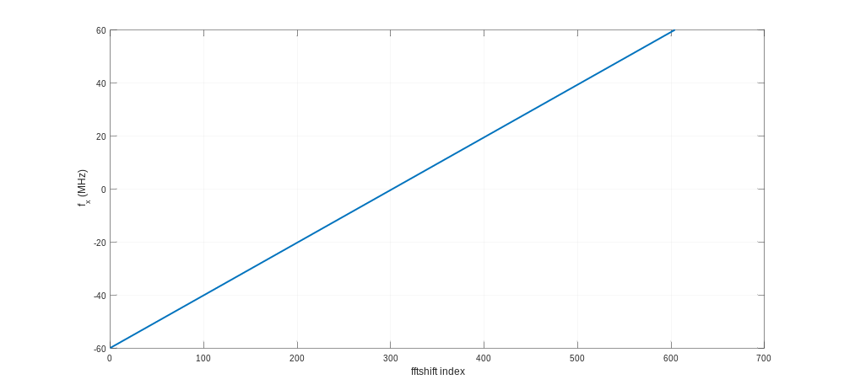

Along-track spatial frequency axis, $f_{x}$

Slide 12
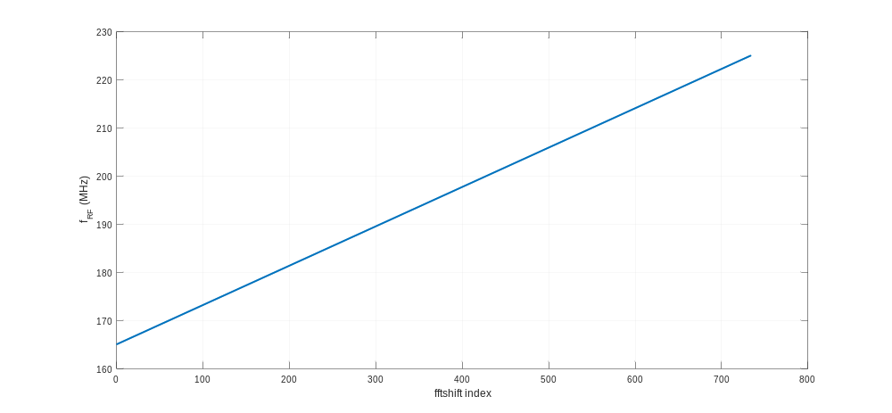

Frequency axis, $f_{c}+f$

Slide 13
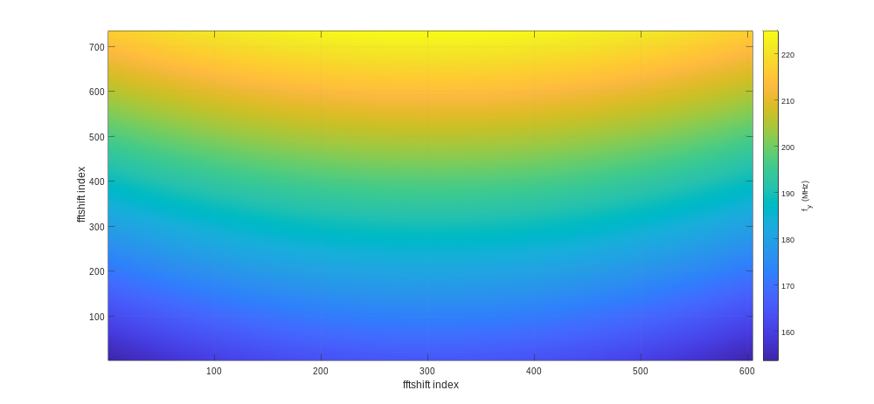

Range spatial frequency axis, $f_{y}$

Slide 14
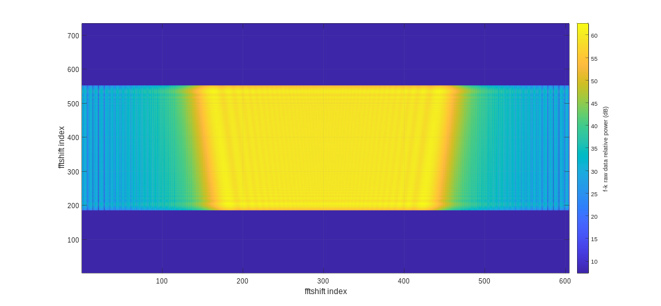
Raw data

Slide 15
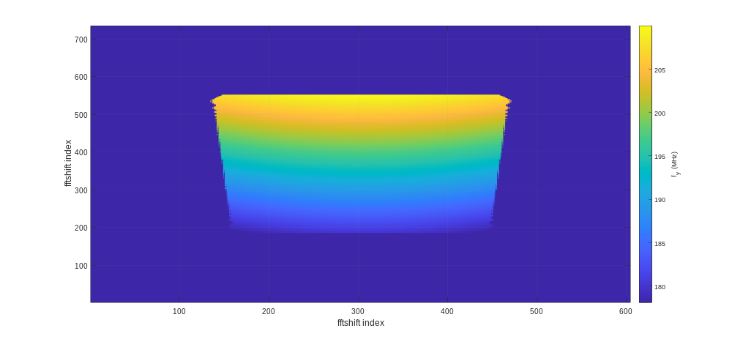

Range spatial frequency axis, $f_{y}$ (masked to data support)

Slide 16
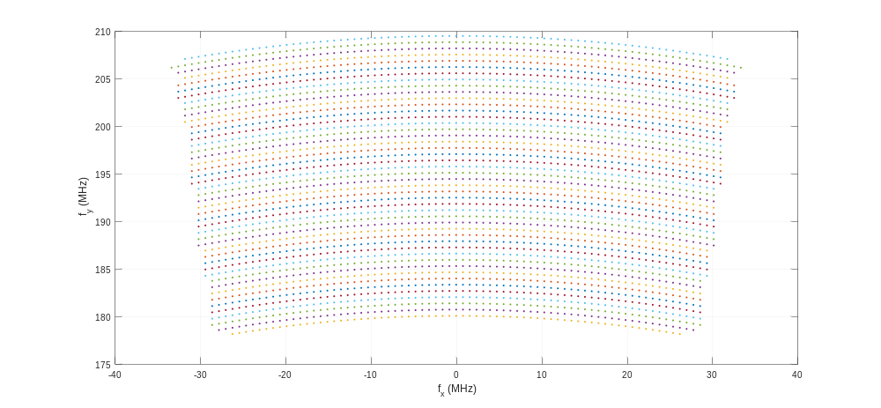
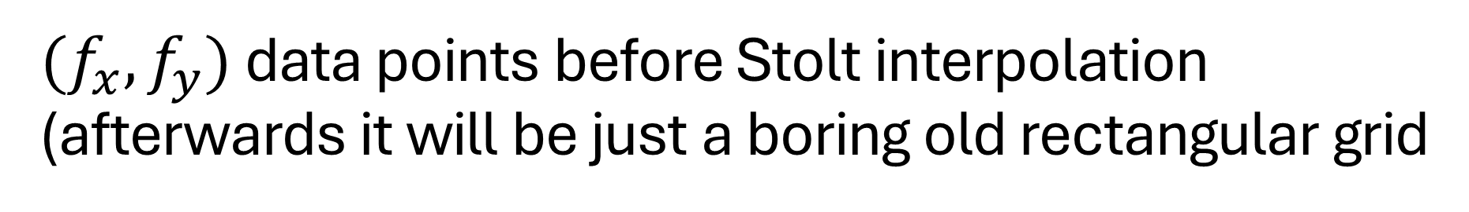
$(f_{x},f_{y})$ data points before Stolt interpolation (afterwards it will be just a boring old rectangular grid

Slide 17
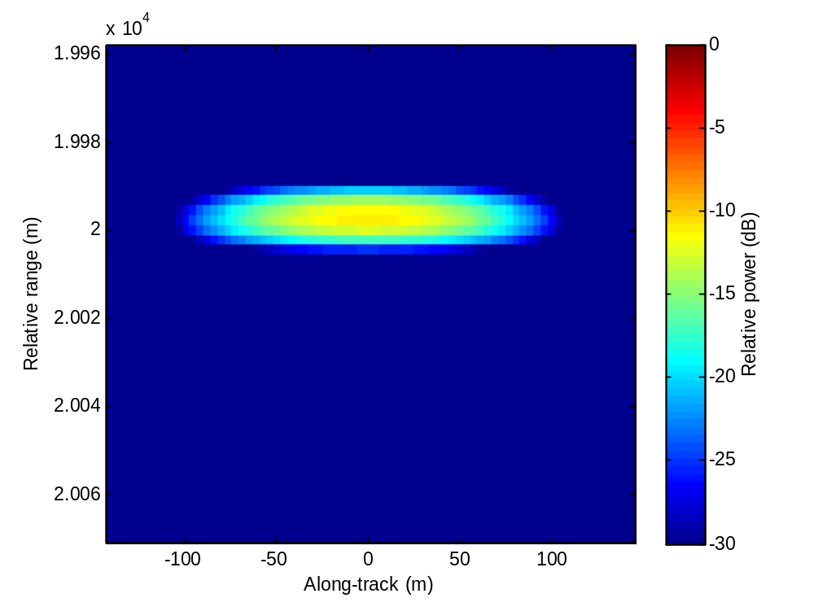
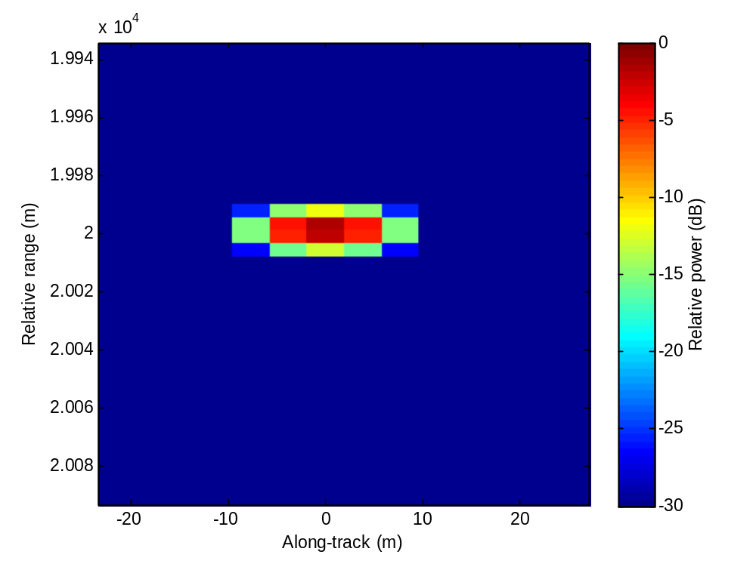
F-k migration: Step 4
Two-dimensional IFFT
  Transform to range-space domain
  Before and after Stolt interpolation for target a long way from the reference range.

