Slide 1
Chirp Scaling Algorithm
SAR Processor

Slide 2
CSA Background
Linear SAR (assume perfectly straight flight path)
  Same as for RDA
CSA is what most of the European satellite radar systems use (developed by Canada and DLR)

Slide 3










CSA Background
(Same as RDA!)

Slide 4



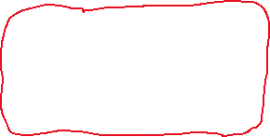


CSA Background
(Same as RDA!)

Slide 5
CSA Background
The primary difference is in how the 1D contour is delayed to create a 1D filter
Chirp scaling using a special property of linear FM chirps!

Slide 6
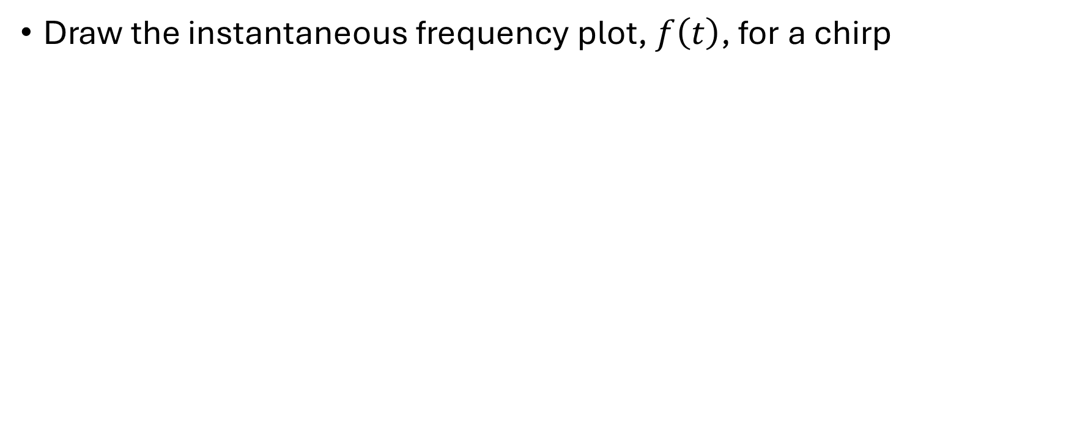
CSA Background
Draw the instantaneous frequency plot, $f\left(t\right)$, for a chirp

Slide 7

CSA Background
Draw the instantaneous frequency plot, $f\left(t\right)$, for a chirp

Slide 8

CSA Background
Now draw the instantaneous frequency plot after pulse compression

Slide 9
CSA Background
Now draw the instantaneous frequency plot after pulse compression

Slide 10
CSA Background
Now draw the instantaneous frequency plot with a frequency shift

Slide 11

CSA Background
Now draw the instantaneous frequency plot with a frequency shift

Slide 12
CSA Background
Now draw the instantaneous frequency plot after pulse compression

Slide 13
CSA Background
Now draw the instantaneous frequency plot after pulse compression

Slide 14
CSA Background
Now draw the instantaneous frequency plot after pulse compression and note it is not quite a perfect time shift

Slide 15
Chirp Scaling Algorithm (CSA)
The problem with RDA is that the RCMC interpolation is slow and requires SRC which is usually approximated with a fixed range.
Chirp scaling does the same thing as RDA (1D contour → 1D filter), but does the RCMC with chirp scaling which also makes the blurring from the Doppler Fourier transform smaller.
  Greater efficiency
  Better focusing
    Range/azimuth decoupling built into range compression (analogous to range Doppler algorithms secondary range compression)

Slide 16
Chirp Scaling
Chirp scaling provides a way to create an arbitrary time shift in the time domain with a simple component-wise multiply
  Normally to do an arbitrary time shift we would need to do this in the frequency domain. The problem with the frequency domain is that the filter is time invariant and all bins get shifted the same amount.
By applying a chirp in the time domain we can create a range varying time shift
Chirp scaling has its limits though as noted earlier, so it is best to do as little time shifting as possible with this method and use frequency domain shifting for the rest.
  So we’ll apply a “bulk” time shift with frequency domain shifting and a range dependent time shifting with chirp scaling

Slide 17
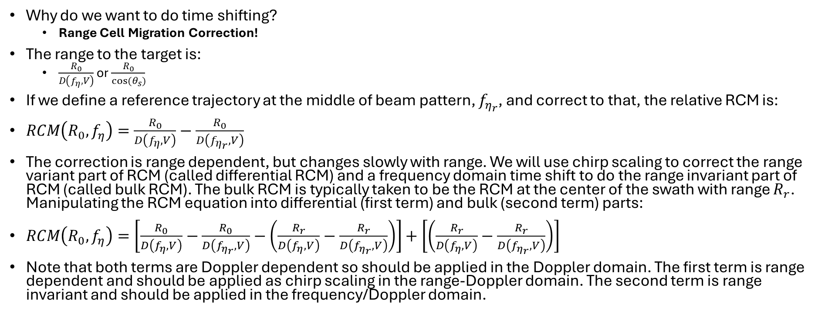
Chirp Scaling
Why do we want to do time shifting?
  Range Cell Migration Correction!
The range to the target is:
  $\frac{R_{0}}{D\left(f_{η},V\right)}$ or $\frac{R_{0}}{cos⁡(θ_{s})}$
If we define a reference trajectory at the middle of beam pattern, $f_{η_{r}}$, and correct to that, the relative RCM is:
$RCM\left(R_{0},f_{η}\right)=\frac{R_{0}}{D\left(f_{η},V\right)}−\frac{R_{0}}{D\left(f_{η_{r}},V\right)}$
The correction is range dependent, but changes slowly with range. We will use chirp scaling to correct the range variant part of RCM (called differential RCM) and a frequency domain time shift to do the range invariant part of RCM (called bulk RCM). The bulk RCM is typically taken to be the RCM at the center of the swath with range $R_{r}$. Manipulating the RCM equation into differential (first term) and bulk (second term) parts:
$RCM\left(R_{0},f_{η}\right)=\left[\frac{R_{0}}{D\left(f_{η},V\right)}−\frac{R_{0}}{D\left(f_{η_{r}},V\right)}−\left(\frac{R_{r}}{D\left(f_{η},V\right)}−\frac{R_{r}}{D\left(f_{η_{r}},V\right)}\right)\right]+\left[\left(\frac{R_{r}}{D\left(f_{η},V\right)}−\frac{R_{r}}{D\left(f_{η_{r}},V\right)}\right)\right]$
Note that both terms are Doppler dependent so should be applied in the Doppler domain. The first term is range dependent and should be applied as chirp scaling in the range-Doppler domain. The second term is range invariant and should be applied in the frequency/Doppler domain.

Slide 18
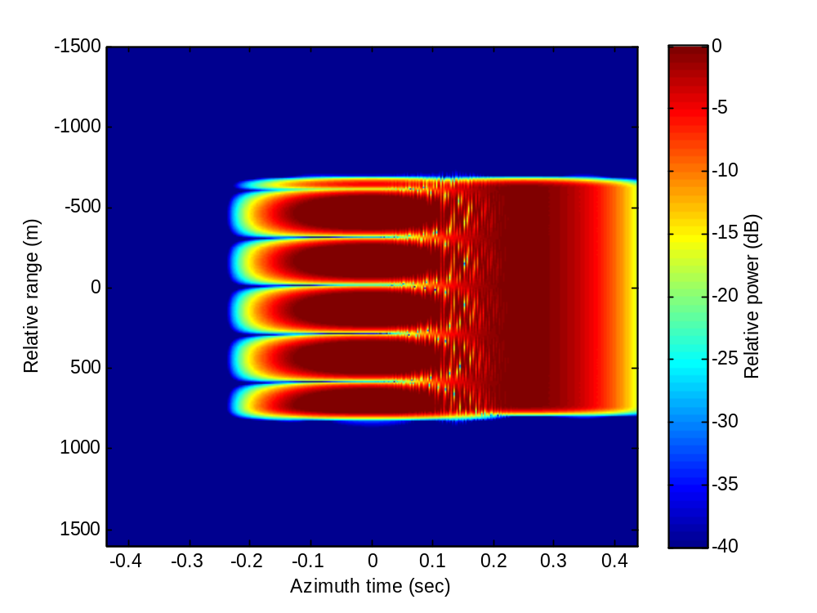
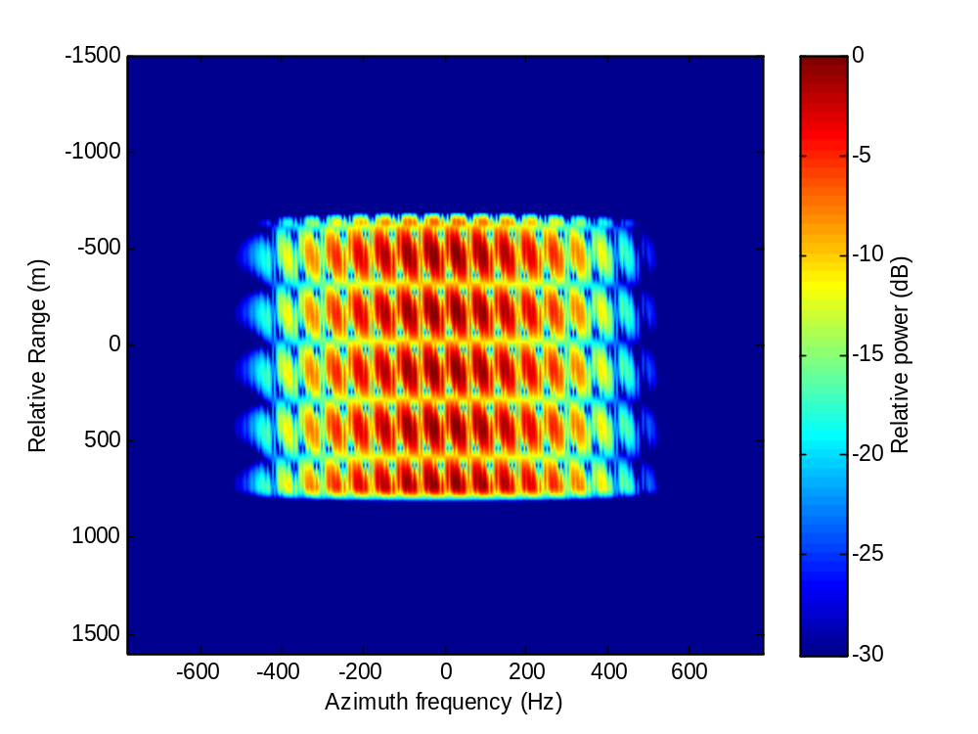
Chirp Scaling Algorithm (CSA): Step 1
Azimuth FFT
  Transform to range / Doppler domain

Slide 19
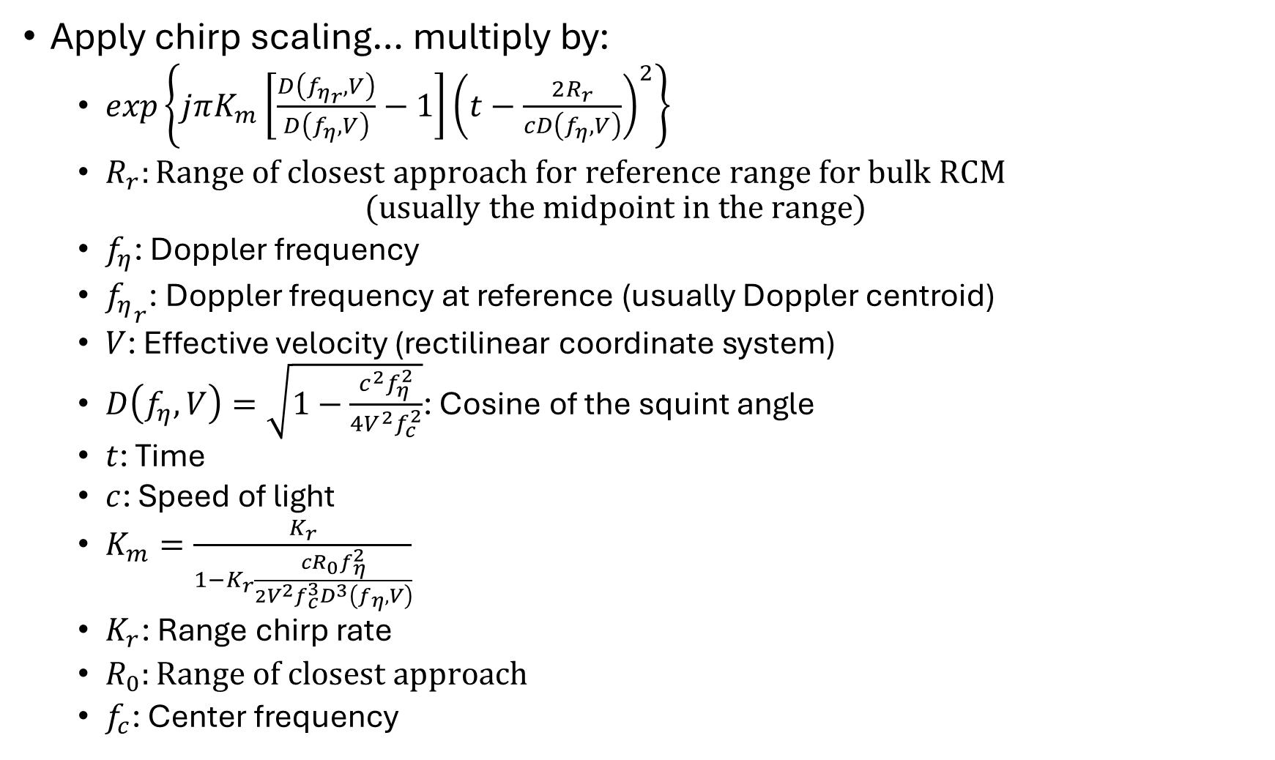
Chirp Scaling Algorithm (CSA): Step 2
Apply chirp scaling… multiply by:
  $exp\left\{jπK_{m}\left[\frac{D\left(f_{η_{r}},V\right)}{D\left(f_{η},V\right)}−1\right]{\left(t−\frac{2R_{r}}{cD\left(f_{η},V\right)}\right)}^{2}\right\}$
  $R_{r}:Range of closest approach for reference range for bulk RCM$
  $(usually the midpoint in the range)$
  $f_{η}$: Doppler frequency
  ${f_{η}}_{r} \text{: Doppler frequency}\text{ at reference (usually Doppler centroid)}$
  $V$: Effective velocity (rectilinear coordinate system)
  $D\left(f_{η},V\right)=\sqrt{1−\frac{c^{2}f_{η}^{2}}{4V^{2}f_{c}^{2}}}$: Cosine of the squint angle
  $t$: Time
  $c$: Speed of light
  $K_{m}=\frac{K_{r}}{1−K_{r}\frac{cR_{0}f_{η}^{2}}{2V^{2}f_{c}^{3}D^{3}\left(f_{η},V\right)}}$
  $K_{r}$: Range chirp rate
  $R_{0}:Range of closest approach$
  $f_{c}\text{: Center frequency}$

Slide 20
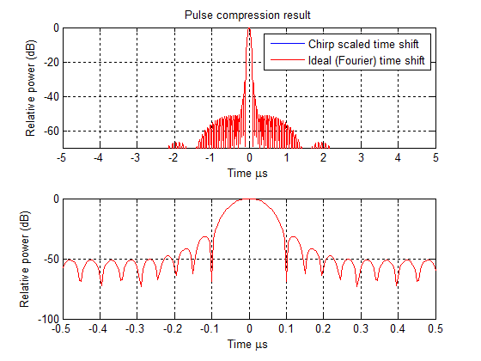
Notes:
Red line shows ideal (Fourier domain) time shift
Blue line shows chirp scaled time shift
20 MHz 10 us chirp: Animation shows from 0% to 10% of bandwidth chirp scaled

Slide 21
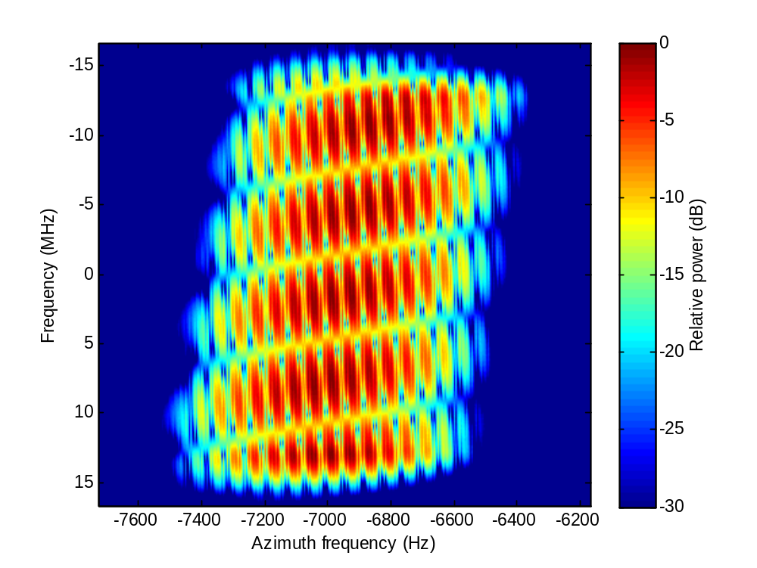
Chirp Scaling Algorithm (CSA): Step 3
Range FFT
  Transform to range-frequency / Doppler domain

Slide 22
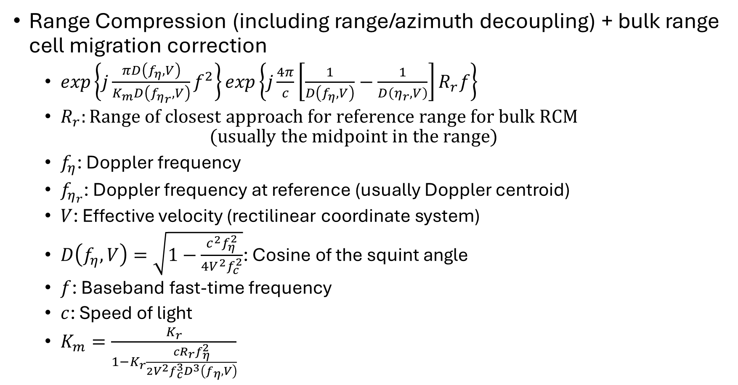
Chirp Scaling Algorithm (CSA): Step 4
Range Compression (including range/azimuth decoupling) + bulk range cell migration correction
  $exp\left\{j\frac{πD\left(f_{η},V\right)}{K_{m}D\left(f_{η_{r}},V\right)}f^{2}\right\}exp\left\{j\frac{4π}{c}\left[\frac{1}{D\left(f_{η},V\right)}−\frac{1}{D\left(η_{r},V\right)}\right]R_{r}f\right\}$
  $R_{r}:Range of closest approach for reference range for bulk RCM$
  $(usually the midpoint in the range)$
  $f_{η}$: Doppler frequency
  $f_{η_{r}}\text{: Doppler frequency at reference (usually Doppler centroid)}$
  $V$: Effective velocity (rectilinear coordinate system)
  $D\left(f_{η},V\right)=\sqrt{1−\frac{c^{2}f_{η}^{2}}{4V^{2}f_{c}^{2}}}$: Cosine of the squint angle
  $f$: Baseband fast-time frequency
  $c$: Speed of light
  $K_{m}=\frac{K_{r}}{1−K_{r}\frac{cR_{r}f_{η}^{2}}{2V^{2}f_{c}^{3}D^{3}\left(f_{η},V\right)}}$

Slide 23
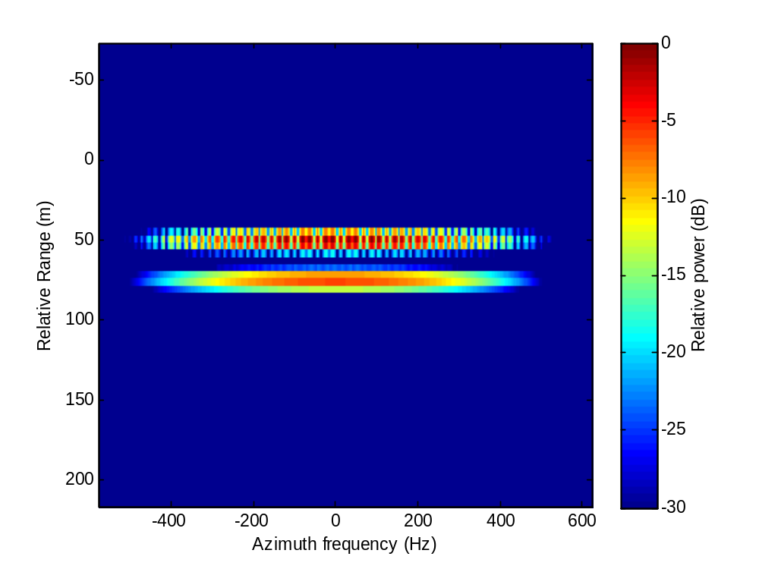
Chirp Scaling Algorithm (CSA): Step 5
Range IFFT
  Transform to range / Doppler domain

Slide 24
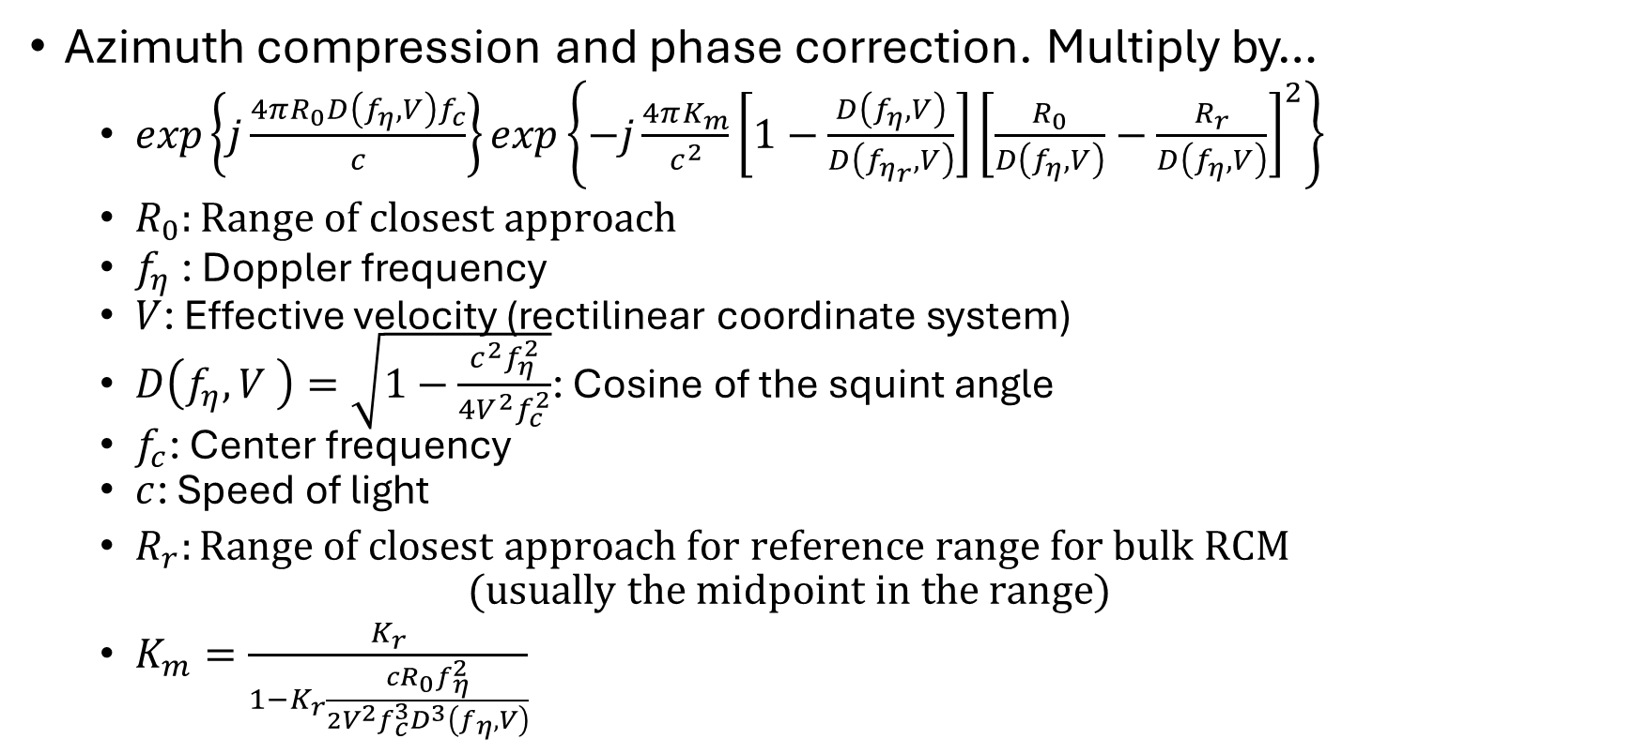
Chirp Scaling Algorithm (CSA): Step 6
Azimuth compression and phase correction. Multiply by…
  $exp\left\{j\frac{4πR_{0}D\left(f_{η},V\right)f_{c}}{c}\right\}exp\left\{−j\frac{4πK_{m}}{c^{2}}\left[1−\frac{D\left(f_{η},V\right)}{D\left(f_{η_{r}},V\right)}\right]{\left[\frac{R_{0}}{D\left(f_{η},V\right)}−\frac{R_{r}}{D\left(f_{η},V\right)}\right]}^{2}\right\}$
  $R_{0}:Range of closest approach$
  $f_{η}$: Doppler frequency
  $V$: Effective velocity (rectilinear coordinate system)
  $D\left(f_{η},V \right)=\sqrt{1−\frac{c^{2}f_{η}^{2}}{4V^{2}f_{c}^{2}}}$: Cosine of the squint angle
  $f_{c}$: Center frequency
  $c$: Speed of light
  $R_{r}:Range of closest approach for reference range for bulk RCM$
  $(usually the midpoint in the range)$
  $K_{m}=\frac{K_{r}}{1−K_{r}\frac{cR_{0}f_{η}^{2}}{2V^{2}f_{c}^{3}D^{3}\left(f_{η},V\right)}}$

Slide 25
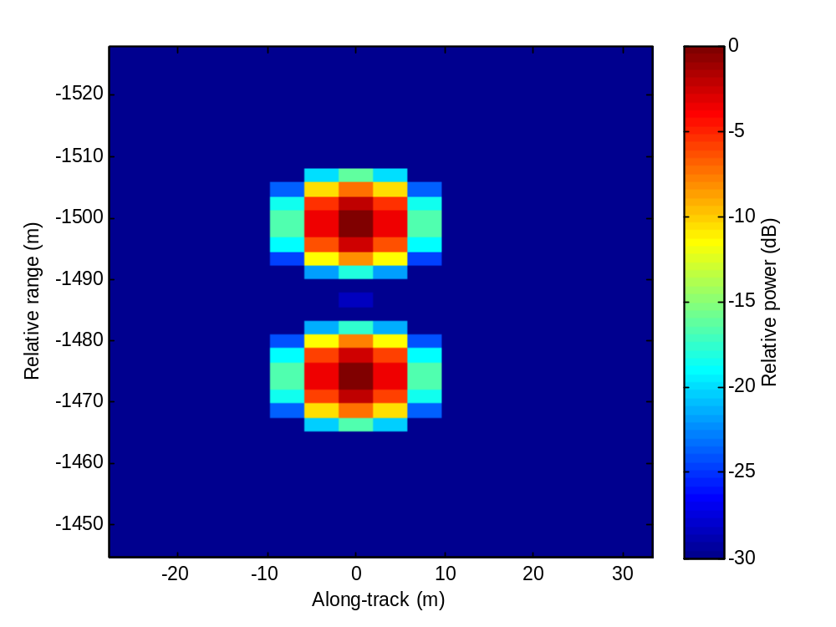
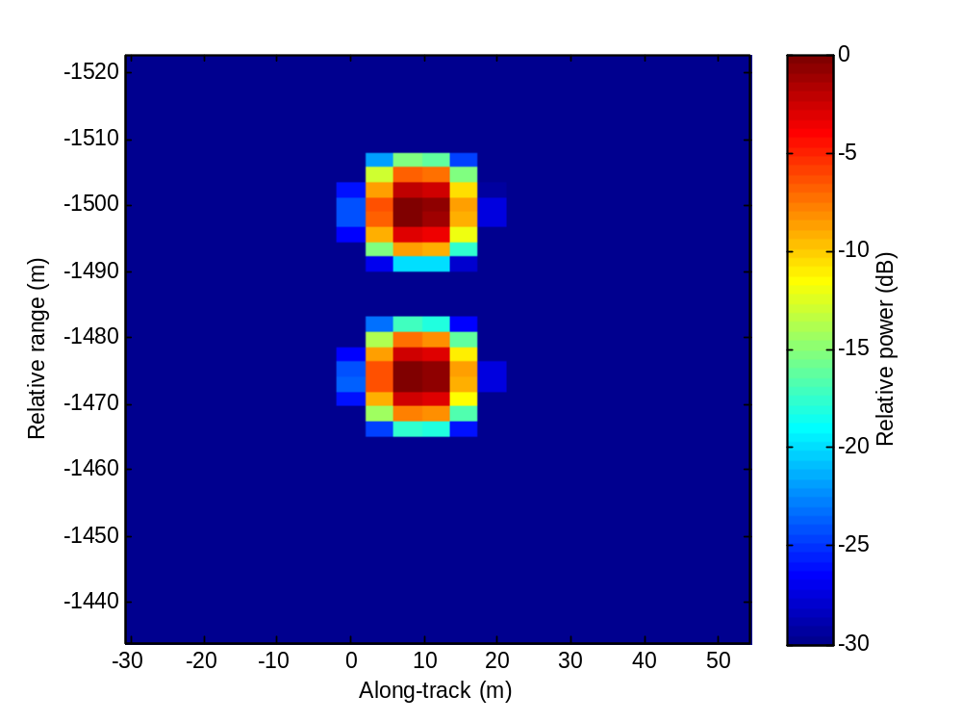
Chirp Scaling Algorithm (CSA): Step 7
Azimuth IFFT
  Transform to range / azimuth-space domain

Slide 26
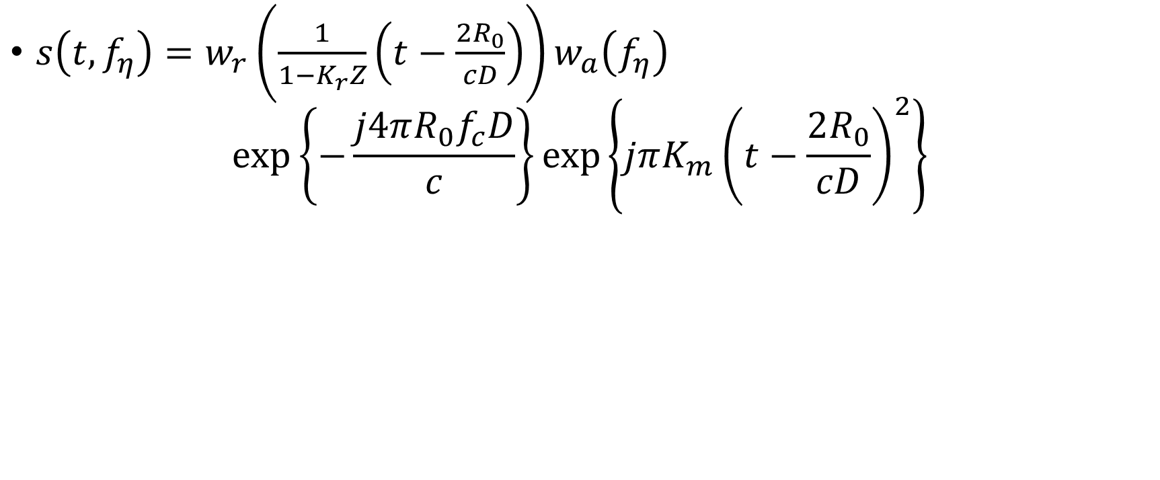
CSA starts in the Range-Doppler Domain
$s\left(t,f_{η}\right)=w_{r}\left(\frac{1}{1−K_{r}Z}\left(t−\frac{2R_{0}}{cD}\right)\right)w_{a}\left(f_{η}\right)$
$$\exp\left\{−\frac{j4πR_{0}f_{c}D}{c}\right\}\exp\left\{jπK_{m}{\left(t−\frac{2R_{0}}{cD}\right)}^{2}\right\}$$

Slide 27
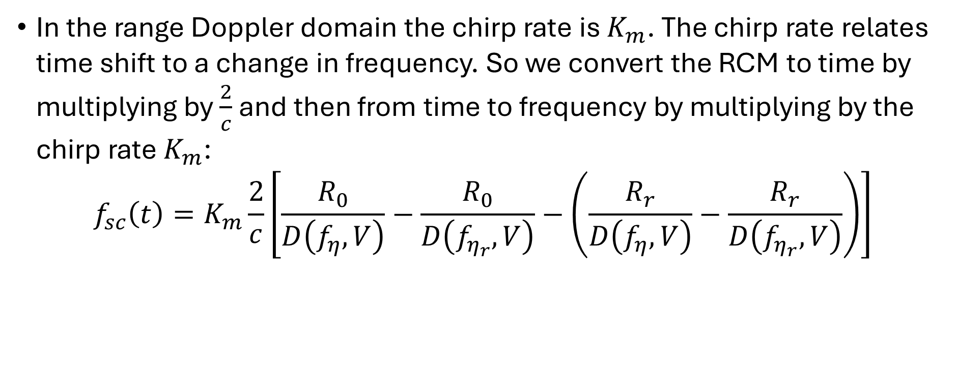
Chirp Scaling Frequency Term for Differential RCM
In the range Doppler domain the chirp rate is $K_{m}$. The chirp rate relates time shift to a change in frequency. So we convert the RCM to time by multiplying by $\frac{2}{c}$ and then from time to frequency by multiplying by the chirp rate $K_{m}$:
$$f_{sc}\left(t\right)=K_{m}\frac{2}{c}\left[\frac{R_{0}}{D\left(f_{η},V\right)}−\frac{R_{0}}{D\left(f_{η_{r}},V\right)}−\left(\frac{R_{r}}{D\left(f_{η},V\right)}−\frac{R_{r}}{D\left(f_{η_{r}},V\right)}\right)\right]$$

Slide 28
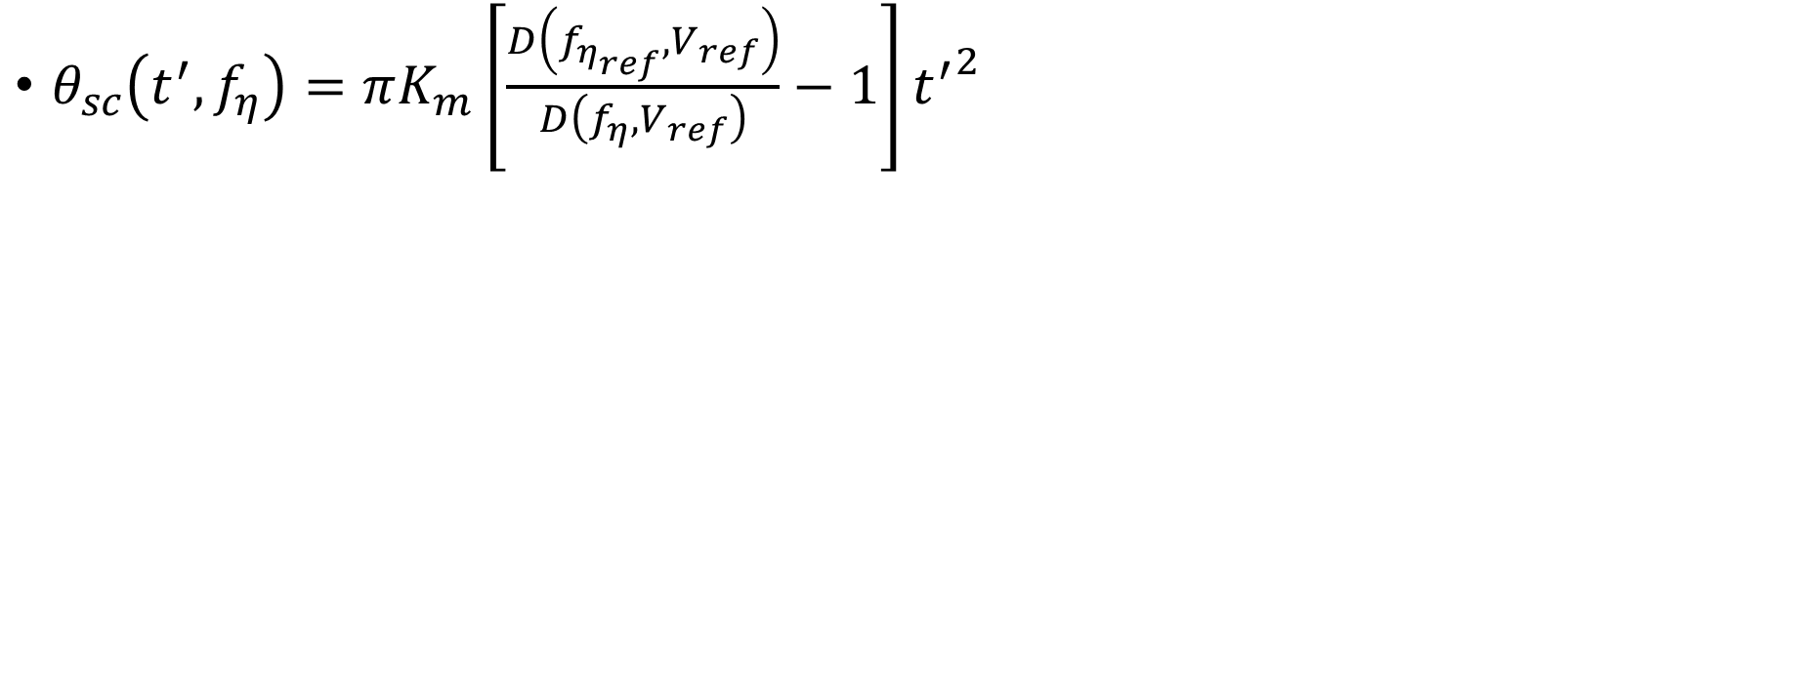
Convert Frequency Term to Phase Term
$θ_{sc}\left(t^{′},f_{η}\right)=πK_{m}\left[\frac{D\left(f_{η_{ref}},V_{ref}\right)}{D\left(f_{η},V_{ref}\right)}−1\right]{t^{′}}^{2}$

Slide 29
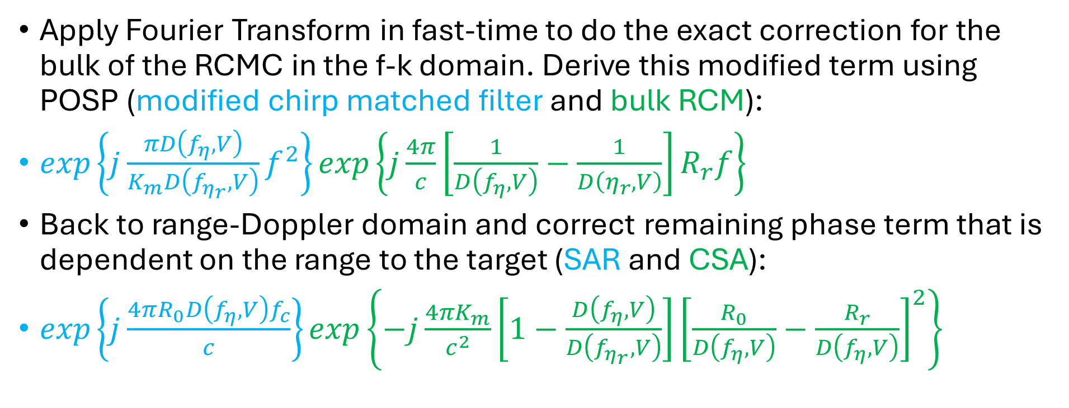
Chirp Scaling Azimuth Correction
Apply Fourier Transform in fast-time to do the exact correction for the bulk of the RCMC in the f-k domain. Derive this modified term using POSP (modified chirp matched filter and bulk RCM):
$exp\left\{j\frac{πD\left(f_{η},V\right)}{K_{m}D\left(f_{η_{r}},V\right)}f^{2}\right\}exp\left\{j\frac{4π}{c}\left[\frac{1}{D\left(f_{η},V\right)}−\frac{1}{D\left(η_{r},V\right)}\right]R_{r}f\right\}$
Back to range-Doppler domain and correct remaining phase term that is dependent on the range to the target (SAR and CSA):
$exp\left\{j\frac{4πR_{0}D\left(f_{η},V\right)f_{c}}{c}\right\}exp\left\{−j\frac{4πK_{m}}{c^{2}}\left[1−\frac{D\left(f_{η},V\right)}{D\left(f_{η_{r}},V\right)}\right]{\left[\frac{R_{0}}{D\left(f_{η},V\right)}−\frac{R_{r}}{D\left(f_{η},V\right)}\right]}^{2}\right\}$

Slide 30
CSA Derivations

Slide 31
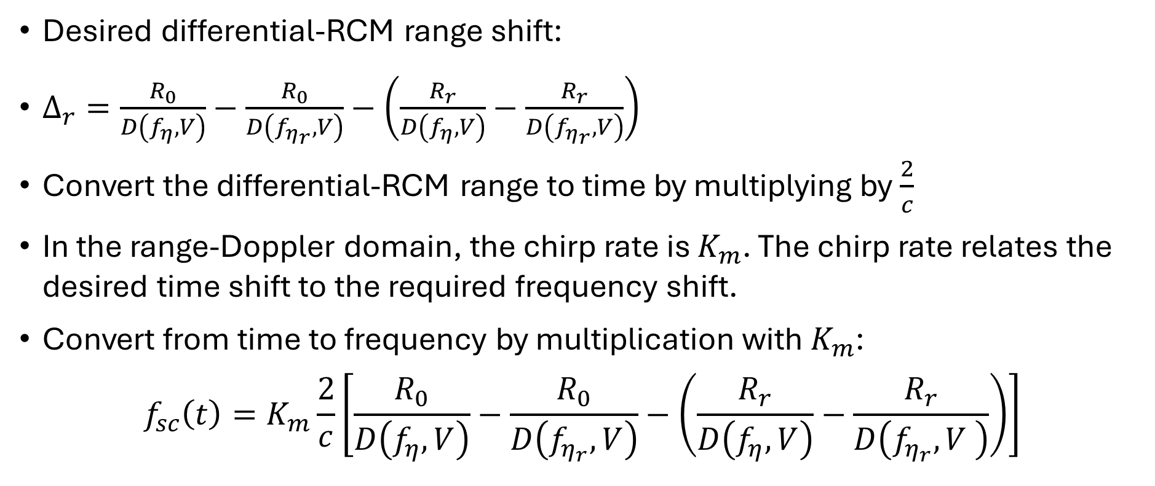
Frequency Scaling or Shift Term
Desired differential-RCM range shift:
$Δ_{r}=\frac{R_{0}}{D\left(f_{η},V\right)}−\frac{R_{0}}{D\left(f_{η_{r}},V\right)}−\left(\frac{R_{r}}{D\left(f_{η},V\right)}−\frac{R_{r}}{D\left(f_{η_{r}},V\right)}\right)$
Convert the differential-RCM range to time by multiplying by $\frac{2}{c}$
In the range-Doppler domain, the chirp rate is $K_{m}$. The chirp rate relates the desired time shift to the required frequency shift.
Convert from time to frequency by multiplication with $K_{m}$:
$$f_{sc}\left(t\right)=K_{m}\frac{2}{c}\left[\frac{R_{0}}{D\left(f_{η},V\right)}−\frac{R_{0}}{D\left(f_{η_{r}},V\right)}−\left(\frac{R_{r}}{D\left(f_{η},V\right)}−\frac{R_{r}}{D\left(f_{η_{r}},V \right)}\right)\right]$$

Slide 32
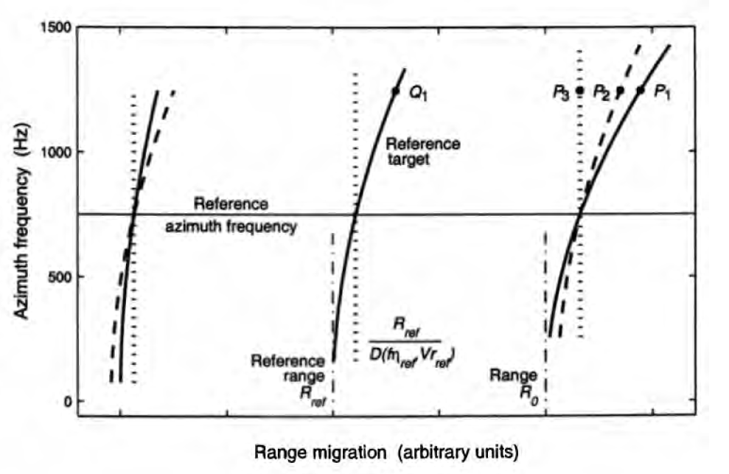


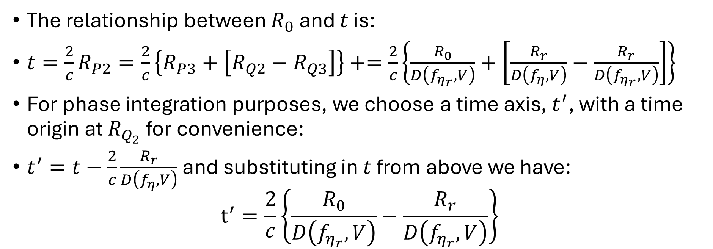
Frequency Scaling or Shift Term
The relationship between $R_{0}$ and $t$ is:
$t=\frac{2}{c}R_{P2}=\frac{2}{c}\left\{R_{P3}+\left[R_{Q2}−R_{Q3}\right]\right\}+=\frac{2}{c}\left\{\frac{R_{0}}{D\left(f_{η_{r}},V\right)}+\left[\frac{R_{r}}{D\left(f_{η},V\right)}−\frac{R_{r}}{D\left(f_{η_{r}},V\right)}\right]\right\}$
For phase integration purposes, we choose a time axis, $t^{′}$, with a time origin at $R_{Q_{2}}$ for convenience:
$t^{′}=t−\frac{2}{c}\frac{R_{r}}{D\left(f_{η},V\right)}$ and substituting in $t$ from above we have:
$$t^{′}=\frac{2}{c}\left\{\frac{R_{0}}{D\left(f_{η_{r}},V\right)}−\frac{R_{r}}{D\left(f_{η_{r}},V\right)}\right\}$$

Slide 33
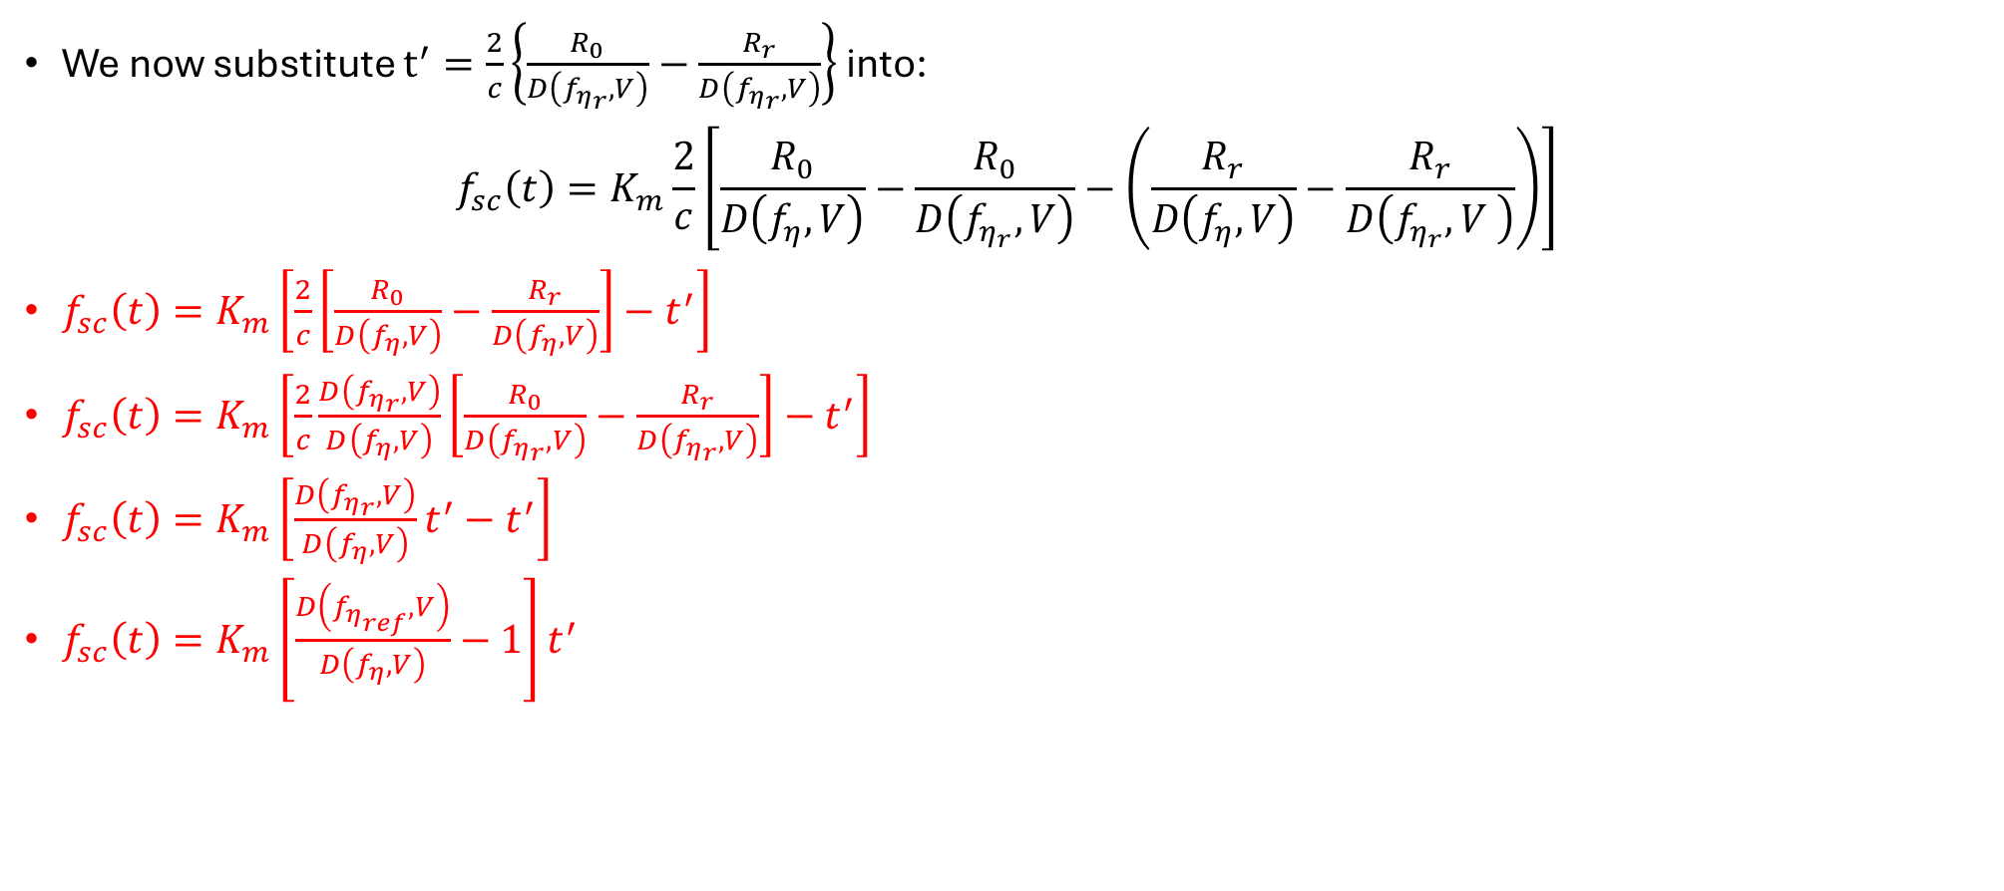
Frequency Scaling or Shift Term
We now substitute $t^{′}=\frac{2}{c}\left\{\frac{R_{0}}{D\left(f_{η_{r}},V\right)}−\frac{R_{r}}{D\left(f_{η_{r}},V\right)}\right\}$ into:
$$f_{sc}\left(t\right)=K_{m}\frac{2}{c}\left[\frac{R_{0}}{D\left(f_{η},V\right)}−\frac{R_{0}}{D\left(f_{η_{r}},V\right)}−\left(\frac{R_{r}}{D\left(f_{η},V\right)}−\frac{R_{r}}{D\left(f_{η_{r}},V \right)}\right)\right]$$
$f_{sc}\left(t\right)=K_{m}\left[\frac{2}{c}\left[\frac{R_{0}}{D\left(f_{η},V\right)}−\frac{R_{r}}{D\left(f_{η},V\right)}\right]−t^{′}\right]$
$f_{sc}\left(t\right)=K_{m}\left[\frac{2}{c}\frac{D\left(f_{η_{r}},V\right)}{D\left(f_{η},V\right)}\left[\frac{R_{0}}{D\left(f_{η_{r}},V\right)}−\frac{R_{r}}{D\left(f_{η_{r}},V\right)}\right]−t^{′}\right]$
$f_{sc}\left(t\right)=K_{m}\left[\frac{D\left(f_{η_{r}},V\right)}{D\left(f_{η},V\right)}t^{′}−t^{′}\right]$
$f_{sc}\left(t\right)=K_{m}\left[\frac{D\left(f_{η_{ref}},V\right)}{D\left(f_{η},V\right)}−1\right]t^{′}$

Slide 34
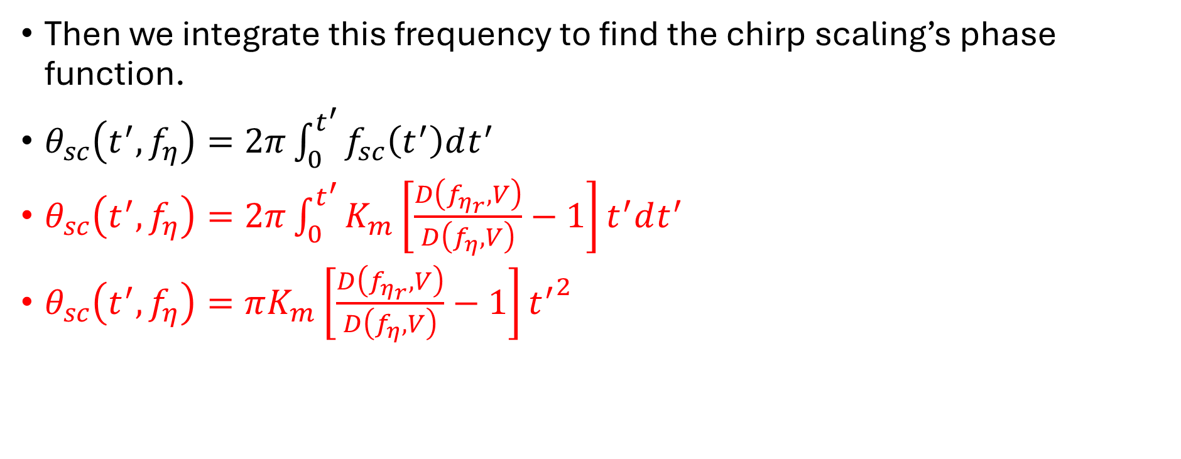
Phase Scaling Term
Then we integrate this frequency to find the chirp scaling’s phase function.
$θ_{sc}\left(t^{′},f_{η}\right)=2π\int_{0}^{t^{′}}{f_{sc}\left(t^{′}\right)dt^{′}}$
$θ_{sc}\left(t^{′},f_{η}\right)=2π\int_{0}^{t^{′}}{K_{m}\left[\frac{D\left(f_{η_{r}},V\right)}{D\left(f_{η},V\right)}−1\right]t^{′}dt^{′}}$
$θ_{sc}\left(t^{′},f_{η}\right)=πK_{m}\left[\frac{D\left(f_{η_{r}},V\right)}{D\left(f_{η},V\right)}−1\right]{t^{′}}^{2}$

Slide 35
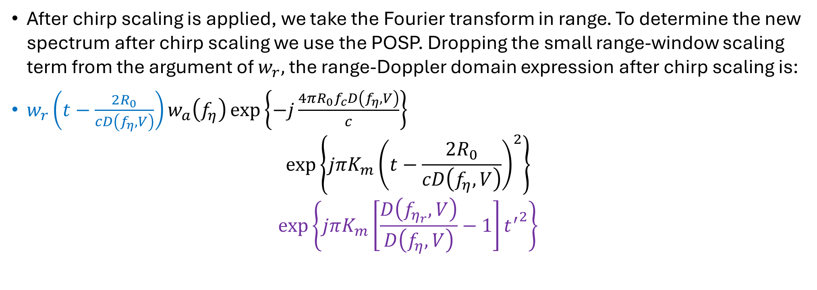
POSP of Range Fourier Transform
After chirp scaling is applied, we take the Fourier transform in range. To determine the new spectrum after chirp scaling we use the POSP. Dropping the small range-window scaling term from the argument of $w_{r},$the range-Doppler domain expression after chirp scaling is:
$w_{r}\left(t−\frac{2R_{0}}{cD\left(f_{η},V\right)}\right)w_{a}\left(f_{η}\right)\exp\left\{−j\frac{4πR_{0}f_{c}D\left(f_{η},V\right)}{c}\right\}$
$$\exp\left\{jπK_{m}{\left(t−\frac{2R_{0}}{cD\left(f_{η},V\right)}\right)}^{2}\right\}$$
$$\exp\left\{jπK_{m}\left[\frac{D\left(f_{η_{r}},V\right)}{D\left(f_{η},V\right)}−1\right]{t^{′}}^{2}\right\}$$

Slide 36
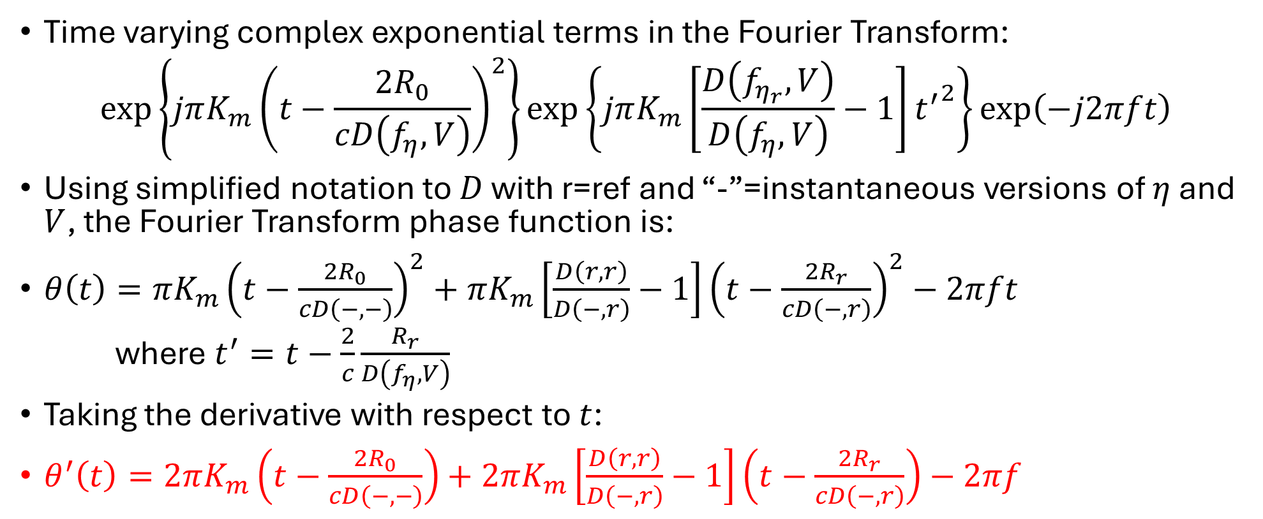
POSP of Range Fourier Transform
Time varying complex exponential terms in the Fourier Transform:
$$\exp\left\{jπK_{m}{\left(t−\frac{2R_{0}}{cD\left(f_{η},V\right)}\right)}^{2}\right\}\exp\left\{jπK_{m}\left[\frac{D\left(f_{η_{r}},V\right)}{D\left(f_{η},V\right)}−1\right]{t^{′}}^{2}\right\}\exp\left(−j2πft\right)$$
Using simplified notation to $D$ with r=ref and “-”=instantaneous versions of $η$ and $V$, the Fourier Transform phase function is:
$θ\left(t\right)=πK_{m}{\left(t−\frac{2R_{0}}{cD\left(−,−\right)}\right)}^{2}+πK_{m}\left[\frac{D\left(r,r\right)}{D\left(−,r\right)}−1\right]{\left(t−\frac{2R_{r}}{cD\left(−,r\right)}\right)}^{2}−2πft$
where $t^{′}=t−\frac{2}{c}\frac{R_{r}}{D\left(f_{η},V\right)}$
Taking the derivative with respect to $t$:
$θ^{′}\left(t\right)=2πK_{m}\left(t−\frac{2R_{0}}{cD\left(−,−\right)}\right)+2πK_{m}\left[\frac{D\left(r,r\right)}{D\left(−,r\right)}−1\right]\left(t−\frac{2R_{r}}{cD\left(−,r\right)}\right)−2πf$

Slide 37
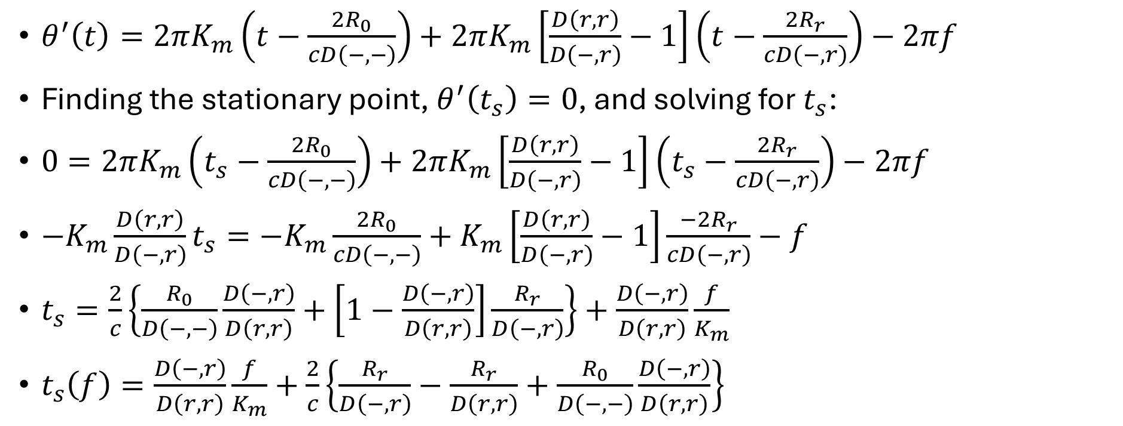
POSP of Range Fourier Transform
$θ^{′}\left(t\right)=2πK_{m}\left(t−\frac{2R_{0}}{cD\left(−,−\right)}\right)+2πK_{m}\left[\frac{D\left(r,r\right)}{D\left(−,r\right)}−1\right]\left(t−\frac{2R_{r}}{cD\left(−,r\right)}\right)−2πf$
Finding the stationary point, $θ^{′}\left(t_{s}\right)=0$, and solving for $t_{s}$:
$0=2πK_{m}\left(t_{s}−\frac{2R_{0}}{cD\left(−,−\right)}\right)+2πK_{m}\left[\frac{D\left(r,r\right)}{D\left(−,r\right)}−1\right]\left(t_{s}−\frac{2R_{r}}{cD\left(−,r\right)}\right)−2πf$
$−K_{m}\frac{D\left(r,r\right)}{D\left(−,r\right)}t_{s}=−K_{m}\frac{2R_{0}}{cD\left(−,−\right)}+K_{m}\left[\frac{D\left(r,r\right)}{D\left(−,r\right)}−1\right]\frac{−2R_{r}}{cD\left(−,r\right)}−f$
$t_{s}=\frac{2}{c}\left\{\frac{R_{0}}{D\left(−,−\right)}\frac{D\left(−,r\right)}{D\left(r,r\right)}+\left[1−\frac{D\left(−,r\right)}{D\left(r,r\right)}\right]\frac{R_{r}}{D\left(−,r\right)}\right\}+\frac{D\left(−,r\right)}{D\left(r,r\right)}\frac{f}{K_{m}}$
$t_{s}\left(f\right)=\frac{D\left(−,r\right)}{D\left(r,r\right)}\frac{f}{K_{m}}+\frac{2}{c}\left\{\frac{R_{r}}{D\left(−,r\right)}−\frac{R_{r}}{D\left(r,r\right)}+\frac{R_{0}}{D\left(−,−\right)}\frac{D\left(−,r\right)}{D\left(r,r\right)}\right\}$

Slide 38
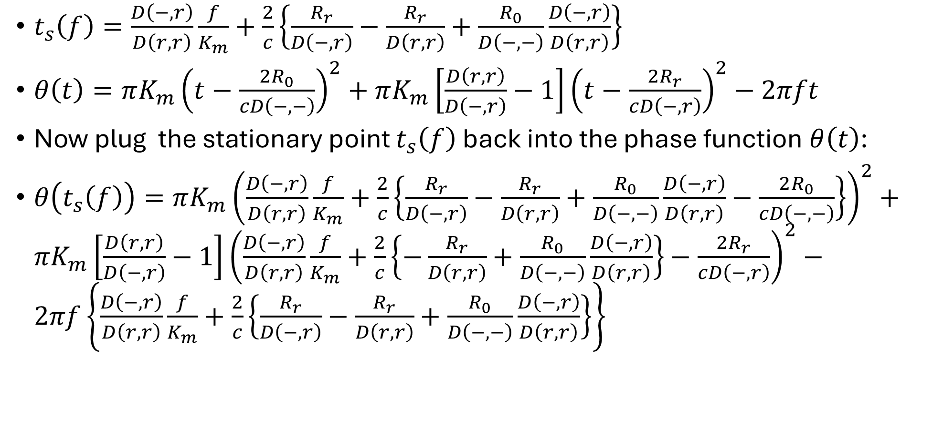
POSP of Range Fourier Transform
$t_{s}\left(f\right)=\frac{D\left(−,r\right)}{D\left(r,r\right)}\frac{f}{K_{m}}+\frac{2}{c}\left\{\frac{R_{r}}{D\left(−,r\right)}−\frac{R_{r}}{D\left(r,r\right)}+\frac{R_{0}}{D\left(−,−\right)}\frac{D\left(−,r\right)}{D\left(r,r\right)}\right\}$
$θ\left(t\right)=πK_{m}{\left(t−\frac{2R_{0}}{cD\left(−,−\right)}\right)}^{2}+πK_{m}\left[\frac{D\left(r,r\right)}{D\left(−,r\right)}−1\right]{\left(t−\frac{2R_{r}}{cD\left(−,r\right)}\right)}^{2}−2πft$
Now plug the stationary point $t_{s}\left(f\right)$ back into the phase function $θ\left(t\right)$:
$θ\left(t_{s}\left(f\right)\right)=πK_{m}{\left(\frac{D\left(−,r\right)}{D\left(r,r\right)}\frac{f}{K_{m}}+\frac{2}{c}\left\{\frac{R_{r}}{D\left(−,r\right)}−\frac{R_{r}}{D\left(r,r\right)}+\frac{R_{0}}{D\left(−,−\right)}\frac{D\left(−,r\right)}{D\left(r,r\right)}−\frac{2R_{0}}{cD\left(−,−\right)}\right\}\right)}^{2}+πK_{m}\left[\frac{D\left(r,r\right)}{D\left(−,r\right)}−1\right]{\left(\frac{D\left(−,r\right)}{D\left(r,r\right)}\frac{f}{K_{m}}+\frac{2}{c}\left\{−\frac{R_{r}}{D\left(r,r\right)}+\frac{R_{0}}{D\left(−,−\right)}\frac{D\left(−,r\right)}{D\left(r,r\right)}\right\}−\frac{2R_{r}}{cD\left(−,r\right)}\right)}^{2}−2πf\left\{\frac{D\left(−,r\right)}{D\left(r,r\right)}\frac{f}{K_{m}}+\frac{2}{c}\left\{\frac{R_{r}}{D\left(−,r\right)}−\frac{R_{r}}{D\left(r,r\right)}+\frac{R_{0}}{D\left(−,−\right)}\frac{D\left(−,r\right)}{D\left(r,r\right)}\right\}\right\}$

Slide 39
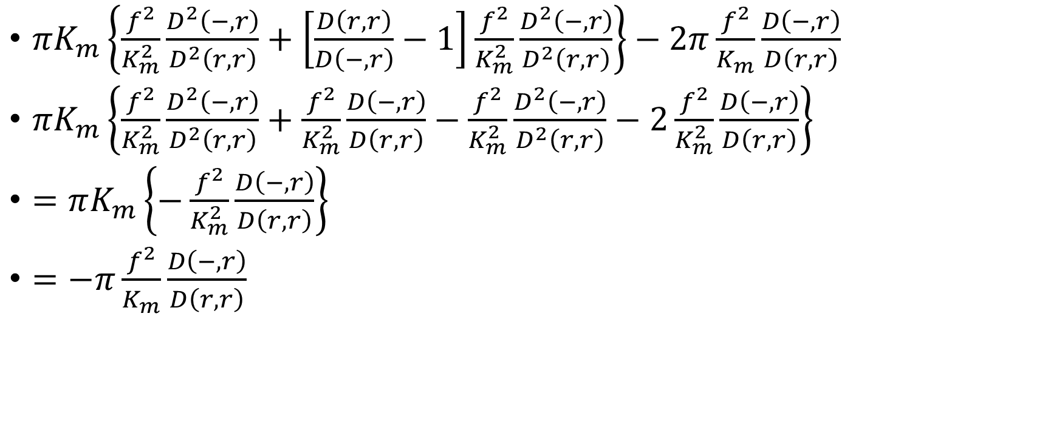
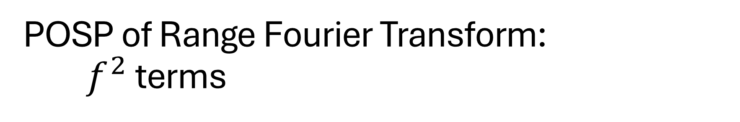
POSP of Range Fourier Transform:
$f^{2}$ terms
$πK_{m}\left\{\frac{f^{2}}{K_{m}^{2}}\frac{D^{2}\left(−,r\right)}{D^{2}\left(r,r\right)}+\left[\frac{D\left(r,r\right)}{D\left(−,r\right)}−1\right]\frac{f^{2}}{K_{m}^{2}}\frac{D^{2}\left(−,r\right)}{D^{2}\left(r,r\right)}\right\}−2π\frac{f^{2}}{K_{m}}\frac{D\left(−,r\right)}{D\left(r,r\right)}$
$πK_{m}\left\{\frac{f^{2}}{K_{m}^{2}}\frac{D^{2}\left(−,r\right)}{D^{2}\left(r,r\right)}+\frac{f^{2}}{K_{m}^{2}}\frac{D\left(−,r\right)}{D\left(r,r\right)}−\frac{f^{2}}{K_{m}^{2}}\frac{D^{2}\left(−,r\right)}{D^{2}\left(r,r\right)}−2\frac{f^{2}}{K_{m}^{2}}\frac{D\left(−,r\right)}{D\left(r,r\right)}\right\}$
$=πK_{m}\left\{−\frac{f^{2}}{K_{m}^{2}}\frac{D\left(−,r\right)}{D\left(r,r\right)}\right\}$
$=−π\frac{f^{2}}{K_{m}}\frac{D\left(−,r\right)}{D\left(r,r\right)}$

Slide 40
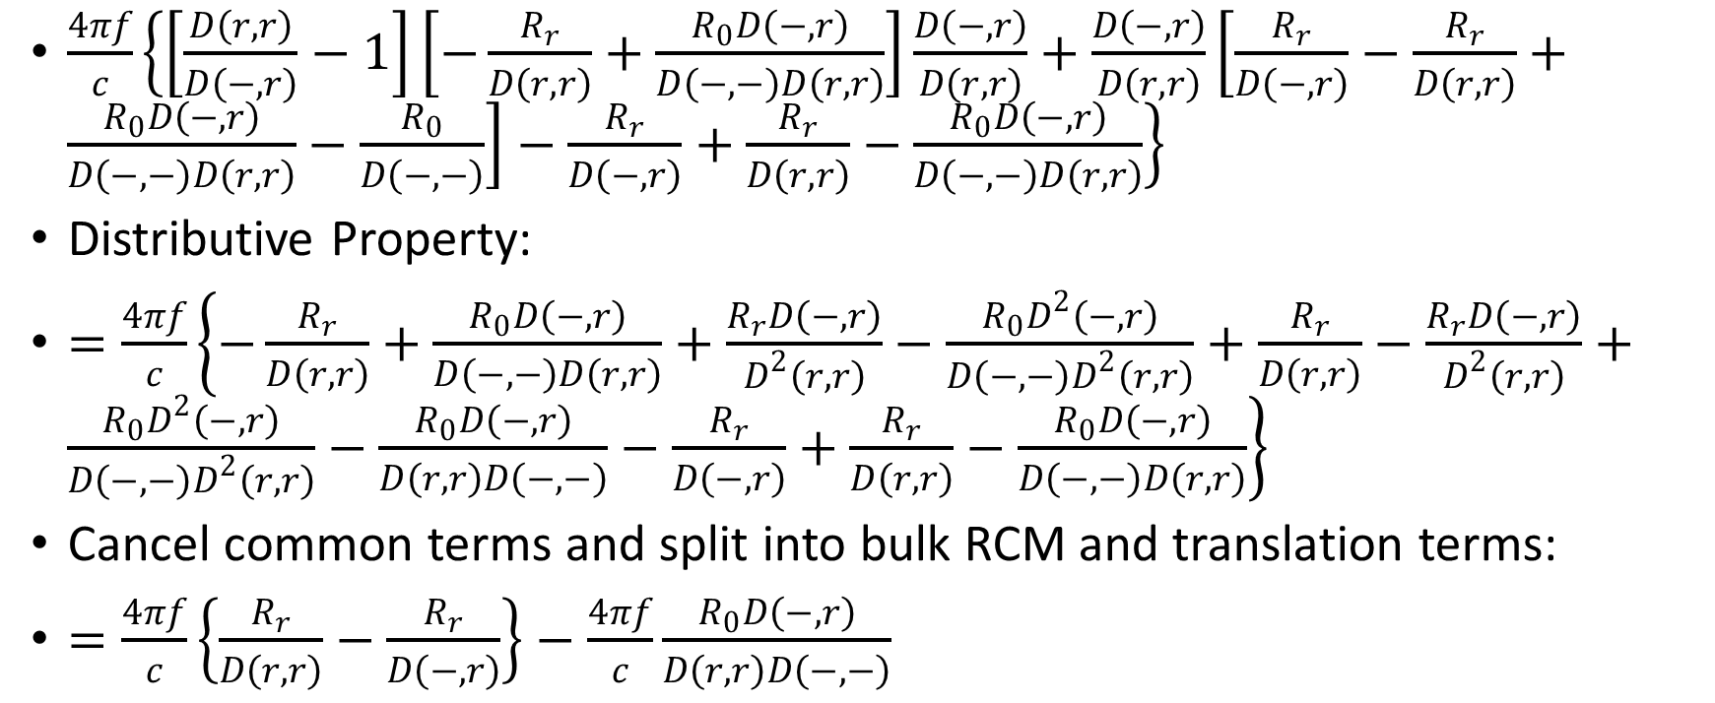
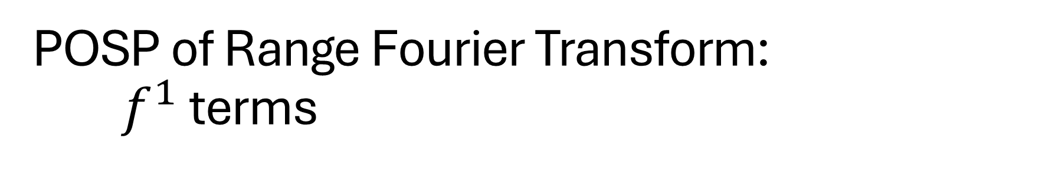
POSP of Range Fourier Transform:
$f^{1}$ terms
$\frac{4πf}{c}\left\{\left[\frac{D\left(r,r\right)}{D\left(−,r\right)}−1\right]\left[−\frac{R_{r}}{D\left(r,r\right)}+\frac{R_{0}D\left(−,r\right)}{D\left(−,−\right)D\left(r,r\right)}\right]\frac{D\left(−,r\right)}{D\left(r,r\right)}+\frac{D\left(−,r\right)}{D\left(r,r\right)}\left[\frac{R_{r}}{D\left(−,r\right)}−\frac{R_{r}}{D\left(r,r\right)}+\frac{R_{0}D\left(−,r\right)}{D\left(−,−\right)D\left(r,r\right)}−\frac{R_{0}}{D\left(−,−\right)}\right]−\frac{R_{r}}{D\left(−,r\right)}+\frac{R_{r}}{D\left(r,r\right)}−\frac{R_{0}D\left(−,r\right)}{D\left(−,−\right)D\left(r,r\right)}\right\}$
Distributive Property:
$=\frac{4πf}{c}\left\{−\frac{R_{r}}{D\left(r,r\right)}+\frac{R_{0}D\left(−,r\right)}{D\left(−,−\right)D\left(r,r\right)}+\frac{R_{r}D\left(−,r\right)}{D^{2}\left(r,r\right)}−\frac{R_{0}D^{2}\left(−,r\right)}{D\left(−,−\right)D^{2}\left(r,r\right)}+\frac{R_{r}}{D\left(r,r\right)}−\frac{R_{r}D\left(−,r\right)}{D^{2}\left(r,r\right)}+\frac{R_{0}D^{2}\left(−,r\right)}{D\left(−,−\right)D^{2}\left(r,r\right)}−\frac{R_{0}D\left(−,r\right)}{D\left(r,r\right)D\left(−,−\right)}−\frac{R_{r}}{D\left(−,r\right)}+\frac{R_{r}}{D\left(r,r\right)}−\frac{R_{0}D\left(−,r\right)}{D\left(−,−\right)D\left(r,r\right)}\right\}$
Cancel common terms and split into bulk RCM and translation terms:
$=\frac{4πf}{c}\left\{\frac{R_{r}}{D\left(r,r\right)}−\frac{R_{r}}{D\left(−,r\right)}\right\}−\frac{4πf}{c}\frac{R_{0}D\left(−,r\right)}{D\left(r,r\right)D\left(−,−\right)}$

Slide 41
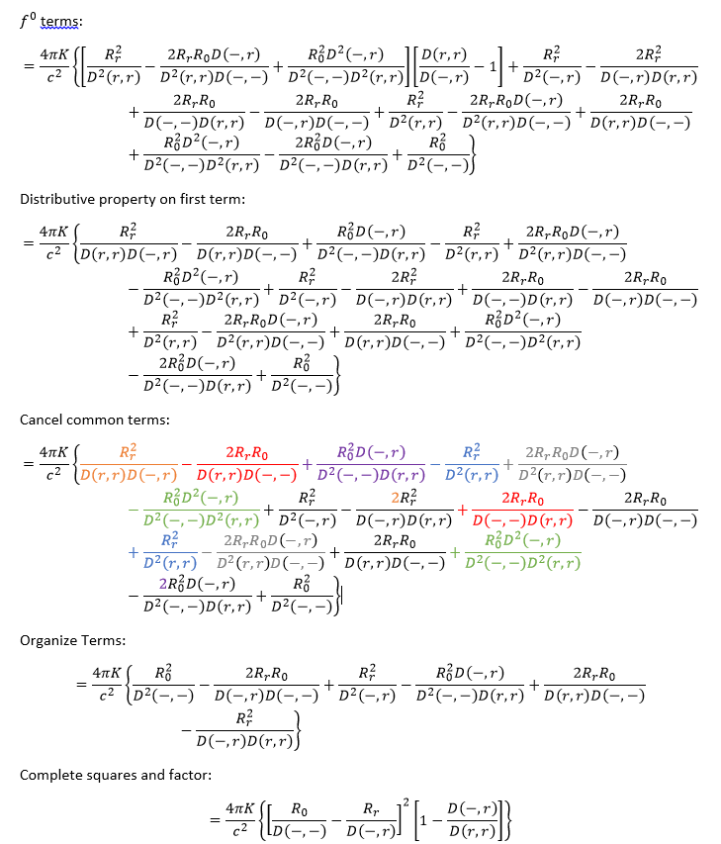
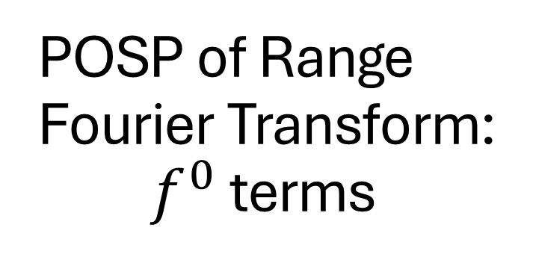
POSP of Range Fourier Transform:
$f^{0}$ terms

Slide 42
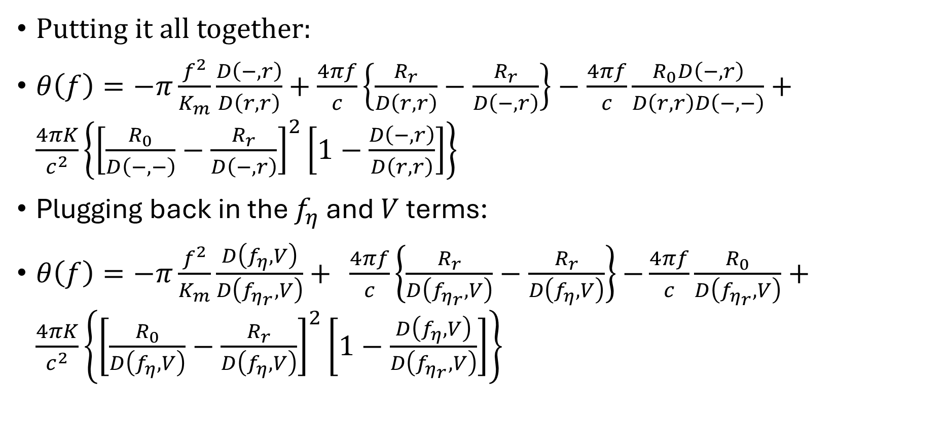
POSP of Range Fourier Transform
Putting it all together:
$θ\left(f\right)=−π\frac{f^{2}}{K_{m}}\frac{D\left(−,r\right)}{D\left(r,r\right)}+$ $\frac{4πf}{c}\left\{\frac{R_{r}}{D\left(r,r\right)}−\frac{R_{r}}{D\left(−,r\right)}\right\}−\frac{4πf}{c}\frac{R_{0}D\left(−,r\right)}{D\left(r,r\right)D\left(−,−\right)}+\frac{4πK}{c^{2}}\left\{{\left[\frac{R_{0}}{D\left(−,−\right)}−\frac{R_{r}}{D\left(−,r\right)}\right]}^{2}\left[1−\frac{D\left(−,r\right)}{D\left(r,r\right)}\right]\right\}$
Plugging back in the $f_{η}$ and $V$ terms:
$θ\left(f\right)=−π\frac{f^{2}}{K_{m}}\frac{D\left(f_{η},V\right)}{D\left(f_{η_{r}},V\right)}+ \frac{4πf}{c}\left\{\frac{R_{r}}{D\left(f_{η_{r}},V\right)}−\frac{R_{r}}{D\left(f_{η},V\right)}\right\}$ $−\frac{4πf}{c}\frac{R_{0}}{D\left(f_{η_{r}},V\right)}+\frac{4πK}{c^{2}}\left\{{\left[\frac{R_{0}}{D\left(f_{η},V\right)}−\frac{R_{r}}{D\left(f_{η},V\right)}\right]}^{2}\left[1−\frac{D\left(f_{η},V\right)}{D\left(f_{η_{r}},V\right)}\right]\right\}$

Slide 43
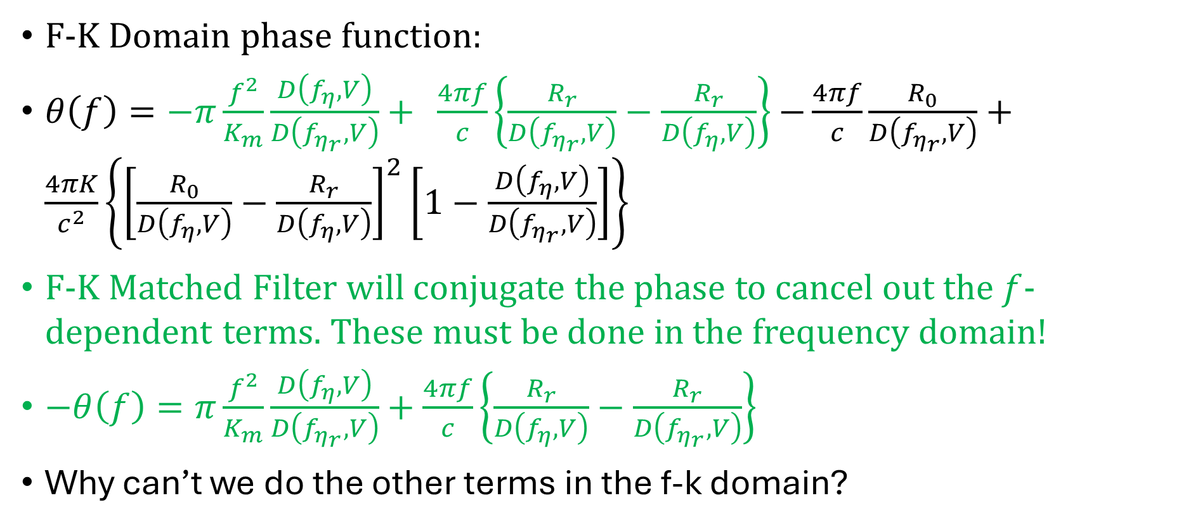
CSA Algorithm Step 4
F-K Domain phase function:
$θ\left(f\right)=−π\frac{f^{2}}{K_{m}}\frac{D\left(f_{η},V\right)}{D\left(f_{η_{r}},V\right)}+ \frac{4πf}{c}\left\{\frac{R_{r}}{D\left(f_{η_{r}},V\right)}−\frac{R_{r}}{D\left(f_{η},V\right)}\right\}$ $−\frac{4πf}{c}\frac{R_{0}}{D\left(f_{η_{r}},V\right)}+\frac{4πK}{c^{2}}\left\{{\left[\frac{R_{0}}{D\left(f_{η},V\right)}−\frac{R_{r}}{D\left(f_{η},V\right)}\right]}^{2}\left[1−\frac{D\left(f_{η},V\right)}{D\left(f_{η_{r}},V\right)}\right]\right\}$
F-K Matched Filter will conjugate the phase to cancel out the $f$-dependent terms. These must be done in the frequency domain!
$−θ\left(f\right)=π\frac{f^{2}}{K_{m}}\frac{D\left(f_{η},V\right)}{D\left(f_{η_{r}},V\right)}+$ $\frac{4πf}{c}\left\{\frac{R_{r}}{D\left(f_{η},V\right)}−\frac{R_{r}}{D\left(f_{η_{r}},V\right)}\right\}$
Why can’t we do the other terms in the f-k domain?

Slide 44
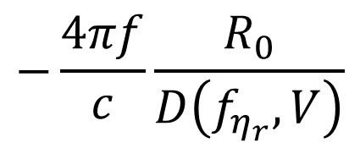
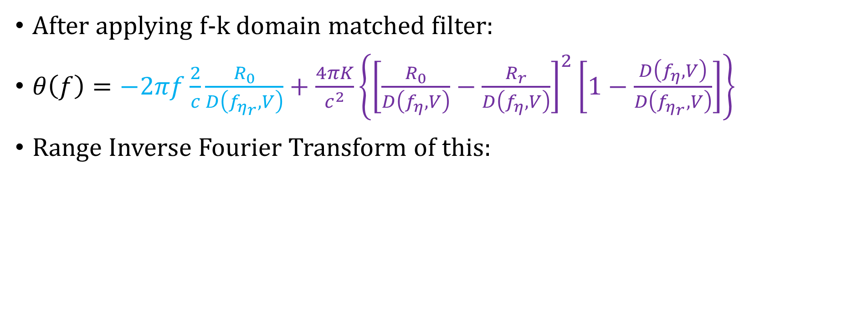
CSA Algorithm Step 5
$$−\frac{4πf}{c}\frac{R_{0}}{D\left(f_{η_{r}},V\right)}$$
After applying f-k domain matched filter:
$θ\left(f\right)=−2πf\frac{2}{c}\frac{R_{0}}{D\left(f_{η_{r}},V\right)}+\frac{4πK}{c^{2}}\left\{{\left[\frac{R_{0}}{D\left(f_{η},V\right)}−\frac{R_{r}}{D\left(f_{η},V\right)}\right]}^{2}\left[1−\frac{D\left(f_{η},V\right)}{D\left(f_{η_{r}},V\right)}\right]\right\}$
Range Inverse Fourier Transform of this:

Slide 45
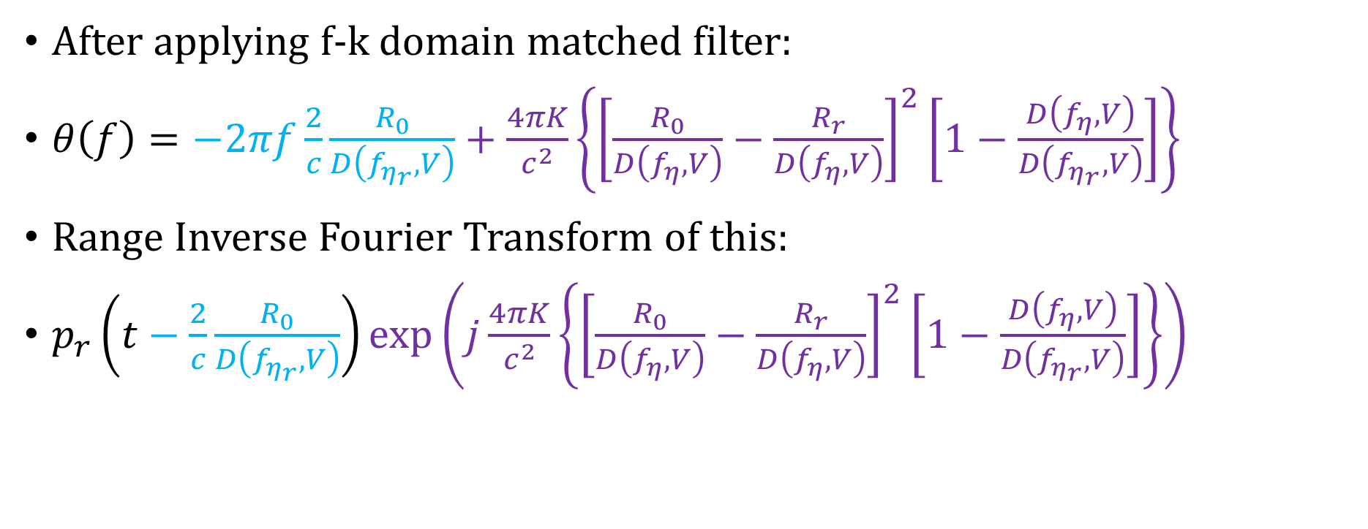
CSA Algorithm Step 5
After applying f-k domain matched filter:
$θ\left(f\right)=−2πf\frac{2}{c}\frac{R_{0}}{D\left(f_{η_{r}},V\right)}+\frac{4πK}{c^{2}}\left\{{\left[\frac{R_{0}}{D\left(f_{η},V\right)}−\frac{R_{r}}{D\left(f_{η},V\right)}\right]}^{2}\left[1−\frac{D\left(f_{η},V\right)}{D\left(f_{η_{r}},V\right)}\right]\right\}$
Range Inverse Fourier Transform of this:
$p_{r}\left(t−\frac{2}{c}\frac{R_{0}}{D\left(f_{η_{r}},V\right)}\right)\exp\left(j\frac{4πK}{c^{2}}\left\{{\left[\frac{R_{0}}{D\left(f_{η},V\right)}−\frac{R_{r}}{D\left(f_{η},V\right)}\right]}^{2}\left[1−\frac{D\left(f_{η},V\right)}{D\left(f_{η_{r}},V\right)}\right]\right\}\right)$

Slide 46
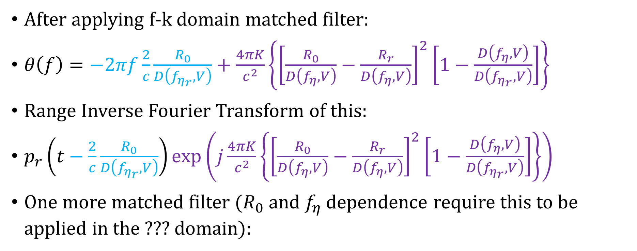
POSP of Range Fourier Transform
After applying f-k domain matched filter:
$θ\left(f\right)=−2πf\frac{2}{c}\frac{R_{0}}{D\left(f_{η_{r}},V\right)}+\frac{4πK}{c^{2}}\left\{{\left[\frac{R_{0}}{D\left(f_{η},V\right)}−\frac{R_{r}}{D\left(f_{η},V\right)}\right]}^{2}\left[1−\frac{D\left(f_{η},V\right)}{D\left(f_{η_{r}},V\right)}\right]\right\}$
Range Inverse Fourier Transform of this:
$p_{r}\left(t−\frac{2}{c}\frac{R_{0}}{D\left(f_{η_{r}},V\right)}\right)\exp\left(j\frac{4πK}{c^{2}}\left\{{\left[\frac{R_{0}}{D\left(f_{η},V\right)}−\frac{R_{r}}{D\left(f_{η},V\right)}\right]}^{2}\left[1−\frac{D\left(f_{η},V\right)}{D\left(f_{η_{r}},V\right)}\right]\right\}\right)$
One more matched filter ($R_{0}$ and $f_{η}$ dependence require this to be applied in the ??? domain):

Slide 47
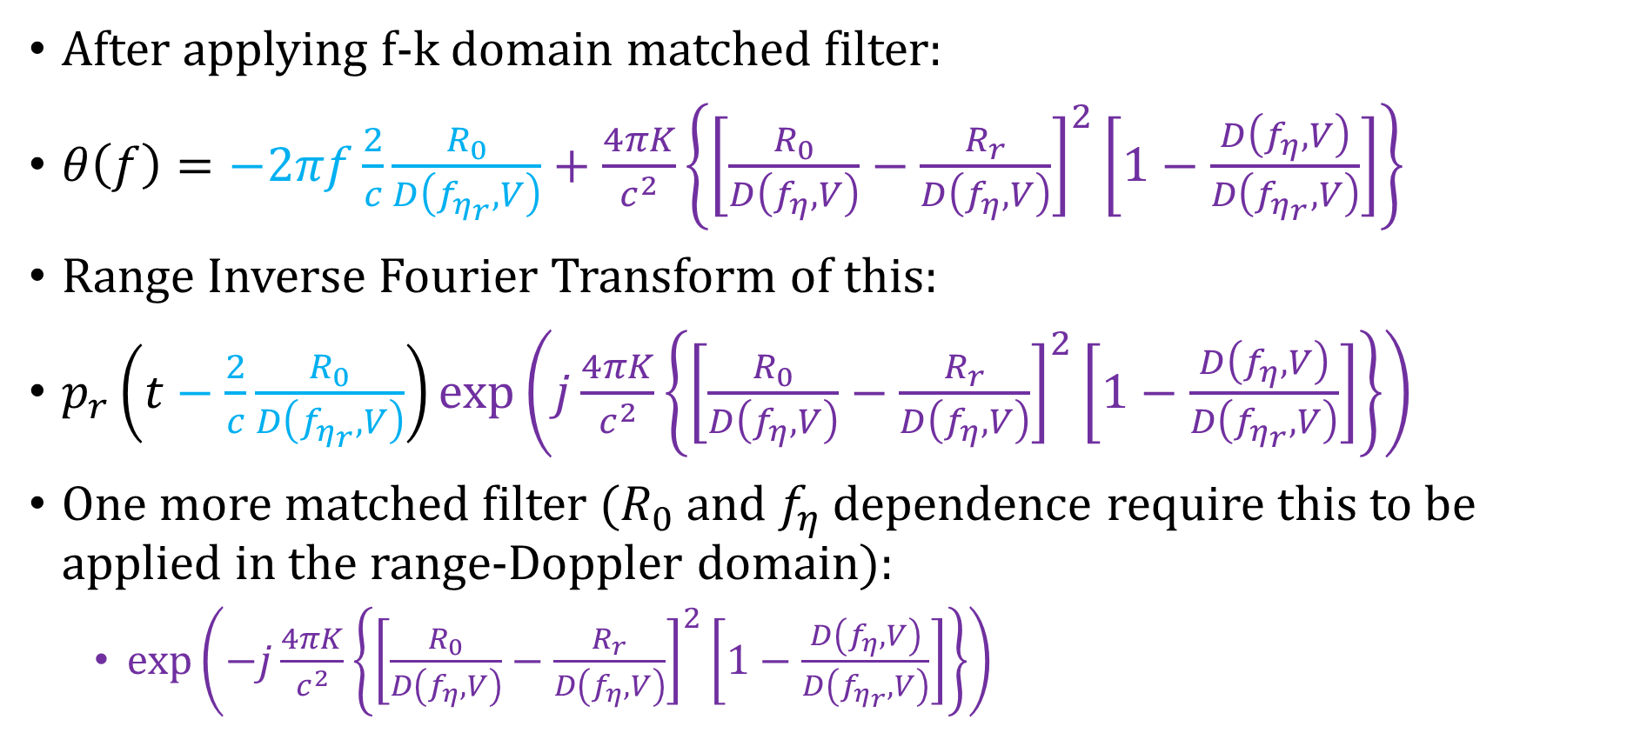
POSP of Range Fourier Transform
After applying f-k domain matched filter:
$θ\left(f\right)=−2πf\frac{2}{c}\frac{R_{0}}{D\left(f_{η_{r}},V\right)}+\frac{4πK}{c^{2}}\left\{{\left[\frac{R_{0}}{D\left(f_{η},V\right)}−\frac{R_{r}}{D\left(f_{η},V\right)}\right]}^{2}\left[1−\frac{D\left(f_{η},V\right)}{D\left(f_{η_{r}},V\right)}\right]\right\}$
Range Inverse Fourier Transform of this:
$p_{r}\left(t−\frac{2}{c}\frac{R_{0}}{D\left(f_{η_{r}},V\right)}\right)\exp\left(j\frac{4πK}{c^{2}}\left\{{\left[\frac{R_{0}}{D\left(f_{η},V\right)}−\frac{R_{r}}{D\left(f_{η},V\right)}\right]}^{2}\left[1−\frac{D\left(f_{η},V\right)}{D\left(f_{η_{r}},V\right)}\right]\right\}\right)$
One more matched filter ($R_{0}$ and $f_{η}$ dependence require this to be applied in the range-Doppler domain):
  $\exp\left(−j\frac{4πK}{c^{2}}\left\{{\left[\frac{R_{0}}{D\left(f_{η},V\right)}−\frac{R_{r}}{D\left(f_{η},V\right)}\right]}^{2}\left[1−\frac{D\left(f_{η},V\right)}{D\left(f_{η_{r}},V\right)}\right]\right\}\right)$

