Slide 1
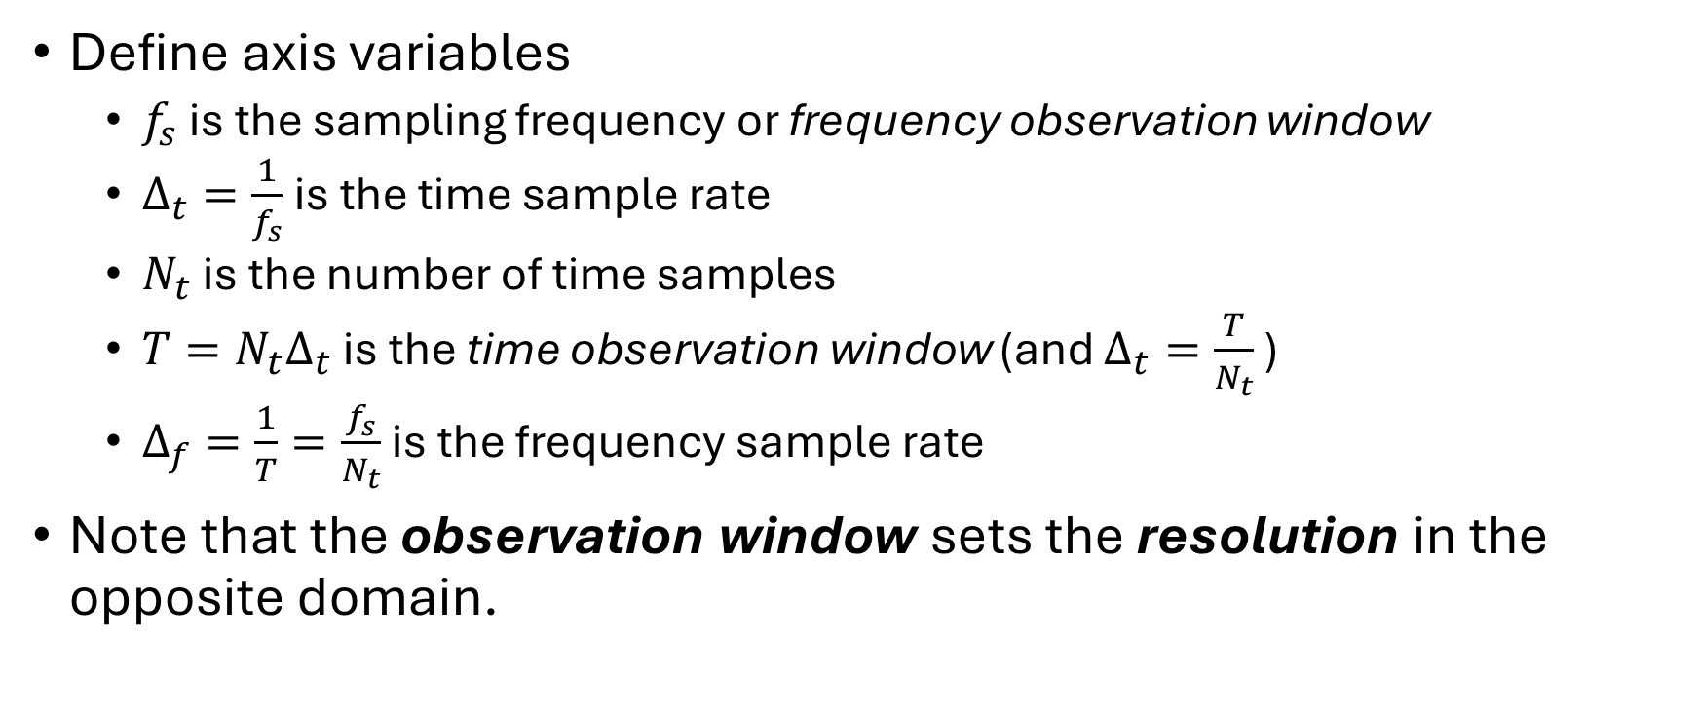
Time and Frequency Axis Definition
Define axis variables
  $f_{s}$ is the sampling frequency or frequency observation window
  $Δ_{t}=\frac{1}{f_{s}}$ is the time sample rate
  $N_{t}$ is the number of time samples
  $T=N_{t}Δ_{t}$ is the time observation window (and $Δ_{t}=\frac{T}{N_{t}}$ )
  $Δ_{f}=\frac{1}{T}=\frac{f_{s}}{N_{t}}$ is the frequency sample rate
Note that the observation window sets the resolution in the opposite domain.

Slide 2
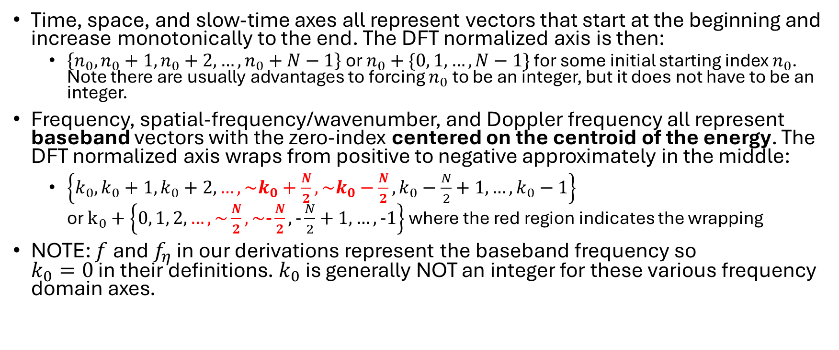
Baseband
Time, space, and slow-time axes all represent vectors that start at the beginning and increase monotonically to the end. The DFT normalized axis is then:
  $\left\{n_{0},n_{0}+1,n_{0}+2, …,n_{0}+N−1\right\}$ or $n_{0}+\{0, 1, …, N−1\}$ for some initial starting index $n_{0}$. Note there are usually advantages to forcing $n_{0}$ to be an integer, but it does not have to be an integer.
Frequency, spatial-frequency/wavenumber, and Doppler frequency all represent baseband vectors with the zero-index centered on the centroid of the energy. The DFT normalized axis wraps from positive to negative approximately in the middle:
  $\left\{k_{0},k_{0}+1,k_{0}+2, …,\sim k_{0}+\frac{N}{2},\sim k_{0}−\frac{N}{2},k_{0}−\frac{N}{2}+1,…,k_{0}−1\right\}$
  or $k_{0}+\left\{0, 1, 2, …, \sim \frac{N}{2}, \sim \text{−}\frac{N}{2}, \text{−}\frac{N}{2}+1,…, \text{−}1\right\}$ where the red region indicates the wrapping
NOTE: $f$ and $f_{η}$ in our derivations represent the baseband frequency so
$k_{0}=0$ in their definitions. $k_{0}$ is generally NOT an integer for these various frequency domain axes.

Slide 3
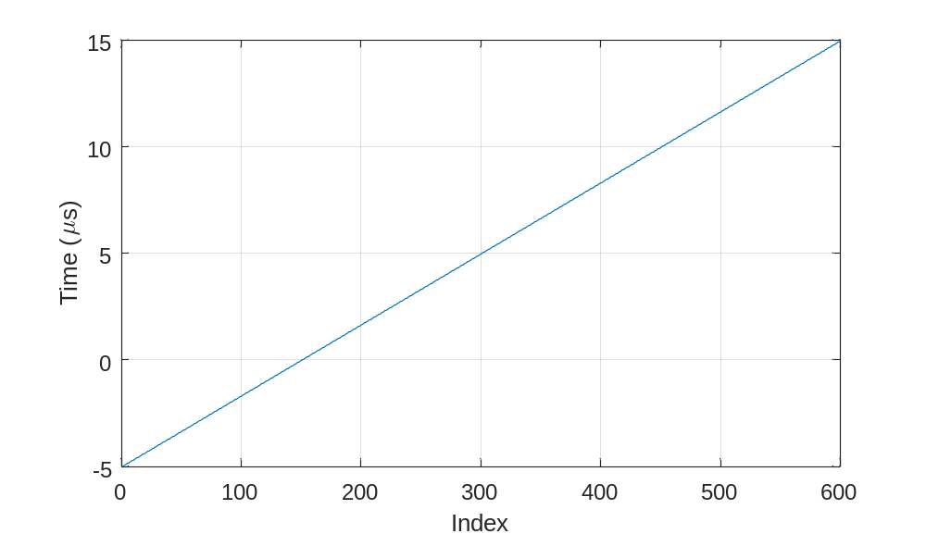
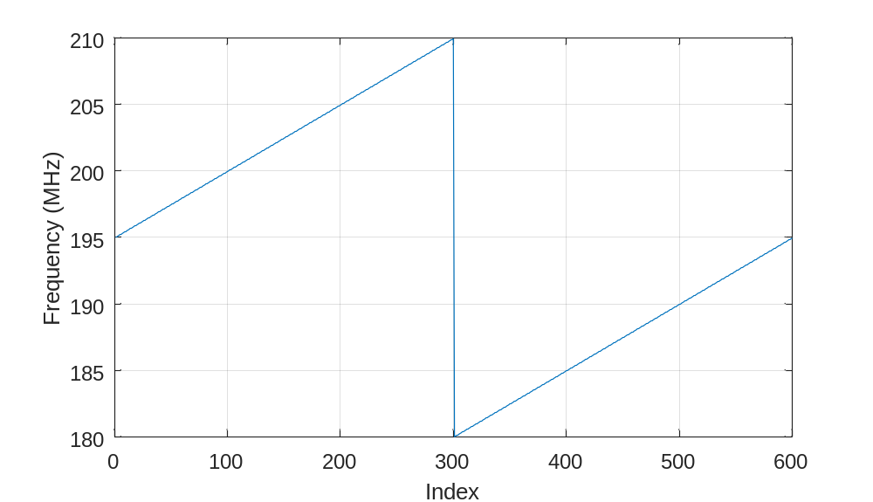
NOTE: Care should be taken to make sure the indexes at the transition from positive to negative are done correctly. The correct representation for even and odd is shown below.
% Even example
Nt = 4
ifftshift( -floor(Nt/2):floor((Nt-1)/2) )
ans =
0 1 -2 -1
% Odd example
Nt = 5
ifftshift( -floor(Nt/2):floor((Nt-1)/2) )
ans =
0 1 2 -2 -1
% Axis Example
% fs - sampling frequency (Hz)
fs = 30e6;
% dt - fast-time stepsize (sec)
dt = 1/fs;
% Nt - number of samples
Nt = round(20e-6/dt);
% T - fast-time observation window duration (sec)
T = dt*Nt;
% df - fast-time frequency-domain stepsize (Hz)
df = 1/T;
df = fs/Nt;
t0 = -5e-6;
time = t0 + dt*(0:Nt-1).';
fc = 195e6;
freq = fc + df*ifftshift( -floor(Nt/2):floor((Nt-1)/2) );
figure(1); clf;
plot(time*1e6)
grid on;
xlabel('Index')
ylabel('Time ({\mu}s)')
figure(2); clf;
plot(freq/1e6)
grid on;
xlabel('Index')
ylabel('Frequency (MHz)')

Slide 4
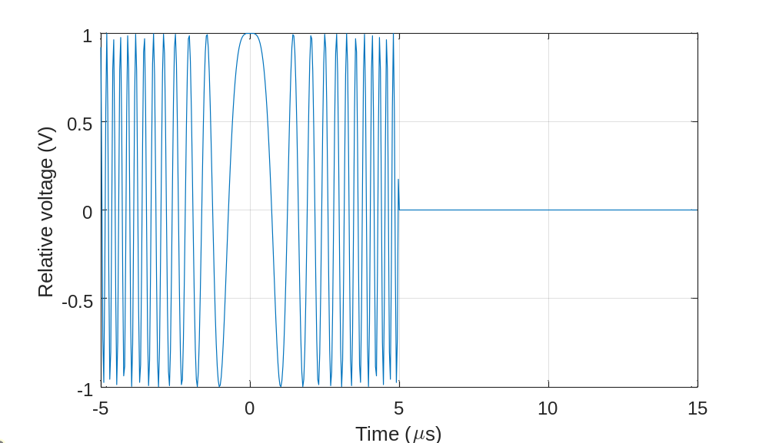
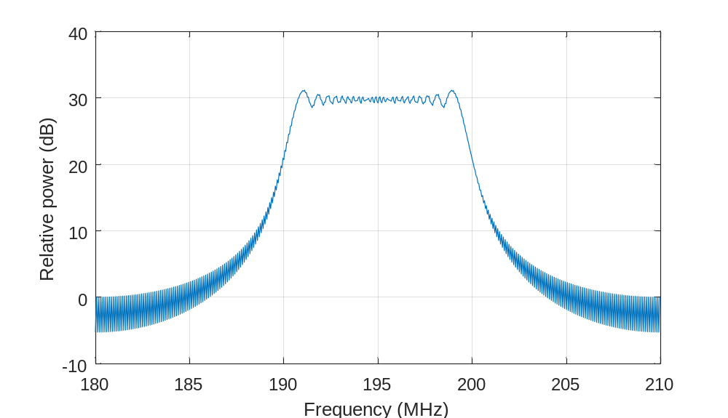
LFM Chirp Signal Example
Tpd = 10e-6;
BW = 30e6;
K = BW/Tpd;
x = rectpuls(time/Tpd) .* exp(j*K*time.^2);
figure(1); clf;
plot(time*1e6,real(x))
grid on;
xlabel('Time ({\mu}s)')
ylabel('Relative voltage (V)')
figure(2); clf;
plot(fftshift(freq/1e6),fftshift(db(fft(x),'voltage')))
grid on;
xlabel('Frequency (MHz)')
ylabel('Relative power (dB)')

Slide 5
fftshift and ifftshift
>> A = reshape(1:16,[4 4]) % some time-space matrix
A =
1 5 9 13
2 6 10 14
3 7 11 15
4 8 12 16
>> fftshift(A) % correct for frequency-wavenumber
ans =
11 15 3 7
12 16 4 8
9 13 1 5
10 14 2 6
>> fftshift(A,1) % correct for frequency-space
ans =
3 7 11 15
4 8 12 16
1 5 9 13
2 6 10 14
Note that these functions operate on all dimensions.
Therefore, for matrices, they should generally be restricted to just the dimension that you need the operation applied on.
In the case of frequency-wavenumber where both dimensions represent baseband axes, then no dimension should be specified since both dimensions really do need to be shifted.

Slide 6
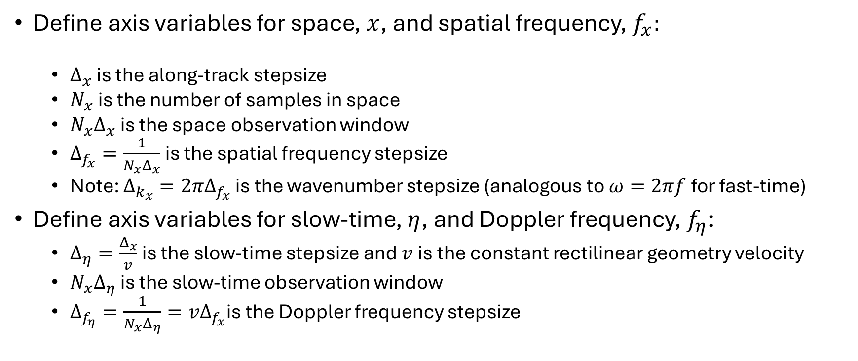
Axis Definitions for Slow-Time and Space
Define axis variables for space, $x$, and spatial frequency, $f_{x}:$
  $Δ_{x}$ is the along-track stepsize
  $N_{x}$ is the number of samples in space
  $N_{x}Δ_{x}$ is the space observation window
  $Δ_{f_{x}}=\frac{1}{N_{x}Δ_{x}}$ is the spatial frequency stepsize
  Note: $Δ_{k_{x}}={2πΔ}_{f_{x}}$ is the wavenumber stepsize (analogous to $ω=2πf$ for fast-time)
Define axis variables for slow-time, $η$, and Doppler frequency, $f_{η}$:
  $Δ_{η}=\frac{Δ_{x}}{v}$ is the slow-time stepsize and $v$ is the constant rectilinear geometry velocity
  $N_{x}Δ_{η}$ is the slow-time observation window
  $Δ_{f_{η}}=\frac{1}{N_{x}Δ_{η}}={vΔ}_{f_{x}}$is the Doppler frequency stepsize

Slide 7
Oversampling
Essential for checking SAR accuracy of main lobes and side lobes
Oversampling is usually done by zero-padding in the opposite domain because that is faster than trying to use sinc interpolation to fill in so many new points.
Zero padding should be done where zeros are expected!

Slide 8
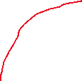



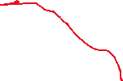




Oversampling
For example, consider that we are trying to oversample a signal at complex baseband. We will have a situation like this where the DFT points are ifftshift:
THE ZEROS SHOULD GO IN THE MIDDLE OF
THE DFT SEQUENCE AND NOT AT THE END!

Slide 9
Oversampling
The Matlab interpft function does the zero padding for complex baseband and handles the special cases of even and odd numbers of points.
Here is a simple example of oversampling a SAR image and how to generate the corresponding time and spatial axes (note: time_sar and x_sar represent the axes of sar_image before oversampling)
Mt = 8;
time_sar_Mt = time_sar(1) + dt/Mt*(0:Nt_sar*Mt-1).';
Mx = 8;
x_sar_Mx = x_sar(1) + sigma_x/Mx*(0:Nx_sar*Mx-1).’;
sar_image_M = interpft(interpft(sar_image,size(sar_image,1)*Mt,1),size(sar_image,2)*Mx,2);

Slide 10
Oversampling
The “zero” point of the time and space IDFT does not move with oversampling via zero-padding. The sample spacing and number of points just need to be updated then and added to the old zero location.

Slide 11
Oversampling
What about zero padding time and space to oversample in the frequency and wavenumber domains?
Usually the zero padding should be done at the end (i.e. NOT with interpft). This is because we assume the data are time or space gated and therefore everything outside our original gate is zero so that if those samples are added back with zero padding, there values really should be zero at this point.
The centroid of the spectrum does not shift and again the axes should be generated in the usual way by adjusting the spacing and number of points and re-generating just like the original axes.

Slide 12
Oversampling
Essential for checking SAR accuracy of main lobes and side lobes
This example shows how to correctly create oversampled axes for interpft.
time_sar and x_sar represent the axes of sar_image before oversampling
Mt = 8;
time_sar_Mt = time_sar(1) + dt/Mt*(0:Nt_sar*Mt-1).';
Mx = 8;
x_sar_Mx = x_sar(1) + sigma_x/Mx*(0:Nx_sar*Mx-1).';
sar_image_M = interpft(interpft(sar_image,size(sar_image,1)*Mt,1),size(sar_image,2)*Mx,2);

Slide 13
hw2_problem1.m

Slide 14
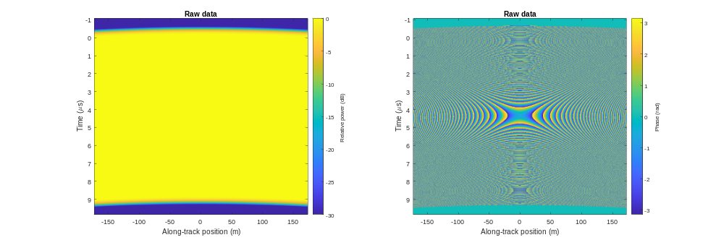

Slide 15
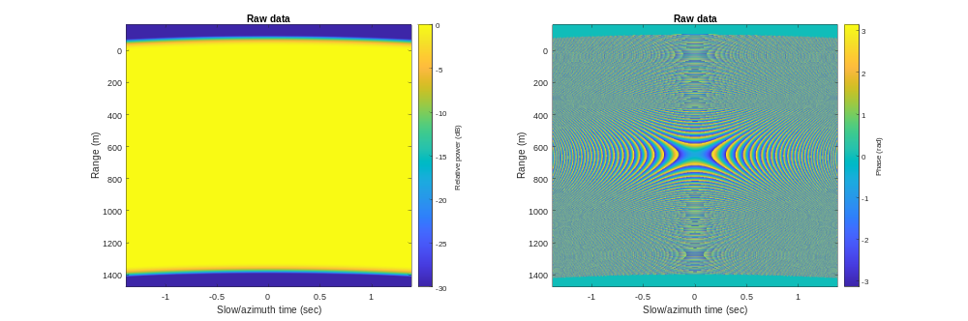

Slide 16
hw2_problem2.m

Slide 17
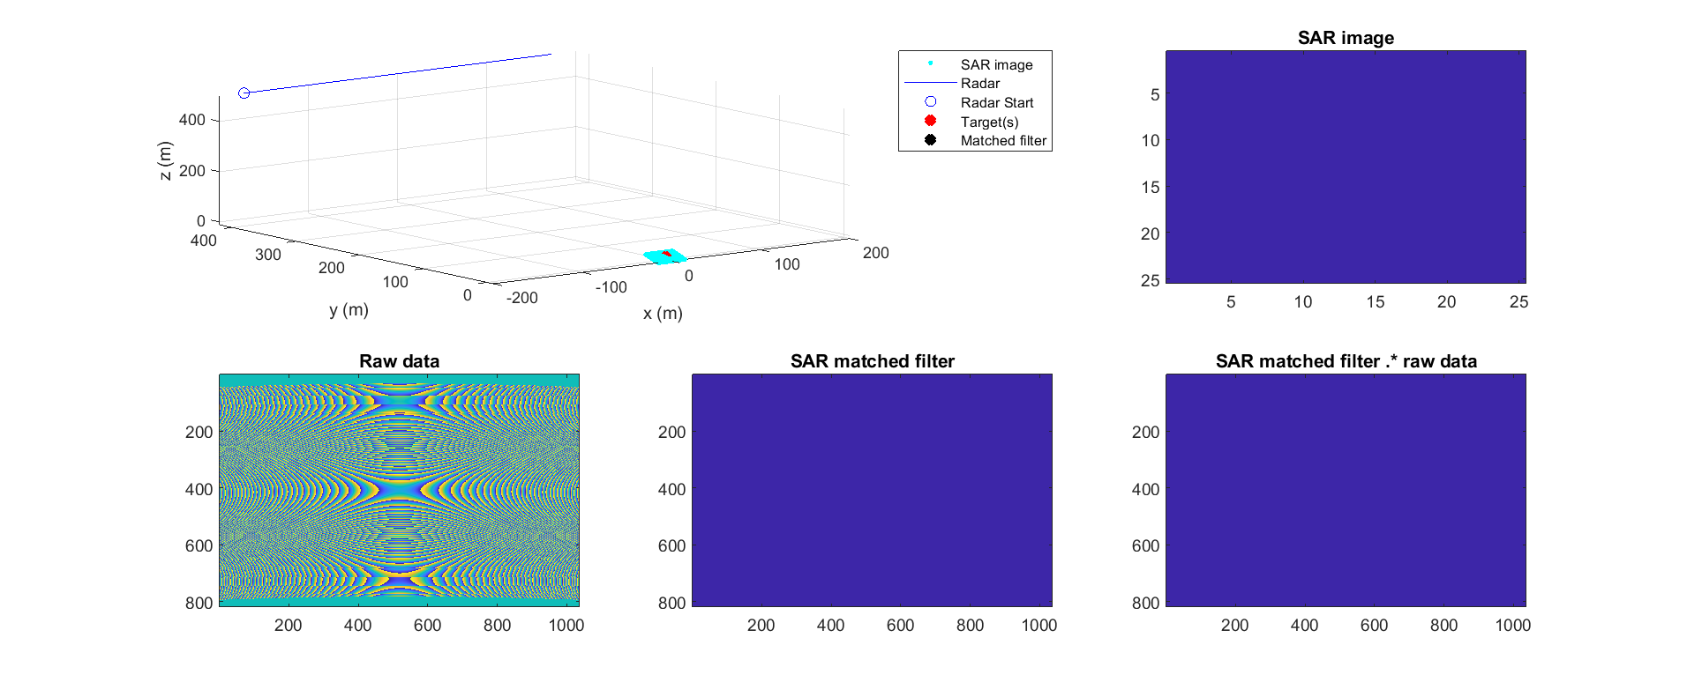

Slide 18
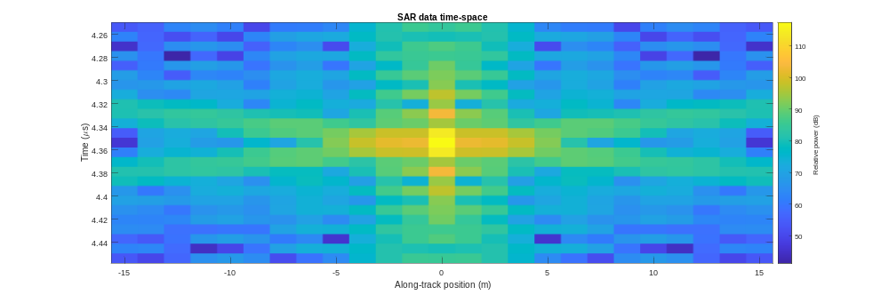

Slide 19
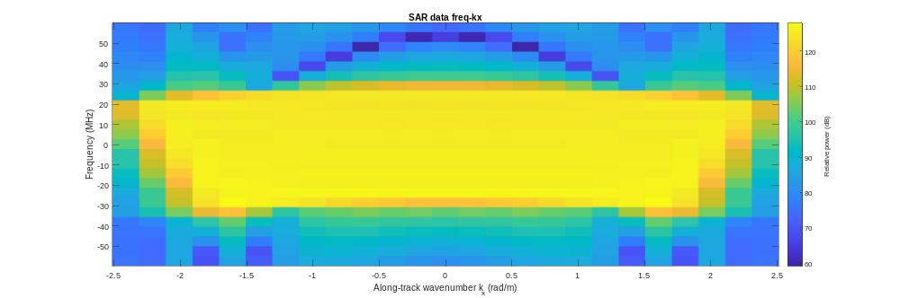

Slide 20
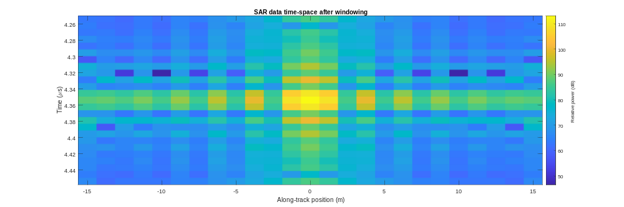

Slide 21
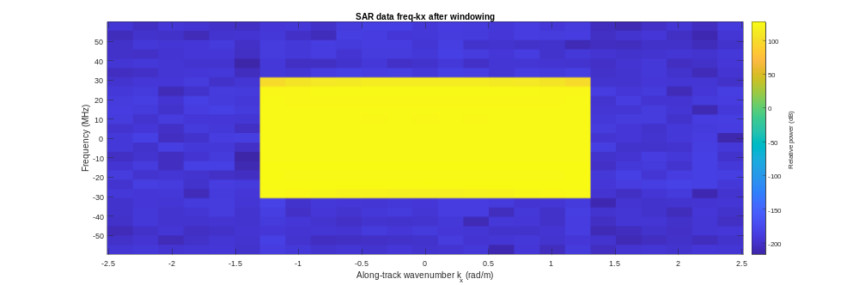

Slide 22
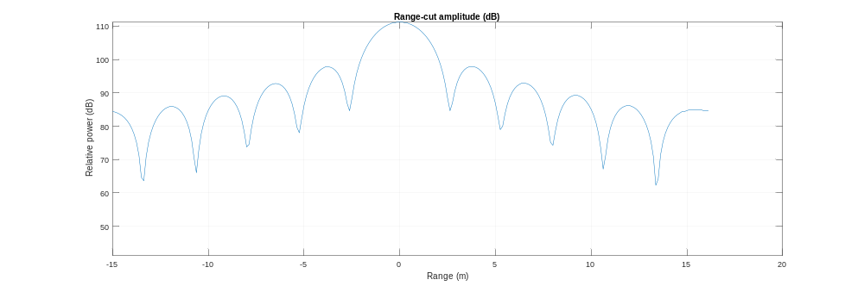

Slide 23
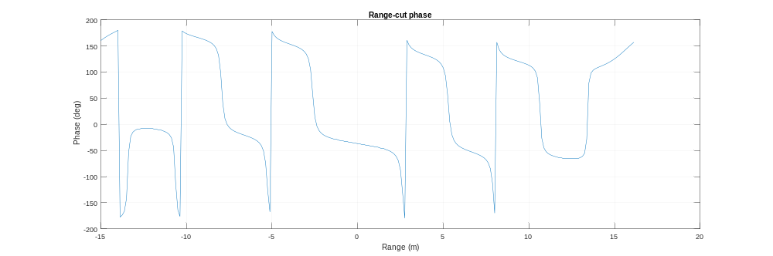

Slide 24
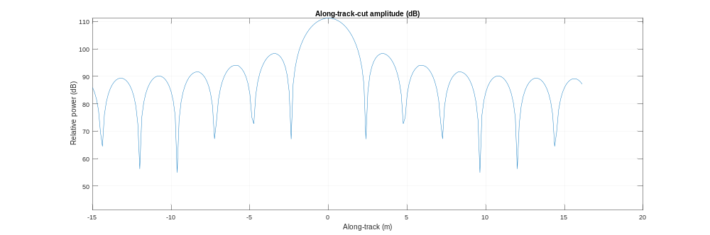

Slide 25
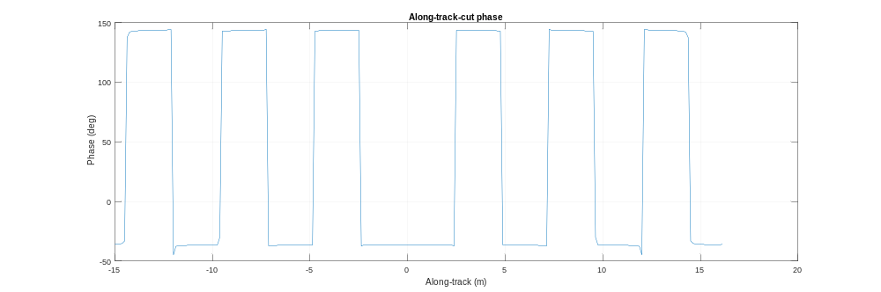

Slide 26
hw2_problem3.m

Slide 27
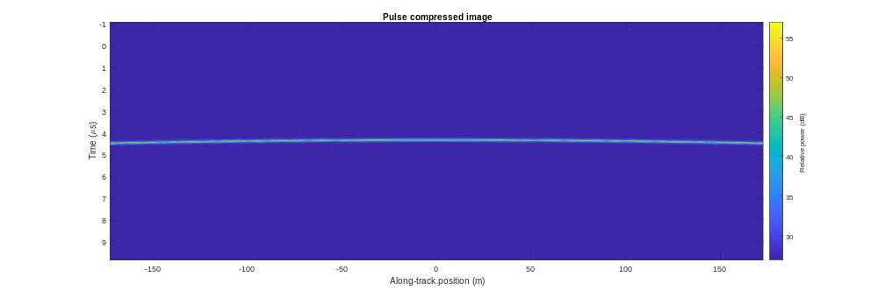

Slide 28
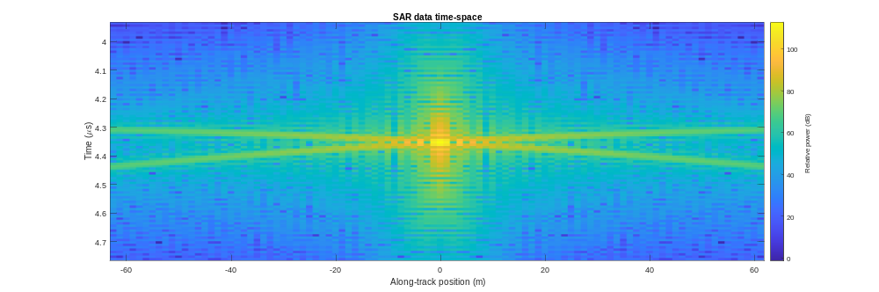

Slide 29
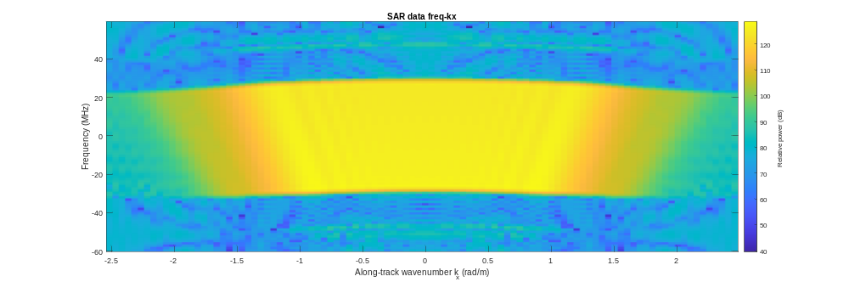

Slide 32
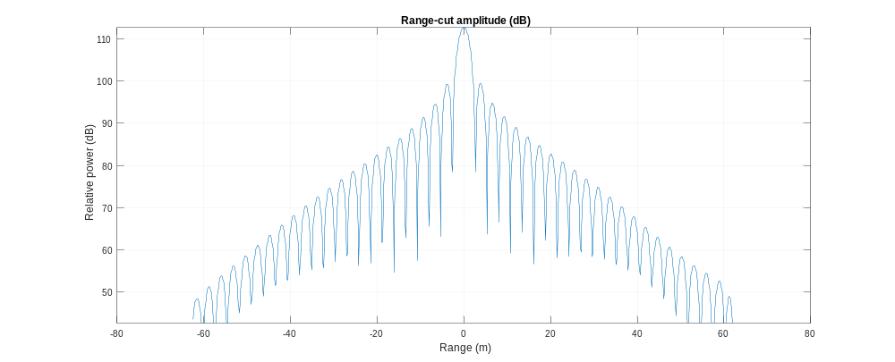

Slide 33
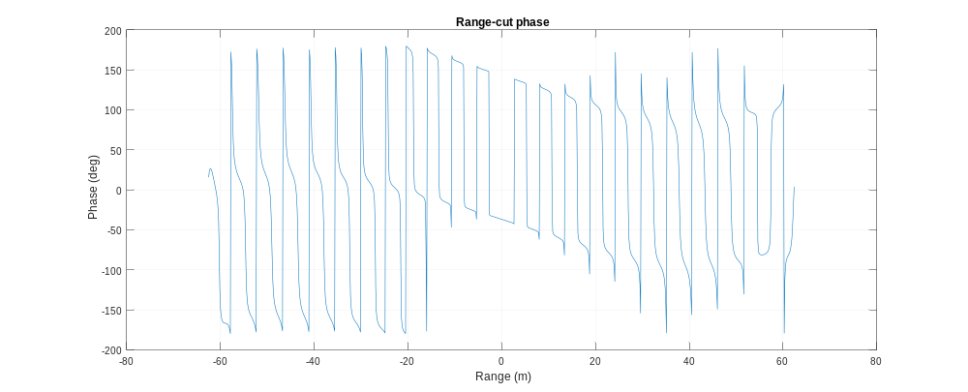

Slide 34
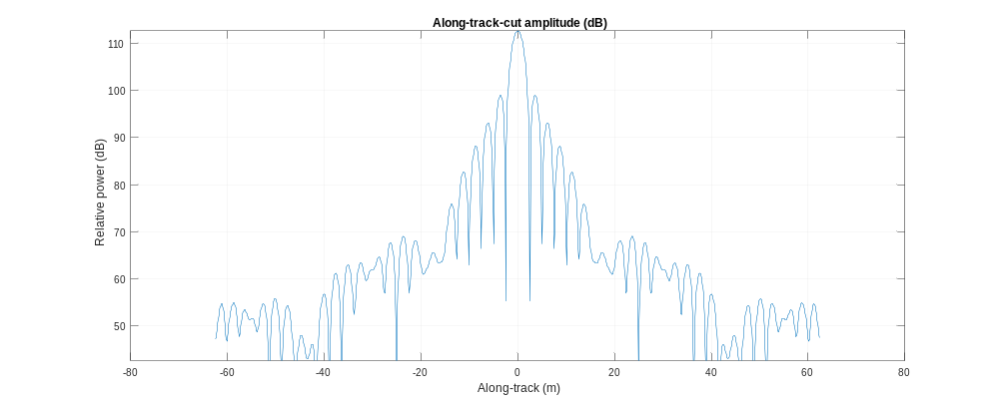

Slide 35
