Slide 1
HW #1

Slide 2
Decide on extra zoom office hours

Slide 3
Computer and Matlab
Does everyone have access to a computer?
  Administrator access to install programs (git for windows, VS code)
  Fast computer with >32 GB of RAM?
Access to Matlab?
  Image processing, signal processing, and mapping toolboxes

Slide 4
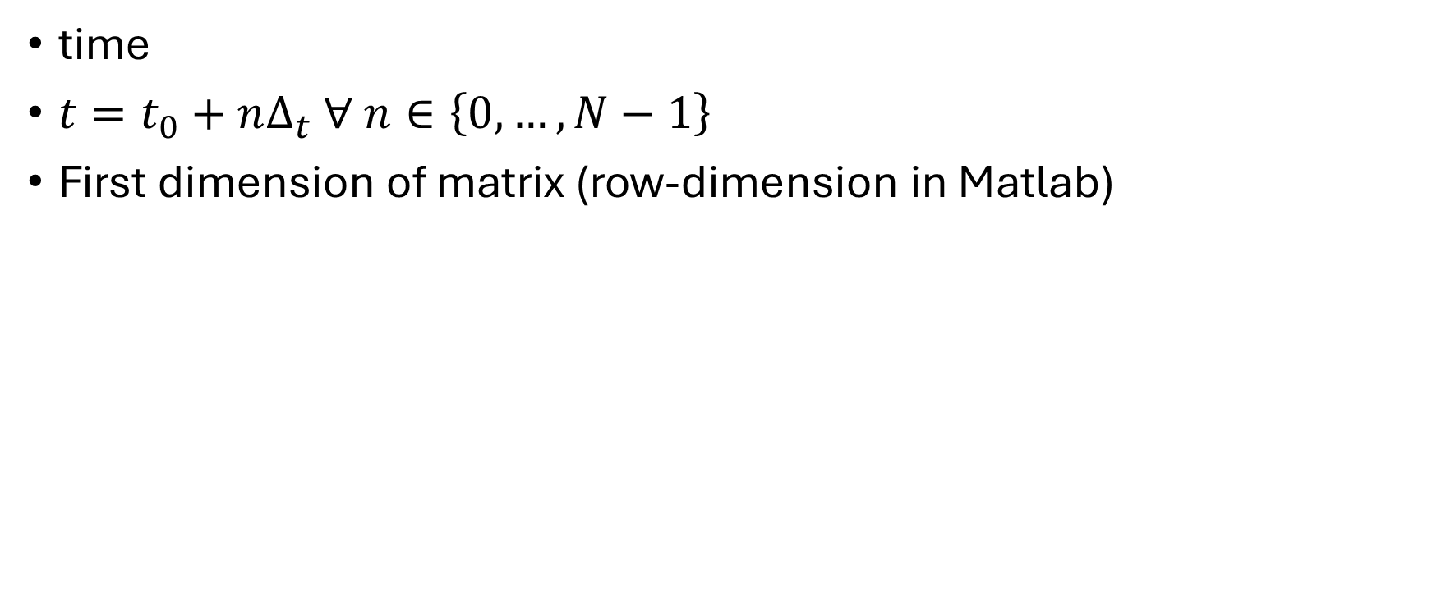
Time Axis
time
$t=t_{0}+nΔ_{t} ∀ n∈\left\{0,…,N−1\right\}$
First dimension of matrix (row-dimension in Matlab)

Slide 5
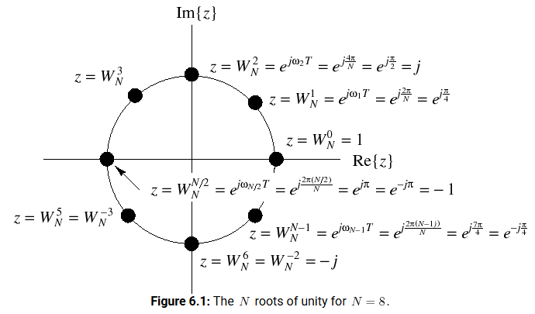
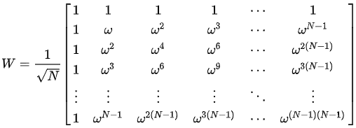
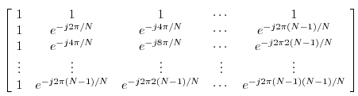
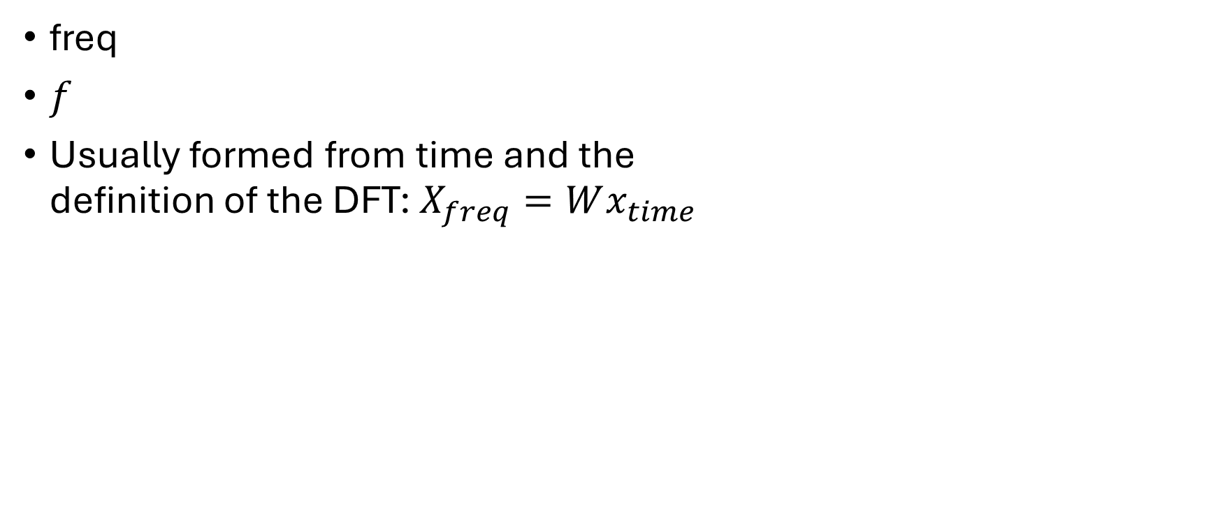
Frequency Axis
freq
$f$
Usually formed from time and the
definition of the DFT: $X_{freq}=Wx_{time}$

Slide 6






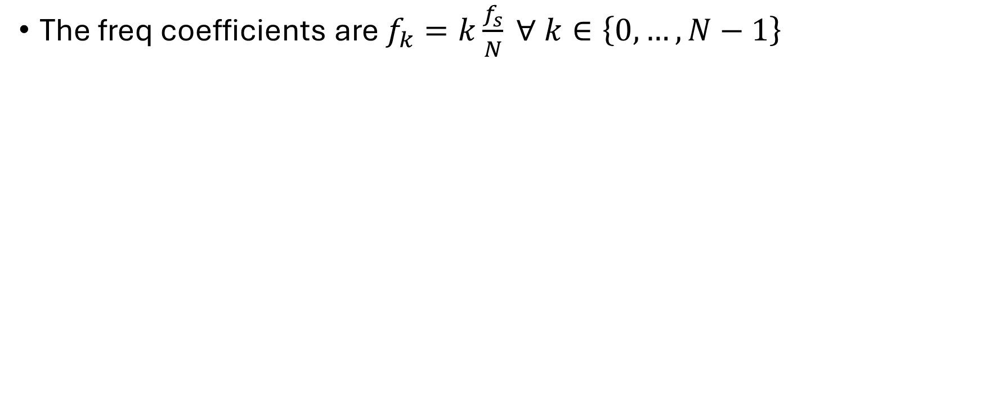

1. Calculate the step $Δ_{t}$; 2. $f_{s}=\frac{1}{Δ_{t}}$; 3. Indexing
The freq coefficients are $f_{k}=k\frac{f_{s}}{N} ∀ k∈\left\{0,…,N−1\right\}$

Slide 7
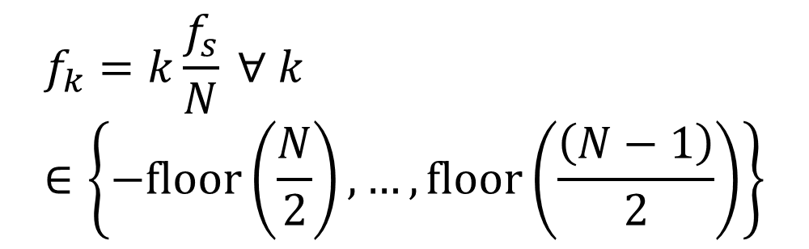
1. Calculate the step $Δ_{t}$; 2. $f_{s}=\frac{1}{Δ_{t}}$; 3. Indexing
The freq coefficients are $f_{k}=k\frac{f_{s}}{N} ∀ k∈\left\{0,…,N−1\right\}$
$$f_{k}=k\frac{f_{s}}{N} ∀ k∈\left\{−floor\left(\frac{N}{2}\right),…,floor\left(\frac{\left(N−1\right)}{2}\right)\right\}$$

Slide 8
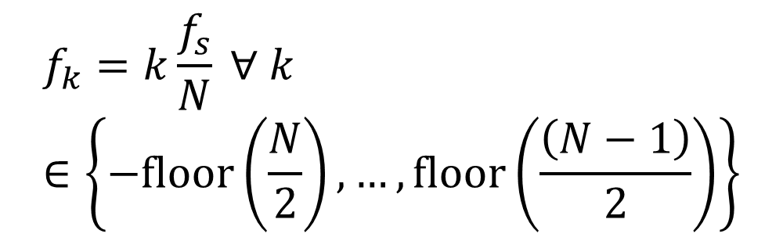
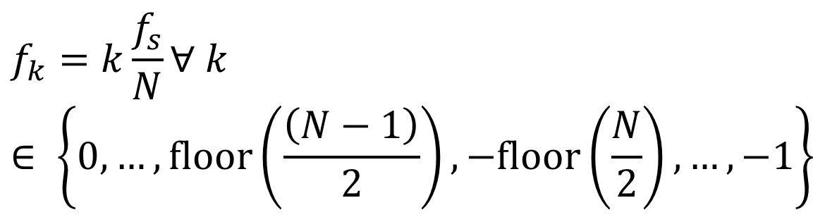
1. Calculate the step $Δ_{t}$; 2. $f_{s}=\frac{1}{Δ_{t}}$; 3. Indexing
The freq coefficients are $f_{k}=k\frac{f_{s}}{N} ∀ k∈\left\{0,…,N−1\right\}$
$$f_{k}=k\frac{f_{s}}{N}∀ k∈ \left\{0,…,floor\left(\frac{\left(N−1\right)}{2}\right),−floor\left(\frac{N}{2}\right),…,−1\right\}$$
$$f_{k}=k\frac{f_{s}}{N} ∀ k∈\left\{−floor\left(\frac{N}{2}\right),…,floor\left(\frac{\left(N−1\right)}{2}\right)\right\}$$

Slide 9
FINAL NOTE: ifftshift
The frequency, wavenumber, spatial frequency, and Doppler frequency axes should generally be ifftshift versions. Therefore the definitions of all these axes should be done with an ifftshift.
In other words (note the transpose since this is the fast-time or row axes):
  freq = ifftshift( df * (-floor(Nt/2) : floor((Nt-1)/2) ) ).';
Usually the time, space, slow-time axes are ordered and should not have ifftshift applied, so they should always be ordered.

Slide 10
Space Axis
X: along-track (usually line fit to phase center trajectory)
Z: elevation vector projected orthogonal to along-track
Y: cross-track horizontal (completes the RHC)
Origin is the scene center
  Other locations are sometimes used like the start of the line-fitted trajectory
[x;y;z] represent the antenna phase center (APC) and are the offset from the scene center to the antenna’s phase center for the corresponding column
Second dimension of matrix (column-dimension in Matlab)

Slide 11
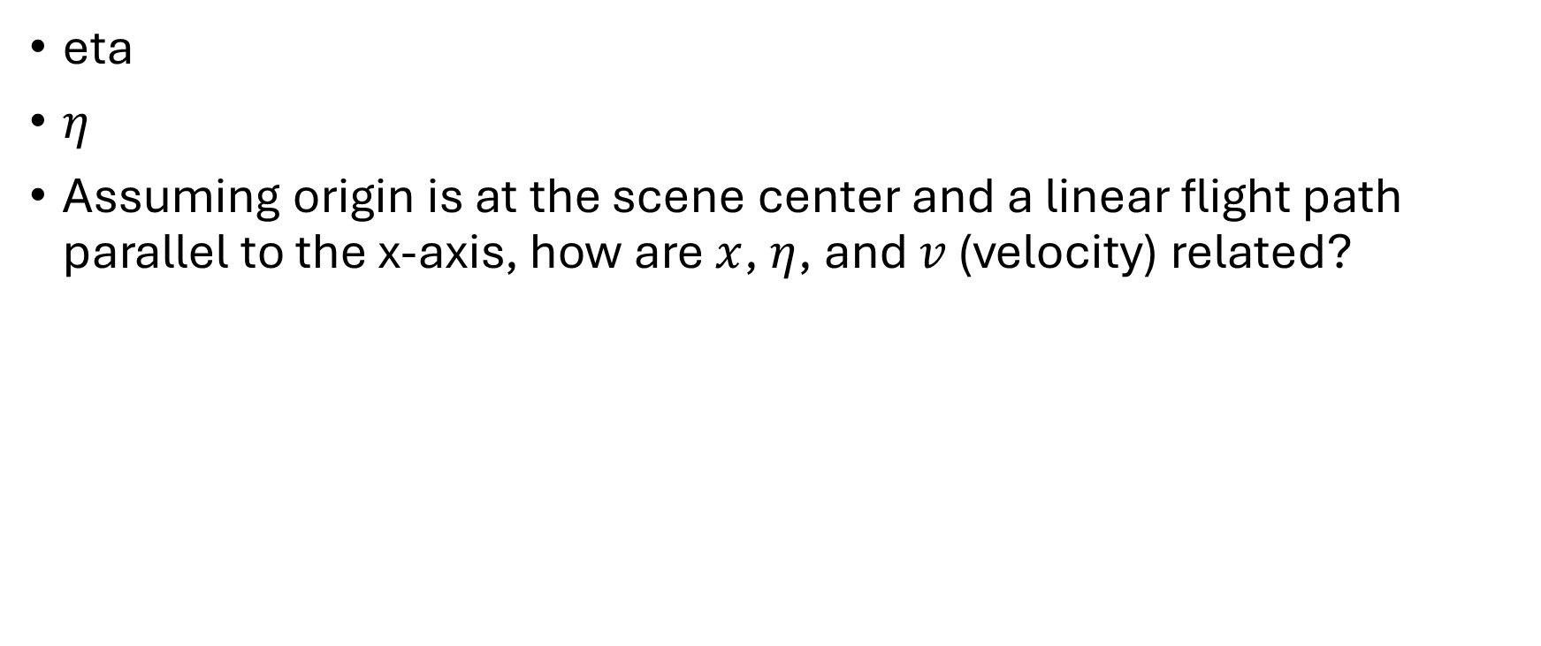
Slow-time Axis
eta
$η$
Assuming origin is at the scene center and a linear flight path parallel to the x-axis, how are $x$, $η$, and $v$ (velocity) related?

Slide 12
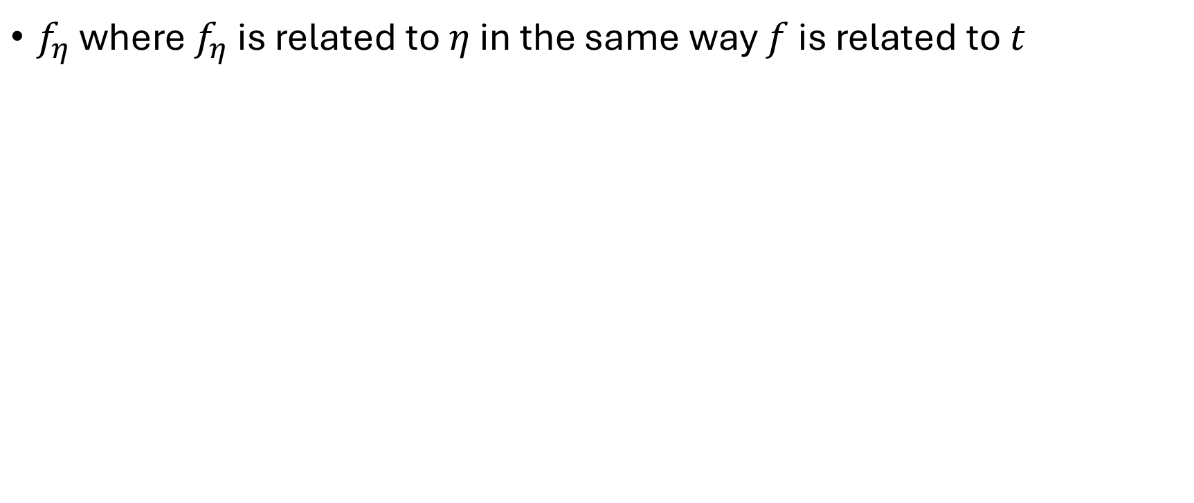
Doppler frequency
$f_{η}$ where $f_{η}$ is related to $η$ in the same way $f$ is related to $t$

Slide 13
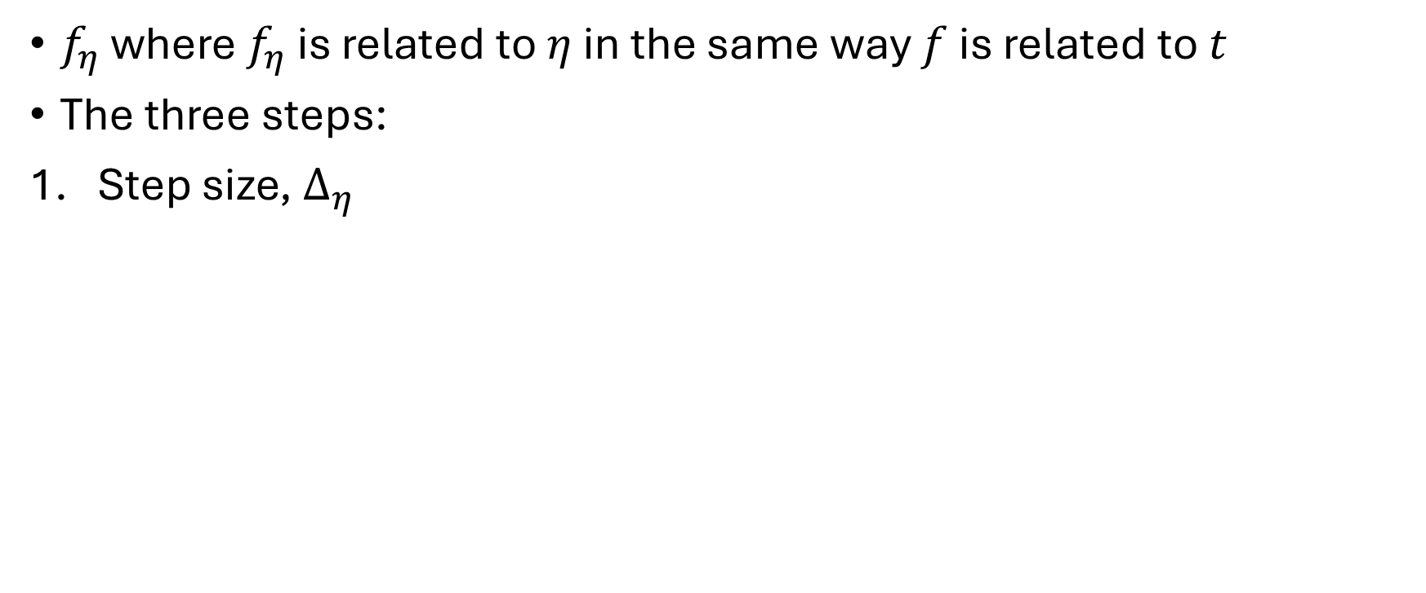
Doppler frequency
$f_{η}$ where $f_{η}$ is related to $η$ in the same way $f$ is related to $t$
The three steps:
Step size, $Δ_{η}$

Slide 14
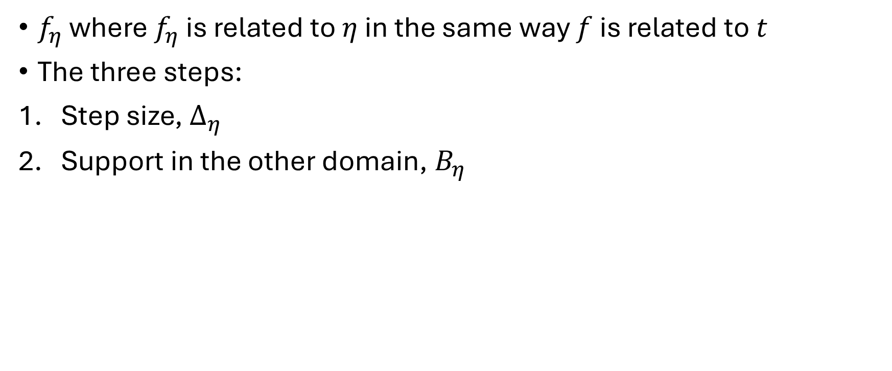
Doppler frequency
$f_{η}$ where $f_{η}$ is related to $η$ in the same way $f$ is related to $t$
The three steps:
Step size, $Δ_{η}$
Support in the other domain, $B_{η}$

Slide 15
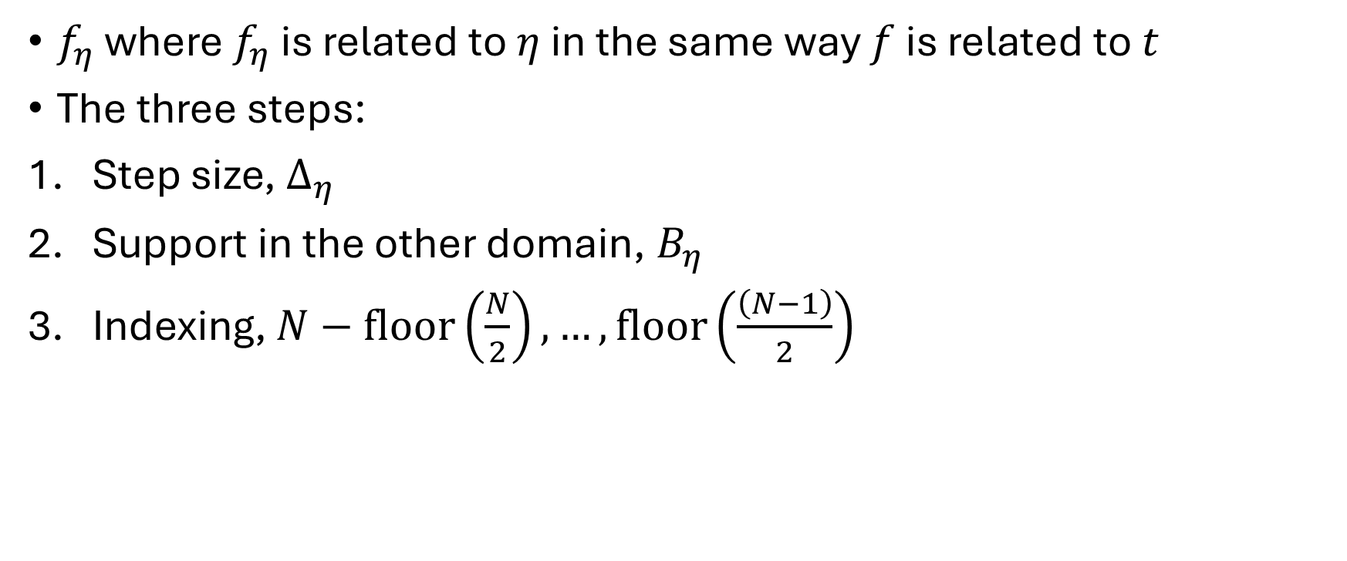
Doppler frequency
$f_{η}$ where $f_{η}$ is related to $η$ in the same way $f$ is related to $t$
The three steps:
Step size, $Δ_{η}$
Support in the other domain, $B_{η}$
Indexing, $N−floor\left(\frac{N}{2}\right),…,floor\left(\frac{\left(N−1\right)}{2}\right)$

Slide 16
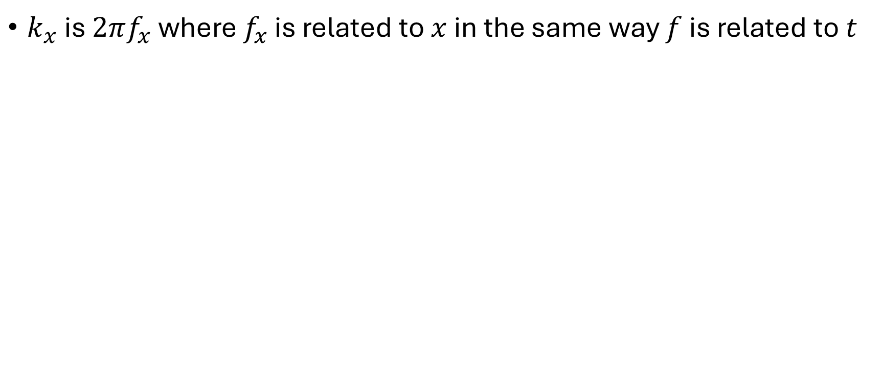

Wavenumber, $k_{x}$
$k_{x}$ is $2πf_{x}$ where $f_{x}$ is related to $x$ in the same way $f$ is related to $t$

Slide 17
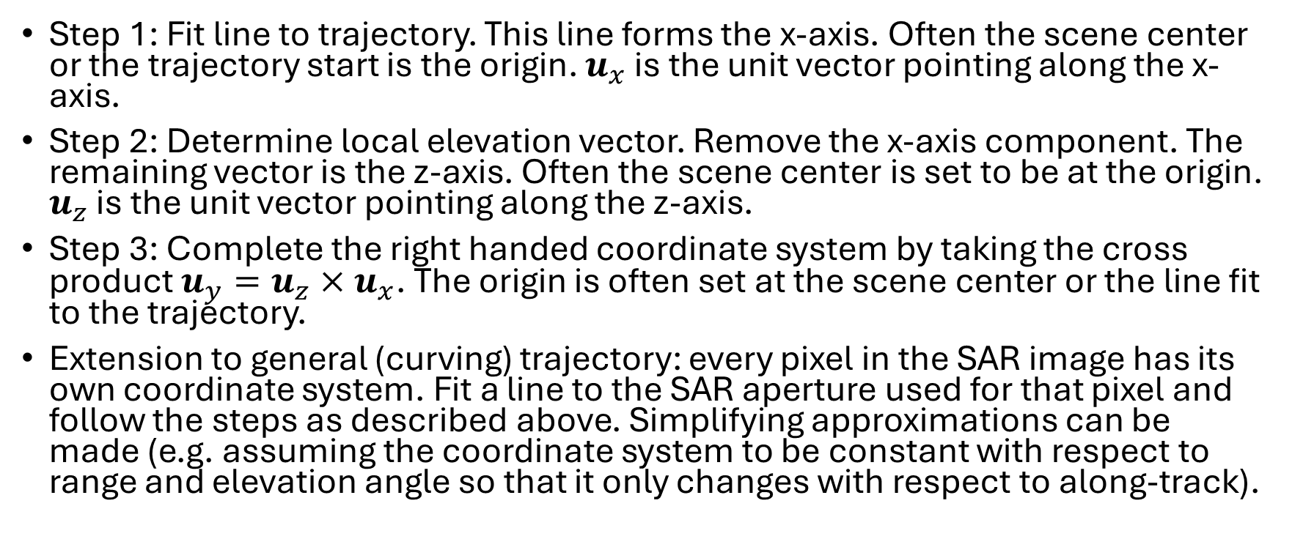
System Geometry
Step 1: Fit line to trajectory. This line forms the x-axis. Often the scene center or the trajectory start is the origin. $u_{x}$ is the unit vector pointing along the x-axis.
Step 2: Determine local elevation vector. Remove the x-axis component. The remaining vector is the z-axis. Often the scene center is set to be at the origin. $u_{z}$ is the unit vector pointing along the z-axis.
Step 3: Complete the right handed coordinate system by taking the cross product $u_{y}=u_{z}×u_{x}$. The origin is often set at the scene center or the line fit to the trajectory.
Extension to general (curving) trajectory: every pixel in the SAR image has its own coordinate system. Fit a line to the SAR aperture used for that pixel and follow the steps as described above. Simplifying approximations can be made (e.g. assuming the coordinate system to be constant with respect to range and elevation angle so that it only changes with respect to along-track).

Slide 18



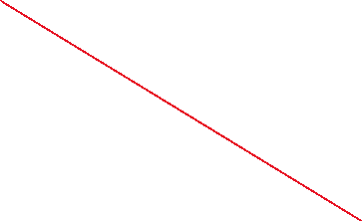











System Geometry

Slide 19









Image Extent, SAR aperture, and pulse duration dictate the sampling extent of the raw data simulator

Slide 20
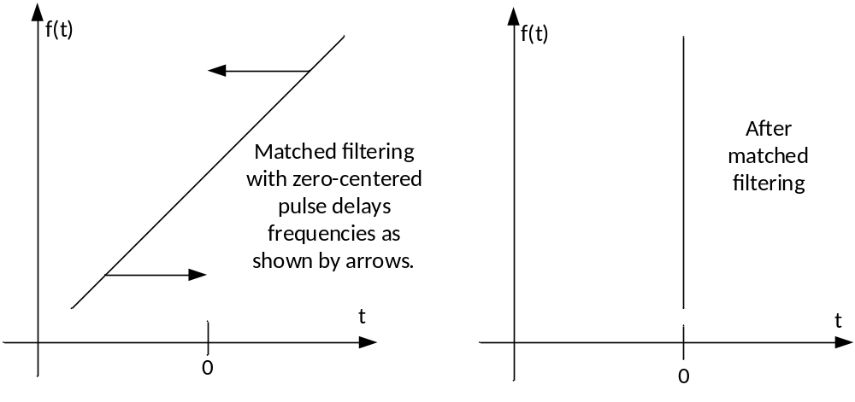
Pulse Compression in instantaneous frequency domain

Slide 21
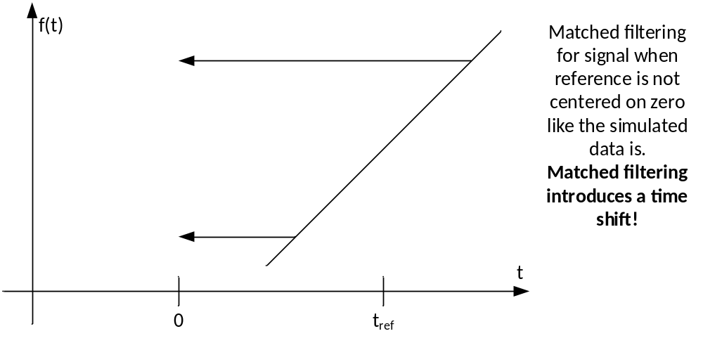
Pulse Compression in instantaneous frequency domain

Slide 22
Vectorize operations
Matlab and Python are both interpreted languages which means they do not compile the code into machine binary commands like assembly and C do.
They do call C-libraries that are highly optimized.
This means that operations that can be vectorized (i.e. same operation applied to a lot of data), will run very fast, but operations running on small amounts of data will likely suffer from very large overhead (sometimes running 100x slower than their compiled counterparts).
  For example: try to write your code to run the same command on every range line rather than writing a for loop doing each range line individually

Slide 23
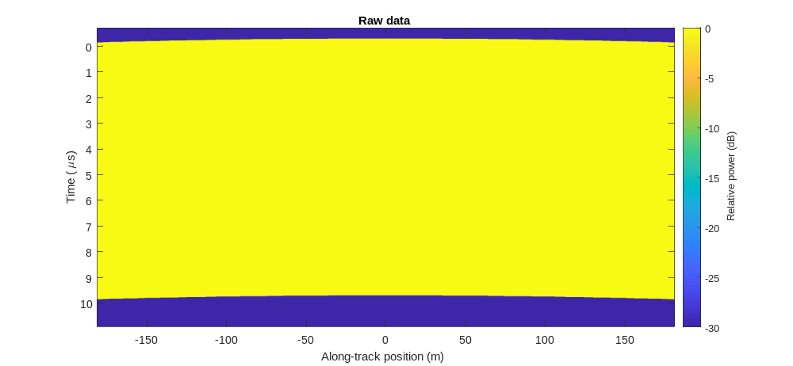
Problem 3

Slide 24

Problem 3

Slide 25
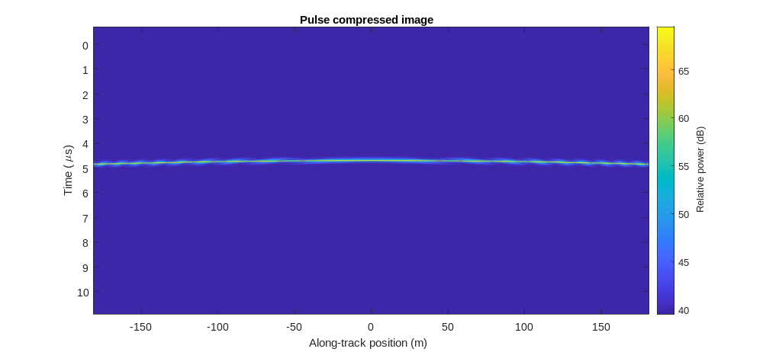
Problem 4

Slide 26

Problem 4

Slide 27
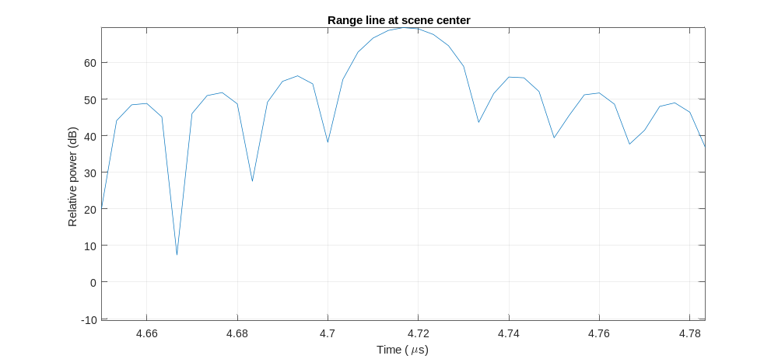
Problem 4

Slide 28
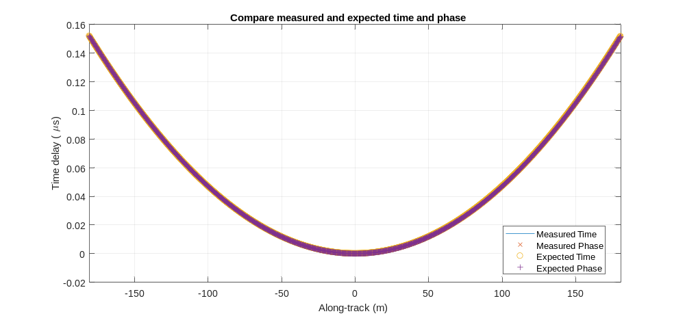
Problem 4

Slide 29
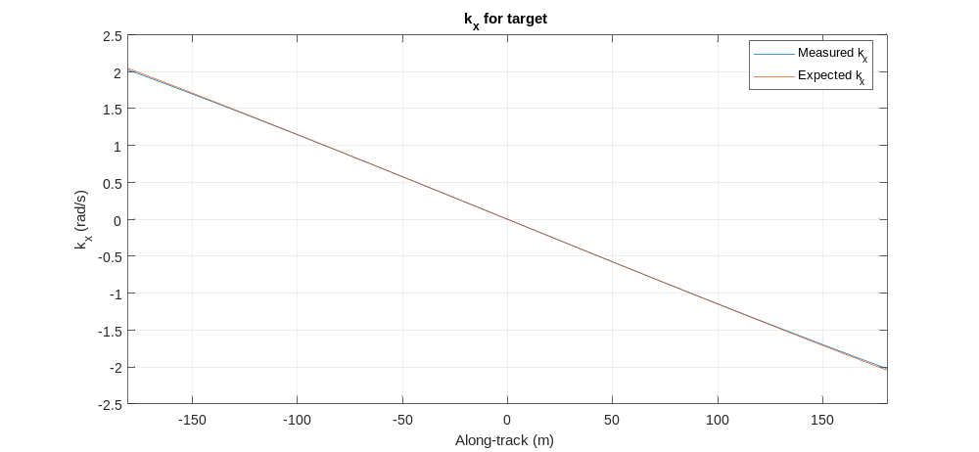
Problem 4

