Slide 1
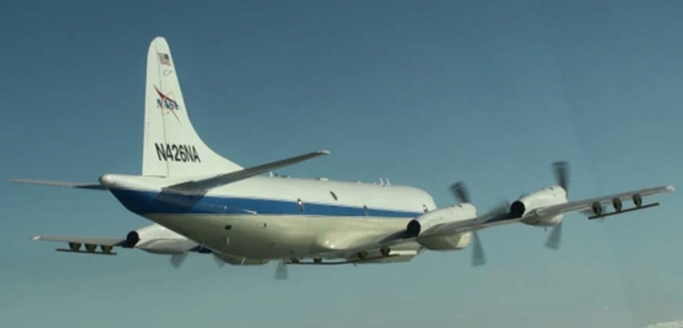
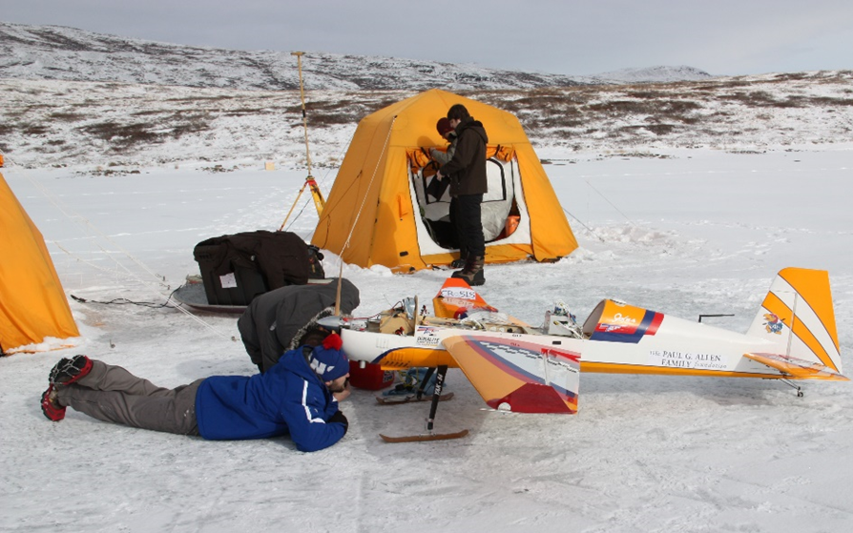
Center for Remote Sensing and Integrated Systems
(CReSIS)
Overview:
KU/RSL has a long 50+ year history of remote sensing with a focus on the polar regions since the early 90s.
CReSIS was founded in 2005 as part of a $50 million 10-year NSF Science and Technology Center to study ice sheets.
The center is internationally recognized as a leader in radar system design, deployment, and data analysis for monitoring of sea ice and ice sheets.
Other major investments include projects such as
  10-year involvement in NASA Operation Ice Bridge, the largest NASA airborne mission to date
  Development of systems for purchase and loans (e.g. German Alfred Wegener Institute, the British Antarctic Survey, etc.)
  Projects from Paul G. Allen Family Foundation and Heising-Simons Foundation,
CReSIS includes faculty from aerospace and electrical engineering, geology, and geography as well as dedicated research faculty, technicians, administrative staff. Post docs, GRAs, and undergraduates are involved in all aspects of the center research.

Slide 2
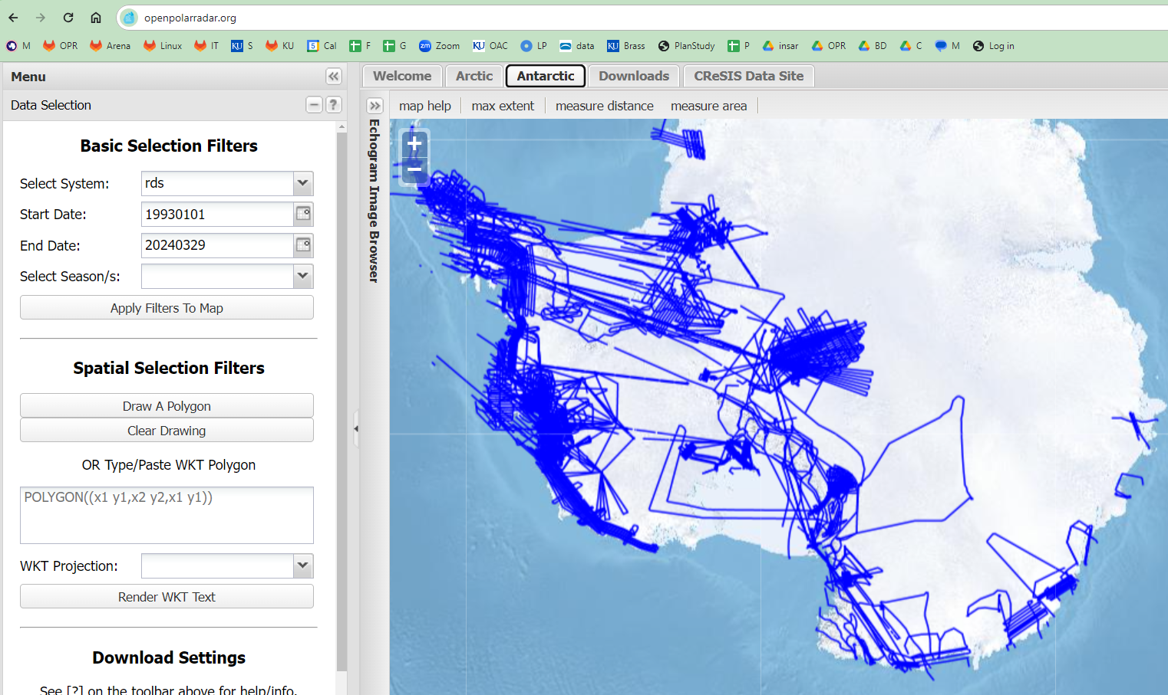
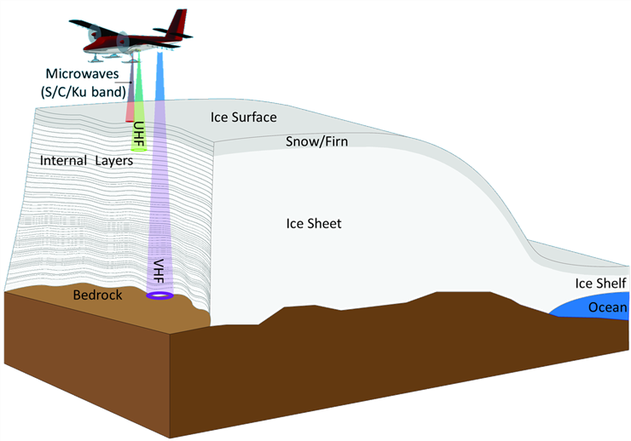
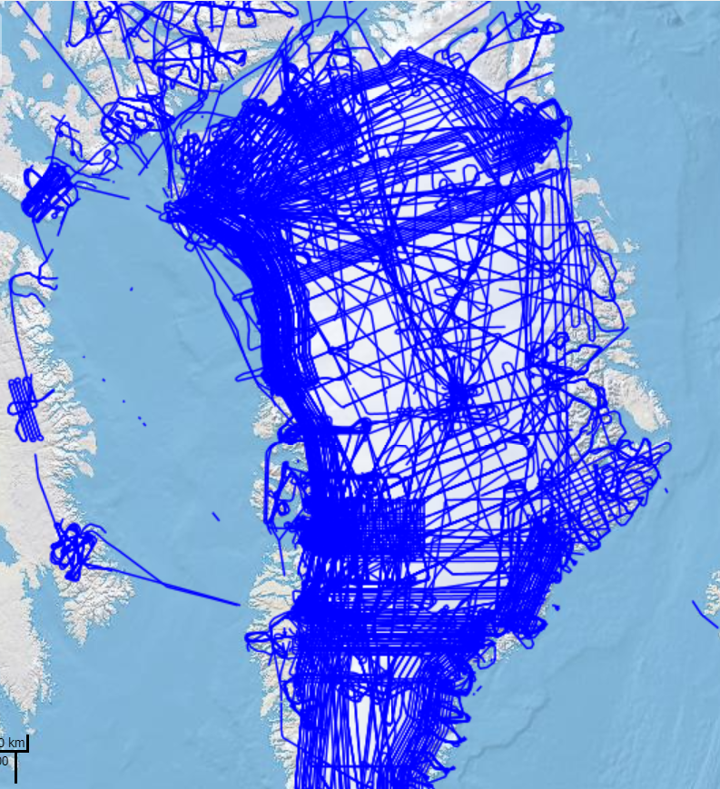
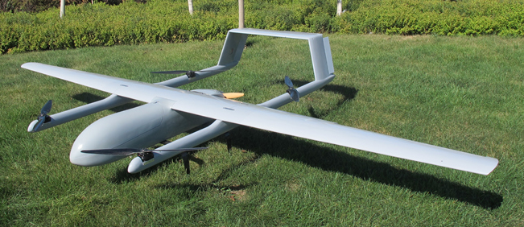
CReSIS
Activities: (What we do)
Design and build sensors and UAS
Integrate sensors on manned and unmanned platforms
Perform field measurements (US, internationally, remote camping field locations)
Process and disseminate the results
Investigate new survey strategies (autonomous and cooperative)
Develop new signal processing algorithms to enhance interface detection and 3-D subsurface imaging
Some Recent and Current Projects:
Currently working in a DOE Consortium on Miniaturization and Repackaging of Microwave Components for Ultra-Wideband Radar
NOAA and NASA projects that designed multichannel UWB microwave radars and performed surveys in the Black Hills of South Dakota, Canada, Greenland, and Arctic Ocean to investigate the ability to monitor snow cover.
Radar and antenna fairing installations on the NASA GV and Basler which deployed multichannel radar depth sounder and snow radars to polar regions
NASA proof-of-concept project worked with a company in Maryland to use snow radar on a long-endurance (up to 9 days) UAV over sea ice. Ongoing projects funded to design multichannel radar sounder and improved snow radar on the same platform.
Heising-Simons Foundation Project designed and deployed UAS radars to measure glacier thickness at Helheim Glacier in Greenland
Expanding to other application such as crop/infrastructure monitoring.

Slide 3
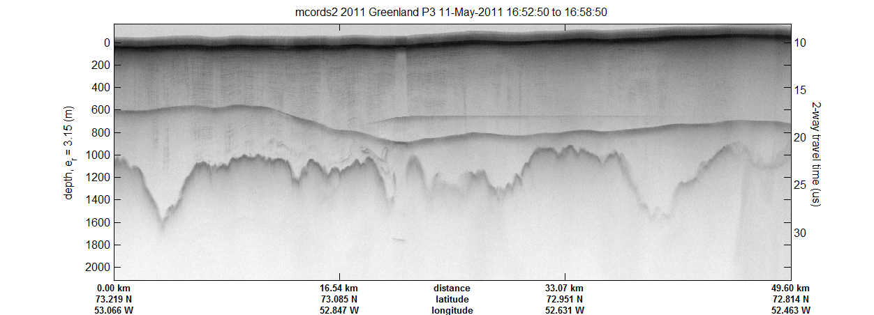
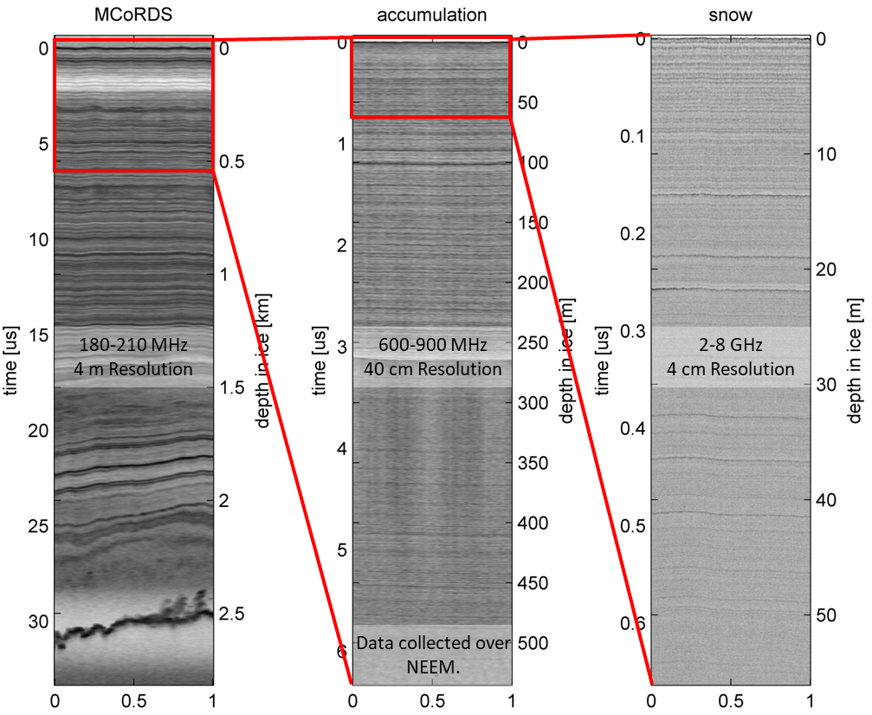
CReSIS
Radar Sounding/Imaging
Products:
1.5 PB of raw and processed data products
2D echograms for 1D layers
3D subsurface images for 2D surfaces
Resources
Strong inhouse build capability
  Machine shop and 3-axis CNC Milling Machine (enclosures, microwave, large PCB assemblies)
  PCB mill, reflow oven, rework stations
  Test equipment and temperature chamber
24'x24'x38' anechoic chamber developed as part of an NSF/MRI.
  https://chamber.ku.edu/
Radars operating from HF to Ka-Band
Multiple UAVs and Cessna 172 (FRL)

Slide 4
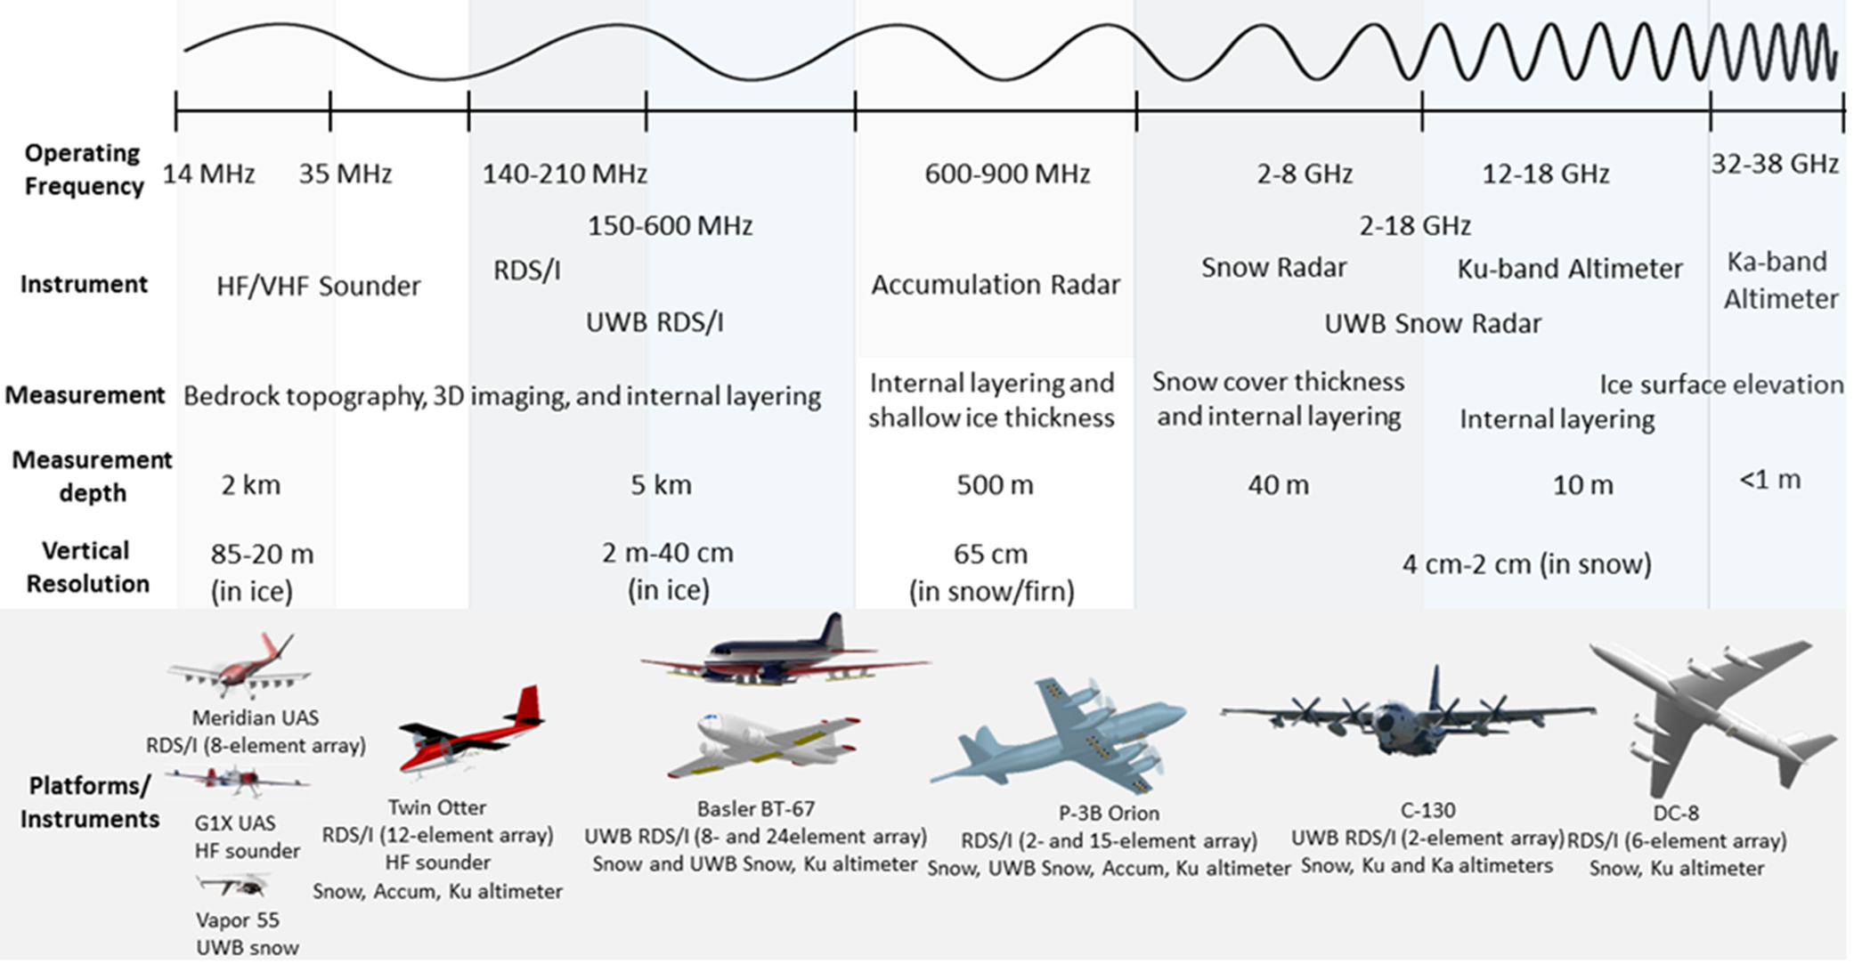
CReSIS

Slide 5
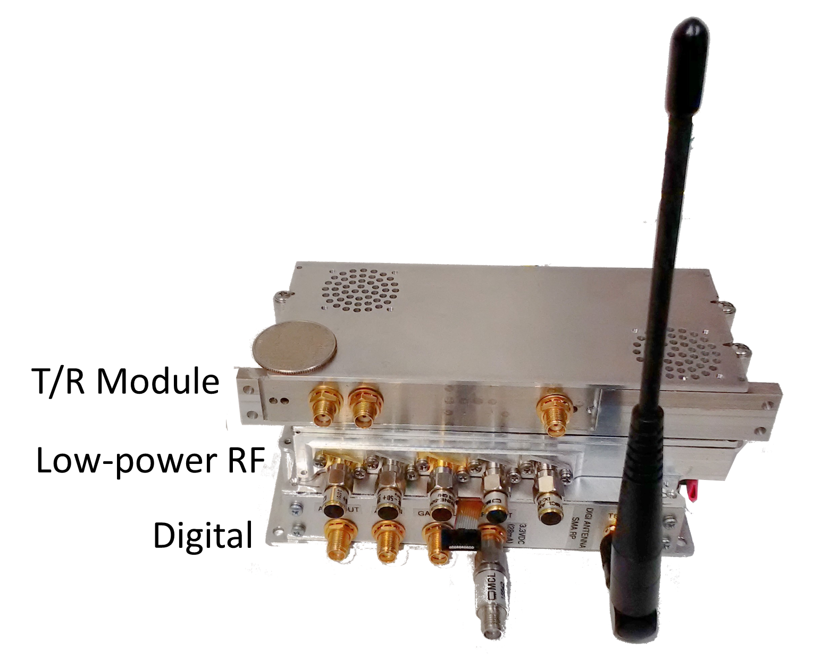
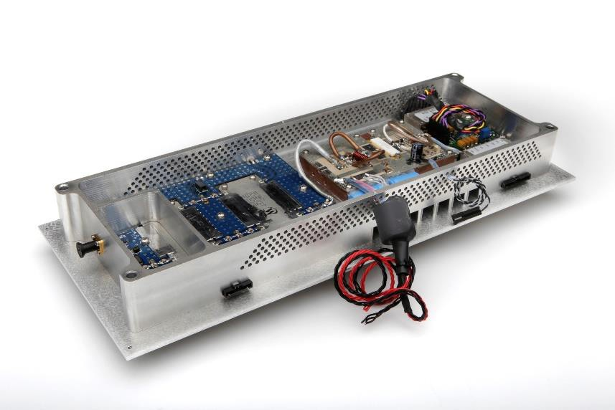
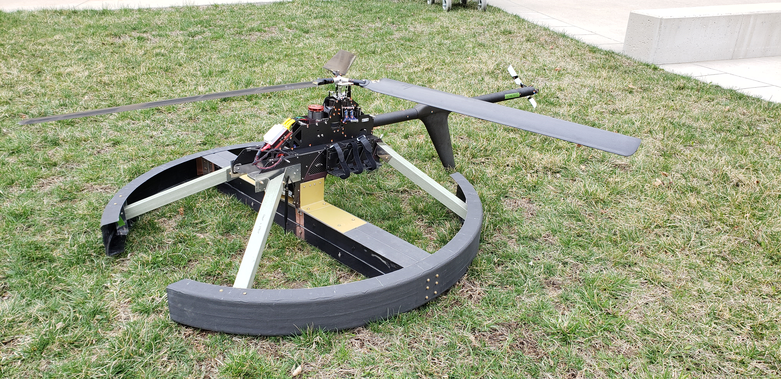
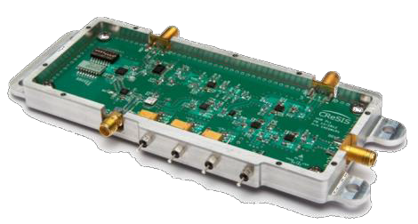
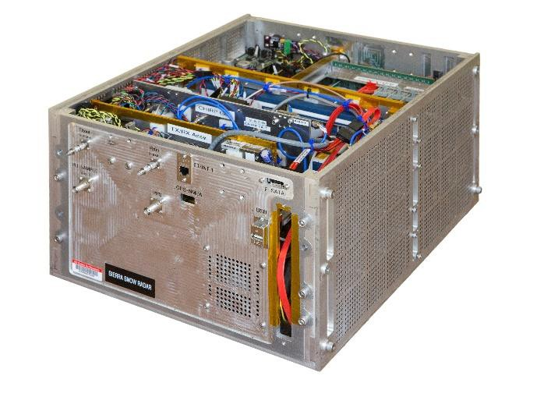
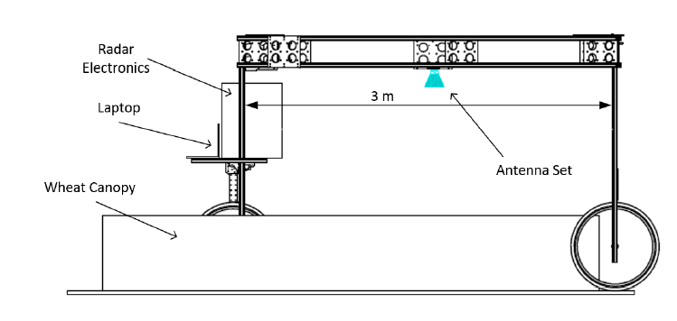
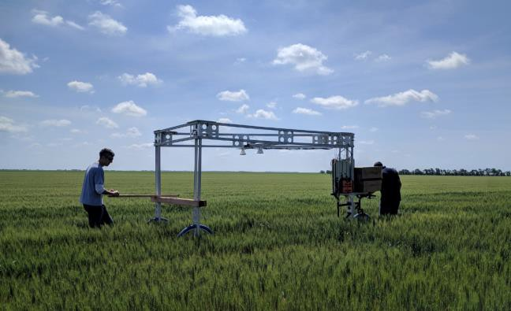
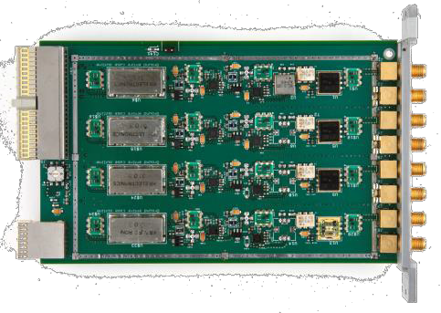
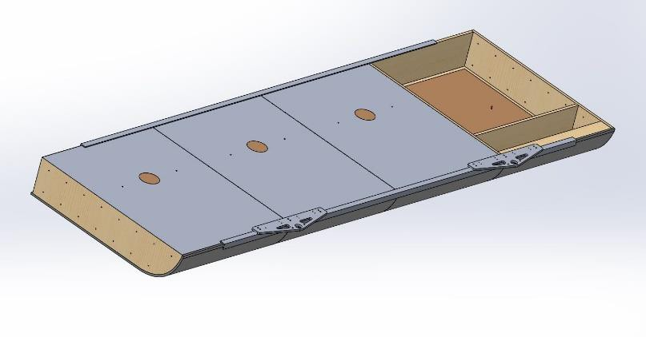
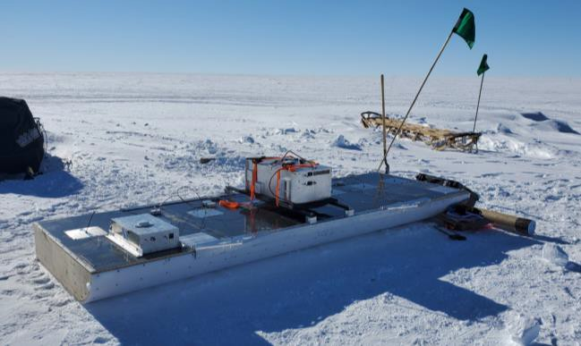
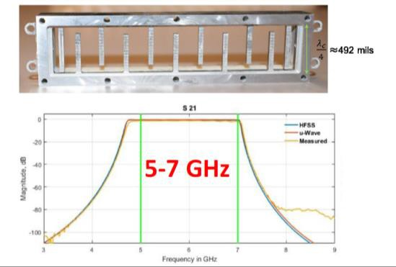
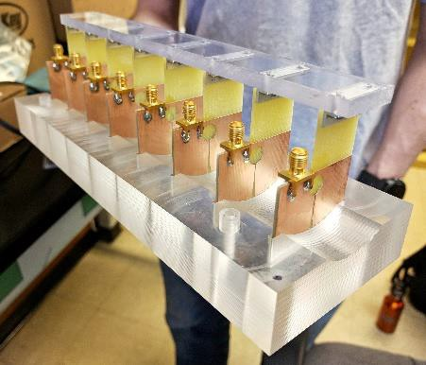
Example Projects – Manufacturing Capabilities
100W HF/VHF UAV Radar
1kW T/R module with integrated PA
µwave assembly
Multi-channel VHF receiver
Cart for radar tests on wheat fields
Compact µwave radar
Custom microwave filters
µwave antenna array
VHF/UHF sled antenna

Slide 6
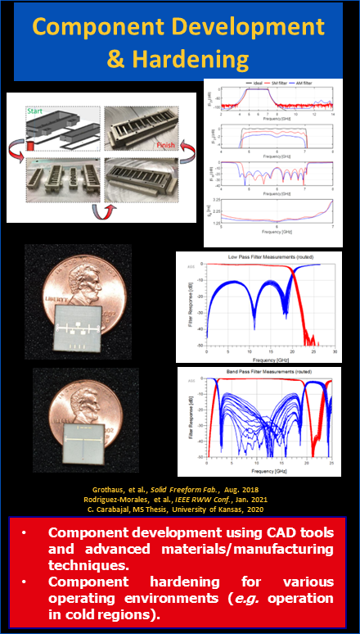
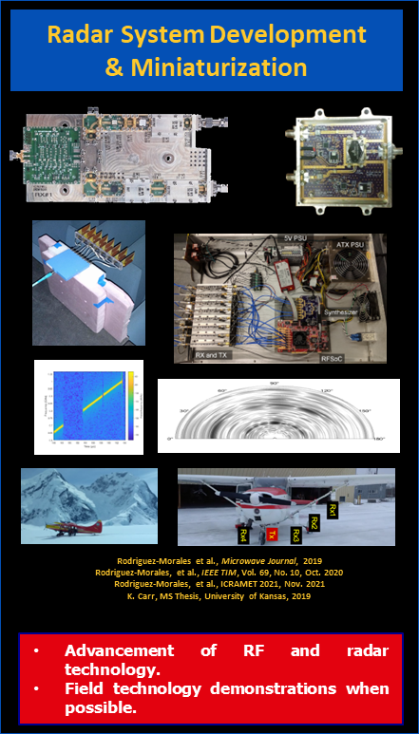
CReSIS DOE-funded Radar Consortium
The research consortium focuses on radio-frequency (RF) and radar technology.
Funded by the DOE NSC out of Kansas City, Missouri, and managed by Honeywell FM&T.
Partners include OU, KSU, Uark, UNL, and MSU.
    Training the next generation of RF/radar engineers through heavy undergraduate and grad student involvement.
Graduates employed in the academic and industrial sectors.

Slide 7
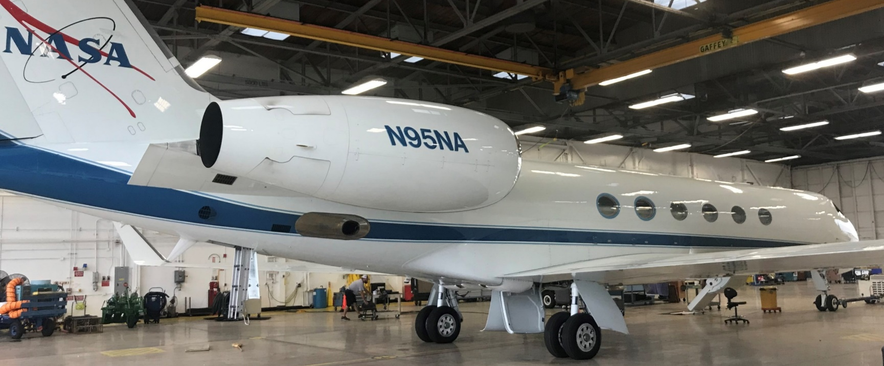
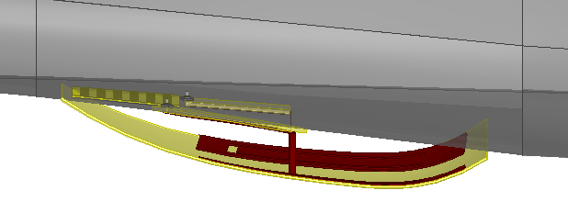
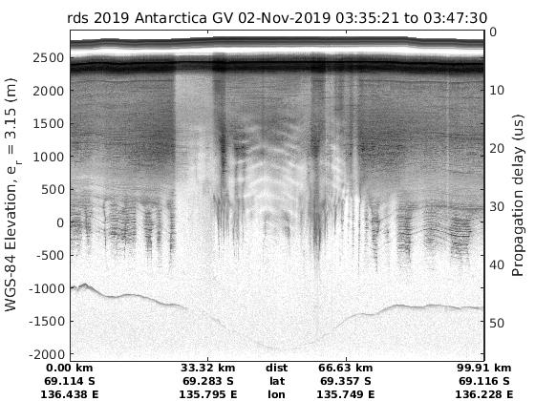
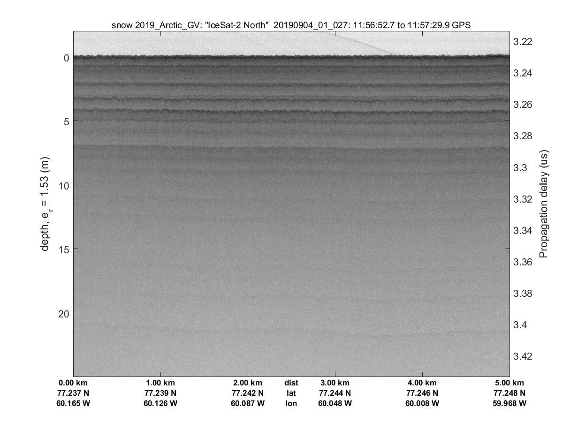
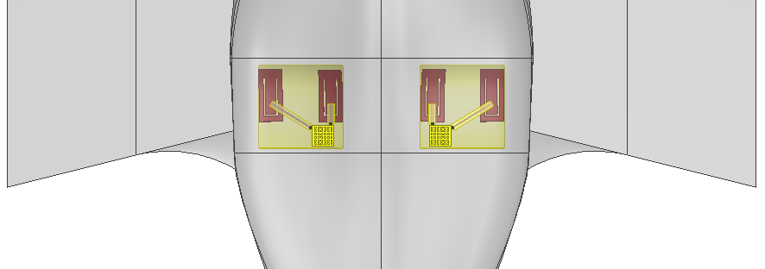
CReSIS Radars Integration and Surveys on NASA GV
Project Description:
Design and build a VHF radar sounder for ice thickness mapping and a microwave radar for cm-scale snow accumulation surveys from NASA GV.
Conducted surveys over the Arctic from Thule, Greenland and the Antarctic from Hobart, Tasmania.
Final installation on NASA GV at JSC.
Antarctica Results:
Bed mapping through over 4 km of ice.
CAD Models for Electromagnetic Simulations
Greenland Results:
Centimeter scale mapping of snow accumulation

Slide 8
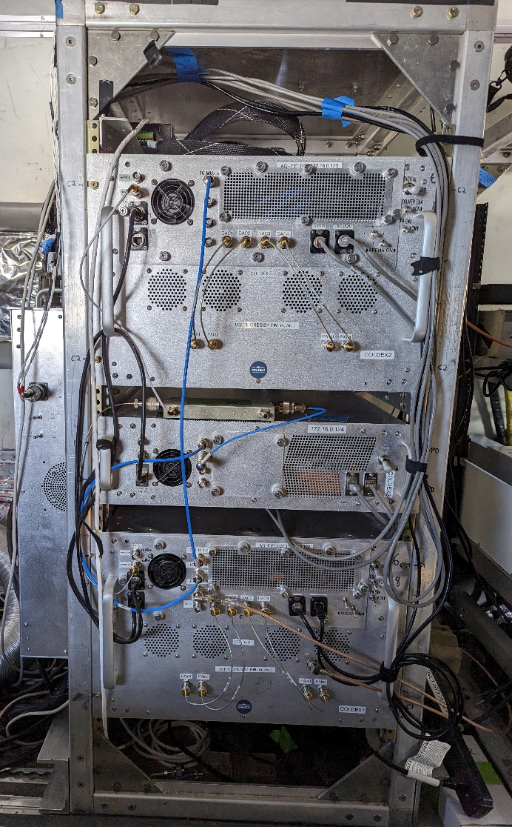
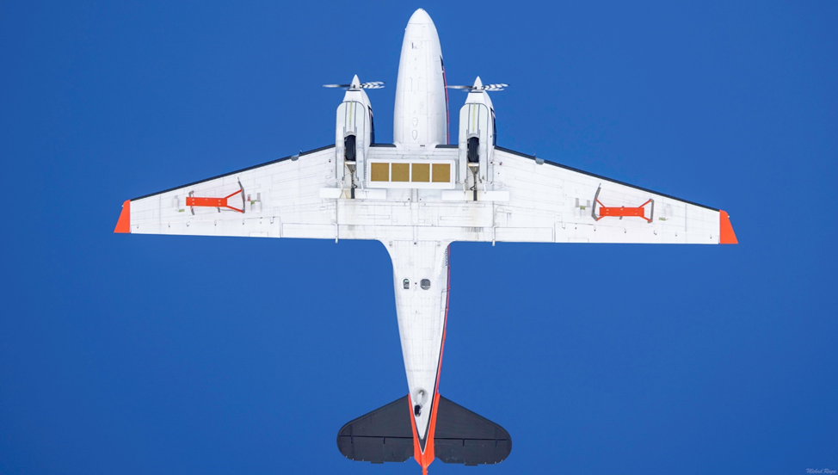
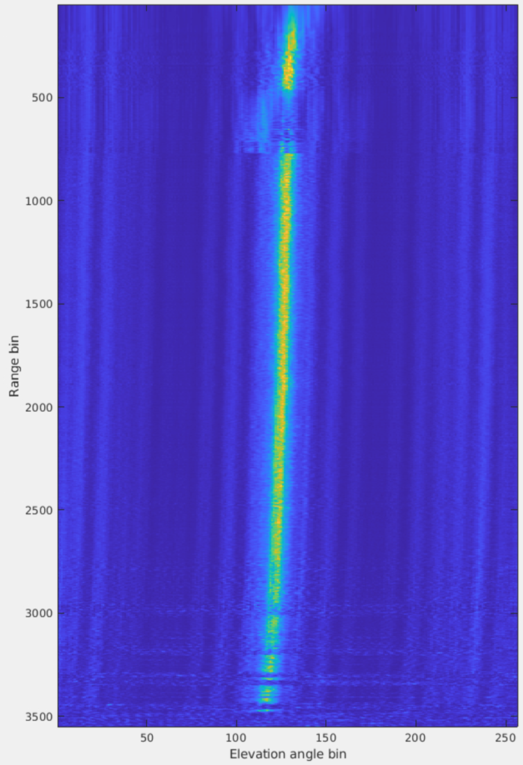
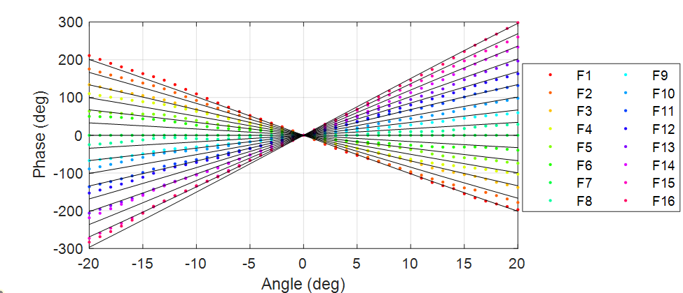
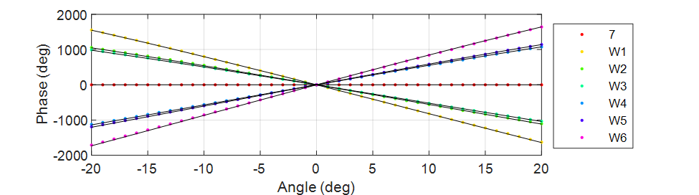
22-Channel UHF Radar on Basler Aircraft

Slide 9
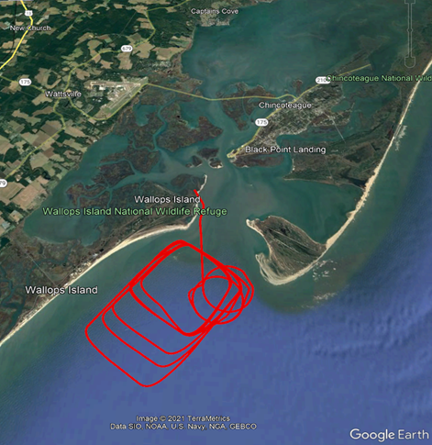
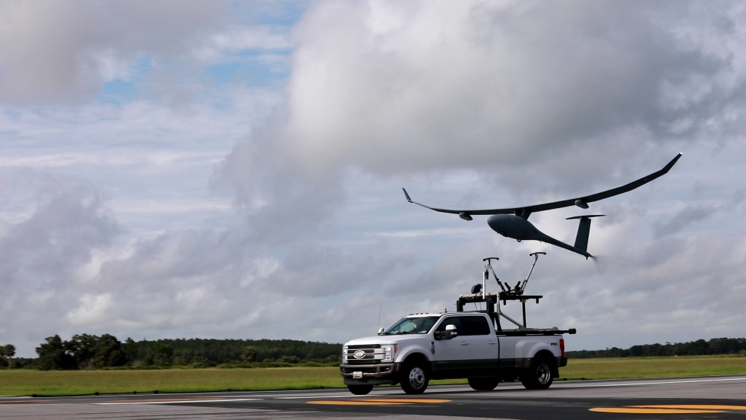
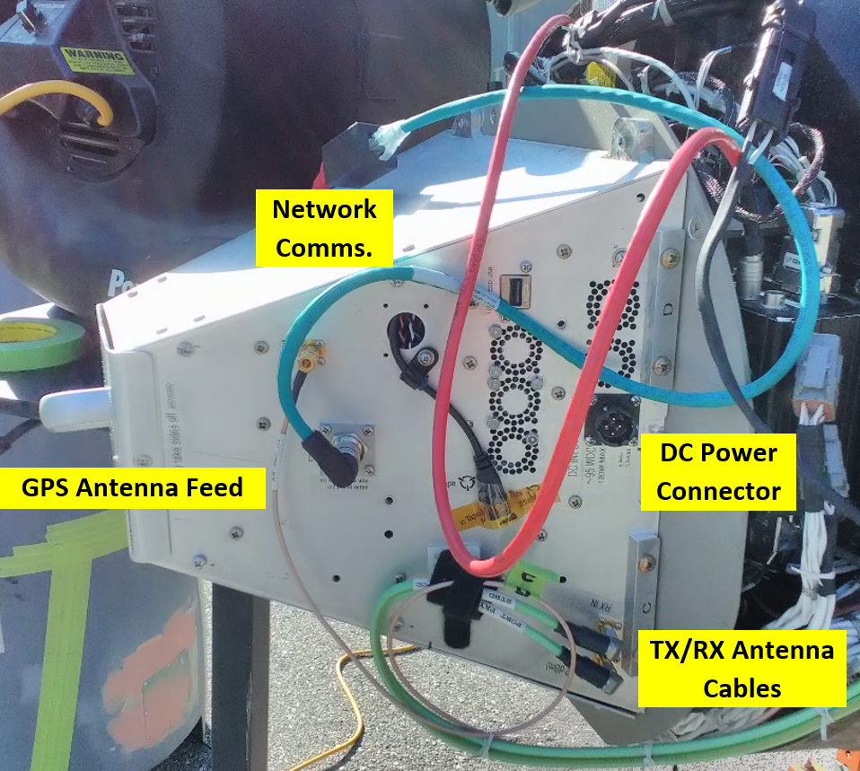
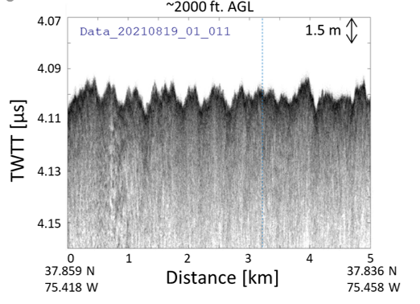
Radar Equipped Long Endurance UAS
Vanilla UAV with the KU CReSIS Snow Radar installed in pods, shown here during workup flight tests. Electronics installed during ground test 6/2021. Initial radar test flights in 8/2021. Science flights in 11/2021 (Deadhorse, Alaska).

Slide 10
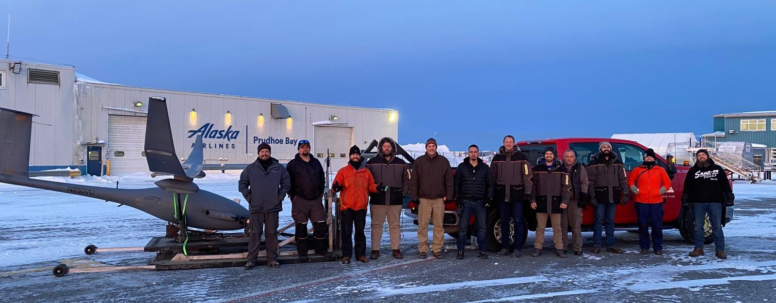
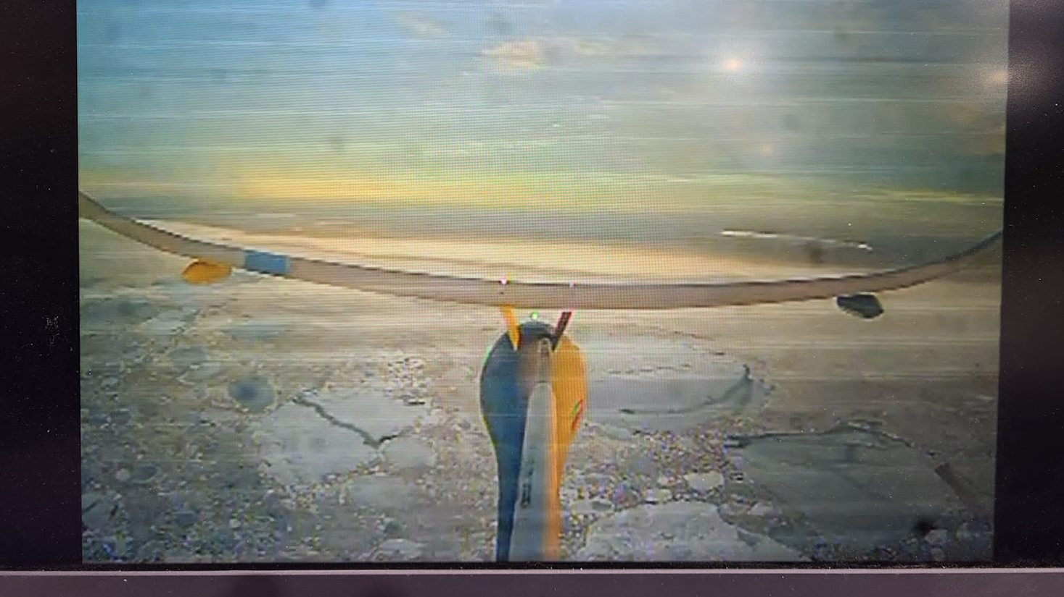
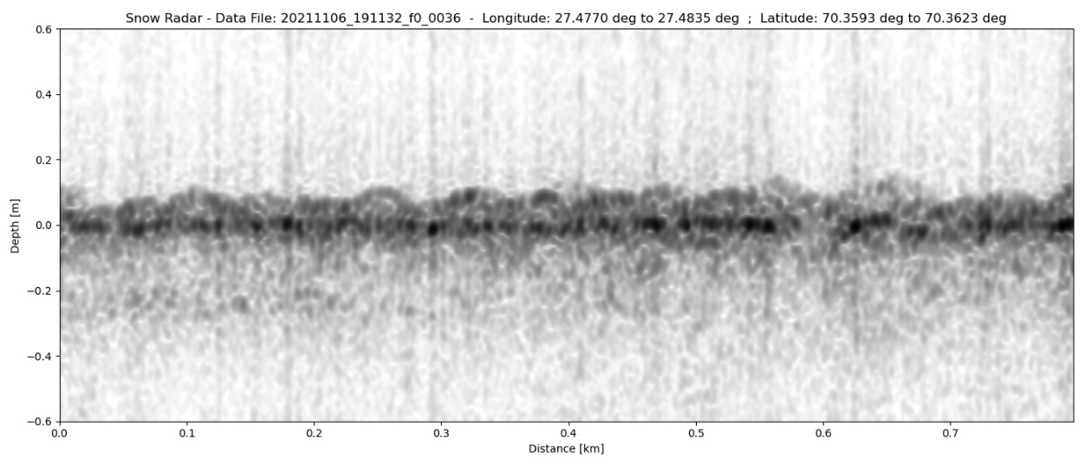
Success &
Future Research
https://www.nasa.gov/feature/goddard/2022/nasa-helps-fly-drone-in-alaska-to-study-sea-ice-thickness

Slide 11
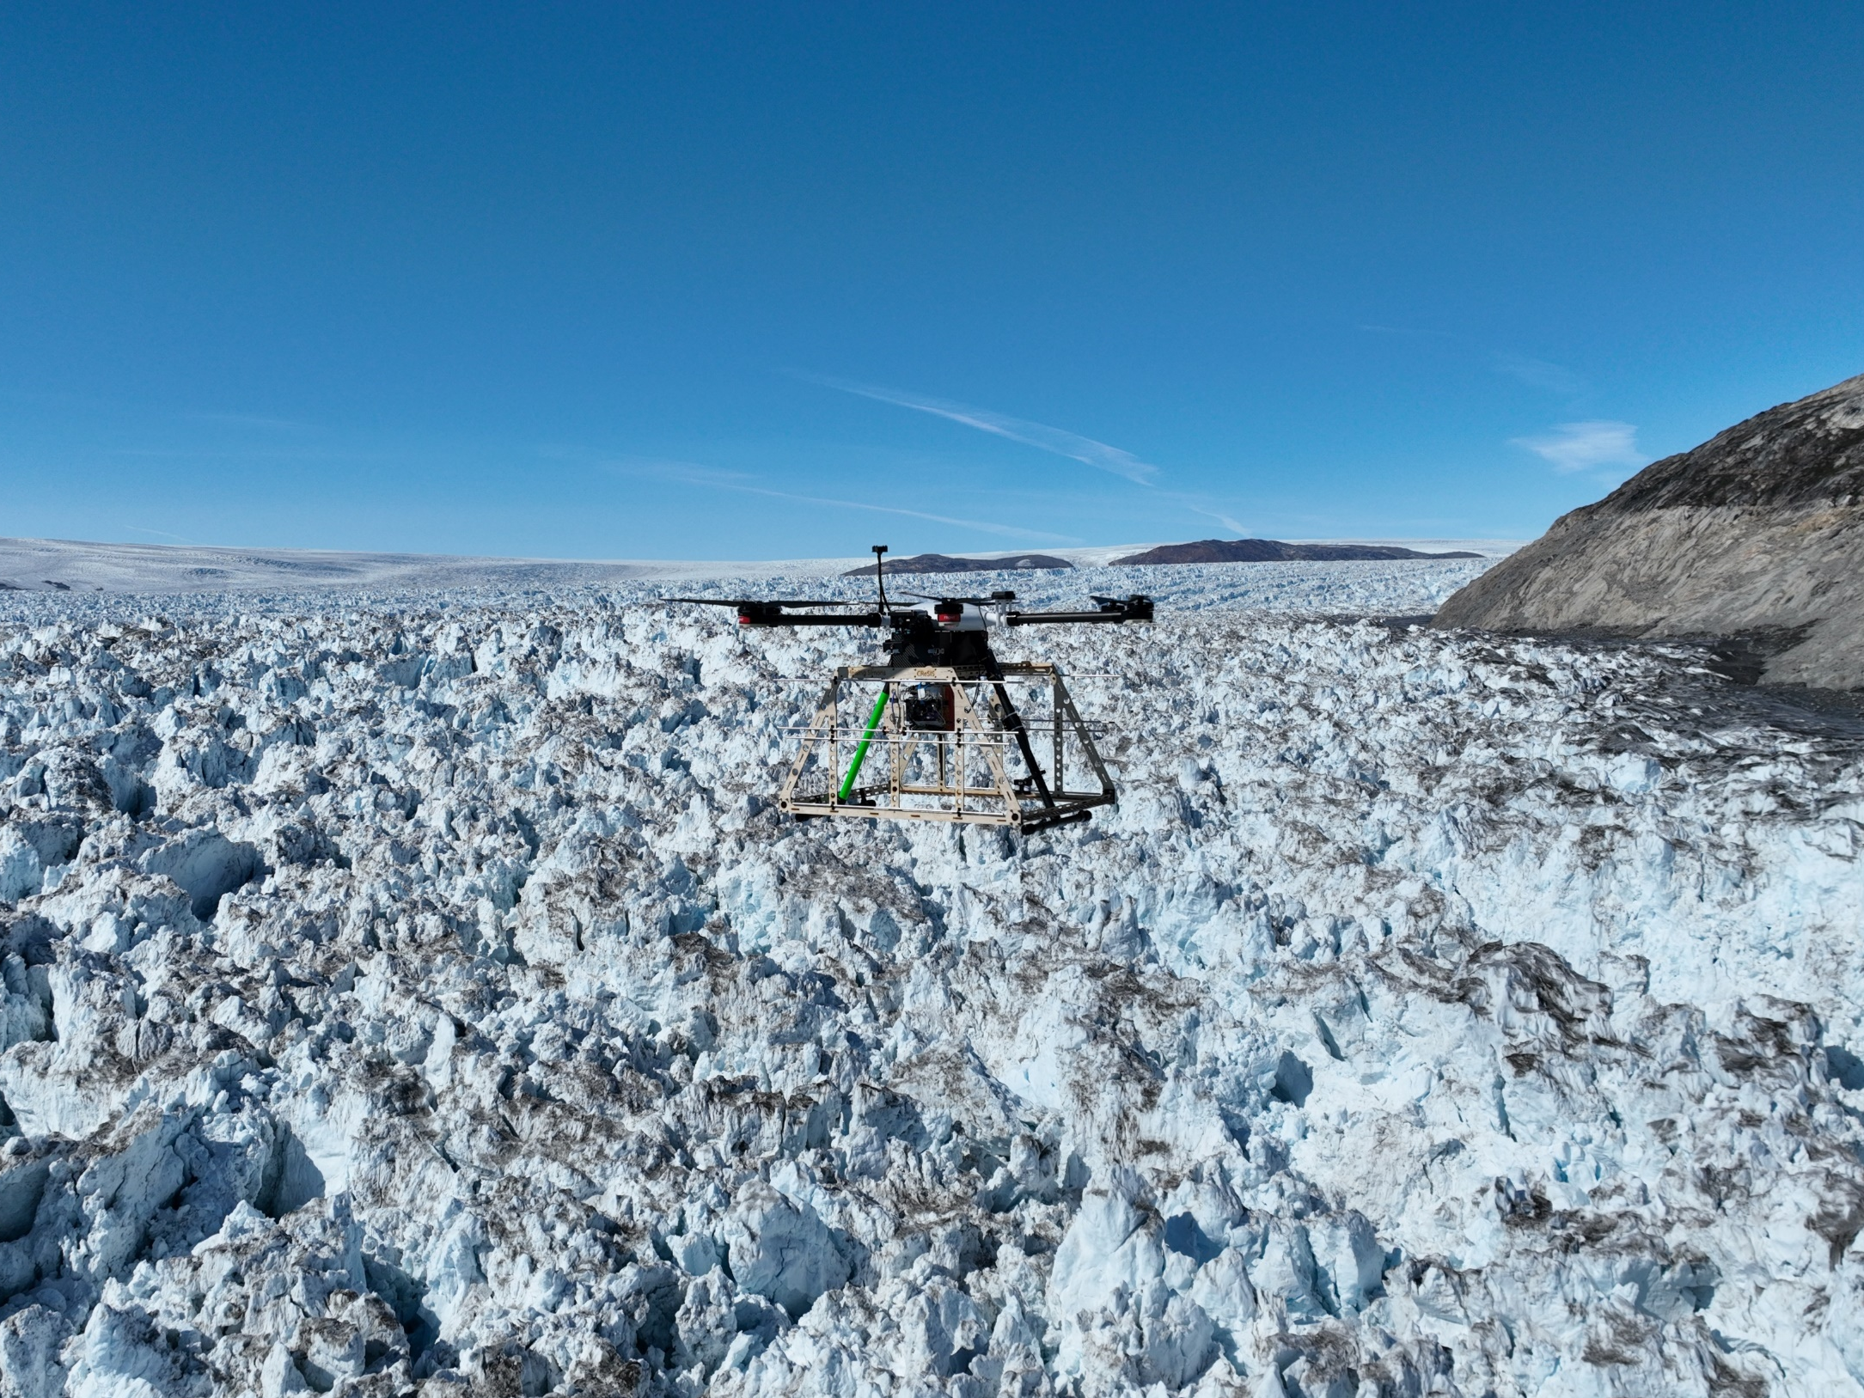
Deployed VHF and HF RADAR Sounders in 2022 (and soon 2024)
VHF Radar integrated to Aurelia X6-Pro shown here.

Slide 12
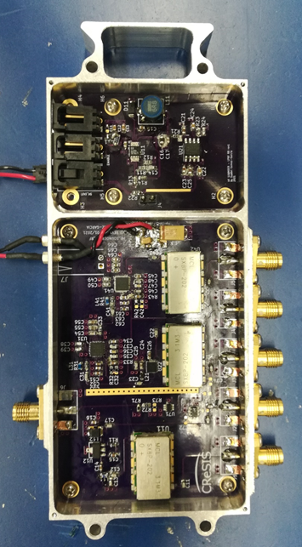
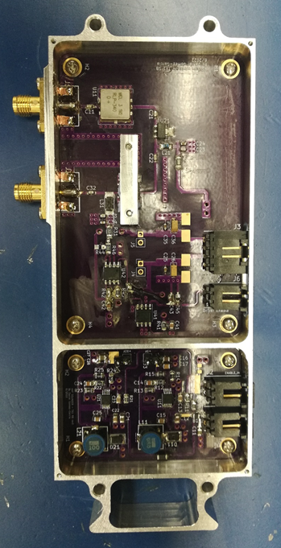
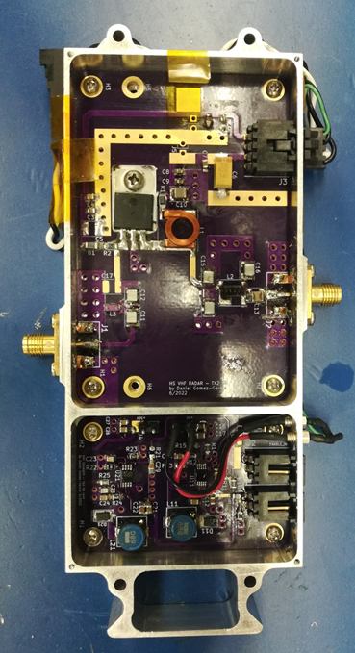
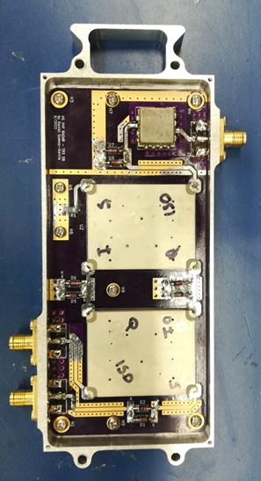
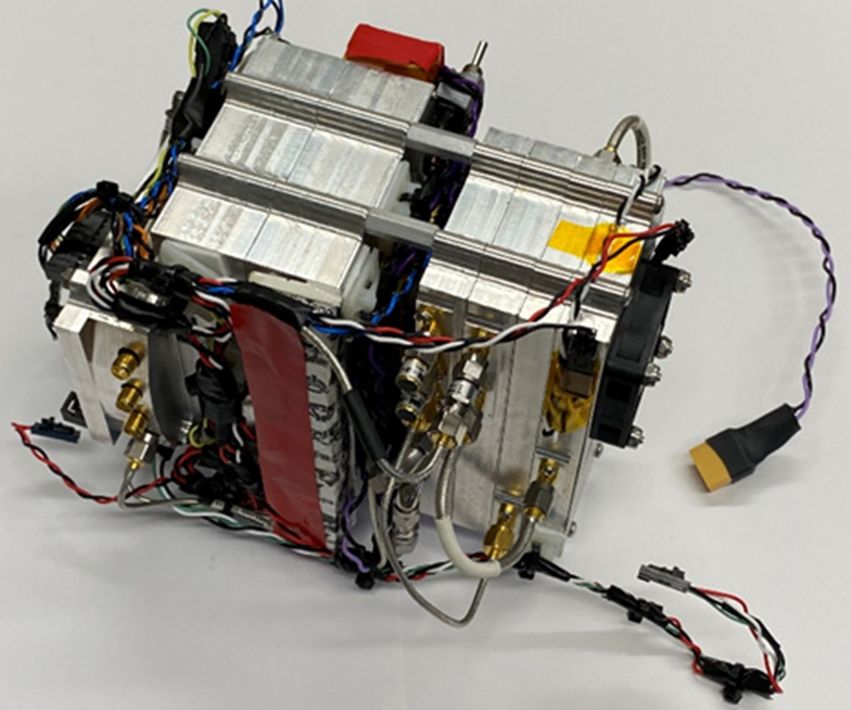
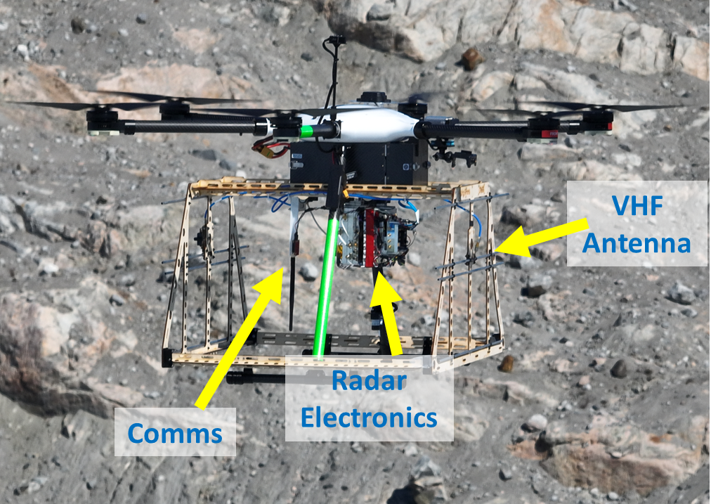
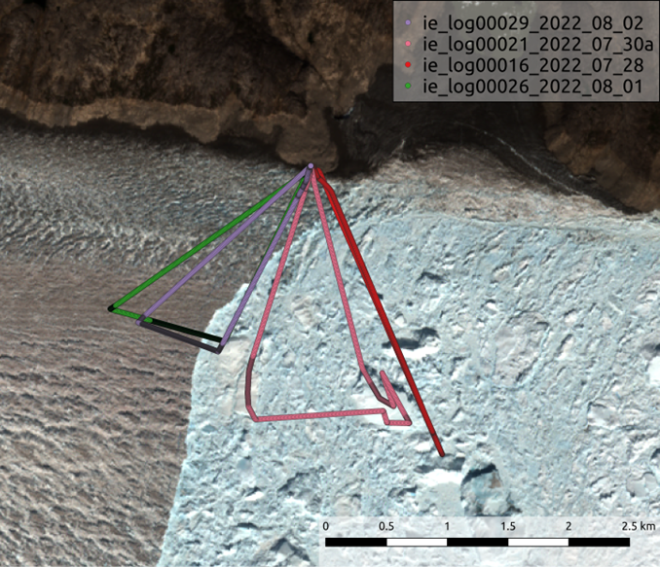
RADAR (Electronics)
Integrated with
Data Acq. System and DGPS.
RX Module
TX Driver
TX PA
T/R Module
Parameter | Value
Center Freq. | 195 MHz
Bandwidth | 18 MHz
TX Power | 100 W
RX Gain | 50 dB
Antenna Gain | 10 dB

Slide 13
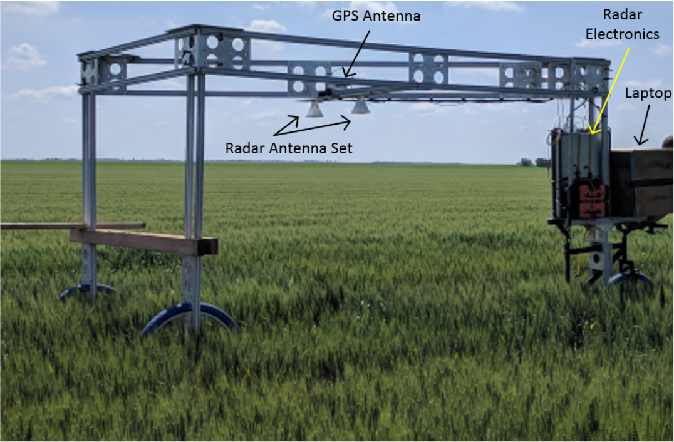
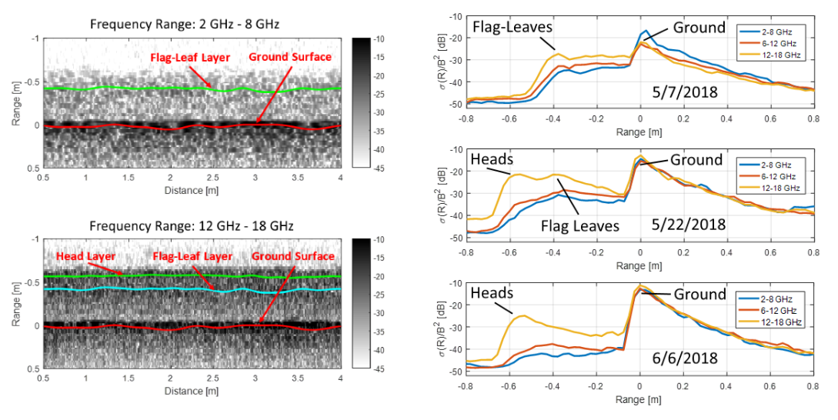
Wheat Canopy Height using Ultra-Wideband Radar
Project Description:
Collaborative effort with KSU to develop an efficient platform to collect high-resolution radar sounding measurements of the internal structure of wheat plots for breeding trial.
Wheat Cart & Radar in Viola, Kansas
Radar results show the ability to detect and track wheat head and flag leaf layers at various frequency bands and growth stage.
Image and Results: D. Gomez-Garcia, F. Rodriguez-Morales, C. Leuschen, and S. Welch, High-Throughput Phenotyping of Wheat Canopy Height using Ultra-Wideband Radar: First Results, IEEE Geosci. Rem. Sens. Lett., 2019.

Slide 14


UWB Soil/Snow Mini Radar System
A miniaturized snow radar system is being developed for integration on a small rotary wing UAV.

Slide 15


Iceberg GPS Tagging and Tracking
Rezvanbehbahani, S., Stearns, L.A., Keramati, R. et al. Significant contribution of small icebergs to the freshwater budget in Greenland fjords. Commun Earth Environ 1, 31 (2020).

